Slide 1
Loops

Slide 2
Announcements
Practical 1 - work on it right away!
Only three files have errors (rest are read only)
Debugging is hard!
Especially if you wait until all the code is written…
Next week:
Monday – help on debugging / coding follow along
Coding exam – Tuesday in Lab
Wednesday - review session – based purely on your questions
Canvas exam – Thursday in Lab

Slide 3
What are computers good at?
Computers are good at three things
Calculations
Formal logic
Repeating what you just asked it to do (iteration) - Loops
Coincidently
Three things humans tend to struggle with
If you understand
Calculations
Formal Logic
And Loops
You will be able to accomplish impressive programs

Slide 4
Loop Types in Java (and most langs)
While Loops
For Loops
For:each loops (we will cover this later)
Do While loops (we will cover this later)
All loops have
An iterator - a way to cycle through the values you want to look at
A condition to exit (else, your computer blows up - it happens to everyone)

Slide 5
Reading Check In
public static void complexFor(int lines) { String count_up = ""; String count_down = ""; for(int i=0,j = lines; i < lines; i++, j--) { count_up = count_up + i; count_down = count_down + j; } System.out.println(count_down); } public static void main(String[] args) { complexFor(7); }
7654321

Slide 6
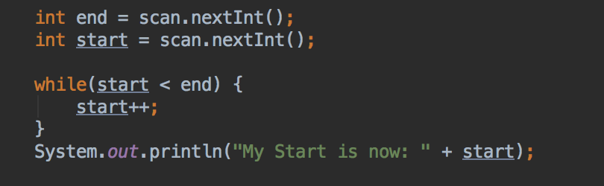
While Loop
Good when:
Your “iteration” variable is created outside the loop
You need your iterator variable outside of the loop
while(TRUE-CONDITION) {/*block of code to execute*/}

Slide 7
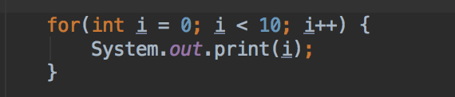
For Loop
Good when:
Your loop has a set start and end
You don’t need to keep your iterator outside the loop
for(variables; condition; iterator) { /* block of code to execute*/ }

Slide 8
Activity
Write the following as a for loop
public static void simpleLoop(int total) { int i = 1; while(i <= total) { System.out.print(i + ","); i = i + 1; } }

Slide 9
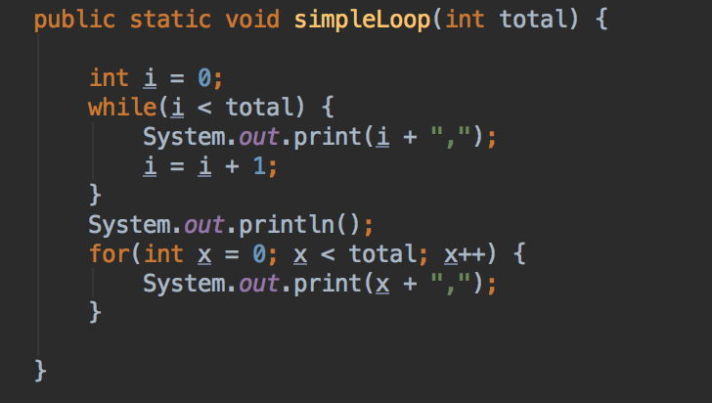
While/For Mostly Interchangeable
Let total = 10
0,1,2,3,4,5,6,7,8,9,

Slide 10

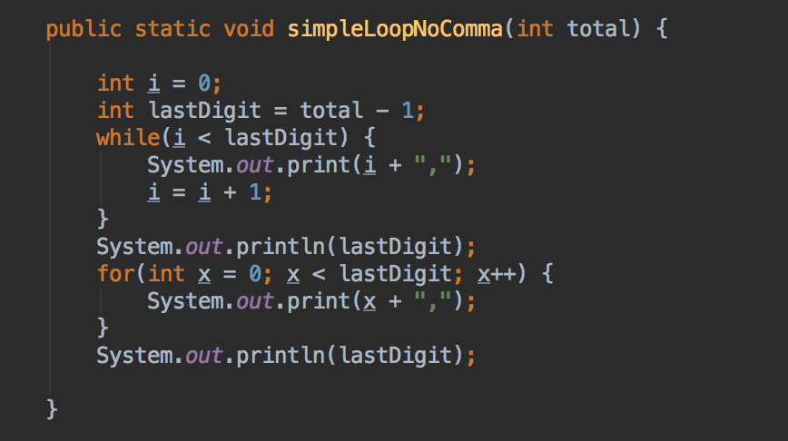
Trailing Comma?
What if I wanted to write same simple loop, but
NO trailing comma?
Let’s face it, that looks bad and probably isn’t what we want

