Slide 1
Review Session
File OS, Exceptions, More Classes, Arrays, 2D Arrays, Inheritance, ArrayList

Slide 2
Announcements
Opening Question:
Did you practice each Knowledge Check/RPA at least 3 different days already?
THIS WEEK:
Tuesday – Review Lab (Student request - Coding Exam anytime you want)
Wednesday – Review Lecture 2
Thursday – CANVAS EXAM (In lab)
Friday – No Class / Catch Up Day (Accommodation Exams – In CSB110)
Todo:
Start Final Practical! (summative)
Help Sessions and Help Desk – as normal!
CS 165 – Next Course In Sequence (also 201 is popular with 165)
CO Jobs Report 2021 – 77% of *all* new jobs in Colorado require programming
60% of all STEM jobs requires *advanced* (200-300 level)
31% of all Bachelor of Arts degree titled jobs also required coding skills
2016 Report found on average jobs that require coding skills paid $22,000 more
Math and Stats majors, at least consider CS 220 (Discrete Structures) – substitutes in your program requirements

Slide 3
Topics Requested (not in order)
Loops – How to track variables/handwritten method
Arrays
PrintWriter
Class/Objects
Inheritance
Including Super
Recursion
ArrayLists
Javadoc Reading
not on exam, so will save for Wednesday – or ask Terryn to cover it in the Wednesday help session if we don’t get to it.

Slide 4
Tracking Variables (Especially Loops)
Best way to track – Build a TABLE!
We will try a number of code examples throughout this lecture
I will ask you to use a table to track them
Step 1:
Write out all variables you need to track
Larger variables (Like arrays)
I draw out the memory structure next to the table.
Step 2:
As you iterate through the loop
Add a row to the table, with the columns being variables

Slide 5


Example To Try One
public static String loopExample() {
String rtn = "";
int i = 4;
while(i >= 0) {
for(int x = 1; x < i; x++) {
rtn += x + ",";
}
rtn += ";";
i -= 1;
}
return rtn;
}
i
x
rtn
pre
4
-
“”
4
1,2,3,;
i = 4, rtn=“”
3
1,2,3,;1,2,;
x
rtn
i = 3, rtn=“1,2,3,;”
2
1,2,3,;1,2,;1,;
1
1,
x
rtn
1
NA
1,2,3,;1,2,;1,;;
2
1,2,
1
1,2,3,;1,
0
NA
1,2,3,;1,2,;1,;;;
3
1,2,3,
2
1,2,3,;1,2,
i = 2, rtn=“1,2,3,;1,2,;”
For arrays, I keep a separate memory block with an arrow back!
x
rtn
1
1,2,3,;1,2,;1,

Slide 6
Arrays
public static void basicArray() {
int[] values = {1, 2, 3, 4, 5}; // short hand
values[0] = 0;
for(int i = 0; i < values.length; i++) {
values[i] = values[i] + i;
}
System.out.println(Arrays.toString(values));
for(int val : values) {
val += 10; // thinking deeper!
}
System.out.println(Arrays.toString(values));
}
Arrays
Allocate X amount of memory of a certain TYPE
Does not instantiate!
TYPE[] variable = new TYPE[X];
What is printed? (use the table technique)
[0, 3, 5, 7, 9]
[0, 3, 5, 7, 9]
1
2
3
4
5
0
2
3
4
5
0
3
5
7
9

Slide 7
Arrays with Objects
Objects are allocated, but not instantiated
Meaning, what the value of an object that is declared, but no created? null
String[] values2 = new String[3];
System.out.println(Arrays.toString(values2));
values2[1] = "Time Warp";
System.out.println(Arrays.toString(values2));
[null, null, null]
[null, Time Warp, null]

Slide 8
PrintWriter Example
Takes a Stream of data
File - creates a stream to read or write from a file
Prints out to the location – using standard “print” commands
Stores info in buffer until .close() is called (won’t save until then!)
Let’s look at an example in action
public static void main(String[] args) {
String[][] csv_data = {{"Row1", "Header Value", "Header Value"},
{"Row2", "some value", "3"},
{"Row3", "some value3", "three"}};
printWriter(csv_data);
}
public static void printWriter(String[][] values) {
File file = new File("ouptut.txt");
try {
PrintWriter writer = new PrintWriter(file);
for(String[] row : values) {
writer.println(stringToCSV(row));
}
writer.close(); // else it won't save it!
} catch (Exception e) {
e.printStackTrace();
}
}
private static String stringToCSV(String[] row) {
StringBuilder bld = new StringBuilder();
for(String val : row) {
bld.append(val).append(",");
}
bld.deleteCharAt(bld.length()-1); // remove end comma
return bld.toString();
}

Slide 9
Recursion
Recursion is thinking of
Doing one thing – and then the “rest of the things”
Takes practice (you will get tons of it)
Always look a simple examples, and then build up when figuring out a problem.
Let’s look at a knowledge check..

Slide 10
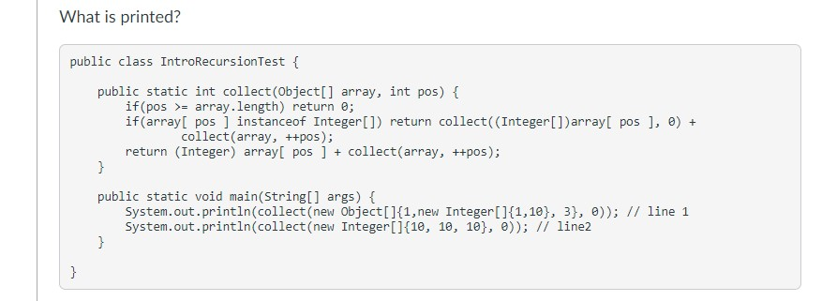
Knowledge Check
Identify Base case
Check variable that triggers it!
Identify the incrementor
++pos
Identify recursive call
Work through simple case
[0] or [0, 1]
Look for oddities
In English, adds all the numbers together!
If there is another array, starts again, adding numbers
So – 15 first answer, 30 second answer

Slide 11
Another Recursion Example
public static void inPlace(int[] array, int pos1, int pos2) {
if (pos2 <= pos1) return;
int tmp = array[pos1];
array[pos1] = array[pos2];
array[pos2] = tmp;
inPlace(array, ++pos1, --pos2);
}
public static void inPlace(int[] array) {
inPlace(array, 0, array.length-1);
}
Write out what this does on paper (individually)
Share solution with others, how do you keep track of it?
In your IDE, write the ‘loop’ version of this code
int[] arr = {10, 2, 3, 1, 5, 9};
inPlace(arr);
System.out.println(Arrays.toString(arr));
How could we modify this method to work on all types?

Slide 12
Classes and Objects
Yes, drawing a table for every class helps track variables and memory!
public class Review3 {
public static final int MY_VAL = 3;
public static int counter = 0;
private String name;
private final String[] widgets;
public Review3(String name, String[] widgets) {
setName(name);
this.widgets = widgets;
counter++;
} public void setName(String name) {
this.name = name;
}
public String getName() {
return name;
} public String getWidget(int ID) {
return widgets[ID];
}
}
Review3 (Static / Shared Space)
MY_VAL | 3 (fixed)
counter | 2
Review3 (Static / Shared Space)
MY_VAL | 3 (fixed)
counter | 0
Review3 (Static / Shared Space)
MY_VAL | 3 (fixed)
counter | 1
one
name | hema
widgets | @w1
widgets (@w1)
Phones
Boxes
Toys
two
name | akau
widgets | @w1
String[] widgets = {"Phones", "Boxes", "Toys"};
Review3 one = new Review3("hema", widgets);
System.out.println(Review3.counter);
Review3 two = new Review3("akau", widgets);
System.out.println(Review3.counter);
System.out.println(one.getName());

Slide 13
Inheritance
Review3Super
getName() : String
setName() : void
Keep your code DRY
HAS A – relationship
Review3 HAS A String[] widgets
IS A – relationship
Review3 IS A Review3Super
Review3 has all protected and public methods Review3Super
It is *one* direction
Reivew3Super doesn’t know about Review3
Let’s look at some code!
Extends!
Review3
Review3(String name, String[] widgets)
getWidget(int ID) : String

Slide 14
ArrayList
Arrays are great when – you know exact size!
But what if you don’t know exact size?
Use ArrayList!
Build a list (need to specify type in <>)
You can add to a list using .add
you can remove to the list .remove
You can access specific spots in the list .get
ArrayList<Review3Super> list = new ArrayList<>();
list.add(one);
list.add(two);
System.out.println(list);
list.remove(0);
System.out.println(list);
list.add(0, one);
System.out.println(list);

Slide 15
More practice
Teacher
- id:int
-subject:String
+Teacher()
+Teacher(subject:String)
+getSubject(): String
+setSubject(subject: String)
+getId(): int
+toString():String
Identify super class and sub class
Identify attributes and methods for each class
Where overloading occurs?
Where overriding occurs?
Implement those classes considering the inheritance model.
Create a new class that test those classes
In the main method create an ArrayList of Teachers and add Teachers and FullTimeTeacher in that ArrayList and print that list
FullTimeTeacher
-salary: double
+FullTimeTeacher()
+FullTimeTeacher(subject:String, salary:double)
+getSalary(): double
+setSalary(salary: double)
+toString():String

