Slide 1
Classes and Objects

Slide 2
Announcements
Reminder – readings are due before lecture
You don’t have to do all of it - challenge problems can be challenging…
You can return to them.
We start off each lecture with a quiz from your reading!
Todo:
Busy Week! (reflection + readings + labs)
Practical 2 started!
ACM - Association for Computing Machinery
ACM will be hosting a board game night this Wednesday (Sept 22nd) at 6:00pm in CSB 130. Bring any board games from home that you would like to play, and join us for a fun evening. As always, there will be free pizza too! You can RSVP using the link below.
https://forms.gle/VkoZMeMi8HgTM5pq6

Slide 3
Reading Check – Primitive Types
Which option contains only primitive types:
A) short, long, char, String, boolean
B) int, double, char, String
C) byte, long, int, double
D) int, double, String, Scanner

Slide 4
Reading Check – Object Type
Consider the following statement:
Objects are instances of a class and contain data and methods.
A) TRUE
B) FALSE

Slide 5
Reminder – Objects verses Primitives
Additional reading: https://medium.com/javascript-scene/the-forgotten-history-of-oop-88d71b9b2d9f
Primitive Types
Values only
The java primitives are:
byte, short, int, long, double, float, char, boolean
Operators expect primitives (exception String addition)
Object Types
Collections of data and methods (actions)
String – object you have been working with
All objects are defined by their class file
Objects are the building blocks of programs in Object-Oriented Programming
Shout out to Alan Kay who coined the term in 1966/1967 as part of his MIT research dissertation on Scratchpad
He was inspired by the LISP programming language
Simula was the first programming language to include objects like java designed by Kristen Nygaard and Ole-Johan Dahl
I thought of objects being like biological cells and/or individual computers on a network, only able to communicate with messages. – Alan Kay (reference)

Slide 6
Reading Check – Object Type
The _____ operator explicitly allocates an object of the specified class type .
A) private
B) public
C) new
D) String

Slide 7
Class is a recipe
class(es) are recipes!
A cake recipe
A punch recipe
In Java (an OOP language) - everything must be in a class!
You can create Objects out of classes
use the new keyword
Rectangle myHouse = new Rectangle();
Scanner scnr = new Scanner(System.in);
new Reserves memory for that ‘instance’ / object
public class Cake {
//everything between the
//curly brackets is part of
//the class block
}
Pro Tip
While variables start lowercase, classes tend to start uppercase and use camelCase from there.

Slide 8
Reading Check – Object Type
Usually, a class has _________ fields and _______ methods.
A) private, private
B) private, public
C) public, private
D) public, public

Slide 9
Classes have variables / data
Classes can have any number of variables and types in them
Variables in the class code block
May be static
Variable value is shared across all classes / the program
May be instance (not-static)
Variable value is only set for every instance / object uniquely
Length of String only makes sense for unique strings!
Variables may have scope
Who has access to read them
public – everyone in every class can read and write to them
private – only methods in that class can read and write to them (suggested!)
who has access to it - ideally private unless reason
public class Cake {
public static final boolean IS_GOOD = true;
private String name = “”;
private double cost = 0;
}
setting a default value (optional)
all variables have type

Slide 10
Classes Have Methods (actions)
Static methods are instructions that aren’t tied to anything other than the name
Math.round(3.7); // notice no object with it!
Instance methods need data from the object
String str = “Ada”;
str.length(); // returns 3
Common method classification
Accessors – methods that access the data in the class (gets)
Mutators – methods that modify the data in the class (sets)
Technically just definitions to know
this can be used to reference the class level instance variables
public class Cake {
/* … */
public void setName(String str) {
name = str;
}
public String getName() {
return name;
}
public void setCost(double cost) {
this.cost = cost;
}
public double getCost() {
return this.cost;
}
}

Slide 11
Classes can have constructors
All classes have a default constructor
Cake chocolate = new Cake();
chocolate.setName(“Chocolate”);
This can be tedious
Constructors are special methods that only work with new
Notice, the type is the class, so no need to put a type in there
Used often especially in classes that just contain data
public class Cake {
public Cake(String name, double cost) {
setName(name); // let the methods work
setCost(cost); }
}

Slide 12
Practice: All Together Now
public class Cake {
public static final boolean IS_GOOD = true;
private String name = “”;
private double cost = 0;
public void setName(String str) {
name = str;
}
public String getName() {
return name;
}
public void setCost(double cost) {
this.cost = cost;
}
public double getCost() {
return this.cost;
}
public Cake(String name, double cost) {
setName(name); // let the methods work
setCost(cost); }
}
public class Baker {
public static void main(String[] args) {
System.out.println(Cake.IS_GOOD);
Cake choco = new Cake(“Chocolate”, 3.5);
System.out.println(choco.getName());
System.out.println(choco.getCost());
choco.setName(“Coconut”);
System.out.println(choco.getName());
System.out.println(choco.name); // ERROR!!
}
}
true
Chocolate
3.5
Coconut

Slide 13
Why Classes?
Divide
Conquer
Conquer
Conquer
You get to build your own LEGO blocks!
Each class is a new type
It separates concerns
Using the biology example
Each class is a cell doing work, white blood and red blood cells have different jobs, together they help you live
Like methods, the more separated your concerns
the better!
You have already been writing classes
Nothing new, but think more about it in terms of building blocks
Glue

Slide 14
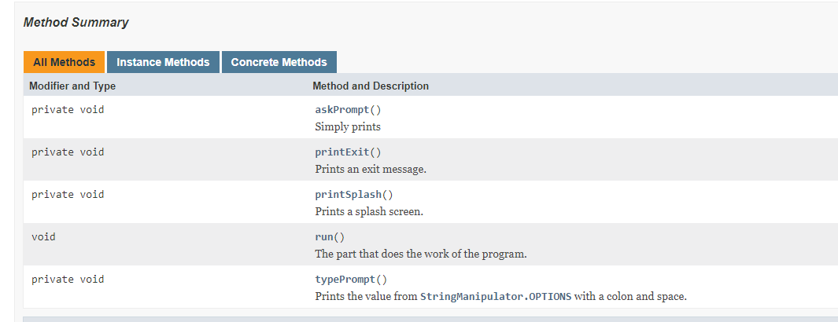
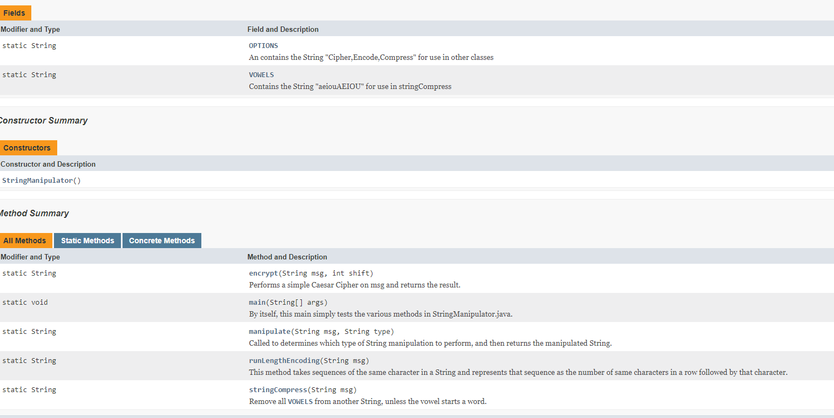
Going from Javadoc to Classes? P2 Help
First look through the Javadoc…
Are there hints at how it interacts?
Are there files that ‘complete’ without other files?
https://www.cs.colostate.edu/~cs163/practicals/p2/javadoc/

Slide 15













Drawing It Out?
Start
Main.java
Methods: main (goal – main program entry point – code given)
EncryptedMessageApp.java
public run()… (void)
StringManipulator.java
static String manipulate(String, String)
static String runLengthEncoding(String)
static String stringCompress(String)
static String encrypt(String)

Slide 16
Building Applications
Think it through!
Draw, write notes, how do you plan?
Build a skeleton
‘stub’ out methods
Add comments, etc
Prototype!
Build simple methods, test, rebuild
Keep Cycling
Most importantly
Test as you are working on it!

