Slide 1
Advanced Topics: Collections

Slide 2

Announcements
NEXT Week (week before finals)
Monday – Review
Wednesday – No Lecture, use time to catch up and work on finalizing your projects
Thursday – Time to work finish your labs and practical project work
Friday – Early Take Option, Final Exam
HELP DESK CLOSES - Friday May 3, plan accordantly!
Finals Week
Tuesday May 7 7:30am-9:30am at CS110 – 002 section
Help Desk
Day | Time : Room
Monday | 2 PM - 5 PM : CSB 120
Tuesday | 6 PM - 8 PM : Teams
Wednesday | 3 PM - 5 PM : CSB 120
Thursday | 6 PM - 8 PM : Teams
Friday | 3 PM - 5 PM : CSB 120
Saturday | 12 PM - 4 PM : Teams
Sunday | 12 PM - 4 PM : Teams

Slide 3
ArrayLists
ArrayLists
Part of Java Collections Library
Assumes default naming conventions
done through interfaces and abstract classes!
.add(Type)
.remove(location)
.size()
Is ArrayList always best to use?
What happens if it is *very* large?
Hard to find continuous memory in order!
Causes actions to slow down
Introducing Data Structures (CS 165)

Slide 4

LinkedList
Additional Reading: https://www.geeksforgeeks.org/linked-list-in-java/
Simulator: Visualgo: https://visualgo.net/en/list
Blockchain: https://www.ibm.com/topics/what-is-blockchain
Think about a chain
Each link connects to the next
Linked Lists
Connect objects to the next
But don’t worry about it all being order in memory
If you know the next, they can be anywhere
pros
memory efficient
cons
what if a link is broken?
Can you easily jump to the middle? – no!
Also a foundation of blockchain!
List<String> list = new LinkedList<>(); list.add("A"); list.add("B"); for(String str : list) System.out.println(str);

Slide 5
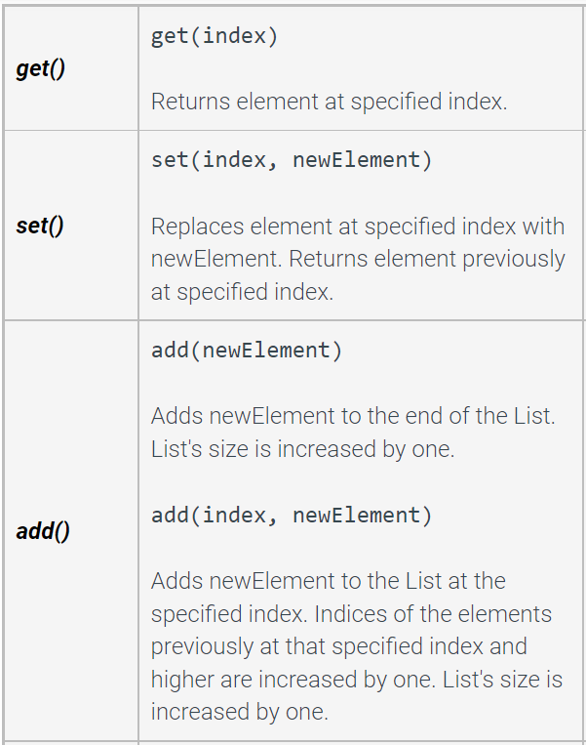
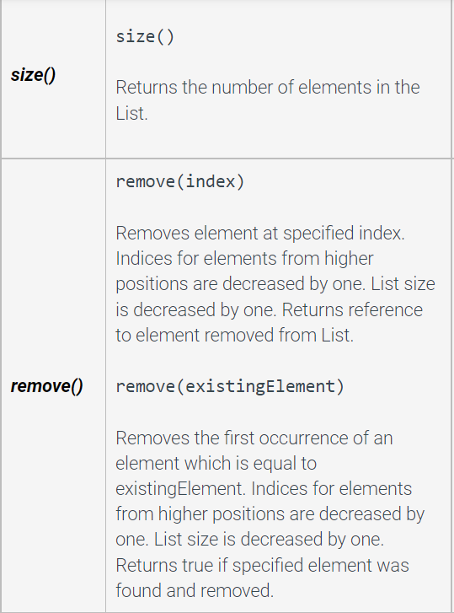
LinkedList basic methods and Practice
import java.util.LinkedList;
Import java.util.List; import java.util.ListIterator; public class LLTest { public static void main(String args[]){ List<Integer> list = new LinkedList<>(); list.add(2); list.add(4); list.add(6); ListIterator<Integer> intIterator = list.listIterator(); //what is printed? while(intIterator.hasNext()){ System.out.print(intIterator.next()); } System.out.println(""); //how to add number 5 between numbers 4 and 6? //how to add number 1 before number 2? //how to remove number 2? //how to remove the second element in the list? //what is printed?
intIterator = list.listIterator(); while(intIterator.hasNext()){ System.out.print(intIterator.next()); } } }

Slide 6
LinkedList versus ArrayList
A LinkedList typically provides faster element insertion and removal at the list's ends (and middle if using ListIterator)
LinkedList methods with index parameters, such as get() or set(), cause the list to be traversed from the first element to the specified element each time the method is called. Thus, using the LinkedLists' get() or set() methods within a loop that iterates through all list elements is inefficient.
ArrayList offers faster positional access with indices
it maintains index based system for its elements as it uses array data structure implicitly which makes it faster for searching an element in the list.

Slide 7
Linked List – Practical Examples
Image viewer – Previous and next images are linked and can be accessed by the next and previous buttons.
Previous and next page in a web browser – We can access the previous and next URL searched in a web browser by pressing the back and next buttons since they are linked as a linked list.
Music Player – Songs in the music player are linked to the previous and next songs. So you can play songs either from starting or ending of the list.
https://coderspacket.com/to-create-a-simple-song-playlist-using-linked-list-in-java

Slide 8
Map
Additional Reading: https://www.geeksforgeeks.org/java-util-hashmap-in-java-with-examples/
What if you had key value pairs?
Example: Your address points to your house
Does a book of addresses, store all the information about your house?
Or simply the address, that can get the info?
Introducing Maps
Pairs keys to values
Keys needs to be unique
Some uses: database indexing, network routing
HashMap<String, String> contacts = new HashMap<>(); contacts.put("awonder", "awonder@wonderland.colostate.edu"); contacts.put("queen", "redqueen@wonderland.colostate.edu"); contacts.put("hatter", "madhatter@wonderland.colostate.edu"); System.out.println(contacts.get("queen")); // prints redqueen@wonderland.colostate.edu

Slide 9
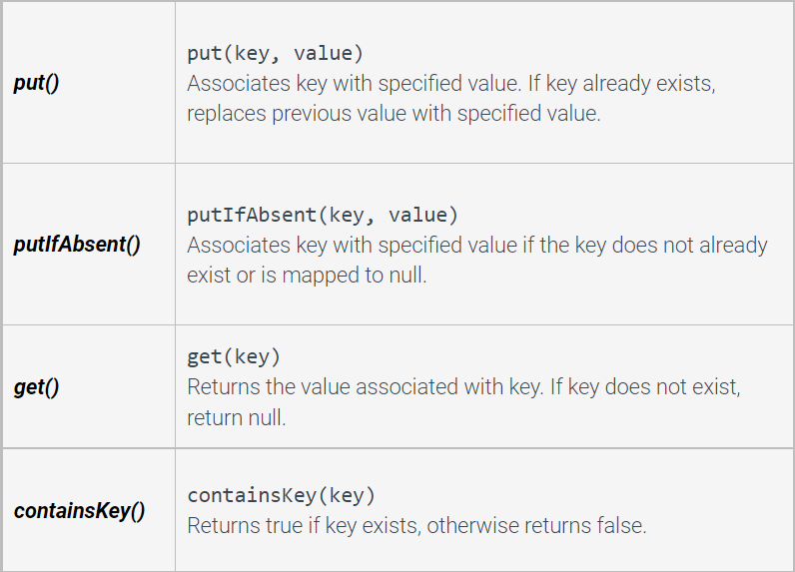
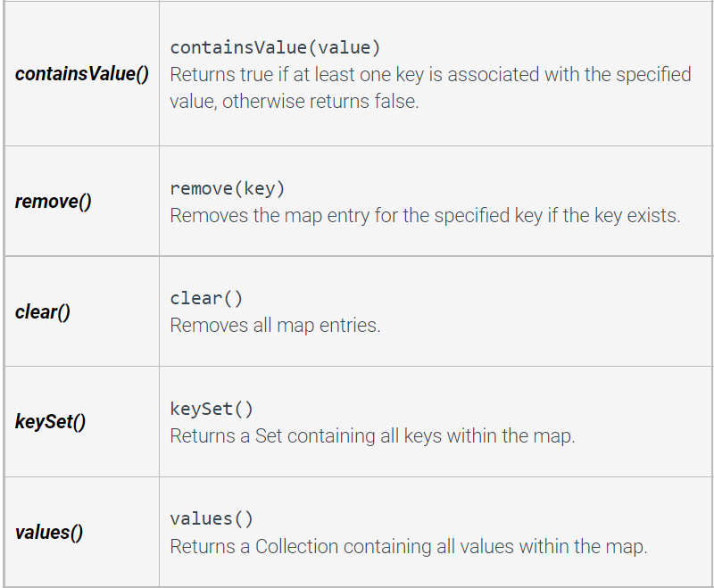
HashMap basic methods and Practice
import java.util.Collection; import java.util.HashMap; import java.util.Set; public class CountryMap { public static void main(String args []){ HashMap<String, Double> mapCountry = new HashMap<String, Double>(); mapCountry.put("Brazil",3288000.0); mapCountry.put("USA", 3797000.0); mapCountry.put("Portugal", 35603.0); mapCountry.put("India", 1269000.0); System.out.println(mapCountry); //how to return a list of keys? System.out.println(keys); //how to return a list of values? System.out.println(values); } }

Slide 10


Other Types of Data Structures
https://docs.oracle.com/javase/8/docs/api/java/util/Queue.html
https://docs.oracle.com/javase/7/docs/api/java/util/PriorityQueue.html

Slide 11

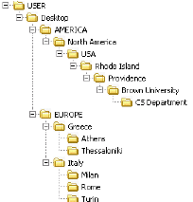

Other Types of Data Structures
Stack
https://docs.oracle.com/javase/7/docs/api/java/util/Stack.html
Graph – can be implemented
in Java using a HashMap
Tree
https://docs.oracle.com/javase/7/docs/api/java/util/TreeSet.html

Slide 12
Why does it matter?
Different data structures
affects speed, memory and storage
important for all fields
biology – large datasets
graphics – speed is needed
cybersecurity - processing serialized information over networks
If you interview at Google, Amazon, etc
they often give you a tech quiz
Most of what is on that quiz – you learn in CS 165
Take CS 165, it provides major programming foundation!

Slide 13

Last but not least
Thank you!!!
Please fill out course survey
Keep coding, keep learning, and have a great time at CS 165!

