Slide 1
is-a – The Polymorphic Life

Slide 2
Announcements
Opening Question:
What are we saying when we say List<Object> list = new ArrayList<>();
Todo:
Labs this week
Work on Practical 5
Wednesday Help Session in CSB 315
Make sure to read this week’s announcement
Come see me during office hours
CS 165 – Next Course In Sequence (also 201 is popular with 165)
CO Jobs Report 2021 – 77% of *all* new jobs in Colorado require programming
60% of all STEM jobs requires *advanced* (200-300 level)
31% of all Bachelor of Arts degree titled jobs also required coding skills
2016 Report found on average jobs that require coding skills paid $22,000 more
Math and Stats majors, at least consider CS 220 (Discrete Structures) – substitutes in your program requirements

Slide 3
Warm Up
AbstractShape
+ AbstractShape(int)
+ getSides() : int
+ getArea() : double abstract
Select a dedicated programmer
Write the following classes & interfaces
We will use them throughout the lecture
Write a main class that constructs
3 rectangles
2 circles
1 triangle
Stores them into an ArrayList
For color Strings use:
0-255,0-255,0-255
Example: 30,77,43
(red,green,blue)
extends
Rectangle
Rectangle(int, int)
Circle
Circle(int, String)
Triangle
Triangle(int, int, String)
HasWidthHeight <<interface>>
getHeight() : int
getWeight(): int
setHeight(int): int
setWidth(int): int
HasColor <<interface>>
setColor(String)
getColor(String)

Slide 4
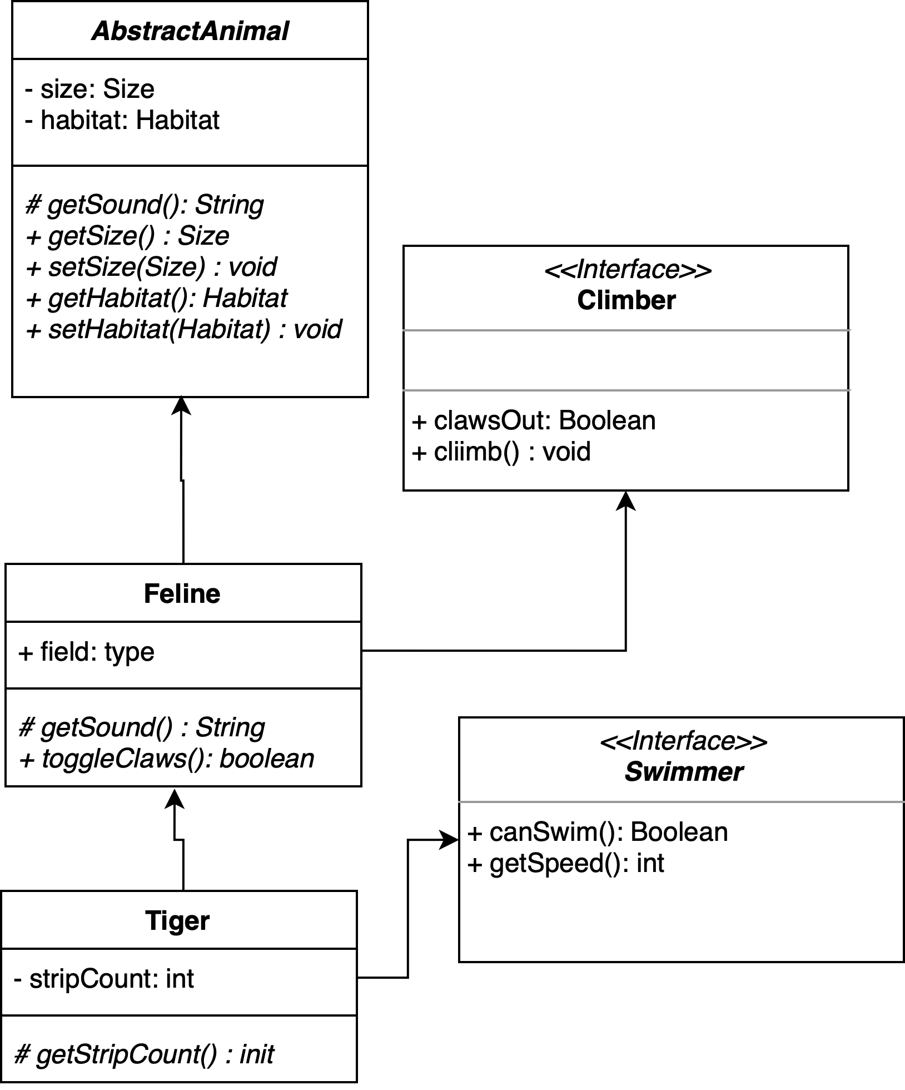
More Inheritance
Keep your programs DRY
Super/Parent classes
Child Class extends parent
Can only extend one immediate parent
Child Classes
gain public, protected, package-protected methods and variables of parent
Polymorphic
children can appear ‘as the parent’ when type matters
is-a relationship
AbstractAnimal great = new Tiger();
Feline great2 = new Tiger();
Tiger tony = new Tiger();
boolean isFeline = tony instanceof Tiger; // returns true

Slide 5
Practice
In your main class
Write a method that takes in two objects
The objects should have a .getWidth() method
(what type??)
Returns -1 if the first is narrower than the second, 0 if equal, 1 if larger
Loop through your Array, comparing the first object to every object after it that has a width
Print out the result
Can you do it, so all objects are compared to each other (loop with a loop)
instanceOf will help you!

Slide 6
Practice – Next Step
Colorblindness is a major concern!
Write an id_protanopia method
Takes in any object that has a color value
If the Red value is below 64, returns true
Else returns false
Count the number of objects in your array list that have a color, and have id_protanopia

Slide 7
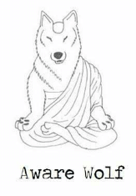
Polymorphism Details
Children may appear as parents
Why?
Comparable example
as long has the objects implements Comparable – it can call compareTo method
Type determines which methods can be called
Also determines how things are stored
AbstractAnimal great = new Tiger();
Feline great2 = new Tiger();
Tiger tony = new Tiger();
All valid, but is
great.canSwim();
No! – You must cast as the object with the method

Slide 8
Architecture Style Thinking
To be successful
You draft your program layout (UML)
You visualize the program
You build before coding!
Inheritance
Is about building blocks
It is about keeping things DRY
Technically
You can avoid it, but life becomes hard
Easier to use, practice and then embrace

Slide 9
Inheriting methods
Given this example, what methods are available to Tiger?
getSound
getSize
setSize
getHabitat
setHabitat
clawsOut
climb
toggleClaws
canSwim
getSpeed
getStripCount
Could easily add a Lion that inherits from Feline
mostly same methods, with out the Swimmer or Stripes, but maybe unique ones on its own.

