Slide 1
Reading Files

Slide 2
Announcements
Opening Question:
How is your Knowledge Checks practice? Are you spacing and interleaving your practice?
Make sure to review knowledge checks and spread out their use!
This Friday: “So you think you want to major or minor in CS?” Albert gives a quick overview, and hint: your first semester is the easiest semester to declare a minor or major in CS – come listen and learn more.
Todo:
Practical 3 – Get started! (finish P2)
Wednesday October 6th at 6:00pm in CSB 130, ACM will be having a startup company called The Guide Network come to give a presentation on their platform and the design process behind their software. https://forms.gle/ABAY8FhPo8TfbSt37
Thursday October 7th 5:30pm in CSB 425, ACM-W Celebrating women in computing will feature the documentary Lo and Behold: Reveries of the Connected World. Bring movie snacks if you like. https://forms.gle/ZFajAM2rM1Q1TcuK7
NEXT WEEK:
Monday: Review / Student Guided Topics
Tuesday: Coding Exam 2 (in lab)
Wednesday: Additional Drop By Hours
Thursday: Canvas Exam (in lab)
Friday: No Class / Catch up day

Slide 3
Scanner
When we want to read something from the terminal we use:
Scanner scnr = new Scanner(System.in);
The parameter System.in indicates that we are reading from the terminal.
What happens if instead of reading from the terminal, we want to read from a file?
We need to use the File class!
And pass an object of File as a parameter instead of System.in when we construct a Scanner object

Slide 4
File IO
Java makes it really simple -
File x = new File(“File/location/name”)
Note: For this class, we use File over FileInputStream. The differences come into play much later.
However, you must first understand how files are stored…
Files are …
Memory stored on your disk
Made up of Bits and Bytes (usually people just say bytes)
Contain
Name
Extension (technically optional on some OSes)
So the OS knows what to do with the file
Data.csv
Hello.txt
Index.html

Slide 5
Reading Files in Java
Consider Scanner
Reads in from a Stream
A file is a stream of bytes! Scanner works
Scanner scanner = new Scanner(new File(“input.txt”));
String line = scanner.nextLine(); // this is most common
double dbl = scanner.nextDouble(); // reads the next token, tries to convert to double
scanner.hasNextLine(); // great if grabbing lines only (most common)
scanner.hasNext(); // is true until End of File (EOF).
Putting it together
Scanner in = new Scanner (new File("input.txt"));

Slide 6
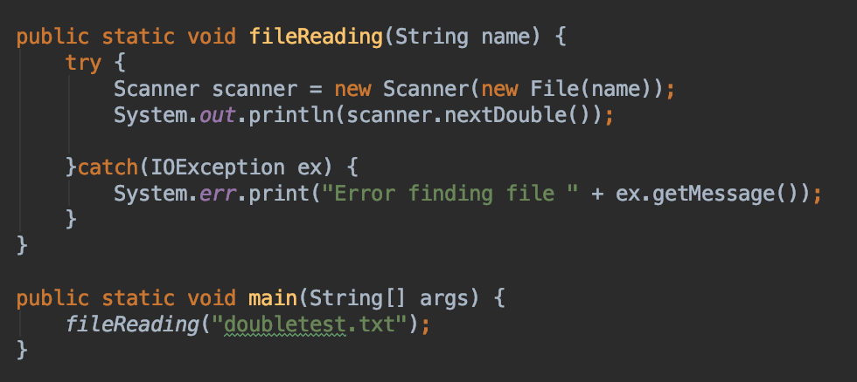
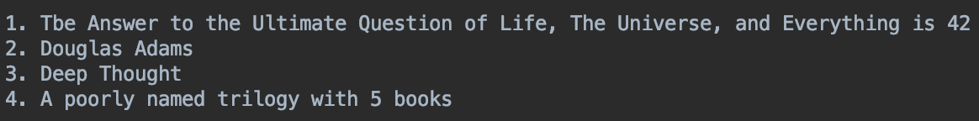
What is printed
1.0

Slide 7
One Line Only
We can access one line
How do we access multiple lines?
Repeat the action!
LOOPS
What methods return true or false in scanner?
hasNextLine() or hasNext()
hasNextLine() is more common
Perfect case for a while loop!
Let’s look at that code
First – what would my condition be for my while loop? Discuss!

Slide 8
Printing Out Contents
public static void main(Strings[] args) {
try {
Scanner fileHandler = new Scanner(new File(“file.txt”));
while(fileHandler.hasNextLine()) {
System.out.println(fileHandler.nextLine());
}
}catch(IOException io) {
// what happens if the file is not there??
}
}
The code would print to the console… This is my awesome file with a number 22.
Look out!
This is my awesome
file with a number 22.
Look out!

Slide 9
More Useful Case
public static void main(Strings[] args) {
try {
Scanner fileHandler = new Scanner(new File(“file.txt”))
while(fileHandler.hasNext()) {
dosomething(fileHandler.nextLine()); // method that handles strings
}
}catch(IOException io) {System.out.println(“error”);}
}
public static void dosomething(String line) {
// now I can just treat the line as a String
// maybe count the characters?
}

Slide 10
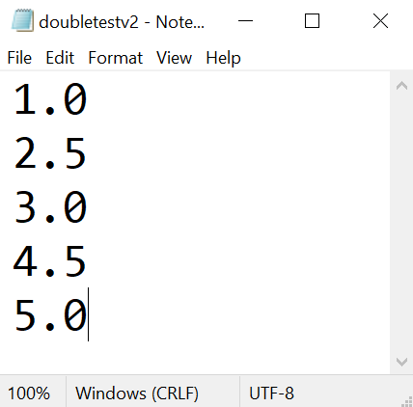
Code Along
Write a method fileReadingDouble(String filename) that reads a file which contains double values and return an array with those values.
The file will have the following structure and content:
We are going to use the following instructions to help us out to code this method:
Path path = Paths.get(name);
int lines = (int) Files.lines(path).count(); //to count the number of lines we have in the file
This instruction needs to be inside a try…catch block

Slide 11
Step 1: Read the File
What is my quest?
Write a method fileReadingDouble(String filename) that reads a file which contains double values and return an array with those values.
Print out the contents of the file by reading it in
Look back at a past slide
Remember try/catch
Just print, don’t worry about the rest
1.0 2.5 3.0 4.5 5.0

Slide 12
Step 2: Doubles?
What is my quest?
Write a method fileReadingDouble(String filename) that reads a file which contains double values and return an array with those values.
Can you convert each line to a double?
Just do that!
Maybe add the values together – just to make sure
Step 2.5
Create a very large double Array (100 positions or so)
Create a line counter
Store Doubles into the double Array
1.0 2.5 3.0 4.5 5.0

Slide 13
Step 3: Fix double[]
What is my quest?
Write a method fileReadingDouble(String filename) that reads a file which contains double values and return an array with those values.
The array is larger than we need
But we have the total values (line count)
And we have the values
Create another method that takes in the double Array, and the linecount
Builds a smaller array, storing the values into a double[] array of the correct size
return the new array
and then return again out of the primary method
1.0 2.5 3.0 4.5 5.0

