Slide 1
Objects and Methods

Slide 2
Announcements
Todo:
Busy Week! (readings + labs)
Lab projects start!
Reminder – readings are due before lecture
You don’t have to do all of it - challenge problems can be challenging…
You can return to them.
We start off each lecture with a quiz from your reading!
Labs are due the night of the lab (meant to be done in lab!)
follow the modules *in order*
You can go back to labs until you get it correct, so submit for 0 is valid!
ACM this Week
Success in CS Panel
Wednesday, 6:00 PM CSB 130
ACM-W this Week
Hike to Horsetooth Falls
Thursday, 5:30 PM Meet outside CSB front of building
Opening Question: (make sure to talk before class starts)
What apps do you use most on your phone? What do they have in common? What problem are they trying to solve? (also – do you know each other’s names!)

Slide 3
Programming == Problem Solving
You look at the problem to solve
Clarify the problem and constraints
Break it up into *smaller* parts (Divide)
Outline the steps needed
Solve each step (Conquer)
Reassemble the pieces (Glue)
Completed program
public class BasicCalculations {
public static void main(String[] args) {
double value1, value2, sum, subtraction;
double multiplication, division;
value1 = 12;
value2= 30;
sum = value1 + value2;
subtraction = value1 - value2;
multiplication = value1 * value2;
division = value1/value2;
System.out.println(value1 + " + " +
value2 + " = " + sum);
System.out.println(value1 + " - " +
value2 + " = " + subtraction);
System.out.println(value1 + " * " +
value2 + " = " + multiplication);
System.out.println(value1 + " / " +
value2 + " = " + division);
}
}
What if we want to do the same set of instructions again?
REUSE CODE

Slide 4
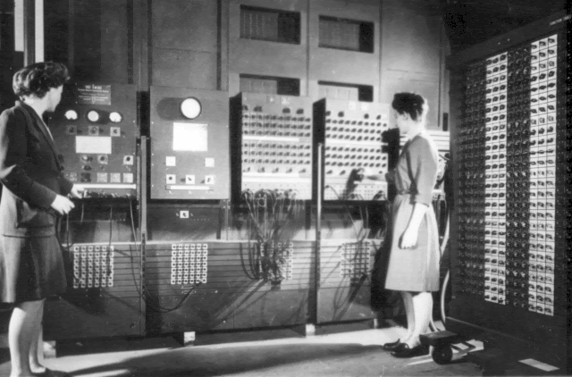
Reusable Code
The ENIAC women pioneered reusable code
public class BasicCalculations {
public static void main(String[] args) {
double value1, value2, sum, subtraction, multiplication, division;
value1 = 12;
value2= 30;
sum = value1 + value2;
subtraction = value1 - value2;
multiplication = value1 * value2;
division = value1/value2;
System.out.println(value1 + " + " + value2 + " = " + sum);
System.out.println(value1 + " - " + value2 + " = " + subtraction);
System.out.println(value1 + " * " + value2 + " = " + multiplication);
System.out.println(value1 + " / " + value2 + " = " + division);
value1 = 100;
value2= 0.5;
sum = value1 + value2;
subtraction = value1 - value2;
multiplication = value1 * value2;
division = value1/value2;
System.out.println(value1 + " + " + value2 + " = " + sum);
System.out.println(value1 + " - " + value2 + " = " + subtraction);
System.out.println(value1 + " * " + value2 + " = " + multiplication);
System.out.println(value1 + " / " + value2 + " = " + division);
}
}
Programmers Betty Jean Jennings (left) and Fran Bilas (right) operate ENIAC's main control panel By United States Army (Image from http://ftp.arl.army.mil/~mike/comphist/) [Public domain], via Wikimedia Commons
Is this a good way to reuse code?
Modularize code
Object-Oriented Design

Slide 5
Why Objects and Methods?

Slide 6
DRY Code
Fun Fact:
Software Engineers, Andy Hunt and Dave Thomas, are credited with first using the the term for coding in the The Pragmatic Programmer
Code should be DRY
Don’t Repeat Yourself
Code should be
Reusable
Small Snippets
Reusable code
Only write once
Use in multiple applications
Java
Objects are blocks of information, with reusable code / methods
Methods are blocks of reusable code
Ideally, no more than 20 instructions
CLUE: If you are cutting and pasting code - it should be a method
Really, that happens
Divide
Conquer
Conquer
Conquer
Glue

Slide 7

Objects are Building Blocks
Think of LEGOs
Blocks
Assembled in different ways - creates new and interesting things
Objects contain information in a logical order
Example: Strings are objects
String companion = “Clara”; // note, Strings are so common, they have this shortcut
companion.length(); // returns 5
Most objects use the new keyword
MyCoolObject obj = new MyCoolObject(); // this reserves room in memory
obj.myCoolMethod();
We will keep coming back to this
Important to know - methods belong to Objects
Even methods that you write
© Ralf Roletschek - Published with permission. Read full copy information on wikicommons.

Slide 8
Reusing code
How many different concepts are in the main method?
public class BasicCalculations {
public static void main(String[] args) {
double value1, value2, sum, subtraction, multiplication, division;
value1 = 12;
value2= 30;
sum = value1 + value2;
subtraction = value1 - value2;
multiplication = value1 * value2;
division = value1/value2;
System.out.println(value1 + " + " + value2 + " = " + sum);
System.out.println(value1 + " - " + value2 + " = " + subtraction);
System.out.println(value1 + " * " + value2 + " = " + multiplication);
System.out.println(value1 + " / " + value2 + " = " + division);
value1 = 100;
value2= 0.5;
sum = value1 + value2;
subtraction = value1 - value2;
multiplication = value1 * value2;
division = value1/value2;
System.out.println(value1 + " + " + value2 + " = " + sum);
System.out.println(value1 + " - " + value2 + " = " + subtraction);
System.out.println(value1 + " * " + value2 + " = " + multiplication);
System.out.println(value1 + " / " + value2 + " = " + division);
}
}
Sum
Subtraction
Multiplication
Division
Print

Slide 9
Quick Practice One
As a group, block out / outline what you need to do for the multiplication method.
For example:
// what do I need to work? – values to add, so takes in two parameters
// what do I need to do? (quest!) Add the two values and return the result
// what is my return type then? double if my params are double..
// what else do I know / what else can I work with? // ---method is self contained, no need to add anything else
// --- self contained – good place to make it static
public static double sum(double val1, double val2) { return 0; // TODO: see comments above }
Called a method stub!

Slide 10
Reading Check-in
Which of the following are valid method “signatures”
public double calcArea(double width, double height) {}
Public static my_method(int x, boolean y) {}
public static void main(String args[]);
All listed
None listed

Slide 11
Method Syntax Basics
[scope] [static] TYPE name(parameters) {}
public static void main(String[] args) {...}
public - is the scope of the method (optional)
static - access type (option)
void - return type (required)
main - method name (required)
String[] args - are parameters for the method
Having parentheses is required
something inside, optional
public double getPercentGrowth(double startingSalary, double midCareerSalary) { …}
public - is the scope of the method
access is not there - that means “instance”
double - return type
getPercentGrowth - method Name
double startingSalary, double midCareerSalary - are parameters for the method

Slide 12
Static vs. Instance Methods
Harder concept (we will come back to it later)
Think of static as shared memory
Variables in it are easily overwritten
Static methods need to be self contained, and only access shared information
Instance methods belong to the object
They need information from the object
They provide the main functionality to the object
Most common

Slide 13

Method Name & Parameters
They should have meaning!
They follow the same rules as variable names
No specials, start with letter, etc
Parameters are part of the name
getArea()
getArea(int x)
getArea(int x, int y)
Are three different methods! (Be careful - Overlapping)
The secret ninja trick for methods
Pass in the variables
Try to keep everything as contained as possible
What is your quest?
What is it you return
What do you know
What do you need (parameters)

Slide 14
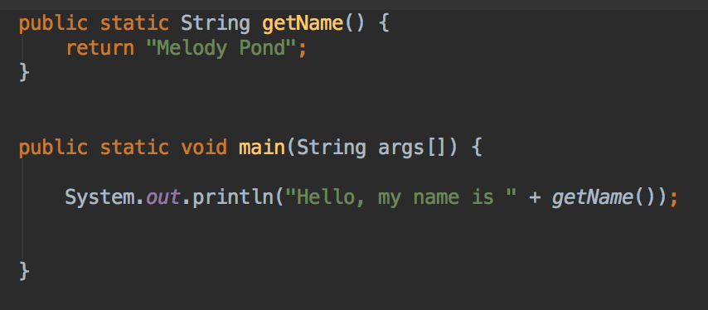
Return Types
Return Types
Critically important
Can return a primitive, array or an object
void is how you say the method returns nothing
Whenever you call a method
Assume the return type is what is returned
Think of replacing the method name with the answer
The program output is
Hello, my name is Melody Pond
Notice: Melody Pond simply replaces ‘getName()’

Slide 15
Code Along
Let’s rewrite this code so it will have the 5 different methods that we discussed!
public class BasicCalculations {
public static void main(String[] args) {
double value1, value2, sum, subtraction, multiplication, division;
value1 = 12;
value2= 30;
sum = value1 + value2;
subtraction = value1 - value2;
multiplication = value1 * value2;
division = value1/value2;
System.out.println(value1 + " + " + value2 + " = " + sum);
System.out.println(value1 + " - " + value2 + " = " + subtraction);
System.out.println(value1 + " * " + value2 + " = " + multiplication);
System.out.println(value1 + " / " + value2 + " = " + division);
value1 = 100;
value2= 0.5;
sum = value1 + value2;
subtraction = value1 - value2;
multiplication = value1 * value2;
division = value1/value2;
System.out.println(value1 + " + " + value2 + " = " + sum);
System.out.println(value1 + " - " + value2 + " = " + subtraction);
System.out.println(value1 + " * " + value2 + " = " + multiplication);
System.out.println(value1 + " / " + value2 + " = " + division);
}
}
Let’s start with the sum method:
What do we need to do?
What do we need to do it (parameters)?
What does the method return?

Slide 16
Code Along
public class BasicCalculations {
public static double sumMethod(double param1, double param2){
return param1 + param2;
}
public static void main(String[] args) {
double value1, value2, sum, subtraction, multiplication, division;
value1 = 12;
value2= 30;
sum = sumMethod(value1, value2);
subtraction = value1 - value2;
multiplication = value1 * value2;
division = value1/value2;
System.out.println(value1 + " + " + value2 + " = " + sum);
System.out.println(value1 + " - " + value2 + " = " + subtraction);
System.out.println(value1 + " * " + value2 + " = " + multiplication);
System.out.println(value1 + " / " + value2 + " = " + division);
value1 = 100;
value2= 0.5;
sum = sumMethod(value1, value2);
subtraction = value1 - value2;
multiplication = value1 * value2;
division = value1/value2;
System.out.println(value1 + " + " + value2 + " = " + sum);
System.out.println(value1 + " - " + value2 + " = " + subtraction);
System.out.println(value1 + " * " + value2 + " = " + multiplication);
System.out.println(value1 + " / " + value2 + " = " + division);
}
}
First step – have the method!
Second step – call the method!
Work in pairs and rewrite the remaining code to include the following methods:
subtractionMethod
multiplicationMethod
divisionMethod
printMethod

