Slide 1
Operating Systems and File Output

Slide 2

Announcements
TODO Reminders:
Readings are due before lecture
Reading 17 (zybooks) – you should have already done that ☺
Lab 11 – participation activity due in lab
Reading 18 (zyBooks)
Lab 12 – participation activity due in lab
Reading 19 (zybooks)
RPA 9
Keep practicing your RPAs in a spaced and mixed manner ☺
https://twitter.com/BradSugars/status/897850608312561664
Help Desk
Day | Time : Room
Monday | 3 PM - 5 PM : CSB 120
Tuesday | 6 PM - 8 PM : Teams
Wednesday | 3 PM - 5 PM : CSB 120
Thursday | 6 PM - 8 PM : Teams
Friday | 3 PM - 5 PM : CSB 120
Saturday | 12 PM - 4 PM : Teams
Sunday | 12 PM - 4 PM : Teams

Slide 3



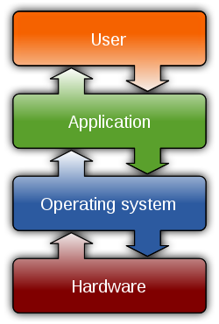




Operating Systems
You use them daily
Most common OS in the world?
Android
Written in Java w/ Kotlin
The control
Resources
Hardware Interaction
Devices
Running applications, memory, etc
Files!

Slide 4
File Systems
Root - c:/ or /
Program that helps manage files and other programs
Directory Structure
Relative
Based on current location
Absolute
Based on Root, the top of the hierarchy
Key “shortcuts”
. (yes dot) - current directory
.. (directory above this directory)
Directory - A
File
Directory - B
File
Directory - C
File
File
File
File

Slide 5
File Systems - Examples
Root - c:/ or /
Windows: drive letter with C:/, D:/ etc
Linux/MacOS/Unix: just a "/“
"/Directory - A/file“
"/Directory - A/Directory - C/file“
"C:\Directory - B\file“
"/file"
Directory - A
File
Directory - B
File
Directory - C
File
File
File
File

Slide 6
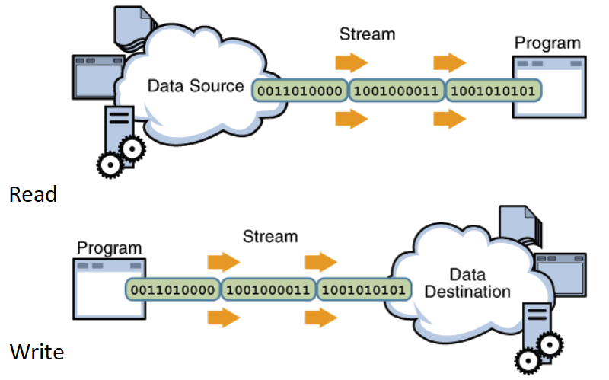
Files and Streams
To read we used:
Scanner in = new Scanner(new File("input.txt"));
To write we will use:
PrintWriter writer =
new PrintWriter(new File(“notes.txt”));
Or
PrintWriter writer =
new PrintWriter(new FileOutputStream(“notes.txt”));

Slide 7
File Object in Java
Has a number of useful methods when dealing with files and directories
File myFile = new File(“filename”);
Creates or reads a file based on the path+filename given
Actually connects to the location which is a ‘stream of bytes’

Slide 8
File Object in Java
File myFile = new File(“output.txt”);
Creates a file in the same directory as that you are executing the java file from - so relative to your program
File myfile = new File(“/Users/lionelle/output.txt”);
Creates a file based on the absolute path that is Root -> Users -> lionelle (folder) -> output.txt
File myfile = new File(“../output.txt”);
What does this do?

Slide 9
FileOutputStream Object in Java
Has a number of useful methods when dealing with writing binary data to a file
FileOutputStream myFile = new FileOutputStream(“output.txt”);
Creates a file in the same directory as that you are executing the java file from - so relative to your program
FileOutputStream myfile = new FileOutputStream(“/Users/lionelle/output.txt”);
Creates a file based on the absolute path that is Root -> Users -> lionelle (folder) -> output.txt
FileOutputStream myfile = new FileOutputStream (“../output.txt”);
What does this do?

Slide 10
Print Writer
PrintWriter is an object designed to write text to a File Stream
What Are Streams?
System.out - stream to the console
System.in - stream from the console
System.err - stream to the error log (often console)
File is also a Stream
FileOutputStream is also a Stream
PrintWriter uses the same interface as System.out but directs the stream
PrintWriter writer = new PrintWriter(new FileOutputStream(“notes.txt”));
writer.println(“#These are my notes”);
writer.print(“This is a note without the extra line”);
writer.print(“ this would append right after the one above”);
writer.close(); //we need to close the stream after writing in the file!

Slide 11
Example of Writing and Reading
public static void printSimpleFile(Scanner in) throws IOException{ PrintWriter file = new PrintWriter(new FileOutputStream("simple.txt")); System.out.println("Enter a string - 'exit' to stop"); String line = in.nextLine(); while(!line.equals("exit")){ file.println(line); System.out.println("Enter another string - 'exit' to stop"); line = in.nextLine(); } file.close(); } public static void readSimpleFile(){ System.out.println("Printing what is in simple.txt file"); try{ Scanner file = new Scanner(new File("simple.txt")); while(file.hasNext()){ System.out.println(file.nextLine()); } }catch (IOException e){ System.out.println("Could not read the file!"); } } }
import java.io.File; import java.io.FileOutputStream; import java.io.IOException; import java.io.PrintWriter; import java.util.Scanner; public class SimpleFileWritingFileOutputStream { public static void main(String args[]){ Scanner in = new Scanner(System.in); try { printSimpleFile(in); }catch(IOException e){ System.out.println("Error! Could open the file to write!"); } readSimpleFile(); }
Discuss in your tables, how this program works.
What the throws IOException in printSimpleFile method means?

Slide 12
Example of Writing and Reading
public static void printSimpleFile(Scanner in) throws IOException{ PrintWriter file = new PrintWriter(new FileOutputStream("simple.txt")); System.out.println("Enter a string - 'exit' to stop"); String line = in.nextLine(); while(!line.equals("exit")){ file.println(line); System.out.println("Enter another string - 'exit' to stop"); line = in.nextLine(); } file.close(); } public static void readSimpleFile(){ System.out.println("Printing what is in simple.txt file"); try{ Scanner file = new Scanner(new File("simple.txt")); while(file.hasNext()){ System.out.println(file.nextLine()); } }catch (IOException e){ System.out.println("Could not read the file!"); } } }
Instead of having the try…catch block inside printSimpleFile this block is implemented where the method is called.
throws means that the method is delegating the dealing of the exception to where the method is being called.
Can we apply the same thing to readSimpleFile method?
public class SimpleFileWritingFileOutputStream { public static void main(String args[]){ Scanner in = new Scanner(System.in); try { printSimpleFile(in); }catch(IOException e){ System.out.println("Error! Could open the file to write!"); } readSimpleFile(); }

Slide 13
Example of Writing and Reading
import java.io.File; import java.io.FileOutputStream; import java.io.IOException; import java.io.PrintWriter; import java.util.Scanner; public class SimpleFileWritingFileOutputStream { public static void main(String args[]){ Scanner in = new Scanner(System.in); try { printSimpleFile(in); readSimpleFile2(); }catch(IOException e){ System.out.println(e.getMessage()); } }
public static void printSimpleFile(Scanner in) throws IOException{ PrintWriter file = new PrintWriter(new FileOutputStream("simple.txt")); System.out.println("Enter a string - 'exit' to stop"); String line = in.nextLine(); while(!line.equals("exit")){ file.println(line); System.out.println("Enter another string - 'exit' to stop"); line = in.nextLine(); } file.close(); } public static void readSimpleFile2() throws IOException{ System.out.println("Printing what is in simple.txt file"); Scanner file = new Scanner(new File("simple.txt")); while(file.hasNext()){ System.out.println(file.nextLine()); } } }
Both methods here
throws
Get the specific message that generated the exception
https://docs.oracle.com/javase/8/docs/api/java/io/IOException.html?is-external=true

Slide 14
In Class Practice
Worksheet
Files available: https://github.com/CSU-CompSci-CS163-4/Handouts/tree/main/ClassExamples/09FileWrite
In Class Activity on zybooks

