Slide 1
Java Exceptions

Slide 2
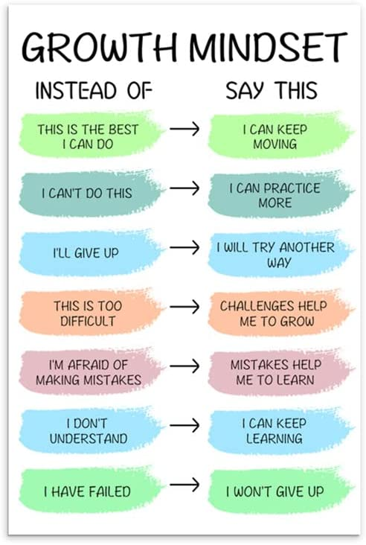
https://www.amazon.com/Inspirational-Motivational-Paintings-Educational-Classroom/dp/B0B5THMZ8F

Slide 3
Announcements
TODO Reminders:
Readings are due before lecture
Reading 17 (zybooks) – you should have already done that ☺
Lab 11
Reading 18 (zyBooks) – you should have already done that ☺
Lab 12
Reading 19 (zybooks)
RPA 9
Keep practicing your RPAs in a spaced and mixed manner ☺
Help Desk
Day | Time : Room
Monday | 3 PM - 5 PM : CSB 120
Tuesday | 6 PM - 8 PM : Teams
Wednesday | 3 PM - 5 PM : CSB 120
Thursday | 6 PM - 8 PM : Teams
Friday | 3 PM - 5 PM : CSB 120
Saturday | 12 PM - 4 PM : Teams
Sunday | 12 PM - 4 PM : Teams
https://www.amazon.com/Inspirational-Motivational-Paintings-Educational-Classroom/dp/B0B5THMZ8F

Slide 4
Recall Activity
What are exceptions in Java? Explain providing an example.
https://rollbar.com/blog/java-exceptions-hierarchy-explained/

Slide 5
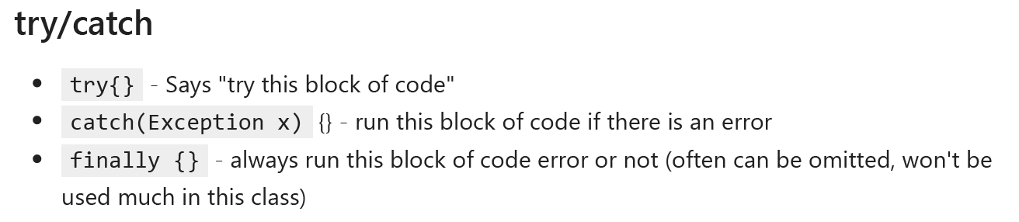
What are Exceptions?
Classes / Objects!
They contain information about the error that is happening
What about try/catch and throws?
Those are commands that use those objects!
https://rollbar.com/blog/java-exceptions-hierarchy-explained/

Slide 6
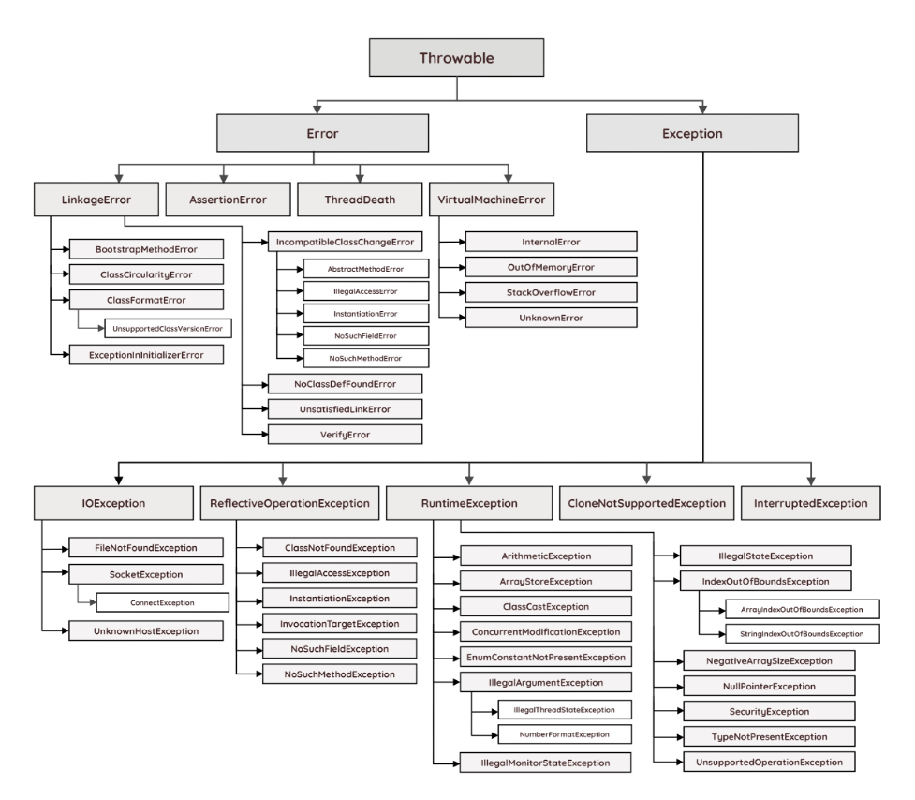
Java Exception Hierarchy
Error class is used to indicate a more serious problem in the architecture and should not be handled in the application code.
Exception class is used for exception conditions that the application may need to handle.
Exceptions are further subdivided into checked (compile-time) and unchecked (run-time) exceptions.
https://rollbar.com/blog/java-exceptions-hierarchy-explained/

Slide 7
Java Exception Hierarchy
Exceptions that can occur at compile-time are called checked exceptions since they need to be explicitly checked and handled in code.
All classes with the exception of Error and RuntimeException are checked
Unchecked exceptions can be thrown "at any time" (i.e. run-time). Therefore, methods don't have to explicitly catch or throw unchecked exceptions.
RuntimeException
https://rollbar.com/blog/java-exceptions-hierarchy-explained/

Slide 8
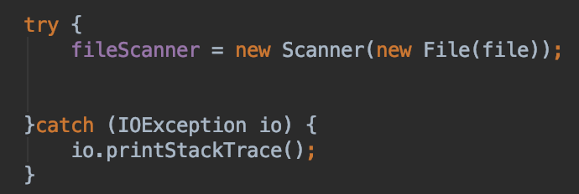
Controlling Exceptions
We can’t control every possible error situation
For example:
What happens if the file is not there?
What if you don’t have permission to read it?
Not just files
What about network connections?
What if printers aren’t there?
Exception handling
try – catch

Slide 9
Try - Catch
try
try a block of code.
If it runs properly, great!
catch
an exception happened!
run the catch block of code
throws
allows you to “throw” the exception
requires someone else to handle it
Exception
an object / class we use for errors!
You can write you own
or use built in cases
Checked (compile time) or Unchecked (run time)
Checked requires try/catch
IOException - Input / output exception - checked
FileNotFoundException - Subset of IOException, but allows you to specify exactly that it is file not found - checked
ArrayIndexOutOfBoundsException - you don’t usually try/catch this, but you can - unchecked
NullPointerException - you don’t usually try/catch this - unchecked
NumberFormatException - Shows up when you take a string that doesn’t look like a number, and try to make it a number - unchecked

Slide 10
import java.util.Scanner; public class BMIExceptHandling { public static int getWeight(Scanner scnr) throws Exception { int weightParam; // User defined weight (lbs) // Get user data System.out.print("Enter weight (in pounds): "); weightParam = scnr.nextInt(); // Error checking, non-negative weight if (weightParam < 0) { throw new Exception("Invalid weight."); } return weightParam; } public static int getHeight(Scanner scnr) throws Exception { int heightParam; // User defined height (in) // Get user data System.out.print("Enter height (in inches): "); heightParam = scnr.nextInt(); // Error checking, non-negative height if (heightParam < 0) { throw new Exception("Invalid height."); } return heightParam; }
public static void main(String[] args) { Scanner scnr = new Scanner(System.in); int weightVal; int heightVal; float bmiCalc; char quitCmd; quitCmd = 'a'; while (quitCmd != 'q') { try { //Get user data weightVal = getWeight(scnr); heightVal = getHeight(scnr); // Calculate BMI and print user health info if no input error // Source: http://www.cdc.gov/ bmiCalc = ((float) weightVal / (float) (heightVal * heightVal)) * 703.0f; System.out.println("BMI: " + bmiCalc); System.out.println("(CDC: 18.6-24.9 normal)"); } catch (Exception excpt) { // Prints the error message passed by throw statement System.out.println(excpt.getMessage()); System.out.println("Cannot compute health info"); } // Prompt user to continue/quit System.out.print("\nEnter any key ('q' to quit): "); quitCmd = scnr.next().charAt(0); } } }

Slide 11
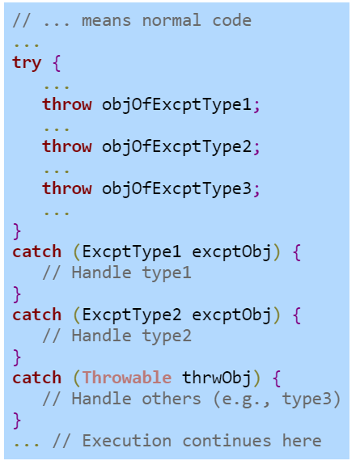
Multiple Handlers
Multiple exceptions can happen
Needs to handle the more specifics first than the more generic

Slide 12
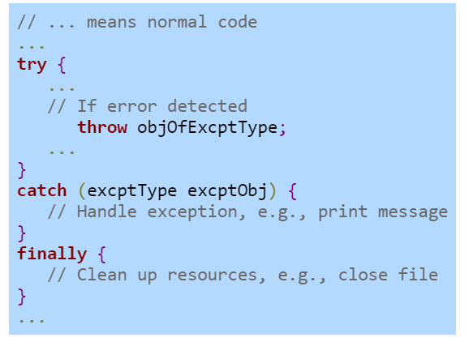
Finally Block
Exception can happen
Handle the exception
Block of commands that executes after the program exits the corresponding try or catch blocks. It is always executed!

Slide 13
Example of Multiple Handlers and Finally
import java.io.File; import java.io.FileNotFoundException; import java.io.IOException; import java.util.Scanner; public class FilesException { private String fileName; public FilesException(String fileName){ this.fileName = fileName; } public String readFile(){ String strFromFile = ""; Scanner scnrFile = null; try{ scnrFile = new Scanner(new File(fileName)); while(scnrFile.hasNext()){ strFromFile += scnrFile.nextLine() + "\n"; } }catch(FileNotFoundException fileExp){ System.out.println("File not found!"); }catch(IOException ioExp){ System.out.println("Something wrong with file!"); }finally { scnrFile.close(); } return strFromFile; } }
First handler
Second handler
Finally – always executed

Slide 14
Advanced: Creating your Own Exception
You can create and throw your own exceptions (often called "raise" in other languages)
In java, you have to extend the Exception class to do that
Ensures certain methods are implements for try/catch/throw/throws
Won't use much in this class, but worth knowing
Especially useful if you are developing an SDK (Software Development Kit)/API (Application Programming Interface)

Slide 15
Advanced: Creating your Own Exception
public class MyCoolException extends Exception {
public MyCoolException(String msg) { super(msg); }
public String getMessage() { return "SUPER COOL: " + super.getMessage(); } }
Inheritance – MyCoolException inherits all attributes and methods from Exception
Calls the super class constructor – setting the message for the Exception
Overrides the getMessage method inherited from Exception
https://docs.oracle.com/javase/7/docs/api/java/lang/Exception.html

Slide 16
Advanced: Creating your Own Exception
public class MyCoolExceptionApp { public static void doSomething(boolean type) throws MyCoolException,Exception { if(type) throw new MyCoolException("This is a personal message"); throw new Exception("General exceptions can have messages"); } public static void test(boolean type) { try { doSomething(type); }catch(MyCoolException ex) { System.err.println(ex.getMessage()); }catch(Exception ey) { System.err.println(ey.getMessage()); } } public static void main(String args[]){ test(true); test(false); } }
throws – other method needs to treat both MyCoolException and Exception
throw new – creates a MyCoolException object
throw new – creates a Exception object
Since doSomething can throw two exception, we need to handle both exceptions
Ordering of the handling – more specific first (MyCoolException), then the more general (Exception)

Slide 17
Group Practice
Worksheet

