Slide 1
Method Overloading, Asserts, and Objects as Parameters of Methods

Slide 2
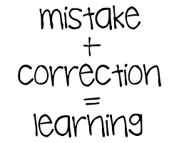
Announcements
TODO Reminders:
Readings are due before lecture
Reading 11 (zybooks) – you should have already done that ☺
Lab 07 – go to your lab to have your participation points
Reading 12 (zyBooks) - you should have already done that ☺
Lab 08 – go to your lab to have your participation points
Reading 13 (zybooks)
RPA 6
Keep practicing your RPAs in a spaced and mixed manner ☺
https://encrypted-tbn0.gstatic.com/images?q=tbn:ANd9GcS_UM2jEt9rPdBktlYNT9O0orskZRG5_0eh0Q&usqp=CAU
Help Desk
Day | Time : Room
Monday | 12 PM - 2 PM : CSB 120
Tuesday | 6 PM - 8 PM : Teams
Wednesday | 3 PM - 5 PM : CSB 120
Thursday | 6 PM - 8 PM : Teams
Friday | 3 PM - 5 PM : CSB 120
Saturday | 12 PM - 4 PM : Teams
Sunday | 12 PM - 4 PM : Teams

Slide 3
Recall Activity
Grab a paper, write your name, as it is in Canvas, and your answers to the following questions. Turn this as your attendance for today’s lecture.
What is method overloading?
Explain with your own words and provide examples.

Slide 4
Review – Method Signature
[scope] [static] TYPE name(parameters) {}
Scope
public, private, protected, or blank (package protected)
we often use public or private
private is class only
public other classes have access
(return) TYPE
Required
Can be any type + void.
Classes you create are objects, that can be returned
void means returns nothing
Parameters are part of the name
getArea(int x)
getArea(int x, int y)
indexOf(char x)
indexOf(char x, int start)
We have seen this example before
Called “overloading”
But how do we keep it DRY (Don’t Repeat Yourself)?

Slide 5
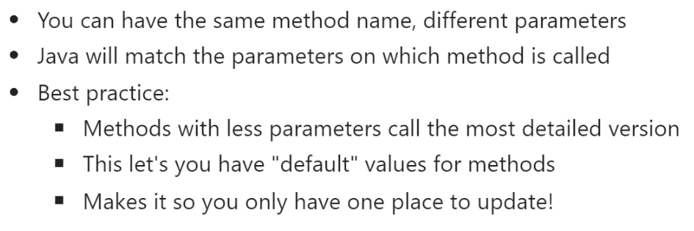
Method Overloading

Slide 6
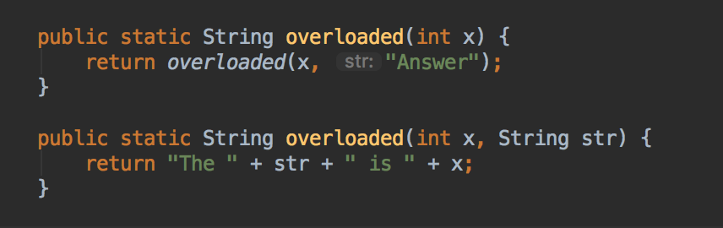
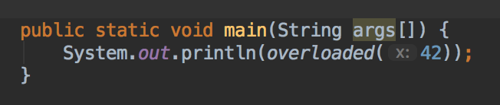
Method Overloading
main
The answer is 42
42
The answer is 42
overloaded(int)
overloaded(int, string)
42, answer
Method overloading works because:
We keep it DRY (Don’t Repeat Yourself)
Make the more specific method do the work
Assume default values for different parameters
When lost, draw it out!

Slide 7
Method Overloading - Practice
public class DatePrinter { public void datePrint(int day, int month, int year) { System.out.print("1"); } public void datePrint(int day, String month, int year) { System.out.print("2"); datePrint(day, Integer.parseInt(month), year); } public void datePrint(int month, int year) { System.out.print("3"); datePrint(1, month, year); datePrint(1, String.valueOf(month), year); } }
public class AppDatePrinter { public static void main(String args[]){ DatePrinter dp = new DatePrinter(); dp.datePrint(22,2, 2023); System.out.println(); dp.datePrint(22,"2", 2023); System.out.println(); ArrayList<String> months = new ArrayList<>(); months.add("January"); months.add("February"); dp.datePrint(months.indexOf("January"), 2023); } }
What is the output?

Slide 8
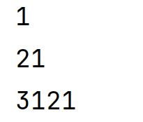
Method Overloading - Practice
public class DatePrinter { public void datePrint(int day, int month, int year) { System.out.print("1"); } public void datePrint(int day, String month, int year) { System.out.print("2"); datePrint(day, Integer.parseInt(month), year); } public void datePrint(int month, int year) { System.out.print("3"); datePrint(1, month, year); datePrint(1, String.valueOf(month), year); } }
public class AppDatePrinter { public static void main(String args[]){ DatePrinter dp = new DatePrinter(); dp.datePrint(22,2, 2023); System.out.println(); dp.datePrint(22,"2", 2023); System.out.println(); ArrayList<String> months = new ArrayList<>(); months.add("January"); months.add("February"); dp.datePrint(months.indexOf("January"), 2023); } }
What is the output?

Slide 9
Method Overloading – Coding Along
public String getFormattedPhone() { return String.format("(%d) %d-%d", getAreaCode(), getPrefix(), getNumber()); } public int getPrefix() { long tmp = phone / 10000; return (int) (tmp % 1000); } public int getAreaCode() { long tmp = phone / 10000000; return (int) (tmp % 1000); } public int getNumber() { return (int) phone % 10000; } public long getPhone() { return phone; }
import java.util.ArrayList; public class Contact { private long phone; private String name; public Contact(String name) { this.name = name; phone = 0; } public Contact(String name, String phone){ //to do } public Contact(String name, long phone){ //to do }

Slide 10
Method Overloading – Coding Along
public void setPhone(long phone) { // to do } public void setPhone(String phone) { // to do
//transform the String into a long number
//remove all characters that are not numbers
//Long.parseLong(string)
//call overloaded setPhone } public String toString() { return String.format("Name: %s, phone: %s", name, getFormattedPhone()); }
public static void main(String[] args) { ArrayList<Contact> advisors = new ArrayList<>(); Contact bess = new Contact("Bess"); bess.setPhone(9704915944L); // the "L" at the end is how we tell java it is a long number advisors.add(new Contact("Gabbi","(970) 491-3739")); advisors.add(new Contact("Tran")); advisors.add(new Contact("Heidi")); advisors.add(bess); // just doing this so you can see adding other ways to add objects to ArrayLists for(Contact advisor:advisors) { if(advisor.getPhone() > 0) { System.out.println(advisor); } } } }

Slide 11
Reminder: Keep It Simple
Methods are the conquer: divide -> conquer -> glue
Which means, the smaller problem to solve, the better
Keep what you do in a method simple
If you write 20 lines, you probably have written too much
If you cut and paste, you need a method.
Turn problems into questions
What is your quest?
What do you know
What do you need (parameters)

Slide 12
What about debugging?

Slide 13
Debugging
println/print
One of the best tools to debug code *as you write*
Not sure how something works, toss it in a print and see what happens.
Unsure where the error is? put in print lines to narrow down the issue.
Suggestion use “TESTING:” with all statements, so you don’t accidently leave it in!
Debuggers
IDEs come in with debuggers that help you trace code. Future thing to consider.
assert
New command
Good for testing completed methods (Unit testing)
operator that prints an error message and exits the program if the provided test expression evaluates to false
What you have been doing in labs is perfect for it!
assert testExpression : detailedMessage;

Slide 14
assert example
public static int addNum(int x, int y) {
return x*y;
}
public static void main(String[] args) {
assert (addNum(10, 10) == 20) : “Assert 10,10 == 20 failed!”;
System.out.println(addNum(10,10));
}
1. Print to screen
Assert 10, 10 == 20 failed
2. Ends program
Needs to enable Assertions - Add -ea to the VM options box
https://se-education.org/guides/tutorials/intellijUsefulSettings.html

Slide 15
Parameters In More Depth

Slide 16
Let’s Talk About Variables and Memory
public class Rectangle { private int length = 0; private int width = 0; public Rectangle(int width, int length) { setWidth(width); setLength(length); } public void setLength(int length) { if(length>0) this.length = length; } public void setWidth(int width) { if(width > 0) this.width = width; } public int getLength() { return length; } public int getWidth() { return width; } public int getArea() { return length*width; } }
Discuss: Given the following program
Program Start:
What is the value of:
w
l
rectange.length
rectangle.width
Program End?
What is the value of them?
public class YourProgram { public static void modifyValues(Rectangle rectangle, int w, int l) { rectangle.setLength(rectangle.getLength() / 2); rectangle.setWidth(rectangle.getWidth() * 3 + 1 ); w = w * 3 + 1; l = l / 2; } public static void printValues(Rectangle rectangle, int w, int l) { System.out.printf("Rectangle: Width %d, Length: %d, Area: %d%n", rectangle.getWidth(), rectangle.getLength(), rectangle.getArea()); System.out.printf("Values of w: %d, of l: %d%n", w, l); System.out.printf("Width == w? %b, Length == l? %b%n%n", rectangle.getWidth() == w, rectangle.getLength()==l); } public static void main(String[] args) { int w = 5; int l = 10; Rectangle rectangle = new Rectangle(w,l); printValues(rectangle, w, l); modifyValues(rectangle, w, l); System.out.println("Values Modified!"); printValues(rectangle, w, l); } }

Slide 17
The Output From the Program….
The values in Rectangle were changed!
The values of w, l - where not changed!
What happened?
Why did this happen?
Let’s look at memory
Rectangle: Width 5, Length: 10, Area: 50
Values of w: 5, of l: 10
Width == w? true, Length == l? true
Values Modified!
Rectangle: Width 16, Length: 5, Area: 80
Values of w: 5, of l: 10
Width == w? false, Length == l? false

Slide 18




Java doesn’t ‘copy’ objects
Digging Deeper:
This is called the memory stack, explored in later courses (165/270)
Variable list
for main!
Variable list
for modifyValues!
Here is the memory of the program (simplified)
int w = 5; int l = 10; Rectangle rectangle = new Rectangle(w,l);
10
x873
x873
modifyValues(x873, 5, 10);
modifyValues(rectangle, w, l);
5
16
5
x873
Now running the modifyValues method
modifyValues(Rectangle rectangle, int w, int l)
w = 16
w = 5
5
10
rectangle.setLength(rectangle.getLength() / 2); rectangle.setWidth(rectangle.getWidth() * 3 + 1 );
x873.setLength(x873.getLength() / 2); x873.setWidth(x873.getWidth() * 3 + 1 );
l = 5
l = 10
w = w * 3 + 1; l = l / 2;
modifyValues finishes (local variables go away), returns to main

Slide 19
Passing Objects as Parameters
public static int getAndCountNameLetters(Scanner scnr) { String name = ""; if (scnr.hasNext()) { name = scnr.next(); } return name.length(); }
Scanner object as a parameter in method definition
public static void main(String[] args) { int firstNameLetterCount; int lastNameLetterCount; Scanner scnr = new Scanner(System.in); System.out.println("Enter a person's first and last names:"); firstNameLetterCount = getAndCountNameLetters(scnr); lastNameLetterCount = getAndCountNameLetters(scnr); System.out.println("The first name has " + firstNameLetterCount + " letters."); System.out.println("The last name has " + lastNameLetterCount + " letters."); }
Creates scnr object of Scanner class type
Sending an object as a parameter

Slide 20
Practice – Objects as Parameters
public class Rectangle { private double height; private double width; public Rectangle(double height, double width){ setHeight(height); this.setWidth(width); } public void setHeight(double height){ this.height = height ; } public void setWidth(double width){ this.width = width; } public double getHeight(){ return height; } public double getWidth(){ return width; } }
Rectangle Class
Write a method that calculates the area of a rectangle.
Write a method that receives a Rectangle as a parameter, compare the areas and returns a String with the height, width, and area of the biggest rectangle. If it is the same area, return a String informing that.
RectangleApplication Class
Write a RectangleApplication class that has the following methods:
readDouble: receives a Scanner as a parameter, read, and return an double value;
main: creates two Rectangle objects (use readDouble to read the values to create the objects), prints both objects height and width, calls the methods that return the biggest rectangle.

