Slide 1
Objects and Methods

Slide 2

Announcements
Reminder – readings are due before lecture
You don’t have to do all of it - challenge problems can be challenging…
You can return to them.
We start off each lecture with a quiz from your reading!
Todo:
Busy Week! (readings + labs)
Lab projects start!

Slide 3
Recall Activity - Attendance
Grab a paper, write your name, as it is in our Canvas course, and your answers to the following questions. Turn this as your attendance for today’s lecture.
What is a method?
Which of the following are valid method “signatures”
public double calcArea(double width, double height) {}
Public static my_method(int x, boolean y) {}
public static void main(String args[]);
All listed
None listed

Slide 4
Programming == Problem Solving
You look at the problem to solve
Clarify the problem and constraints
Break it up into *smaller* parts (Divide)
Outline the steps needed
Solve each step (Conquer)
Reassemble the pieces (Glue)
Completed program
public class BasicCalculations {
public static void main(String[] args) {
double value1, value2, sum, subtraction;
double multiplication, division;
value1 = 12;
value2= 30;
sum = value1 + value2;
subtraction = value1 - value2;
multiplication = value1 * value2;
division = value1/value2;
System.out.println(value1 + " + " +
value2 + " = " + sum);
System.out.println(value1 + " - " +
value2 + " = " + subtraction);
13. System.out.println(value1 + " * " +
value2 + " = " + multiplication);
14. System.out.println(value1 + " / " +
value2 + " = " + division);
15. }
16. }
What if we want to do the same set of instructions again?
REUSE CODE

Slide 5
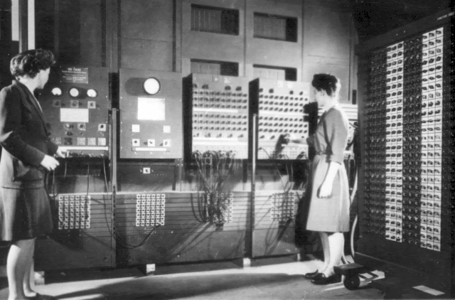
Methods: Reusable Code
Programmers Betty Jean Jennings (left) and Fran Bilas (right) operate ENIAC's main control panel By United States Army (Image from http://ftp.arl.army.mil/~mike/comphist/) [Public domain], via Wikimedia Commons
The ENIAC women pioneered reusable code

Slide 6
Methods
Are ways to modularize / reduce the code
Methods are designed to implement a specific function in our program
Small / Repeatable blocks
Methods are defined inside a class
We can call a method as many times as we want

Slide 7
Methods
When we build a method inside a class that has a main method, the method need to have the following format definition:
public static <typeOfReturn> methodName(<listOfParameters>)
public static: access mode is public, can be called without restrictions
static: method belongs to the class (will talk about this later in detail)
<typeOfReturn>
void: no return
Any class or primitive type
<listOfParameters>
list of parameters separated by comma (,)
Each parameter needs to have it type and name

Slide 8
Methods
public static void main(String [] args)
access mode: public static
static: method belongs to the class
void: method does not have any return
main: name of the method
String [] args: array of Strings (we will talk about this later)

Slide 9
Methods Activity
Identify:
Name of the class
For each method
Access mode
Return
Name
List of parameters
import java.util.Scanner; public class IdentifyingMethods { public static int module(int num1, int num2){ return num1%num2; } public static double average(int num1, int num2, int num3){ return (num1 + num2 + num3)/3.0; } public static void end(){ System.out.println("End of the Program."); System.out.println("Goodbye!"); }
#to be continued in the next slide

Slide 10
Methods
#continued from previous slide
public static void main(String args []){ Scanner scanner = new Scanner(System.in); System.out.println("Enter 3 integer numbers: "); int value1 = scanner.nextInt(); int value2 = scanner.nextInt(); int value3 = scanner.nextInt();
double avg = average(value1, value2, value3); System.out.println("Average of the values entered: " + avg); System.out.println("Module " + value1 + "%" + value2 + " = " + module(value1,value2));
end(); } }
Let's understand this main method!

Slide 11
Methods
Creates and object scanner from the class Scanner
Scanner scanner = new Scanner(System.in); System.out.println("Enter 3 integer numbers: ");
int value1 = scanner.nextInt(); int value2 = scanner.nextInt(); int value3 = scanner.nextInt();
Print to the console the message “Enter 3 integer numbers:” and goes to the next line.
Uses the method nextInt from Scanner class to read an int number.
To call a method using an object:
nameObject.nameMethod(<parameters>)
Example: scanner.nextInt()
Scanner – is the class (S capitalized – indicates class)
scanner – is the object

Slide 12
Methods
Calling method average. Since average expects 3 int values as parameters we need to send 3 int values to the method. The method return is stored in the avg variable.
double avg = average(value1, value2, value3); System.out.println("Average of the values entered: " + avg);
Concatenates the String with the avg variable, prints this new String and go to the next line.

Slide 13
Methods
Will print the return of the module method.
Since module needs two integer parameters, we sent value1 and value2.
System.out.println("Module " + value1 + "%" + value2 + " = " + module(value1,value2));
end();
Calls the end method, which is a void method, meaning that there is no return

Slide 14
Quick Practice Pseudocode
As a group, block out / outline what you need to do for the longDivision method.
It needs to print both the quotient and the remainder of value 1 long divided by value 2
This outline is called pseudocode, and often done in *comments* for example
// multiple value1 and value2 together – store in answer
// Print hello doc, the answer is _answer_
Focus on major “sub tasks” of the method task
Most methods should have one task, with a couple small things needed to accomplish that task
That is it!
public static void longDivision(int value1, int value2) {
// pseudocode here
}
Called a method stub!

Slide 15
Putting it together
public static void longDivision(int value1, int value2) {
int quotient = value1 / value2;
int remainder = value1 % value2;
System.out.println(value1 + " / " + value2 + " = " + quotient);
System.out.println(value1 + " % " + value2 + " = " + remainder);
}
public static void main(String[] args) {
longDivision(12, 30);
longDivision(100, 5);
longDivision(1000, 52);
}

Slide 16
Coupling Ideas Together: Objects

Slide 17

Objects are Building Blocks
Think of LEGOs
Blocks
Assembled in different ways - creates new and interesting things
Objects contain information in a logical order
Most objects use the new keyword
MyCoolObject obj = new MyCoolObject(); // this reserves room in memory
obj.myCoolMethod();
We will keep coming back to this
Important to know - methods belong to Objects
Even methods that you write
© Ralf Roletschek - Published with permission. Read full copy information on wikicommons.

Slide 18
Memory Example
10
length
100
width
x2
smallBuildingOnCampus
public static void main(String[] args) {
int length = 10;
int width = 100;
Rectangle smallBuildingOnCampus = new Rectangle();
smallBuildingOnCampus.setLength(length);
smallBuildingOnCampus.setWidth(width);
System.out.println(smallBuildingOnCampus.getArea());
}
x2
length
0
10
width
0
100
More room for methods

Slide 19
Rectangle? Is a Class
In Java (an Object Oriented Programming – OOP - language) - everything must be in a class!
You can create Objects out of classes
use the new keyword
Rectangle myHouse = new Rectangle();
Scanner scnr = new Scanner(System.in);
new Reserves memory for that ‘instance’ / object

Slide 20
Rectangle Class
public class Rectangle {
private int width; // instance variables
private int length;
public void setLength(int length) {
this.length = length;
}
public void setWidth(int w) {
width = w;
}
public int calculateArea() {
return width * length;
} }
Instance variables
Represent the data (attribute)
private
Means that only the class can access
those values directly
public
Others can access public methods
this – keyword
Means “this object/instance”
Helps keep track of which variable
Common practice
But not required

Slide 21
Class Constructor
public Rectangle() {
width = 0;
this.length = 0;
}
public Rectangle(int w, int l) {
width = w;
length = l;
}
Special method that has the name of the class
No return not even void
Can be overloaded
Meaning that we have more then one
implementation for the method
Same name with different parameters
Rectangle() – no parameters
Rectangle(int w, int l) – with parameters
You can call methods inside of the constructor
Usually, you call mutators (sets) methods, if the class has them defined
OR
public Rectangle() {
setWidth(0);
setLength(0);
}
public Rectangle(int w, int l) {
setWidth(w);
setLength(l);
}

Slide 22
Class Instance Methods
public void setLength(int length) {
this.length = length;
}
public void setWidth(int w) {
width = w;
}
public int calculateArea() {
return width * length;
}
static methods
Belongs to the class / self-contained
instance methods
Need to access instance variables
Uses the data in the object
Unique to that instance

Slide 23
Use Tables!
Current Method
small | 5
one | @rec.one
two | @rec.two
X 12
Every time you are:
In a new method
See a new keyword
Draw a table
@rec.one
length | 10
width | 10
@rec.two
length | 0
width | 5
int small = 5;
Rectangle one = new Rectangle();
one.setLength(10);
one.setWidth(10);
Rectangle two = new Rectangle();
two.setWidth(small);
small = 12;

Slide 24
Why Methods and Objects? DRY Code
Fun Fact:
Software Engineers, Andy Hunt and Dave Thomas, are credited with first using the the term for coding in the The Pragmatic Programmer
Code should be DRY
Don’t Repeat Yourself
Code should be
Reusable
Small Snippets
Reusable code
Only write once
Use in multiple applications
Java
Objects are blocks of information, with reusable code / methods
Methods are blocks of reusable code
Ideally, no more than 20 instructions
CLUE: If you are cutting and pasting code - it should be a method
Really, that happens
Divide
Conquer
Conquer
Conquer
Glue

Slide 25
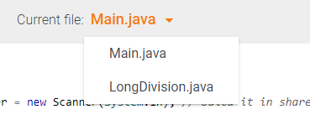
Coding Practice
Go canvas to access In Class: Long Division
We will build a long division object, that the main method will call
Notice – two classes!
Time pending, you should build the memory tables for your code!

Slide 26
Objects are Building Blocks
Think of LEGOs
Blocks
Assembled in different ways - creates new and interesting things
Objects contain information in a logical order
Example: Strings are objects
String companion = “Clara”; // note, Strings are so common, they have this shortcut
companion.length(); // returns 5
Most objects use the new keyword
MyCoolObject obj = new MyCoolObject(); // this reserves room in memory
obj.myCoolMethod();
We will keep coming back to this
Important to know - methods belong to Objects
Even methods that you write
© Ralf Roletschek - Published with permission. Read full copy information on wikicommons.

Slide 27
Reusing code
How many different concepts are in the main method?
public class BasicCalculations {
public static void main(String[] args) {
double value1, value2, sum, subtraction, multiplication, division;
value1 = 12;
value2= 30;
sum = value1 + value2;
subtraction = value1 - value2;
multiplication = value1 * value2;
division = value1/value2;
System.out.println(value1 + " + " + value2 + " = " + sum);
System.out.println(value1 + " - " + value2 + " = " + subtraction);
System.out.println(value1 + " * " + value2 + " = " + multiplication);
System.out.println(value1 + " / " + value2 + " = " + division);
value1 = 100;
value2= 0.5;
sum = value1 + value2;
subtraction = value1 - value2;
multiplication = value1 * value2;
division = value1/value2;
System.out.println(value1 + " + " + value2 + " = " + sum);
System.out.println(value1 + " - " + value2 + " = " + subtraction);
System.out.println(value1 + " * " + value2 + " = " + multiplication);
System.out.println(value1 + " / " + value2 + " = " + division);
}
}
Sum
Subtraction
Multiplication
Division
Print

Slide 28
Method Syntax Basics
[scope] [static] TYPE name(parameters) {}
public static void main(String[] args) {...}
public - is the scope of the method (optional)
static - access type (option)
void - return type (required)
main - method name (required)
String[] args - are parameters for the method
Having parentheses is required
something inside, optional
public double getPercentGrowth(double startingSalary, double midCareerSalary) { …}
public - is the scope of the method
access is not there - that means “instance”
double - return type
getPercentGrowth - method Name
double startingSalary, double midCareerSalary - are parameters for the method

Slide 29
Static vs. Instance Methods
Harder concept (we will come back to it later)
Think of static as shared memory
Variables in it are easily overwritten
Static methods need to be self contained, and only access shared information
Instance methods belong to the object
They need information from the object
They provide the main functionality to the object
Most common

Slide 30

Method Name & Parameters
They should have meaning!
They follow the same rules as variable names
No specials, start with letter, etc
Parameters are part of the name
getArea()
getArea(int x)
getArea(int x, int y)
Are three different methods! (Be careful - Overlapping)
The secret ninja trick for methods
Pass in the variables
Try to keep everything as contained as possible
What is your quest?
What is it you return
What do you know
What do you need (parameters)

Slide 31
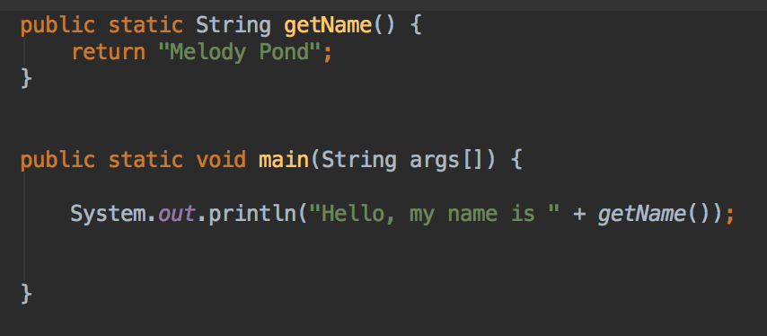
Return Types
Return Types
Critically important
Can return a primitive, array or an object
void is how you say the method returns nothing
Whenever you call a method
Assume the return type is what is returned
Think of replacing the method name with the answer
The program output is
Hello, my name is Melody Pond
Notice: Melody Pond simply replaces ‘getName()’

Slide 32
Code Along
Let’s rewrite this code so it will have the 5 different methods that we discussed!
public class BasicCalculations {
public static void main(String[] args) {
double value1, value2, sum, subtraction, multiplication, division;
value1 = 12;
value2= 30;
sum = value1 + value2;
subtraction = value1 - value2;
multiplication = value1 * value2;
division = value1/value2;
System.out.println(value1 + " + " + value2 + " = " + sum);
System.out.println(value1 + " - " + value2 + " = " + subtraction);
System.out.println(value1 + " * " + value2 + " = " + multiplication);
System.out.println(value1 + " / " + value2 + " = " + division);
value1 = 100;
value2= 0.5;
sum = value1 + value2;
subtraction = value1 - value2;
multiplication = value1 * value2;
division = value1/value2;
System.out.println(value1 + " + " + value2 + " = " + sum);
System.out.println(value1 + " - " + value2 + " = " + subtraction);
System.out.println(value1 + " * " + value2 + " = " + multiplication);
System.out.println(value1 + " / " + value2 + " = " + division);
}
}
Let’s start with the sum method:
What do we need to do?
What do we need to do it (parameters)?
What does the method return?

Slide 33
Code Along
public class BasicCalculations {
public static double sumMethod(double param1, double param2){
return param1 + param2;
}
public static void main(String[] args) {
double value1, value2, sum, subtraction, multiplication, division;
value1 = 12;
value2= 30;
sum = sumMethod(value1, value2);
subtraction = value1 - value2;
multiplication = value1 * value2;
division = value1/value2;
System.out.println(value1 + " + " + value2 + " = " + sum);
System.out.println(value1 + " - " + value2 + " = " + subtraction);
System.out.println(value1 + " * " + value2 + " = " + multiplication);
System.out.println(value1 + " / " + value2 + " = " + division);
value1 = 100;
value2= 0.5;
sum = sumMethod(value1, value2);
subtraction = value1 - value2;
multiplication = value1 * value2;
division = value1/value2;
System.out.println(value1 + " + " + value2 + " = " + sum);
System.out.println(value1 + " - " + value2 + " = " + subtraction);
System.out.println(value1 + " * " + value2 + " = " + multiplication);
System.out.println(value1 + " / " + value2 + " = " + division);
}
}
First step – have the method!
Second step – call the method!
Work in pairs and rewrite the remaining code to include the following methods:
subtractionMethod
multiplicationMethod
divisionMethod
printMethod

