Slide 1
Exam 2 Review

Slide 2

Announcements
TODO Reminders:
Canvas Exam 2 – during your Lab time Thursday March 9th
All Lab retakes – due to Friday March 10th
Coding Exam 2 – due to Friday March 10th – available until March 12
Reflections: Self-reflection and RPA Reflections (Part1-3) – due to Friday March 10th – available until March 12
No Help Desk on Saturday March 11th and Sunday 12th, neither next week – Spring Break
Keep practicing your RPAs in a spaced and mixed manner ☺
https://www.wilkinsontriad.com/dont-give-up-you-are-almost-there

Slide 3

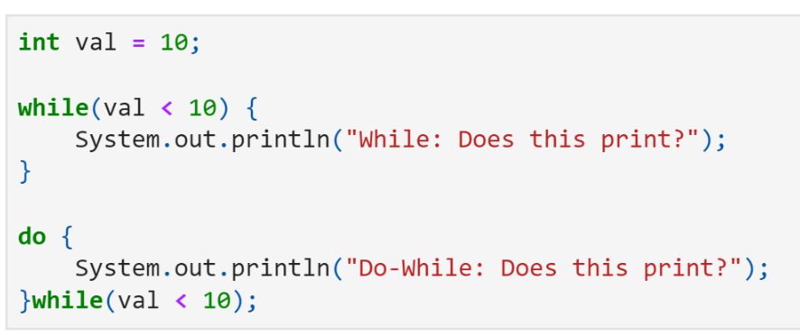
While and Do…While Loops
What is the output?
It is not going to enter the while
Will print one time

Slide 4

this
Is the setID method of Student class correctly implemented?
What is going to be printed?
public class Student { private int id; public Student(){ id = 5; } public void setID(int id){ id = id; } public String toString(){ return String.format("ID: %d", id); } }
public class AppStudent { public static void main(String args[]){ Student stuie = new Student(); stuie.setID(10); System.out.println(stuie); } }
How to correct it?

Slide 5

this
What is going to be printed now?
public class Student { private int id; public Student(){ id = 5; } public void setID(int id){ this.id = id; } public String toString(){ return String.format("ID: %d", id); } }
public class AppStudent { public static void main(String args[]){ Student stuie = new Student(); stuie.setID(10); System.out.println(stuie); } }

Slide 6
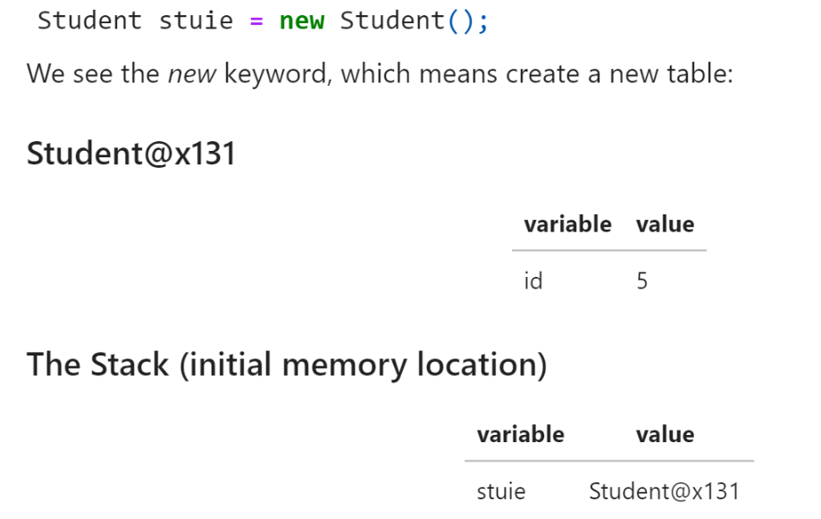
this

Slide 7
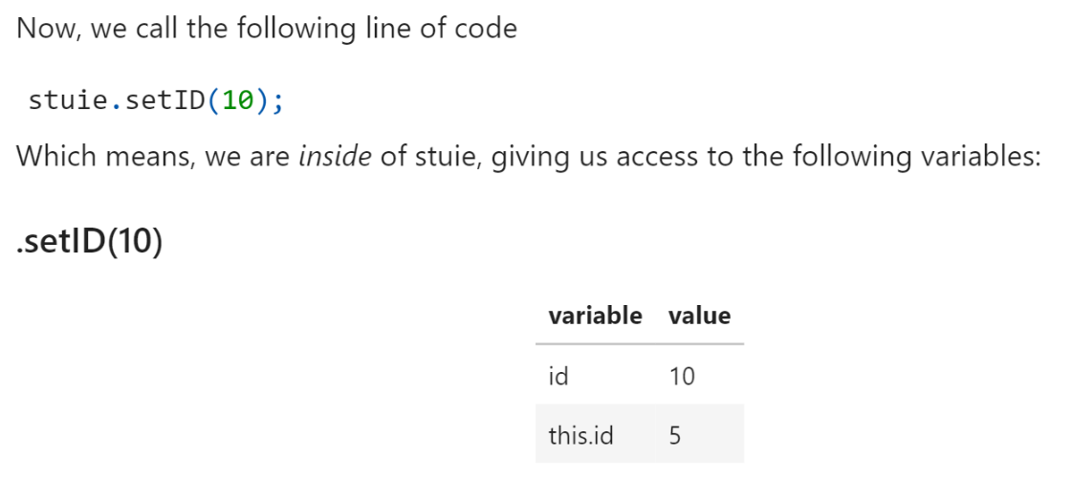
this

Slide 8

Overloaded Methods

Slide 9
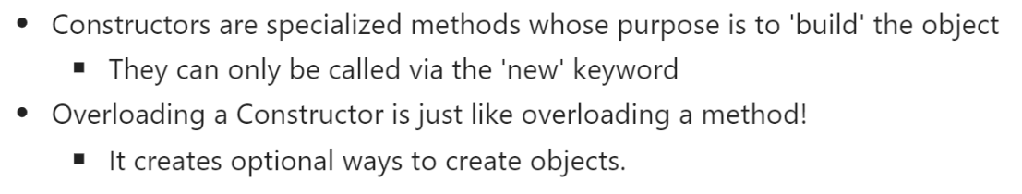
Overloaded Constructor and this

Slide 10
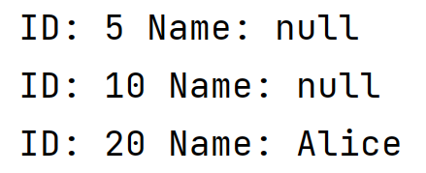
Overloaded Constructor and this
public class Student { private int id; private String name; public Student(){ this(5, null); } public Student(int id){ this(id, null); } public Student(int id, String name){ setID(id); this.name = name; } public void setID(int id){ this.id = id; } public String toString(){ return String.format("ID: %d Name: %s", id, name); } }
What is going to be printed?
public class AppStudent { public static void main(String args[]){ Student stuie = new Student(); Student stuie2 = new Student(10); Student stuie3 = new Student(20,"Alice"); System.out.println(stuie); System.out.println(stuie2); System.out.println(stuie3); } }

Slide 11
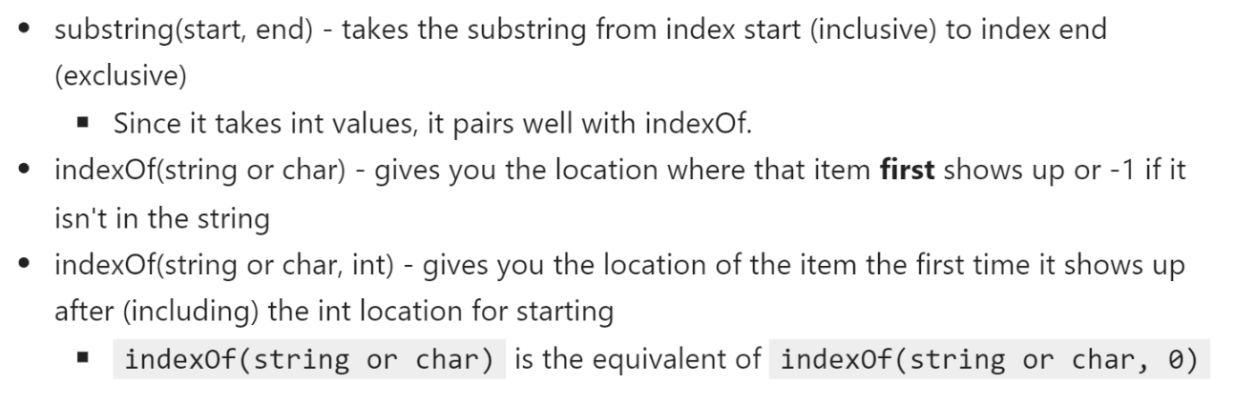
Substring and IndexOf

Slide 12
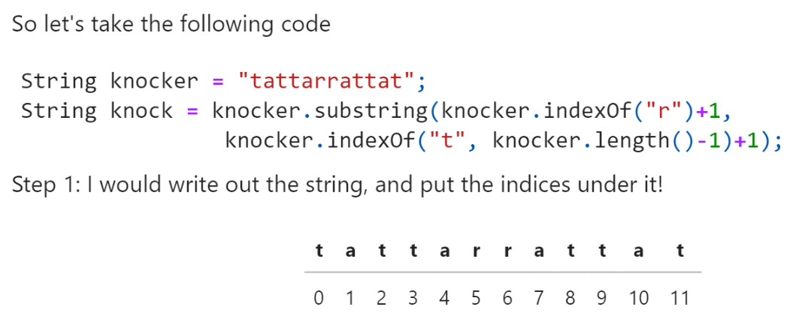
Substring and IndexOf

Slide 13
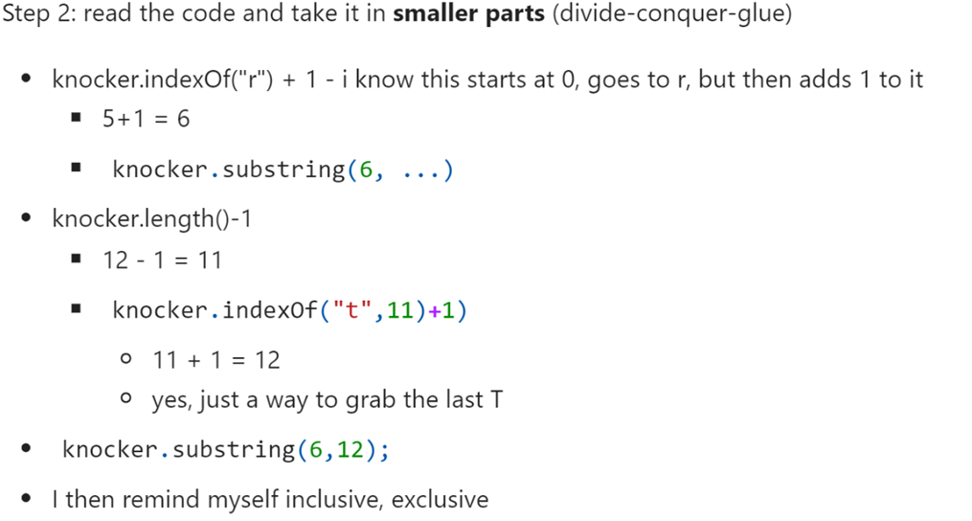

Substring and IndexOf

Slide 14
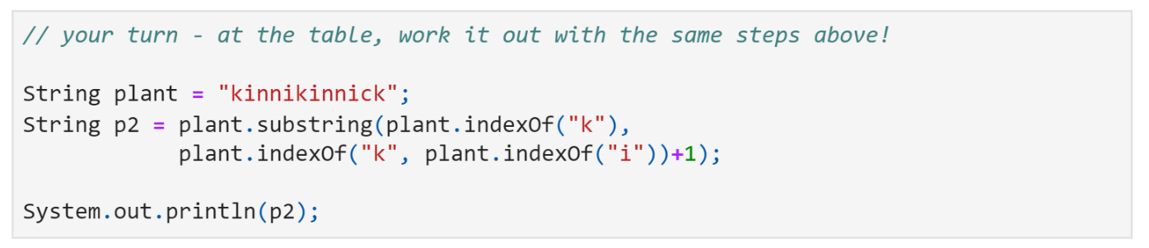

Substring and IndexOf

Slide 15
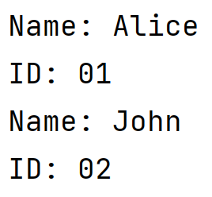
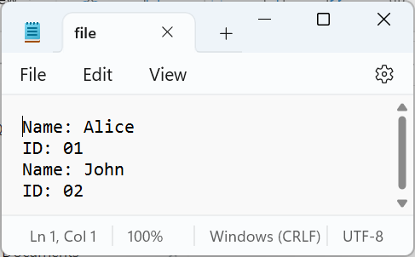
File Input
Fill in the blanks to make this code to work and have the following output, considering the file presented:
import java.io.File; import java.io.IOException; import java.util.ArrayList; import java.util.Scanner; public class FileReading { public static void main(String args[]){ ArrayList<String> lst = new ArrayList<>(); try{ Scanner file = new Scanner(new File("file.txt")); while( ){
} }catch( ){ System.out.println("File not found!"); } for(String s: lst){ System.out.println(s); } } }

Slide 16
File Input
import java.io.File; import java.io.IOException; import java.util.ArrayList; import java.util.Scanner; public class FileReading { public static void main(String args[]){ ArrayList<String> lst = new ArrayList<>(); try{ Scanner file = new Scanner(new File("file.txt")); while(file.hasNext()){ String line = file.nextLine(); lst.add(line); } }catch(IOException ex){ System.out.println("File not found!"); } for(String s: lst){ System.out.println(s); } } }

Slide 17
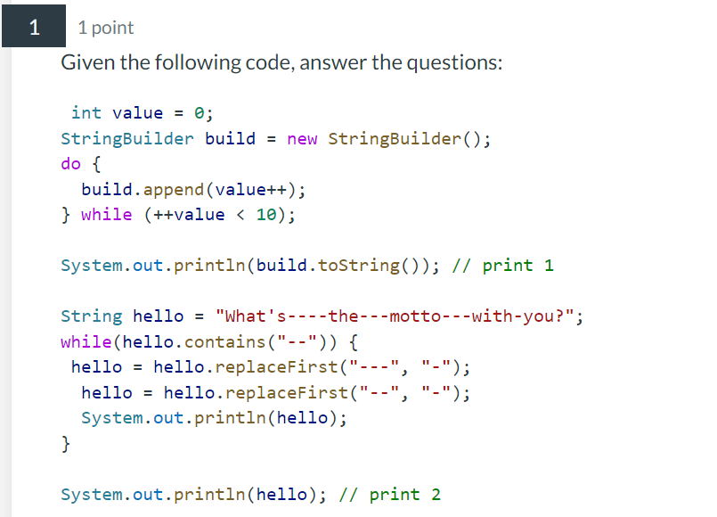
RPA Questions
What is printed in //print 1?
What is printed in //print 2?

Slide 18


RPA Questions
What is printed in //print 1?
What is printed in //print 2?

Slide 19
RPA Questions
Order the classes from parent to child (super to inheriting class)
public class GameObject {
public final int ID;
public final boolean MOVABLE;
public GameObject(int id) {
this(id, false);
}
protected GameObject(int id, boolean canMove) {
ID = id;
MOVABLE = canMove;
}
}
----
public class MobileObject extends GameObject { private int movement = 10; public MobileObject(int id) { super(id, true); } public int getMovement() { return movement; } public void setMovement(int movement) { this.movement = movement; } }
Anyone (both classes that extend, and those that don't) can create a GameObject with MOVABLE set to true.
public class NamedObject extends MobileObject {
public final String name;
private int level = 1;
public NamedObject(int ID, String name) {
super(ID);
this.name = name;
}
public void setLevel(int level) {
this.level = level;
}
public int getLevel() {
return level;
}
public int getMovement() {
return super.getMovement() * getLevel();
}
}

