Slide 1
Unified Modeling Language

Slide 2
Unified Modeling Language
A common standard to draw
OOP classes and layouts
Not required
Not used everywhere
But common enough to learn
Only basics for now!
Much more advanced cases

Slide 3
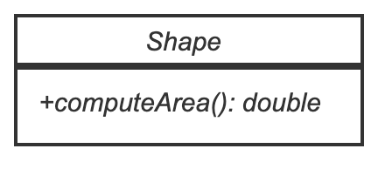
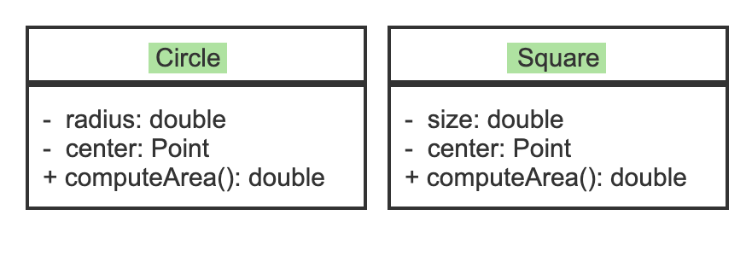
Example
Symbol | Meaning
+ | public
# | protected
- | private
Circle and Square:
Children of shape
Inherit
+computeArea
For now, you will see it in assignment specifications. You won’t be asked to draw it

Slide 4
Translating to Code
public class Shape {
public double computeArea() {
return 0;
}
}
public class Circle extends Shape {
private double radius =0;
private Point center;
@Override
public double computeArea() {
return Math.PI * (radius*radius);
}
}
public class Square extends Shape {
private double size = 0;
private Point center;
@Override
public double computeArea() {
return size*size;
}
}
UML/Examples not complete – just an idea

Slide 5
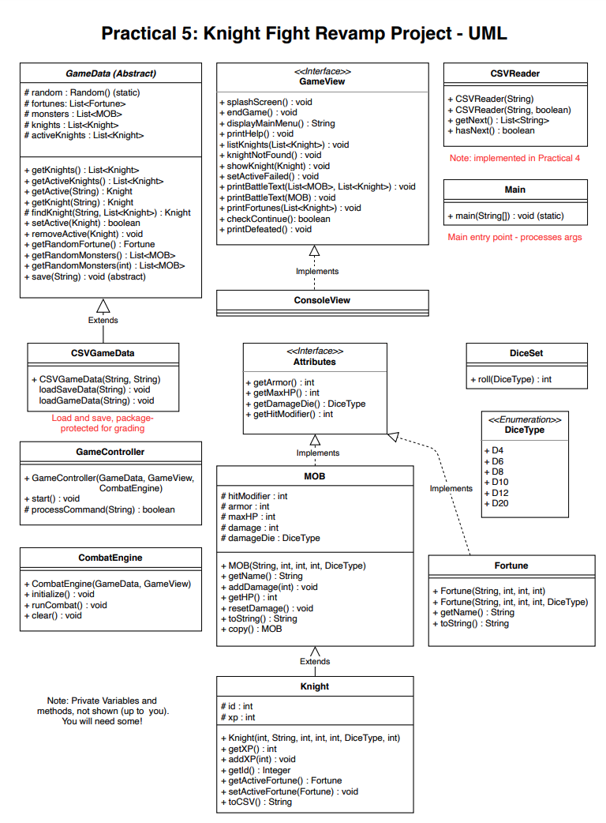
Final Practical Project
Starting with the basic design of a program
Both UML and Javadoc
Let’s Look at the UML
Interfaces/Implements?
Cover this after the exam - you can read ahead or just wait
Essentially ‘contracts’ that require certain methods to be implemented in the class, so MOB has to have the 4 Attribute methods
AbstractClass?
Cover this after the exam – you can just wait, or read ahead
Essentially partially implemented classes with
Looks like a lot
Actually, a lot of one-line methods and small classes

