Slide 1
Complex Logic and Branching

Slide 2
Announcements
Opening Question:
How are you studying for this course? Knowledge checks, practice coding assignments, etc?
Reminder – readings are due before lecture
You don’t have to do all of it - challenge problems can be challenging…
You can return to them.
We start off each lecture with a quiz from your reading!
Make sure to review knowledge checks and spread out their use!
Todo:
Continue Practical 2 (should be started!)
CS 165 – Next Course In Sequence, also consider CS 220 (math and stats especially)
CO Jobs Report 2021 – 77% of new jobs require programming
60% of all STEM jobs requires *advanced* (200-300 level)

Slide 3
Review – Conditional Operators - Primitives
int puppyCounter = 10;
if(puppyCounter > 5) {
if(puppyCounter < 200) {
System.out.println(“Yay! more puppies”);
}
} else {
System.out.println(“not enough puppies”);
}
Conditional operators
== Equals
< Less than (is left less than right)
> Greater than
<= Less than OR equal
>= Greater than OR equal
!= NOT equal ( ! is your NOT character)
if statements
Blocks of code that execute “conditionally”
if – execute block if true
else – execute block if false
int puppyCounter = 10;
boolean isEnough = puppyCounter > 5;
if(isEnough) {
if(puppyCounter < 200) {
System.out.println(“Yay! more puppies”);
}
} else {
System.out.println(“not enough puppies”);
}

Slide 4
Warm Up – Object Compare
Objects have to methods to compare (they can’t use the primitive operators!)
Write a sentence that uses contains to see if any given character in a String is a “AEIOUaeiou”
For example,
Is “e” a vowel, yes or no?
Is “L” a vowel, yes or no?
Hint:
You can store AEIOUaeiou in a variable
You will call contains on the variable, passing in the single letter as the parameter.
public static final String VOWELS = “AEIOUaeiou”;
Comparing Objects:
.equals()
Strings additional methods: equalsIgnoreCase, contains, etc

Slide 5
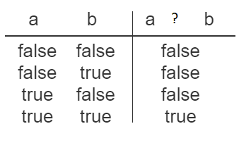


Reading Check – Logical Operators
Consider the table below:
Which logical operator is ?:
AND (&&)
OR (||)
NOT (!)

Slide 6
Logical Operators
int puppyCounter = 10;
if(puppyCounter > 5 && puppyCounter < 10) {
System.out.println(“Yay, puppies”);
}
Logical and - &&
You have already been doing this – nested ranges
Short Circuiting – meaning, once a false is hit, it stops
All must be true
Logical or - ||
Any statement can be true
Continues checking even if false
Only compare true or false
Every statement on each side must evaluate as true or false to use the logical operation.
10 > 5 && 5 < 6 (valid)
10 > 5 && true (valid)
10 > 5 && 10 (invalid – 10 alone is not a condition)
&& example
String cmd = “exit”;
if(cmd.contains(“x”) || cmd.contains(“X”)) {
System.out.println(“Goodbye”);
}
|| example

Slide 7
Practice 2
Write a method that:
(1) Goes through every character in a String
(2) If the String has five white spaces, and the String length() is divisible by 5 (hint – modulo)
Return a String made up of characters from the *after* the spaces! (this is the harder one)
Example:
The Quick Brown Fox Jumped Up!
Returns – QBFJU
Hint – I would always build the second String, whether you return it or not – the if condition is probably *after* the loop using .length() on both Strings.
Hint: Character.isWhitespace(char) will be helpful
Hint: First loop through the String like last Friday, then build from there
(3) Else
Return the String as is.
Yes, this example is meant to help you with P2 and the Lossy Encoding!

Slide 8
Review
Conditional Operators
Compare primitives
Objects need methods
equals
equalsIgnoreCase
Logical Operators
Compare boolean only – true and false
As such, everything must evaluate to true or false before they are used

Slide 9
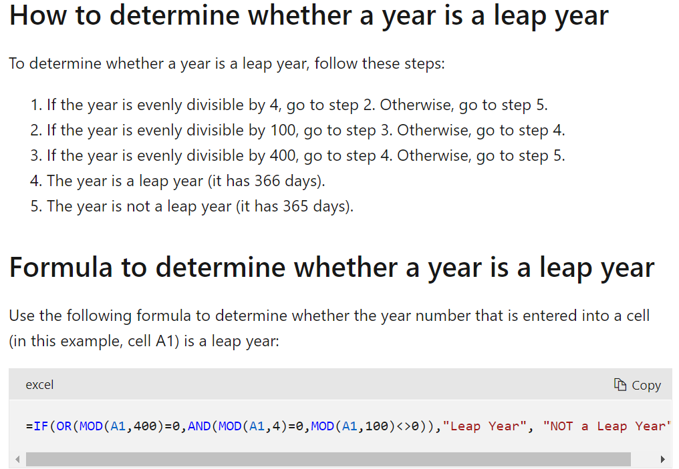
Pair Programming
Build a class to represent a Person which has a name and a birthday. The birthday should be stored in three different variables: year, month, and day of birth.
The Person class needs to make sure that the year, month and day of birth are valid.
The Person class also needs to provide information if a person was born in a leap year or not.
Also build a ApplicationPerson class that has a main method
which creates a person, prints that person information, and prints
if that person was born in a leap year or not.
https://docs.microsoft.com/en-us/office/troubleshoot/excel/determine-a-leap-year

