Slide 1
Unified Modeling Language

Slide 2
Announcements
Opening Question:
How close to done are you with Practical 4?
Todo:
Practical 4 – Continue to work on it
Start Final Practical this week! (summative)
NEXT WEEKS SCHEDULE
Monday – Review Lecture
Tuesday – Review Lab (Student request - Coding Exam anytime you want)
Wednesday – Review Lecture 2
Thursday – CANVAS EXAM (In lab)
Friday – No Class / Catch Up Day (Accommodation Exams – In CSB110)
CS 165 – Next Course In Sequence (also 201 is popular with 165)
CO Jobs Report 2021 – 77% of *all* new jobs in Colorado require programming
60% of all STEM jobs requires *advanced* (200-300 level)
31% of all Bachelor of Arts degree titled jobs also required coding skills
2016 Report found on average jobs that require coding skills paid $22,000 more
Math and Stats majors, at least consider CS 220 (Discrete Structures) – substitutes in your program requirements

Slide 3
Unified Modeling Language
A common standard to draw
OOP classes and layouts
Not required
Not used everywhere
But common enough to learn
Only basics for now!
Much more advanced cases

Slide 4
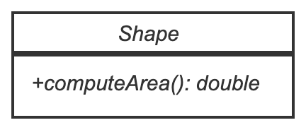
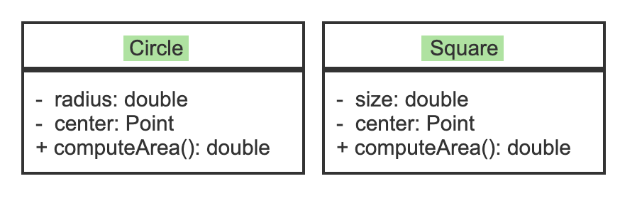
Example
Symbol | Meaning
+ | public
# | protected
- | private
Circle and Square:
Children of shape
Inherit
+computeArea
For now, you will see it in assignment specifications. You won’t be asked to draw it

Slide 5
Translating to Code
public class Shape {
public double computeArea() {
return 0;
}
}
public class Circle extends Shape {
private double radius =0;
private Point center;
@Override
public double computeArea() {
return Math.PI * (radius*radius);
}
}
public class Square extends Shape {
private double size = 0;
private Point center;
@Override
public double computeArea() {
return size*size;
}
}
UML/Examples not complete – just an idea

Slide 6
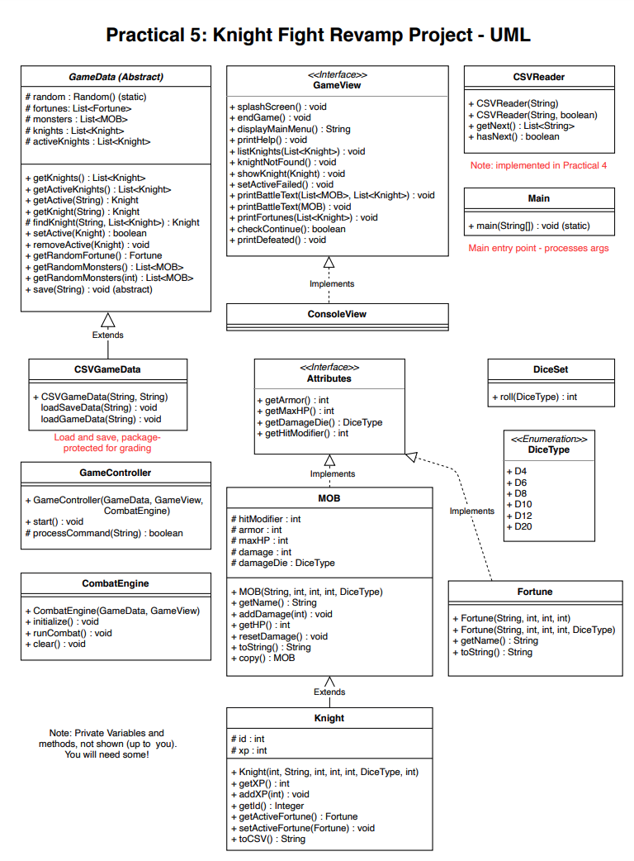
Final Practical Project
Starting with the basic design of a program
Both UML and Javadoc
Let’s Look at the UML
Interfaces/Implements?
Cover this after the exam - you can read ahead or just wait
Essentially ‘contracts’ that require certain methods to be implemented in the class, so MOB has to have the 4 Attribute methods
AbstractClass?
Cover this after the exam – you can just wait, or read ahead
Essentially partially implemented classes
Looks like a lot
Actually, a lot of one-line methods and small classes

Slide 7
Interface Really Quickly
public class Paladin implements MeleeType, HealerType { public double getCureModifier() { return 1.5; } public double getMP() { return 10.5; } public boolean hasSwordAttack() { return true; } public int calcSwordDamage() { return (int)(100*getJobModifier()); }
/** other methods**/ }
public interface HealerType { double getCureModifier(); double getMP(); }
public interface MeleeType { boolean hasSwordAttack(); int calcSwordDamage(); }
Will cover again after break but will help you get some code together. Notice: no scope (public/private) just return, method name and parameters in them.

Slide 8
Where to Start?
Divide-Conquer-Glue
Look at the UML
Which classes don’t need other classes (look at parameter types)
Read Javadoc – which ones are more “I can do this”.
Discuss as a group
Where we are opting to start today…
DiceSet
DiceType
Also, if this looks familiar, we did something similar during the Enum lecture!
If we have time, will also walk through getting an interface setup!

Slide 9
IDEs
Open up your IDEs,
If you don’t have a computer, it is OK to help others at your table
But if you have one, you really want to follow along.
Also, make sure you open the practical project webpage
www.cs.colstate.edu/~cs164
Practical -> Project -> Knight Fight

