Slide 1
Javadocs and UML

Slide 2

Announcements
Reminder – readings are due before lecture
Office Hours/Student Hours and Help Desks
Go to them! They make a difference
This week – Exam Module
You need to work to have this module open so you can do your Exams
Catch up if you are behind!
Ask for help, if you need! Don’t hesitate to reach out!
TAs and myself are here to help you to succeed in this course!
Don’t procrastinate!
https://jefmenguin.com/procrastination/

Slide 3
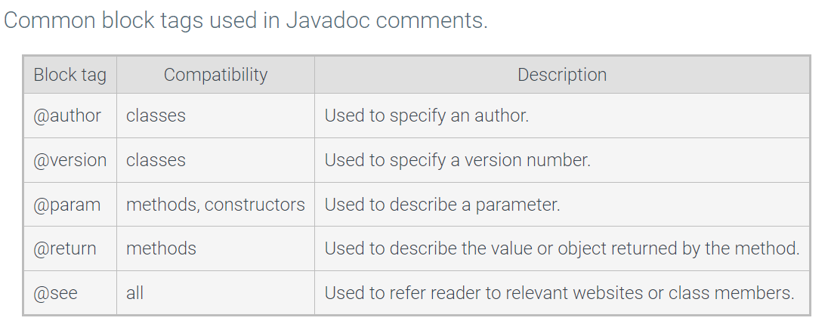
Javadoc
Parses source code along with specially formatted comments to generate documentation.
The documentation generated is known as an API (Application Programming Interface).
Start with /** <enter>
You will have
/**
*
*/

Slide 4
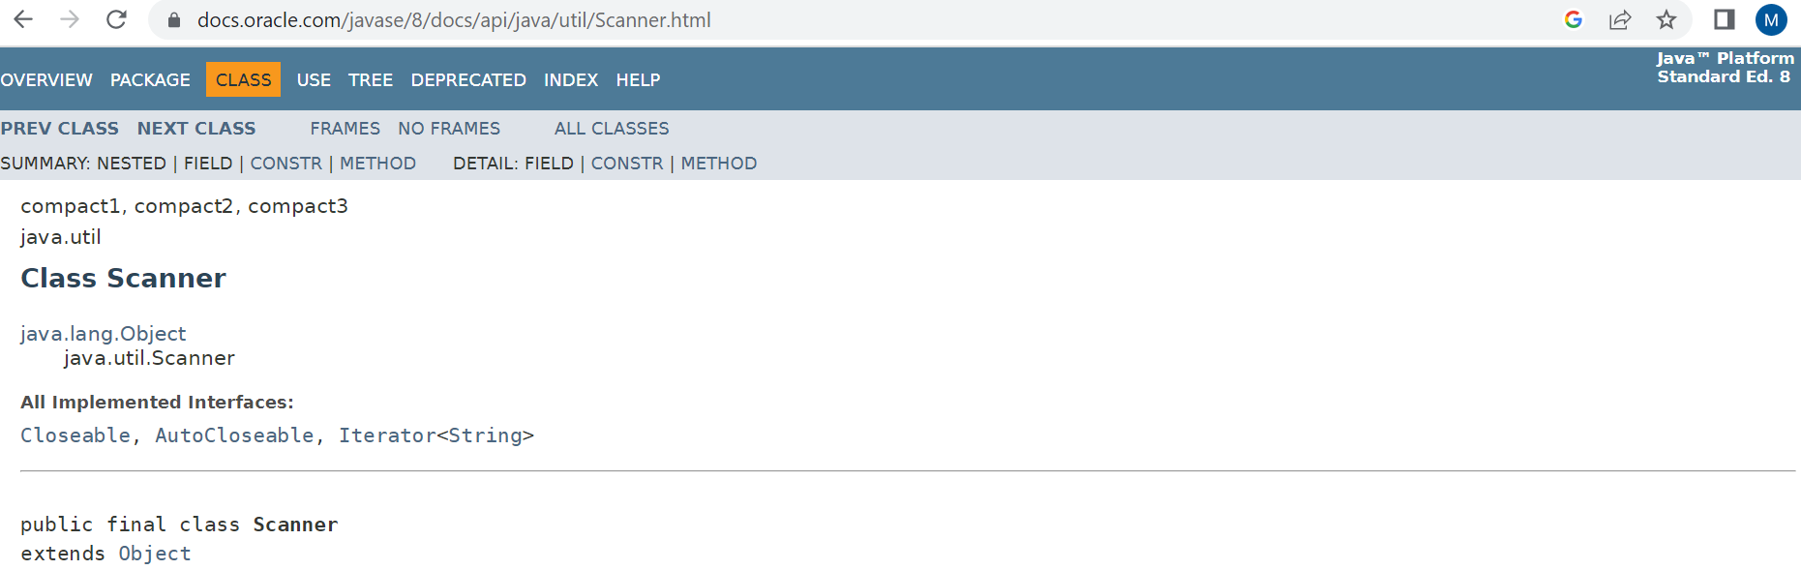
Javadoc
https://docs.oracle.com/javase/8/docs/api/java/util/Scanner.html

Slide 5
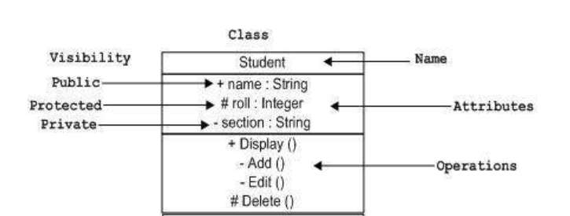
UML
UML (Unified Modeling Language)
is a standard language for specifying, visualizing, constructing, and documenting the artifacts of software systems
Class Notation – Basics
Diagram is divided into three parts.
The top section is used to name the class.
The second one is used to show the attributes of the class.
The third section is used to describe the operations/methods performed by the class.

Slide 6
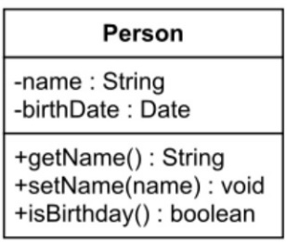
Group Practice Activity 1
Use the UML class diagram presented below to identify the class name, attributes, and methods. Indicate the visibility of the attributes and methods.

Slide 7
Group Practice Activity 2
Use the Javadocs description provided in the code below to implement the method and make the correct calls in the main.
public class Practice2 { /** * Main method used to call other methods * @parameter String args[] */ public static void main(String args[]){ //write the instructions necessary to call the //method you will implement } /** * minMax method * Asks the user to enter the total number to be read. * Determines and print the min and max of the numbers read. * @param Scanner in */
}

Slide 8
Worksheet
Attendance for today’s class will be a worksheet
Each table will receive a worksheet
Remember to write the name of all participants in your table in a legible way ☺

