Slide 1
Polymorphism and More Branching

Slide 2
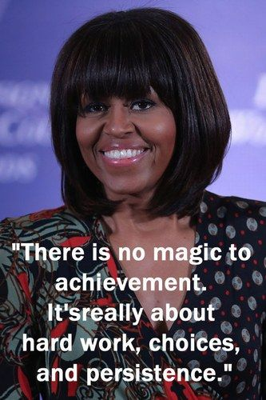
Announcements
TODO Reminders:
Readings are due before lecture
Reading 20 (zybooks) – you should have already done that ☺
Lab 13
Reading 21 (zyBooks) – you should have already done that ☺
Lab 14 – optional because of snow day
Reading 22 (zybooks)
RPA 10
Keep practicing your RPAs in a spaced and mixed manner ☺
https://www.pinterest.com/pin/342062534189160703/
Wednesday Help Desk –
3-4pm CSB120
Wednesday Help Session –
3-4pm CSB305
Thursday Help Desk –
6-8pm Teams
Thursday Help Session –
3:30-4:30pm Teams

Slide 3
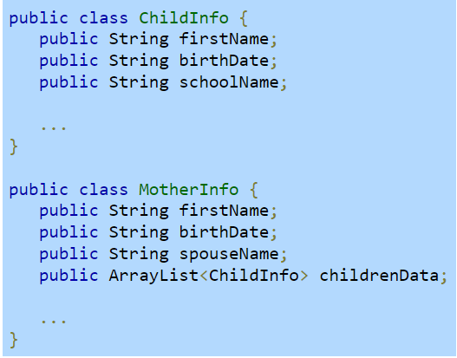
Recall Activity
Analyze the classes below. What type of relationship do we have: ‘has-a’ or ‘is-a’?
Explain using your own words.

Slide 4
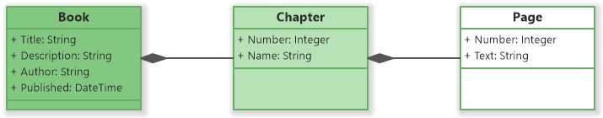
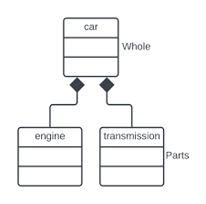
Composition
Has-a relationship

Slide 5
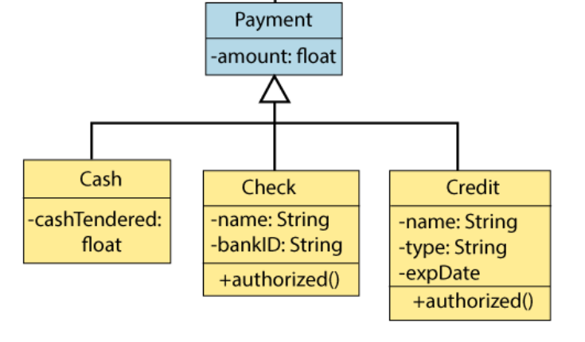
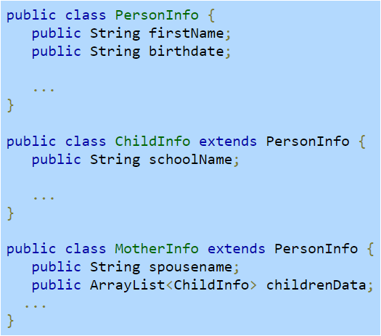
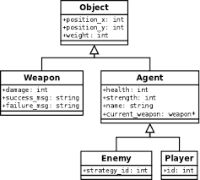
Inheritance
Is-a relationship

Slide 6
Polymorphism
Refers to determining which program behavior to execute depending on data types
Polymorphism of methods – methods overloading
compile-time polymorphism
compiler determines which of several identically-named methods to call based on the method's arguments
Polymorphism of variables – involves derived classes (inheritance)
runtime polymorphism
compiler cannot make the determination but instead the determination is made while the program is running

Slide 7
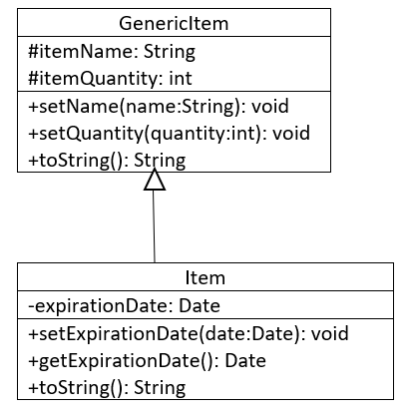
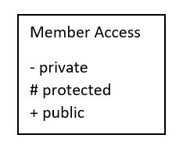
Polymorphism of variable
Substitution principle - you can always use a subclass object when a superclass object is expected
Super class variable can store super class types and sub class types as well
Sub class variable can only store sub class types
GenericItem g1 = new GenericItem();
Correct!
GenericItem g2 = new Item();
Correct!
Item g3 = new Item();
Correct!
Item g4 = new GenericItem();
Incorrect!

Slide 8
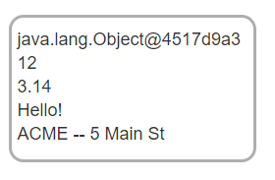
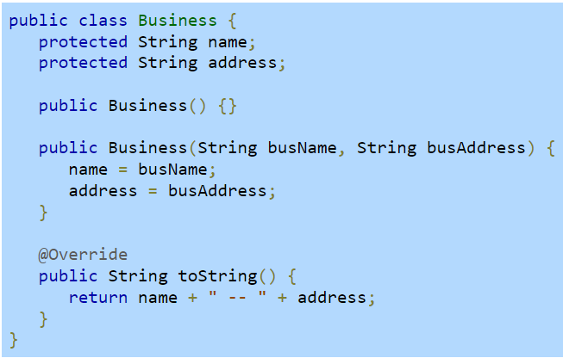
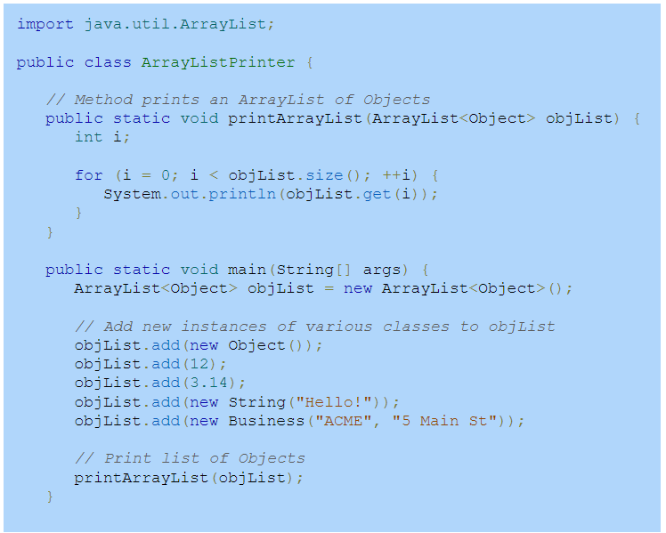
ArrayList of Objects
Store a collection of objects of various class types

Slide 9
instanceof
Rewrite the class Pet to have its constructors properly overloaded.
public static void printArrayListV2(ArrayList<Object> objList) { int i; for (i = 0; i < objList.size(); ++i) { Object obj = objList.get(i); if(obj instanceof String) System.out.println("String:" + objList.get(i)); else if(obj instanceof Integer) System.out.println("Integer:" + objList.get(i)); else if(obj instanceof Double) System.out.println("Double:" + objList.get(i)); else if(obj instanceof Business) System.out.println("Business:" + objList.get(i)); } }

Slide 10
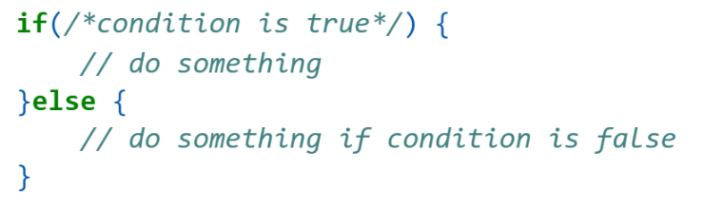

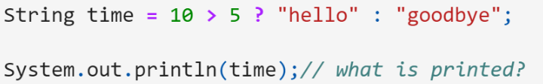

Conditional Statements/Ternary Statements

Slide 11
Switch Statements
public static String switchTest(String name){
String faeType;
switch(name) {
case "dyson":
faeType = "Werewolf";
break;
case "trick":
faeType = "Sage";
break;
case "bo" :
case "aife":
faeType = "Succubus";
break;
case "vex":
faeType = "Mesmer";
break;
default:
faeType = "human";
}
return faeType;
}
switches
a condition that checks each “case” for using ==
concise way to compare against group of options
case
the cases to ==
break
keeps executing code – until break is called
Format:
switch(primitive or String) { case <value>: break; //technically optional, but you want it default: // essentially your else }
public static void main(String[] args) {
System.out.println(switchTest("vex"));
System.out.println(switchTest("bo"));
System.out.println(switchTest(“kenzi”));
}

Slide 12
Enumerations
Declares a name for a new type and possible values for that type
Methods can use them and return them!
public enum Names {
DYSON,
TRICK,
BO,
AIFE,
VEX,
KENZIE
}

Slide 13
Switch + Enum
Switch + Enumerations are strong combinations
Enumeration is part of the case
public static String switchTest(Names name){
String faeType;
switch(name) {
case Names.DYSON:
faeType = "Werewolf";
break;
case Names.TRICK:
faeType = "Sage";
break;
case Names.BO:
case Names.AIFE:
faeType = "Succubus";
break;
case Names.VEX
faeType = "Mesmer";
break;
default:
faeType = "human";
}
return faeType;
}
public enum Names {
DYSON,
TRICK,
BO,
AIFE,
VEX,
KENZIE
}
public static void main(String[] args) {
System.out.println(switchTest(Names.VEX));
System.out.println(switchTest(Names.BO));
System.out.println(switchTest(Names.KENZI)); }

Slide 14
Worksheet
Complete the Polymorphism worksheet
Codes from this lecture and worksheet Polymorphism - https://github.com/CSU-CompSci-CS163-4/Handouts/tree/main/ClassExamples/10Polymorphism
Codes from this lecture on switch and enum - https://github.com/CSU-CompSci-CS163-4/Handouts/tree/main/ClassExamples/10MoreBranching

Slide 15
Practice 1 – if..else/switch
Write an if/else statement that
Checks to see if a student_class (String variable) is:
“Fencing”
Then set meeting_info (String variable) to “Wednesday, 4:30PM”
“Boxing”
Then set meeting_info (String variable) to “Thursday, “5:00 PM”
“Aikido”
Then set meeting_info (String variable) to “Monday, 6:00 AM”
“Nothing” or null
Then set meeting_info to the empty String (“”)
Now write the same statement as a switch statement
May be easier to write this as two separate methods (if_option, switch_option)

Slide 16
Practice 2 – Enum + Switch
Write an enum called DiceType
Contains d4, d6, d8
Write a switch statement that takes in the enum:
d4 - random number between 1-4
d6 – random number between 1-6
d8 – random number between 1-8
Default – randon number between 1-20
Remember, Random rnd = new Random(); and rnd.nextInt(6) // returns a range from 0-5
How do you test this?

