Slide 1
Advanced Topics: Collections

Slide 2
Announcements
Opening Question:
How is your Practical 5?
Todo:
Finish Practical 5
NEXT Week (week before finals)
Monday, Wednesday – Review Lectures
Friday – Early Take Option, Final Exam
Help Desk Closes on the *due date* of the last assignment (not late window)
HELP DESK CLOSES - December 9th!
Finals Week
Monday – early take option, and then scheduled exam time
CS 165 – Next Course In Sequence (also 201 is popular with 165)
CO Jobs Report 2021 – 77% of *all* new jobs in Colorado require programming
60% of all STEM jobs requires *advanced* (200-300 level)
31% of all Bachelor of Arts degree titled jobs also required coding skills
2016 Report found on average jobs that require coding skills paid $22,000 more
Math and Stats majors, at least consider CS 220 (Discrete Structures) – substitutes in your program requirements

Slide 3
ArrayLists
ArrayLists
Part of Java Collections Library
Assumes default naming conventions
done through interfaces and abstract classes!
.add(Type)
.remove(location)
.size()
Is ArrayList always best to use?
What happens if it is *very* large?
Hard to find continuous memory in order!
Causes actions to slow down
Introducing Data Structures (CS 165)

Slide 4

LinkedList
Additional Reading: https://www.geeksforgeeks.org/linked-list-in-java/
Simulator: Visualgo: https://visualgo.net/en/list
Blockchain: https://www.ibm.com/topics/what-is-blockchain
Think about a chain
Each link connects to the next
Linked Lists
Connect objects to the next
But don’t worry about it all being order in memory
If you know the next, they can be anywhere
pros
memory efficient
cons
what if a link is broken?
Can you easily jump to the middle? – no!
Also a foundation of blockchain!
LinkedList<String> list = new LinkedList<>(); list.add("A"); list.add("B"); for(String str : list) System.out.println(str);

Slide 5
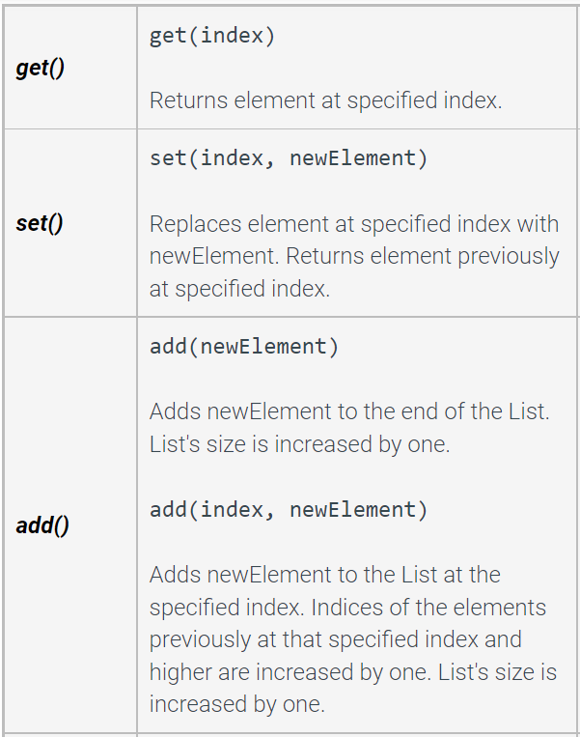
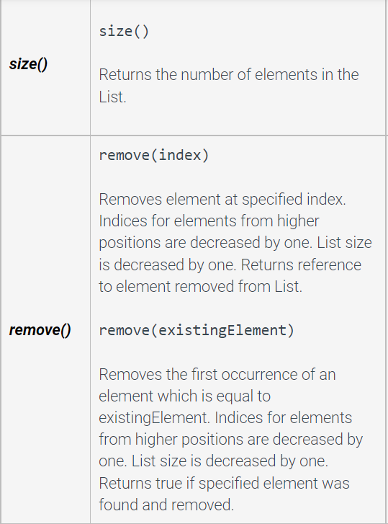
LinkedList basic methods and Practice
import java.util.LinkedList; import java.util.ListIterator; public class LLTest { public static void main(String args[]){ LinkedList<Integer> list = new LinkedList<>(); list.add(2); list.add(4); list.add(6); ListIterator<Integer> intIterator = list.listIterator(); //what is printed? while(intIterator.hasNext()){ System.out.print(intIterator.next()); } System.out.println(""); //how to add number 5 between numbers 4 and 6? //how to add number 1 before number 2? //how to remove number 2? //how to remove the second element in the list? //what is printed?
intIterator = list.listIterator(); while(intIterator.hasNext()){ System.out.print(intIterator.next()); } } }

Slide 6
LinkedList versus ArrayList
A LinkedList typically provides faster element insertion and removal at the list's ends (and middle if using ListIterator)
LinkedList methods with index parameters, such as get() or set(), cause the list to be traversed from the first element to the specified element each time the method is called. Thus, using the LinkedLists' get() or set() methods within a loop that iterates through all list elements is inefficient.
ArrayList offers faster positional access with indices
it maintains index based system for its elements as it uses array data structure implicitly which makes it faster for searching an element in the list.

Slide 7
Map
Additional Reading: https://www.geeksforgeeks.org/java-util-hashmap-in-java-with-examples/
What if you had key value pairs?
Example: Your address points to your house
Does a book of addresses, store all the information about your house?
Or simply the address, that can get the info?
Introducing Maps
Pairs keys to values
Keys needs to be unique
HashMap<String, String> contacts = new HashMap<>(); contacts.put("awonder", "awonder@wonderland.colostate.edu"); contacts.put("queen", "redqueen@wonderland.colostate.edu"); contacts.put("hatter", "madhatter@wonderland.colostate.edu"); System.out.println(contacts.get("queen")); // prints redqueen@wonderland.colostate.edu

Slide 8
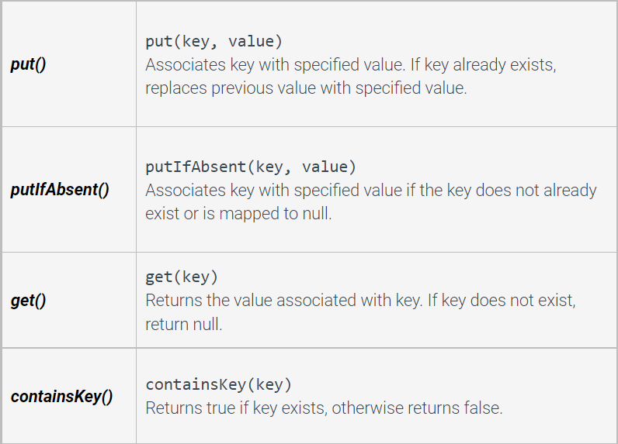
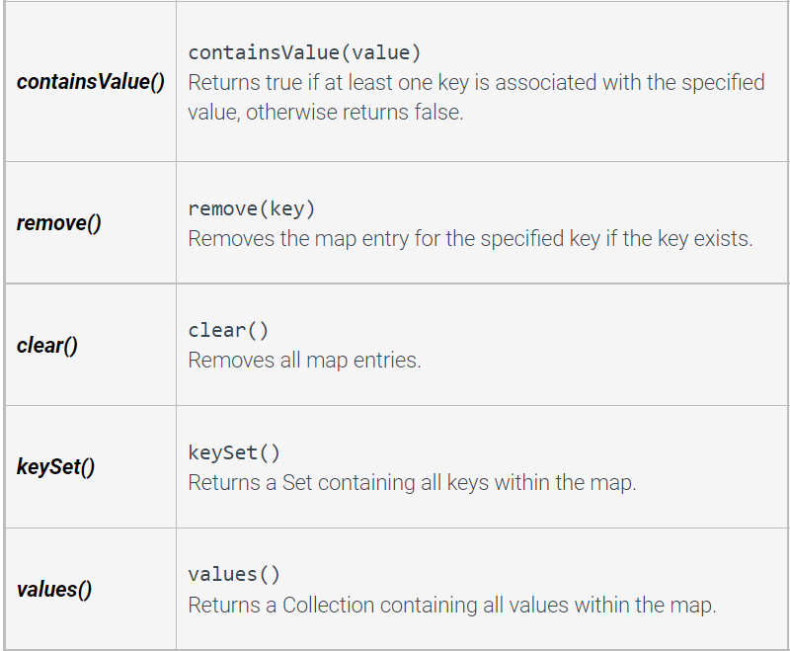
HashMap basic methods and Practice
import java.util.Collection; import java.util.HashMap; import java.util.Set; public class CountryMap { public static void main(String args []){ HashMap<String, Double> mapCountry = new HashMap<String, Double>(); mapCountry.put("Brazil",3288000.0); mapCountry.put("USA", 3797000.0); mapCountry.put("Portugal", 35603.0); mapCountry.put("India", 1269000.0); System.out.println(mapCountry); //how to return a list of keys? System.out.println(keys); //how to return a list of values? System.out.println(values); } }

Slide 9
Why does it matter?
Different data structures
affects speed, memory and storage
important for all fields
biology – large datasets
graphics – speed is needed
cybersecurity - processing serialized information over networks
If you interview at Google, Amazon, etc
they often give you a tech quiz
Most of what is on that quiz – you learn in CS 165
Take CS 165, it provides major programming foundation!

Slide 10

Last but not least
Thank you!!!
Please fill out course survey
Keep coding, keep learning, and we hope to see you in CS 165

