Slide 1
Strings Manipulation

Slide 2

Announcements
TODO Reminders:
Readings are due before lecture
Reading 11 (zybooks) – you should have already done that ☺
Lab 07 - go to your lab to have the participation points
Reading 12 (zyBooks) - you should have already done that ☺
Lab 08 – go to your lab to have the participation points
Reading 13 (zybooks) - you should have already done that ☺
RPA 6
Keep practicing your RPAs in a spaced and mixed manner ☺
https://www.quotespedia.org/authors/h/henry-ford/whether-you-think-you-can-or-think-you-cant-youre-right-henry-ford/
Help Desk
Day | Time : Room
Monday | 12 PM - 2 PM : CSB 120
Tuesday | 6 PM - 8 PM : Teams
Wednesday | 3 PM - 5 PM : CSB 120
Thursday | 6 PM - 8 PM : Teams
Friday | 3 PM - 5 PM : CSB 120
Saturday | 12 PM - 4 PM : Teams
Sunday | 12 PM - 4 PM : Teams

Slide 3
Recall Activity
Grab a paper, write your name, as it is in Canvas, and your answers to the following questions. Turn this as your attendance for today’s lecture.
Explain what is a String, describe at least three methods you can use over Strings and how those methods work.

Slide 4
Strings
A String is a collection of ordered characters
It has data
It has functionality (methods)
It is also immutable ( can’t be directly modified)
Every method that builds a String, returns a copy
Java does this for memory efficiency
Example
String mascot = “CAM”;
String mascot
0
C
1
A
2
M

Slide 5
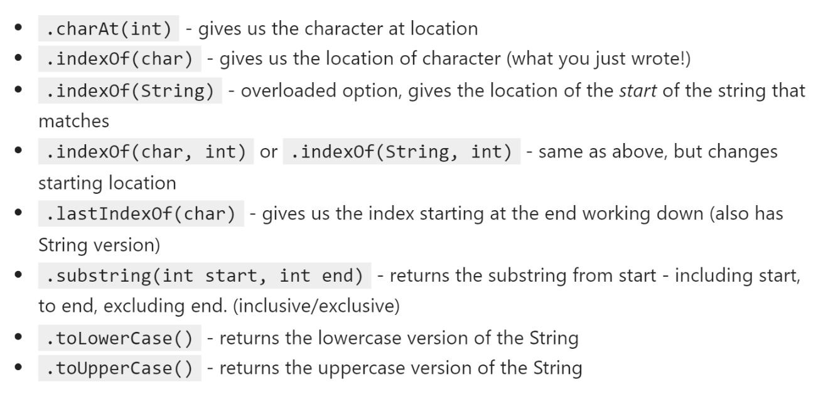
Common Strings Methods

Slide 6
Finding the index
0
k
Sator Square is a 2D palindrome
1
i
What are the outputs for the following instructions?
stops searching, returns 1
2
n
String palindrome = “kinnikinnik”;
stops searching, returns 2
3
n
palidrome.length();
// returns 11
4
i
palidrome.charAt(0);
// return ‘k’
k
// return ‘k’
5
palidrome.charAt(palidrome.length()-1);
6
i
palidrome.indexOf(‘i’);
// return 1
7
n
palidrome.indexOf(‘n’);
// return 2
8
n
palidrome.indexOf(‘niki’);
9
i
// return 3
10
k

Slide 7
lastIndexOf
0
k
String palindrome = “kinnikinnik”;
palidrome.lastIndexOf(‘n’);
1
i
2
n
3
n
4
i
5
k
6
i
What if we wanted the middle ‘k’?
7
n
8
n
9
i
10
k

Slide 8
Practice Loop Review
Write a loop that :
Looks at each character in a String (hint: charAt(i))
Returns the index of that character (don’t use ‘indexOf’)
Return -1 if the loop ends but the character was not found.
Now modify it to start at the end of the word, not the start!
public class YourProgram {
public static int find(String str, char ch) { return find(str, ch, 0); }
public static int find(String str, char ch, int start) {
// LOOP here return 0; // change this } public static void main(String[] args) { System.out.printf("TEST: the index is: %d", find("SATOROTAS", 'A')); System.out.printf("TEST: the index is: %d", find("SATOROTAS", 'T')); System.out.printf("TEST: the index is: %d", find("SATOROTAS", 'Z')); } }
Complete the In Class Activity

Slide 9
indexOf is overloaded
0
k
indexOf can take in two parameters
Second parameter is the start location
String palindrome = “kinnikinnik”;
palindrome.indexOf(‘k’); // returns 0
palindrome.indexOf(‘k’, 1); // returns 5
1
i
2
n
3
n
4
i
5
k
6
i
7
n
8
n
9
i
10
k

Slide 10
Substring
Returns a portion of the string
substring(start, end)
includes start
excludes end! (end is optional, defaults to .length())
String palindrome = “kinnikinnik”;
String sub = palindrome.substring(0, 6); // sub is “kinnik”
int start = palindrome.indexOf(“k”);
int end = palindrome.indexOf(“k”, start+1) + 1;
String sub = palindrome.substring(start, end);
0
k
1
i
2
n
3
n
4
i
5
k
6
i
7
n
8
n
9
i
10
k

Slide 11
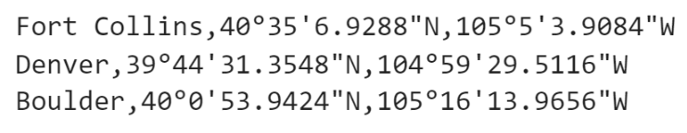
Exploring Patterns
What pattern can be observe in the following Strings?
City,Latitude,Longitude
How can we parse that String to have each one of those elements individually?
Using substring method combined with indexOf method!

Slide 12
Exploring Patterns
What pattern can be observe in the following Strings?
Example: getting the city
Complete the In Class Activity
public class Test { public static void main(String args[]){ String coord = "Fort Collins,40°35'6.9288\"N,105°5'3.9084\"W"; String city = coord.substring(0, coord.indexOf(",")); System.out.println(city); } }

Slide 13
Substring Practice
Write a method that returns all characters after a given character
Example: sub(“SATOROTAS”, ‘O’) // return ROTAS
Example: sub(“SATOROTAS”, ‘A’) // returns TOROTAS
Think about the problem that you need to solve
Write a sequence of steps to solve that problem – your algorithm
Translate your algorithm into a Java program

Slide 14
Take-away
Natural Language Processing is about understanding language, Strings express language – Learn more about NLP
All Strings have indices from 0 to length-1
indexOf(char) – finds the index of a character or substring
charAt(int) - gives you the character at an index
substring(int,int) – gives you a portion of the string
length() – don’t forget to use it!
Additional Reading
Read more about the String Class : Here Read more about the Character Class : Here

