Slide 1
Character and Strings

Slide 2

Announcements
Reminder – readings are due before lecture
You don’t have to do all of it - challenge problems can be challenging…
You can return to them.
We start off each lecture with a recall activity!
Lab teams should be setup
If you are not on a private channel with your other lab mates, let us know
Thursday lab – meant to be done by Monday

Slide 3
Recall Activity
Grab a paper, write your name, as it is on Canvas, and your answers to the following questions. Turn this as your attendance for today’s lecture.
What is an object?
What is the difference between a char and a String?
Given the following Code, what is printed?
public static char characterAddition(char a, int b) { return (char) (a + b);
} public static void main(String[] args) { System.out.println(characterAddition('A', 2)); }
C

Slide 4
Characters (char)
Primitive - stores values only
Example declarations:
A char is an int behind the scenes - and java uses the ASCII Table to figure out the character value
char myChar = 'x'; // notice single quotes
char newLine = '\n'; //the invisible newline character
char myChar2 = 57; // bad idea! It sets the value to the character ‘9’
char what = (char)('A' + 2); // what is now ‘C’ (used in things like the Caesar cipher)

Slide 5
Casting
Type casting is when you assign a value of one primitive data type to another type.
This allows you to change an int back to a char without an error!
public static char characterAddition(char a, int b) { return (char) (a + b);
} public static void main(String[] args) { System.out.println(characterAddition('A', 2)); }
a+b
Converts a to an int (65)
adds b which is 2, so 67 total
(char) takes 67, and makes it ‘C’, a char
‘C’ gets returned

Slide 6
Quick Practice
What happen when we try to run the program?
public class CastingProgram {
public static void main(String[] args) {
int value1 = 12;
double value2 = 25.75;
double resultDouble = value1 + value2;
System.out.print(value1 + " + " + value2 + " = ");
System.out.println(resultDouble);
int resultInt = value1 + value2;
System.out.print(value1 + " + " + value2 + " = ");
System.out.println(resultInt);
}
}
CastingProgram.java:10: error: incompatible types: possible lossy conversion from double to int
int resultInt = value1 + value2; ^ 1 error
How to solve that error?

Slide 7
Quick Practice
public class CastingProgram {
public static void main(String[] args) {
int value1 = 12;
double value2 = 25.75;
double resultDouble = value1 + value2;
System.out.print(value1 + " + " + value2 + " = ");
System.out.println(resultDouble);
int resultInt = value1 + (int) value2;
System.out.print(value1 + " + " + (int) value2 + " = ");
System.out.println(resultInt);
}
}
Manually casting the double variable to an int

Slide 8
Hang’em
Time play Hang’em
In your groups, play a game of hangman
Try to use Java syntax words
Try multiple word sentences
Include the *space* as one of the characters in a multiword sentence
Ok - next part, write numbers below each dash
start at 0
make sure to number (index!) the spaces
H e l l o J a v a
0 1 2 3 4 5 6 7 8 9
You just created a java String

Slide 9

Let’s talk about String
A String is a collection of ordered characters
It has data
It has functionality (methods)
It is also immutable ( can’t be directly modified)
Every method that builds a String, returns a copy
Will cover this more in the future
But what does a String really look like?

Slide 10
First, Let’s Think About Memory
C
char c
Storing variables in memory
Wherever the computer decides
Value stored in the location
Variable name points towards location
Example
char c = ‘C’;
char m = ‘M’;
What about Strings?
String mascot = “CAM”;
char m
String mascot
C
A
M
M

Slide 11
String Methods
Ordered Collection of characters
Indexed – starting at 0
‘C’ is at index 0
‘A’ is at index 1
char character = mascot.charAt(2);
returns ’M’ (character)
How many characters?
int len = mascot.length(); // 3
No matter how large the string
Starts at 0
Has a length
Always know first and last index!
String mascot
0
C
1
A
2
M

Slide 12
Making Strings Look Good

Slide 13
Reading Check-in
Given the following Code, what is printed?
public static String characterAddition(String a, int b) { return a + b; } public static void main(String[] args) { System.out.println(characterAddition("A", 2)); }
A2

Slide 14
String Concatenation
Adds two strings together
Better worded: String objects added to other types (String or primitive or other objects)
Step 1 converts everything to a String. So 1 number becomes “1”
Step 2 puts it all together, exactly as written.
Example:
int aNumber = 42;
String question = "The Answer To Life, The Universe And Everything";
System.out.println(question + aNumber);
Prints “The Answer To Life, The Universe And Everything42” .. whoops
System.out.println(question + " is " + aNumber);
Prints “The Answer To Life, The Universe And Everything is 42”

Slide 15
String.format/printf
We know we can write Strings via Concatenation String towelColor = "pink"; String dontPanic = "Don't forget to bring your " + towelColor + " towel"; String txt = "Don't panic"; String heading1 = "<h1>" + txt + "</h1>";
However, that can be awkward - introducing String.format String towelColor = "pink"; String dontPanic = String.format("Don't forget to bring your %s towel", towelColor); String txt = "Don't panic“; String heading1 = String.format("<h1>%s</h1>", txt);
printf is System.out.printf("<h1>%s</h1>", txt); // prints <h1>Don’t panic</h1> to the screen

Slide 16
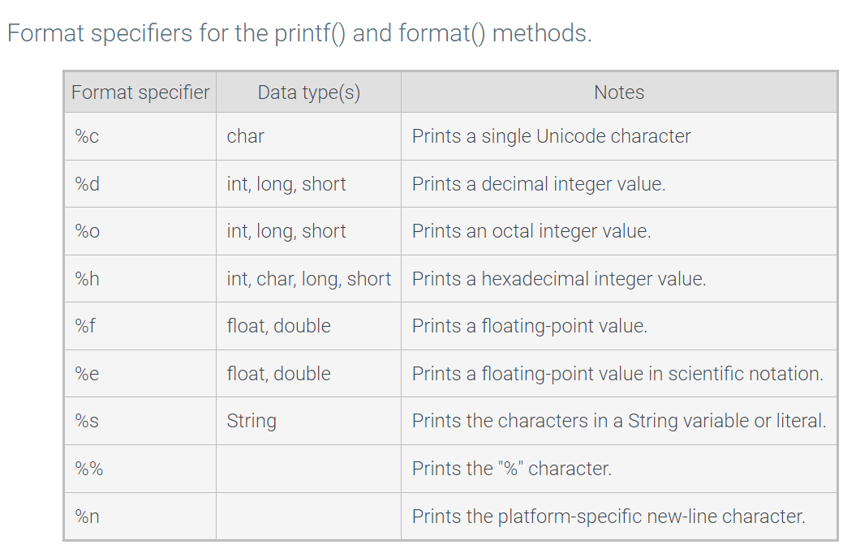
String.format/printf

Slide 17
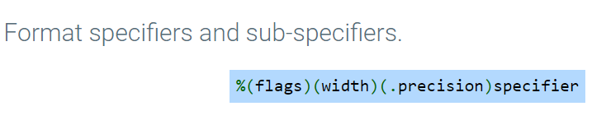
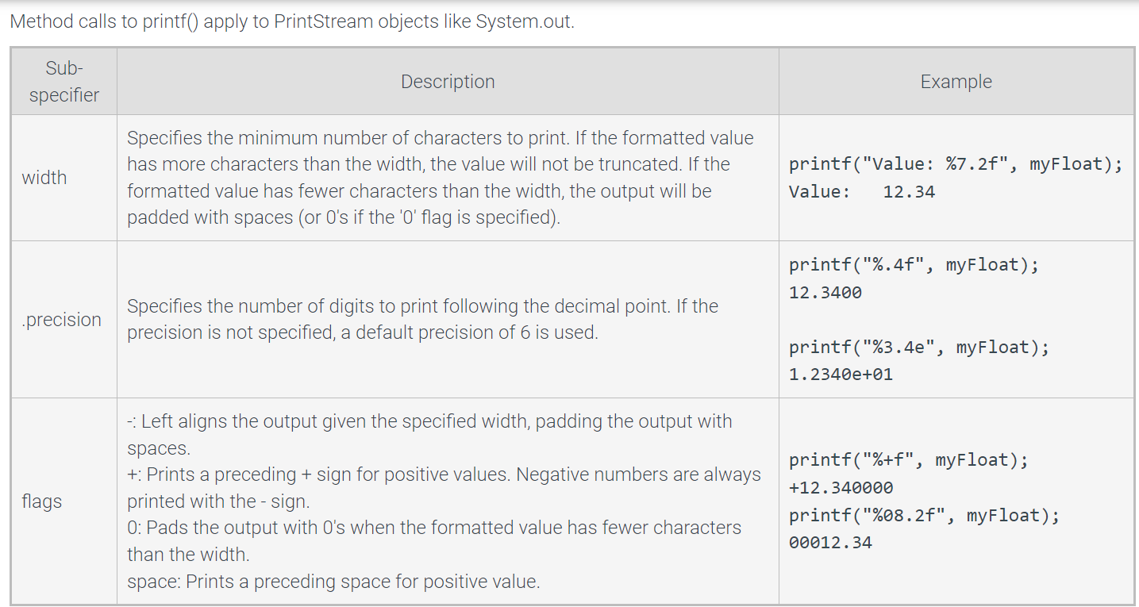
Floating point values

Slide 18
Example
public static String businessCardNoFormat(String name) {
return "+==================================+\n" +
"| Round Table Enterprises |\n" +
"| |\n" +
"| " + name +" |\n" +
"+==================================+";
}
public static String businessCardUsingFormat(String name) {
return "+==================================+\n" +
"| Round Table Enterprises |\n" +
"| |\n" +
String.format("|%33s |\n", name) +
"+==================================+"; }
Without String Format
With String Format
+==================================+
| Round Table Enterprises |
| |
| Lancelot of the Lake |
+==================================+
+==================================+
| Round Table Enterprises |
| |
| Lancelot of the Lake |
+==================================+
+==================================+
| Round Table Enterprises |
| |
| Bors the Younger |
+==================================+
+==================================+
| Round Table Enterprises |
| |
| Bors the Younger |
+==================================+

Slide 19
Numbers in String format
public static String percentNoFormat(double val) {
return val + "%";
}
public static String percentFormat(double val) {
return String.format("%.2f%%", val);
}
33.33333333333333%
33.33%

Slide 20

String.format References
The % character is followed by special characters
%s for string, %f for floating point, etc
Capitalize the %S or %C to force uppercase!
You can specify the number of decimal places by including the numbers
%.2f // example
String.format(“%.2f”, 100)
would produce 100.00
You can also do cool things like pad variables, etc
Search for printf() online
Very common in over 20+ languages
Admittedly, I look up a lot of the formats as I need them
%s, %S, %d, %0.2f, %n
Those are good to know off the top of your head
%n == new line character
%% == % sign (since you can’t just type %)
Additional Reading: Detailed Format Reference

Slide 21
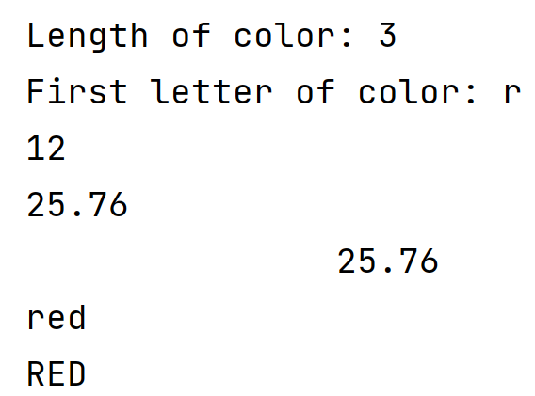
Quick Practice
What is the exactly output of this program?
public class StringFormatProgram {
public static void main(String[] args) {
int value1 = 12;
double value2 = 25.75986;
String color = "red";
int len = color.length();
System.out.println("Length of color: " + len);
System.out.println("First letter of color: " + color.charAt(0));
System.out.printf("%d\n", value1);
System.out.printf("%.2f\n", value2);
System.out.printf("%20.2f\n", value2);
System.out.printf("%s\n", color);
System.out.printf("%S\n", color);
}
}

Slide 22
Quick Practice
public class StringFormatProgram {
public static void main(String[] args) {
int value1 = 12;
double value2 = 25.75986;
String color = "red";
int len = color.length();
System.out.println("Length of color: " + len);
System.out.println("First letter of color: " + color.charAt(0));
System.out.printf("%d\n", value1);
System.out.printf("%.2f\n", value2);
System.out.printf("%20.2f\n", value2);
System.out.printf("%s\n", color);
System.out.printf("%S\n", color);
}
}
Change the System.out.println to System.out.printf

Slide 23
Quick Practice
public class StringFormatProgram {
public static void main(String[] args) {
int value1 = 12;
double value2 = 25.75986;
String color = "red";
int len = color.length();
System.out.printf("%d\n", value1);
System.out.printf("%.2f\n", value2);
System.out.printf("%20.2f\n", value2);
System.out.printf("%s\n", color);
System.out.printf("%S\n", color);
}
}
System.out.printf("Length of color: %d\n", len);
System.out.printf("First letter of color: %c\n", color.charAt(0));

Slide 24
Quick Practice
public class StringFormatProgram {
public static void main(String[] args) {
int value1 = 12;
double value2 = 25.75986;
String color = "red";
int len = color.length();
System.out.println("Length of color: " + len);
System.out.println("First letter of color: " + color.charAt(0));
System.out.printf("%d\n", value1);
System.out.printf("%.2f\n", value2);
System.out.printf("%20.2f\n", value2);
System.out.printf("%s\n", color);
System.out.printf("%S\n", color);
}
}
Print the last character that is stored in the color variable
System.out.printf("%c\n", color.charAt(len-1));

Slide 25
In Class Activity: HTML Color Codes
HTML will use hexadecimal color coding:
#FFFFFF stands for
red at 255
green at 255
blue at 255
to make white
In this activity, you will use String.format to convert ints to hexadecimal (%X) for displaying both the RGB code and the HTML code in a variety of ways. Most of the methods you write will be short (1 line!).
Find the link in canvas
The person with the *least* coding experience should be the designated coder

