Slide 1
Objects and Methods

Slide 2
Announcements
Todo:
Busy Week! (readings + labs)
Labs projects start!
Reminder – readings are due before lecture
You don’t have to do all of it - challenge problems can be challenging…
You can return to them.
We start off each lecture with a quiz from your reading!
Labs are due the night of the lab (meant to be done in lab!)
follow the modules *in order*
You can go back to labs until you get it correct, so submit for 0 is valid!
ACM this Week
TODO
ACM-W this Week
TODO

Slide 3
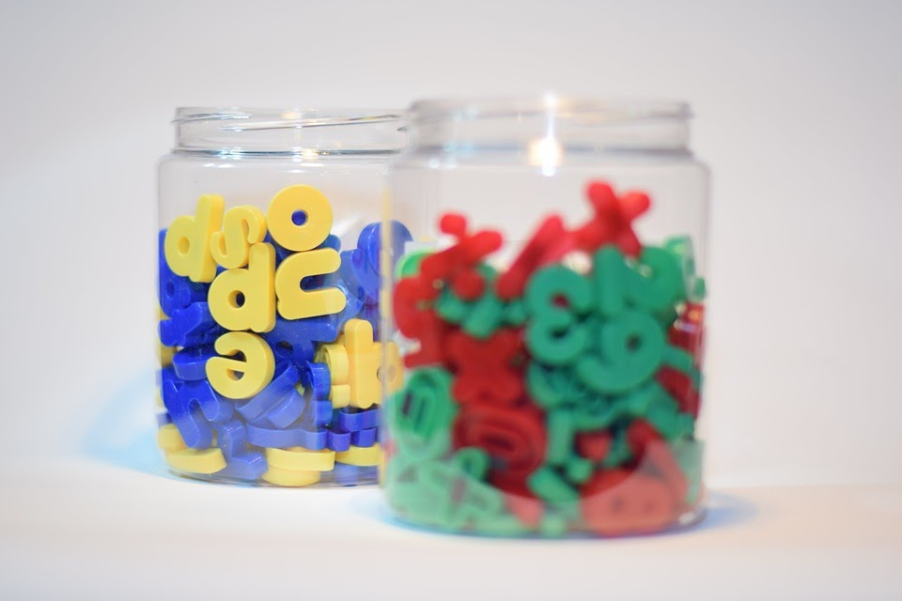
Primitive and Object Types
Primitives
int
double
char
boolean
Store numbers only
char maps ints to ASCII table
boolean maps 0 to false, 1 to true
Only contains the values
No functionality
Repeat: values only
Objects
Are “containers”
Contain multiple primitives
Related to the same ‘idea’
Has functionality (methods)
Extremely key to programming
They are ‘smart’

Slide 4

Objects are Building Blocks
Think of LEGOs
Blocks
Assembled in different ways - creates new and interesting things
Objects contain information in a logical order
Example: Strings are objects
String companion = “Clara”; // note, Strings are so common, they have this shortcut
companion.length(); // returns 5
Most objects use the new keyword
MyCoolObject obj = new MyCoolObject(); // this reserves room in memory
obj.myCoolMethod();
We will keep coming back to this
Important to know - methods belong to Objects
Even methods that you write
© Ralf Roletschek - Published with permission. Read full copy information on wikicommons.

Slide 5
Memory Example
length
10
public static void main(String[] args) {
int length = 10;
int width = 100;
Rectangle smallBuildingOnCampus = new Rectangle();
smallBuildingOnCampus.setLength(length);
smallBuildingOnCampus.setWidth(width);
System.out.println(smallBuildingOnCampus.getArea());
}
public class Rectangle {
int width = 0;
int length = 0;
public setLength(int val) { length = val; }
public setWidth(int val) { width = val; }
public getArea() { return width * height; }
}
100
width
length
0
10
width
0
100
smallBuildingOnCampus
More room for methods

Slide 6
Object Summary
Objects are
Building blocks for code
Recipes of information
Containers for multiple primitives
Have actions/functionality - provided by methods
For now…
You will use objects
You will write methods
You will eventually write your own objects

Slide 7
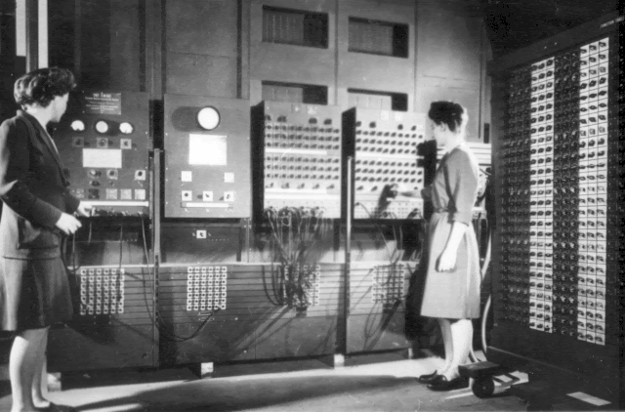
Reusable Code
Programming == Problem Solving
You look at the problem to solve
Clarify the problem and constraints
Break it up into *smaller* parts (Divide)
Outline the steps needed
Solve each step (Conquer)
Reassemble the pieces (Glue)
Completed program
The ENIAC women pioneered reusable code
But they also needed ways to modularize code
Over the years - Object Oriented Designed
Programmers Betty Jean Jennings (left) and Fran Bilas (right) operate ENIAC's main control panel By United States Army (Image from http://ftp.arl.army.mil/~mike/comphist/) [Public domain], via Wikimedia Commons
Divide
Conquer
Conquer
Conquer
Glue

Slide 8
Reading Check-in
Which of the following are valid method “signatures”
public double calcArea(double width, double height) {}
Public static my_method(int x, boolean y) {}
public static void main(String args[]);
All listed
None listed

Slide 9
Method Syntax Basics
[scope] [static] TYPE name(parameters) {}
public static void main(String[] args) {...}
public - is the scope of the method (optional)
static - access type (option)
void - return type (required)
main - method name (required)
String[] args - are parameters for the method
Having parentheses is required
something inside, optional
public double getPercentGrowth(double startingSalary, double midCareerSalary) { …}
public - is the scope of the method
access is not there - that means “instance”
double - return type
getPercentGrowth - method Name
double startingSalary, double midCareerSalary - are parameters for the method

Slide 10
Static vs. Instance Methods
Harder concept (we will come back to it later)
Think of static as shared memory
Variables in it are easily overwritten
Static methods need to be self contained, and only access shared information
Instance methods belong to the object
They need information from the object
They provide the main functionality to the object
Most common

Slide 11

Method Name & Parameters
They should have meaning!
They follow the same rules as variable names
No specials, start with letter, etc
Parameters are part of the name
getArea()
getArea(int x)
getArea(int x, int y)
Are three different methods! (Be careful)
The secret ninja trick for methods
Pass in the variables
Try to keep everything as contained as possible
What is your quest?
What is it you return
What do you know
What do you need (parameters)

Slide 12
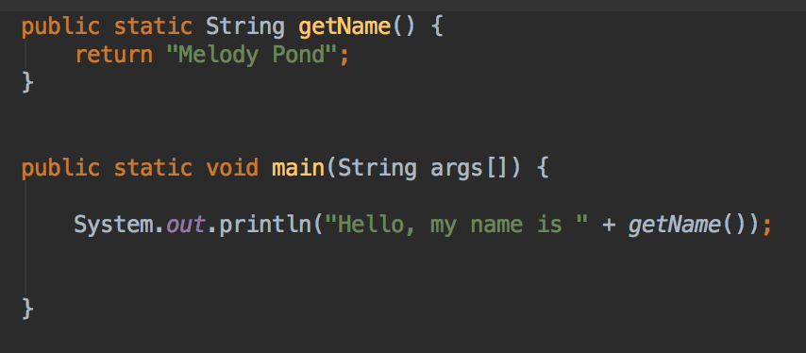
Return Types
Return Types
Critically important
Can return a primitive, array or an object
void is how you say the method returns nothing
Whenever you call a method
Assume the return type is what is returned
Think of replacing the method name with the answer
The program output is
Hello, my name is Melody Pond
Notice: Melody Pond simply replaces ‘getName()’

Slide 13
Code Along
Follow the code- picturing the code

Slide 14
Why Methods and Objects?

Slide 15
DRY Code
Fun Fact:
Software Engineers, Andy Hunt and Dave Thomas, are credited with first using the the term for coding in the The Pragmatic Programmer
Code should be DRY
Don’t Repeat Yourself
Code should be
Reusable
Small Snippets
Reusable code
Only write once
Use in multiple applications
Java
Methods are blocks of reusable code
Ideally, no more than 20 instructions
Objects are blocks of information, with reusable code / methods
CLUE: If you are cutting and pasting code - it should be a method
Really, that happens
Divide
Conquer
Conquer
Conquer
Glue

