Slide 1
Loops

Slide 2
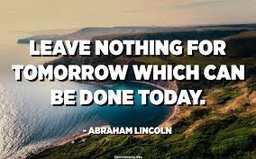
Announcements
Reminder – readings are due before lecture
We start off each lecture with a recall activity from your reading!
Help Sessions and Help Desks
Go to them! They make a difference
Next Week – Exam Module
You need to work to have this module open so you can do your Exams
Catch up if you are behind!
Ask for help, if you need! Don’t hesitate to reach out!
TAs and myself are here to help you to succeed in this course!
Don’t procrastinate!

Slide 3
Recall Activity
Grab a paper, write your name, as it is in Canvas, and your answers to the following questions. Turn this as your attendance for today’s lecture.
What is the difference between a while loop and a for loop?
Analyze the following method:
public static void loop(int max, int inc) { for(int i = 0; i < max; i+= inc) { System.out.println(i); } }
How many lines are printed, given the following call
loop(5, 1)
loop(9, 4)
loop(0, 3)

Slide 4
Recall Activity
public static void loop(int max, int inc) { for(int i = 0; i < max; i+= inc) { System.out.println(i); } }
How many lines are printed, given the following call
loop(5, 1)
5
loop(9, 4)
3
loop(0, 3)
0

Slide 5
What are computers good at?
Computers are good at three things
Calculations
Formal logic
Repeating what you just asked it to do (iteration) - Loops
Coincidently
Three things humans tend to struggle with
If you understand
Calculations
Formal Logic
And Loops
You will be able to accomplish impressive programs

Slide 6
Loop Types in Java (and most languages)
While Loops
For Loops
For:each loops (we will cover this later)
Do While loops (we will cover this later)
All loops have
An iterator - a way to cycle through the values you want to look at
A condition to exit (else, your computer blows up - it happens to everyone)

Slide 7
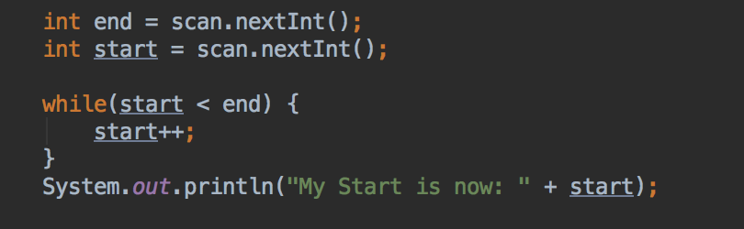
While Loop
Good when:
Your “iteration” variable is created outside the loop
You need your iterator variable outside of the loop
while(TRUE-CONDITION) {/*block of code to execute*/}

Slide 8
While Loop
Lets assume:
end = 3;
start = 1;
end
start
3
1
while(1 < 3){
start++;
}
2
while(2 < 3){
start++;
}
3
while(3 < 3) – out of while
System.out.println(“My Start is now: ”+ start);

Slide 9
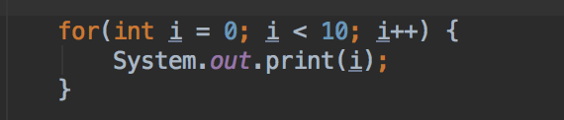
For Loop
Good when:
Your loop has a set start and end
You don’t need to keep your iterator outside the loop
for(variables; condition; iterator) { /* block of code to execute*/ }

Slide 10
For Loop
How the for works:
control variable is initialized
test condition
2.1. if test if true:
execute what is in {}
increment control variable and
go to step 2 again
2.2. if test if false, exit for
What is the program output?
0123456789
What do we need to change to have each number in a different line?
System.out.println(i);
What do we need to change to print the numbers in the reverse order?
for(int i = 9; i >=0; i--)

Slide 11
In Class Activity – Loop Practice
Write a method that reads positive numbers and prints the sum and average of those numbers.
Think about how you are going to solve this problem
What kind of loop do we need? Why?
When the loop is going to stop?
How many variables do we need? Why?
What are those variables types?

Slide 12
In Class Activity – Loop Practice
Write a method that generates the first hundred even numbers.
Think about how you are going to solve this problem
What kind of loop do we need? Why?
When the loop is going to stop?
How many variables do we need? Why?
What are those variables types?

Slide 13
In Class Activity – Loop Practice
Write the following as a for loop
public static void simpleLoop(int total) { int i = 1; while(i <= total) { System.out.print(i + ","); i = i + 1; } }

Slide 14
Code Along: loop Practice
Back to Canvas / Zybooks – work on Activity 2 the number game.
One person codes, the rests assists in the coding
Really, everyone trying it, isn’t as beneficial as everyone working together on these!
You can always try it on our own later

Slide 15
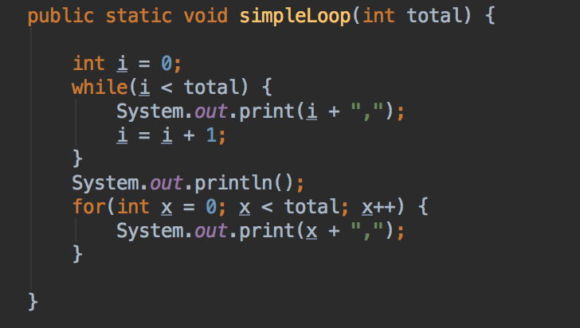
While/For Mostly Interchangeable
Let total = 10
0,1,2,3,4,5,6,7,8,9,

Slide 16
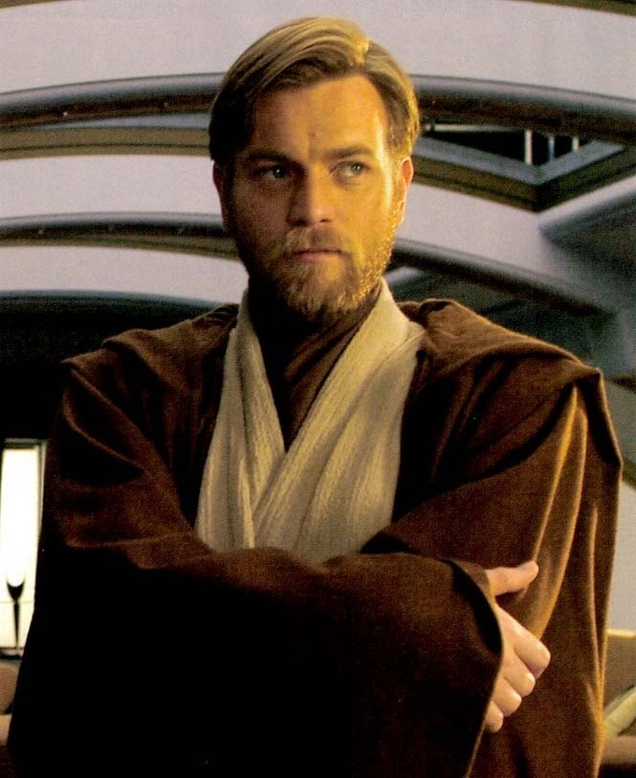
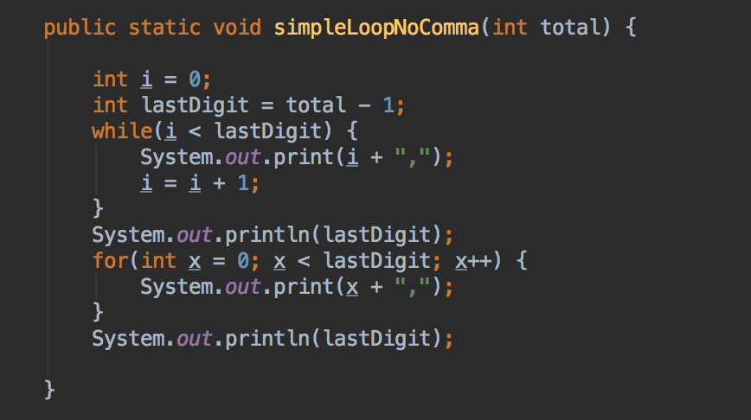
Trailing Comma?
What if I wanted to write same simple loop, but
NO trailing comma?
Let’s face it, that looks bad and probably isn’t what we want

