Slide 1
Datatypes and Wrapper Class

Slide 2

Announcements
TODO Reminders:
Readings are due before lecture
Reading 8 (zybooks) – you should have already done that ☺
Lab 05
Reading 9 (zyBooks) – you should have already done that ☺
Lab 06
Reading 10 (zybooks)
Keep practicing your RPAs in a spaced and mixed manner ☺
https://images.squarespace-cdn.com/content/v1/5e355fb2c950981b57643f21/1580903818935-B9JO2ZTBHH5N4IKXC0WF/Lettering_Practice_Nov2019_lowres.jpg?format=1000w

Slide 3
Recall Activity - Attendance
What is a wrapper class?
Explain using your own words and providing examples.

Slide 4
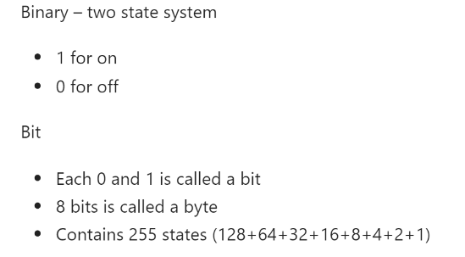
Binary

Slide 5
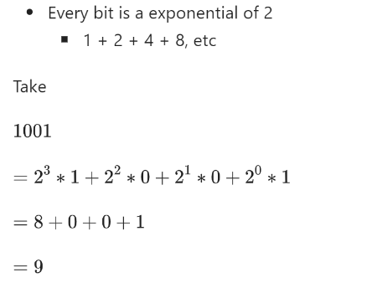
Binary

Slide 6
Binary
public class BinaryToDecimal { public static int convertBinaryToDecimal(String binaryString){ int dec = Integer.parseInt(binaryString, 2); return dec; } public static void main(String args[]){ int answer = convertBinaryToDecimal("110"); System.out.println(answer); System.out.println(Integer.toBinaryString(answer)); answer = convertBinaryToDecimal("1001"); System.out.println(answer); System.out.println(Integer.toBinaryString(answer)); } }

Slide 7
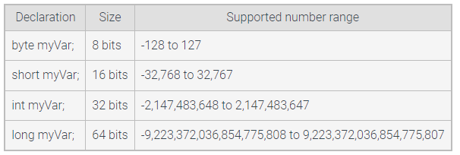
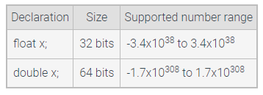
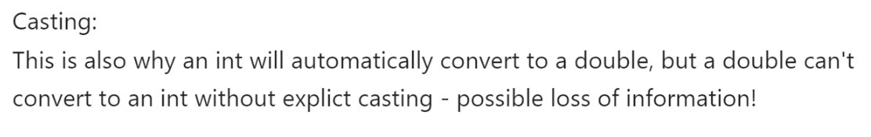
Numeric data types

Slide 8

Numeric data types – Formatting to Hexadecimal
public class FormatHexadecimal { public static void main(String args[]){ short red = 127; short green = 135; short blue = 255; String htmlCode = String.format("#%02X%02X%02X", red, green, blue); System.out.println(htmlCode); } }
Can we use byte instead of short?

Slide 9
Wrapper Class
A primitive type variable directly stores the data for that variable type, such as int, double, or char.
A reference type variable can refer to an instance of a class, also known as an object.
Wrapper classes that are built-in reference types that augment the primitive types

Slide 10
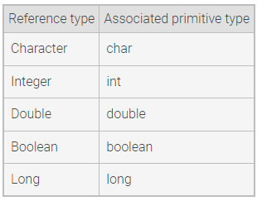
Wrapper Class

Slide 11
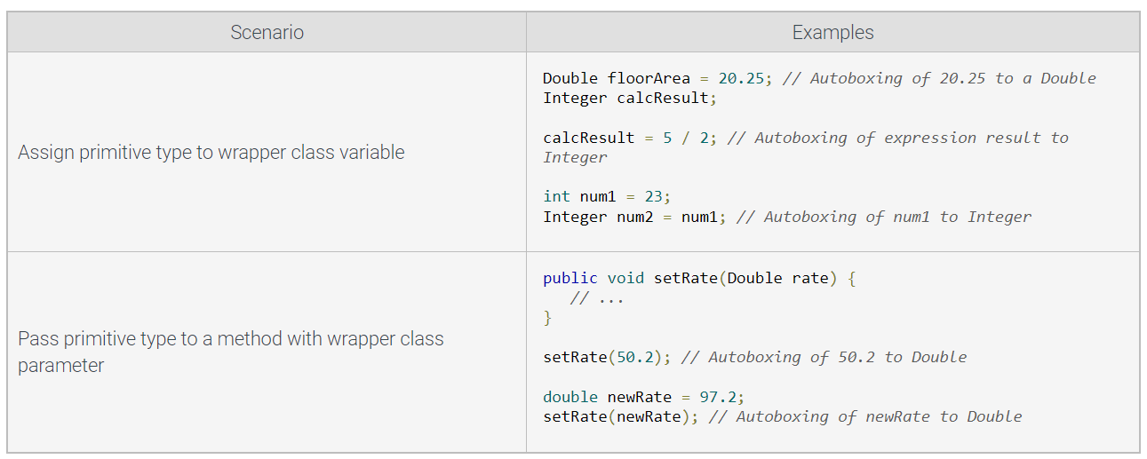
Wrapper Class Conventions
Autoboxing - automatic conversion of primitive types to the corresponding wrapper classes

Slide 12
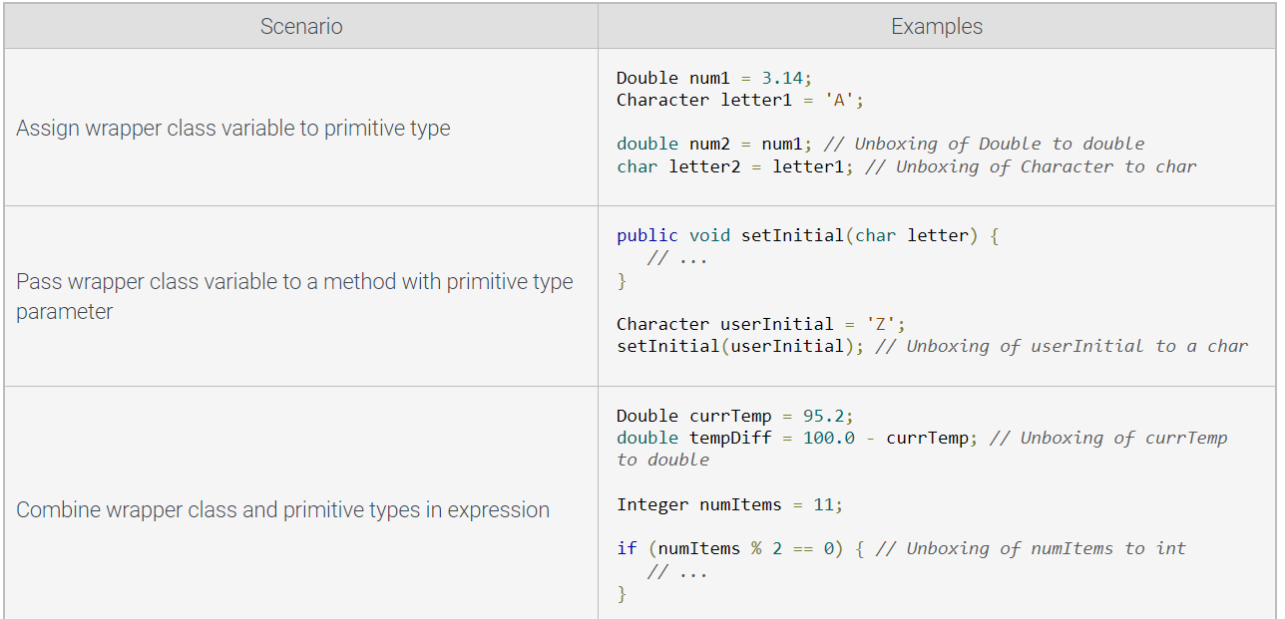
Wrapper Class Conventions
Unboxing - automatic conversion of wrapper class objects to the corresponding primitive types

Slide 13
Character Wrapper Class
Coding Along
Write a method in Java that receives a string as a parameter and removes the whitespaces from the string and print the number of whitespaces removed.
char is a primitive
No methods by itself
Character “wrapper” exists
Methods (mostly static) to help you learn about char
Common and useful methods
Character.isDigit(char)
Example:
char chDigit = ‘9’;
boolean dig = Character.isDigit(chDigit); // true
Character.isWhitespace(char)
All whitespace including \t and \n
Character.isLetter(char)
These are often paired with String charAt, and loops!

Slide 14
Solution to the Code Along
2
2
Do the In Class Activity.
String str = “hello how are you?”;
int counter = 0;
String nospace = “”;
for(int i = 0; i < str.length(); i++) {
char tmp = str.charAt(i);
if(Character.isWhitespace(tmp)) {
counter++;
}else {
nospace += tmp;
}
}
System.out.println(nospace);
System.out.printf(“Whitespace removed %d%n”, counter)
hellohowareyou
Whitespace removed 5

