Slide 1
Unified Modeling Language

Slide 2
Unified Modeling Language
A common standard to draw
OOP classes and layouts
Not required
Not used everywhere
But common enough to learn
Only basics for now!
Much more advanced cases

Slide 3
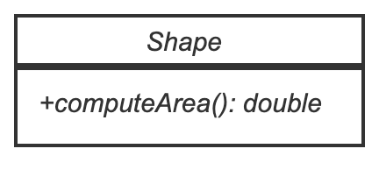
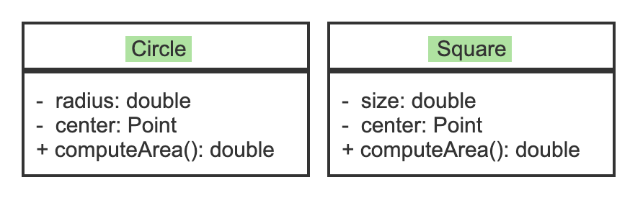
Example
Circle and Square:
Children of shape
Inherit
+computeArea
For now, you will see it in assignment specifications. You won’t be asked to draw it

