Slide 1
is-a – The Polymorphic Life

Slide 2
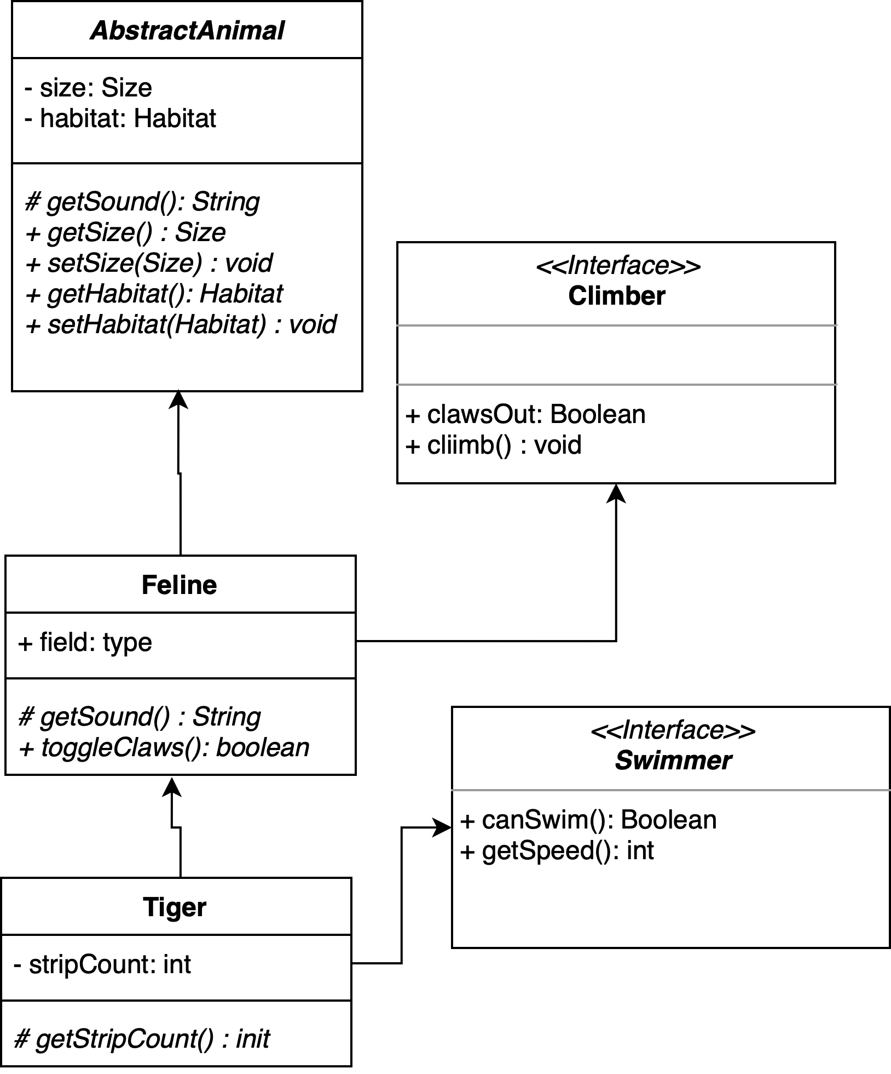
More Inheritance
Keep your programs DRY
Super/Parent classes
Child Class extends parent
Can only extend one immediate parent
Child Classes
gain public, protected, package-protected methods and variables of parent
Polymorphic
children can appear ‘as the parent’ when type matters
is-a relationship
AbstractAnimal great = new Tiger();
Feline great2 = new Tiger();
Tiger tony = new Tiger();
boolean isFeline = tony instanceof Tiger; // returns true

Slide 3
Inheriting methods
Given this example, what methods are available to Tiger?
getSound
getSize
setSize
getHabitat
setHabitat
clawsOut
climb
toggleClaws
canSwim
getSpeed
getStripCount
Could easily add a Lion that inherits from Feline
mostly same methods, with out the Swimmer or Stripes, but maybe unique ones on its own.

Slide 4
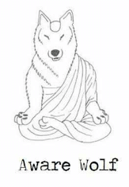
Polymorphism Details
Children may appear as parents
Why?
Comparable example
as long has the objects implements Comparable – it can call compareTo method
Type determines which methods can be called
Also determines how things are stored
AbstractAnimal great = new Tiger();
Feline great2 = new Tiger();
Tiger tony = new Tiger();
All valid, but is
great.canSwim();
No! – You must cast as the object with the method

Slide 5
Architecture Style Thinking
To be successful
You draft your program layout (UML)
You visualize the program
You build before coding!
Inheritance
Is about building blocks
It is about keeping things DRY
Technically
You can avoid it, but life becomes hard
Easier to use, practice and then embrace

