Slide 1
Binary States

Slide 2
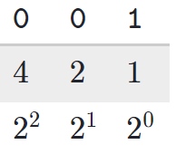
Bits and Numbers
Key Point
With only three “bits” we can represent 8 values. An efficient use of space.
We assign values based on location
Every location can have 2 values (0 or 1)
First spot - even or odd
Second spot - 2
Third spot - 4
3 bits can represent 8 different things (0-7)
000 =
0
001 =
1
110 =
6
111 =
7
1001 =
9
1111 =
15

Slide 3

Bits and Numbers
If we have 4 bits, how many different things can we represent?
And with 8?
8 bits = 1 byte, basic unit of information
128
32
8
2
170

