Slide 1
The Final Frontier Variable, Types & Modulo

Slide 2
Announcements
Opening Question
Are there any habits you have developed over the past 4 weeks that you want to improve / change going into the rest of the semester?
How are you going to hold yourself accountable to building better habits?
Practical 1 - Due Tuesday
Practical 2 – START on it Tuesday
It is meant to take 2 weeks
First program from scratch – remember, take it in small steps.
Do you code on your laptop? Bring it to lab Tuesday. The TAs will help you install IntelliJ if you are stuck.
Guide on installing it is on the website/syllabus – resources page
Canvas Exam 1 Retake via Online Proctoring
First show:
100% Knowledge Checks
100% Readings
80% for labs
Then
Message Instructor on Teams – will enable another attempt
ACM Board Game Night
When: Wednesday, September 22 at 6:00pm
Where: Computer Science Building room 130
RSVP: https://forms.gle/UejirB4uDCJoRhGK9
ACM-W – No meeting, officer meeting only (but others welcome – so ask if interested! )

Slide 3
How to be successful
Make sure the reading is done BEFORE lecture
Really, just the participation, but make sure it is done
Look at the labs before attending lab
Make sure to think about what you need to do
Pro Tip: write what you need to do as comments in each method
Pro Tip: Only write a few lines at a time, sometimes coding something ‘similar’
Pick a Knowledge Check – at random – 3-5 nights a week!
Don’t spend more than 20 minutes
If stuck
Ask about it in general channel!
Copy the code, add variables and print lines to figure out what is going on (changing variables works great also)
They provide you samples of code, and help you better understand how it is all working – they benefit you in multiple ways!
Practiced Recall (testing) spread throughout the week is the single most effective way to study no matter the course
ATTEND LECTURE
Really, the most common problems wrong on the exam…
Are problems we covered in lecture, either as a reading check, or part of the review!
So those who attended lecture, got the answers!

Slide 4
Reading Check
public class Hero {
public static final String LEAGUE = “HERO”;
public String powerLookup(int which) {
final String rtn = LEAGUE + “: Flight”;
if(which < 0) {
rtn = LEAGUE + “: Laser Eyes”;
}
return rtn;
}
public static void main(String[] args) {
System.out.println(Hero.LEAGUE);
Hero.LEAGUE = “Villain”;
Hero ajax = new Hero(); // must build the object
System.out.println(ajax.powerLookup(-1));
}
}
Will this code compile?
A – Yes
B – No
C – Not sure
We will come back to this in a few slides.

Slide 5
Variable Reminder
Variables have TYPE
Variables are named
Declaration
TYPE variableName;
Setting Values
variableName = VALUE;
Initialization
Defined as the first time a variable is set.
Ex:
int doctors = 13;
String drName = “Who”;
What if we did not want to change it after initializing it?

Slide 6
How to fix a value?
Pro Tip
We often capitalize final variables, especially those that are public. It is a standard naming convention for easy reading.
When we declare variables, we can reset the values
What if we don’t want to reset the value?
For example, PI is fixed
Introducing..
final
The compiler will throw an error on changing a final variable
Examples:
final int coinSides = 2;
public final double PI = 3.14;
Another note:
public means other classes can access that variable!
Only used at the top of the class, not inside a method.

Slide 7
Let’s Look At Code
public class Hero {
public static final String LEAGUE = “HERO”;
public String powerLookup(int which) {
final String rtn = LEAGUE + “: Flight”;
if(which < 0) {
rtn = LEAGUE + “: Laser Eyes”;
}
return rtn;
}
public static void main(String[] args) {
System.out.println(Hero.LEAGUE);
Hero.LEAGUE = “Villain”;
Hero ajax = new Hero(); // must build the object
System.out.println(ajax.powerLookup(-1));
}
}
league is accessible by all other classes by saying
Hero.LEAGUE
Since it is static and public, not because it is final. However, other classes can’t change it since it is final.
This code would not compile
the compiler would error on the code in the if block
it is trying to *reset* the value in rtn
rtn is declared as final
Will not compile
Will not compile

Slide 8
Numeric Data Types

Slide 9
Variables have TYPE
double myValue = 0.0;
int myInt = 1;
What is the value of a TYPE?
Why do we have it?

Slide 10

Reminder on Binary and Memory
Binary – two state system
1 for on
0 for off
Each 0 and 1 is called a bit
8 bits is called a byte
Contains 255 states (128+64+32+16+8+4+2+1)
1000 bytes is a kilobyte
1,000,000 bytes is a megabyte
A song is often 3-5 megabytes
Issues
What if I want negative numbers?
You make the left most bit indicate sign and center
255 states become, -128 to 127
What if you need more than that range?
0
0
1
1
1
1
1
0
1
1
2
0
0
0
0
1
0
This Photo by Unknown Author is licensed under CC BY-SA
4
1
0
0
1
8
0
Pro Tip
There is an interactive byte in zybooks. Play with it until you start to see it.
0
0
0
1
16
0
0
0
0
1
32
0
0
0
0
1
64
0
0
0
0
1
128
1
Ask in general channel on teams
on the how for the -128 to 127

Slide 11
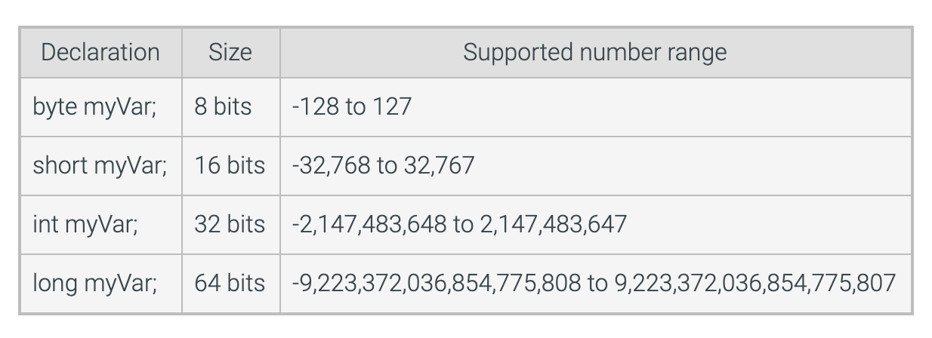
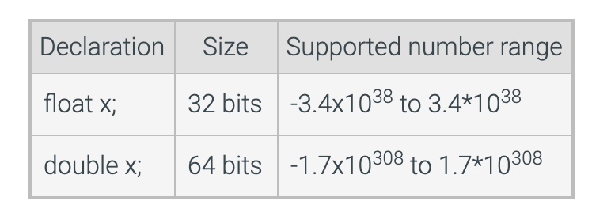
Numeric Types

Slide 12
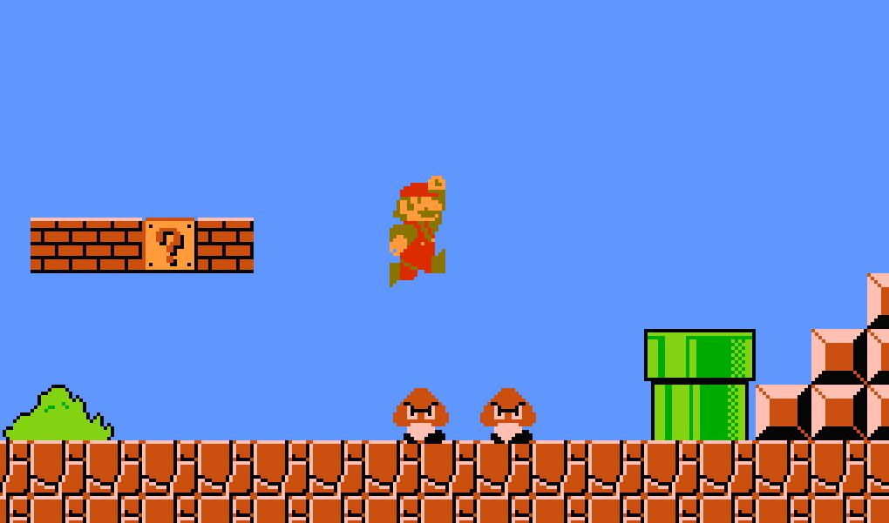
Practice: Why Different Types?
Numeric Types
byte
short
int
long
float
double
8-bit graphics, only 255 color options
If you wanted to represent the national debt?
double
If you wanted to represent color codes on a limited memory system?
short or even byte (8-bit graphics!)
World population projected over time
long
Grades in a grade book for all students on campus?
float
Why use int for loops?
Processors are optimized for int, so if memory is not a concern, use that. Also, not held in long
term memory

Slide 13
The Modulo

Slide 14
Review On Operators
Basic Math Operators
+ (add)
- (minus)
/ (divide)
* (multiply)
= (sets a value to variable)
Follow order of precedence
We also have conditional operators
Will cover this again.

Slide 15

Reminder - Integer Division
You may have realized
int val = 5 / 6; // sets val to 0
int val2 = 10 / 3; // sets val2 to 3
You lose the decimal point
Truncates, does not round!
This is a very, very common thing
both to our advantage
and often to our error
This Photo by Unknown Author is licensed under CC BY-NC-ND

Slide 16
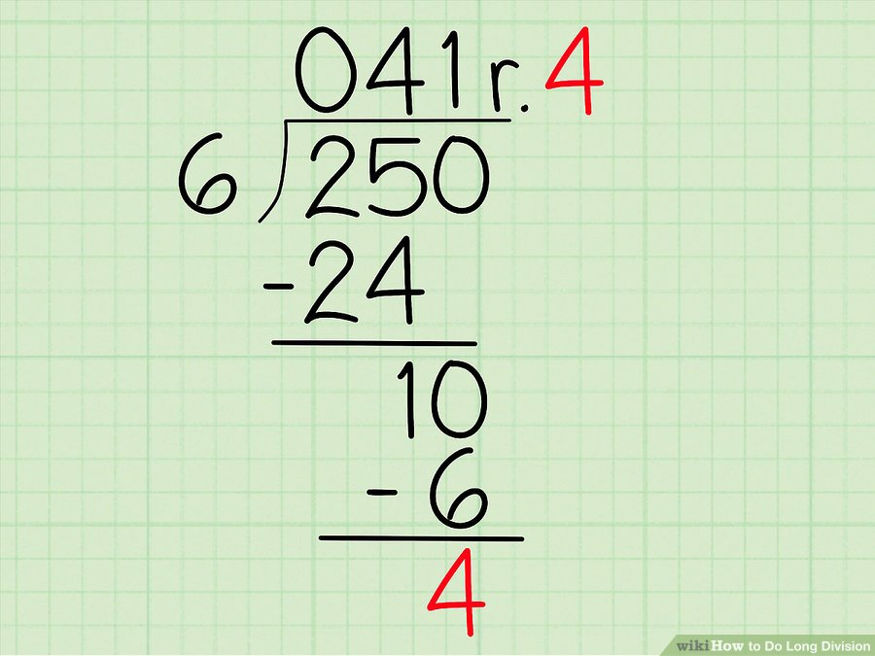
Modulo - Extremely useful operation
modulo (%) gives you the remainder
4th grade math!
This example: int x = 250 % 6; // would be 4 So combining them int whole = 250 / 6; //41 int remainder = 250 % 6; // 4

Slide 17

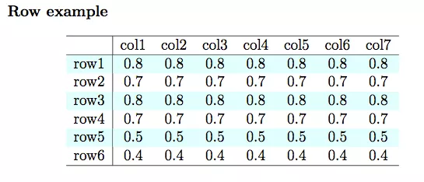
What are some cases to use it?
Forming groups
The remainder is always between 0 and n-1
Value % 6 has a range of 0-5
Value % 4 has a range of 0-3
Think about rolling dice
Math.random() % 6; - random number between 0 and 5
Determining Even and Odd - Math.random() %2 - if 0, even, if 1, odd
Pro Tip
Adding a remainder operator, allows us to handle complex math like GCD and others.

Slide 18
Convenience Operators
We often find ourselves doing things like
int value = 100
value = value + 10;
Introducing operator plus assignment
value += 10; // same as value = value + 10;
+=
-=
/=
*=
%=
We also like to add and subtract by 1
--value and ++value
value++ and value—
Happens after using the value
Examples:
int value = 100;
value++; // value is now 101
value += 10; // value is now 111
value /= 10; // value is now 11
value *= 2; // value is now 22
--value; // value is now 21
value %= 20; // value is now 1

Slide 19
Practice
Write a method that utilizes both division using an int, and modulo
Have the person next to you explain what they think it does
and then run it to see if that works as you think!

