Slide 1
Arrays

Slide 2

Announcements
TODO Reminders:
Readings are due before lecture
Reading 20 (zybooks) – you should have already done that ☺
Lab 13
Reading 21 (zyBooks) – you should have already done that ☺
Lab 14 – optional because of snow day
Reading 22 (zybooks) – you should have already done that ☺
RPA 10
Keep practicing your RPAs in a spaced and mixed manner ☺
https://stock.adobe.com/search/images?k=%22happy+friday%22
Help Desk
Day | Time : Room
Monday | 12 PM - 2 PM : CSB 120
Tuesday | 6 PM - 8 PM : Teams
Wednesday | 3 PM - 5 PM : CSB 120
Thursday | 6 PM - 8 PM : Teams
Friday | 3 PM - 5 PM : CSB 120
Saturday | 12 PM - 4 PM : Teams
Sunday | 12 PM - 4 PM : Teams

Slide 3
Recalling The Past
For every value you want to store
You need a variable
What if you want to store 100 values? 10,000 values?
Use ArrayLists for storing object
But how about primitive types?
Introducing Arrays
Reserving memory for storing values, in order from the 0 index
Sound Familiar - Recall String
The String object contains
chars in order!
It is a character array!
0
k
1
i
2
n
3
n
4
i
5
k
6
i
7
n
8
n
9
i
10
k

Slide 4
Basic Array
char[] palindrome = {‘k’, ‘i’, ‘n’, ‘n’, ‘i’, ‘k’}; // ok shorter version
builds an array with six elements.
with those values in the memory locations
Another way:
char[] palindrome = new char[6]; // declare the size of the array (more common)
palindrome[0] = ‘k’;
palindrome[1] = ‘i’;
palindrome[2] = ‘n’;
palindrome[3] = ‘n’;
palindrome[4] = ‘i’;
palindrome[5] = ‘k’;

Slide 5
Arrays are Mutable
Elements in the array can be changed / reset!
char[] palindrome = {‘k’, ‘i’, ‘n’, ‘n’, ‘i’, ‘k’};
palindrome[0] = ‘c’;
palindrome[2] = ‘i’;
System.out.println(Arrays.toString(palindrome)); // prints [c,i,i,n,i,k]

Slide 6
Arrays can be any type!
String[] rhps = new String[10];
rhps[0] = “brad”;
rhps[1] = “janet”;
rhps[2] = “magenta”;
rhps[3] = “columbia”;
rhps[4] = “riff-raff”;
rhps[5] = “eddie”;
rhps[6] = “scott”;
rhps[7] = “frankie”;
rhps[5] = “rocky”;
System.out.println(Arrays.toString(rhps));
int[] values = new int[100];
default values are 0
true for numeric primitives
String[] names = new String[10];
default values are null
true for all objects
Format is:
TYPE[] name = new TYPE[size];
[brad, janet, magenta, columbia, riff-raff, rocky, scott, frankie, null, null]

Slide 7
Array Length
Array size allocated to size 10
0..9 indices valid
rhps[20]
throws IndexOutOfBoundsException!
How to check for that?
.length
notice no parenthesis, command, not a method
rhps.length
returns 10
which means
we always know the 1st index (0)
and the last (rhps.length-1)
no matter the size of the array
String[] rhps = new String[10];
rhps[0] = “brad”;
rhps[1] = “janet”;
rhps[2] = “magenta”;
rhps[3] = “columbia”;
rhps[4] = “riff-raff”;
rhps[5] = “eddie”;
rhps[6] = “scott”;
rhps[7] = “frankie”;
rhps[20] = “rocky”; // error!

Slide 8
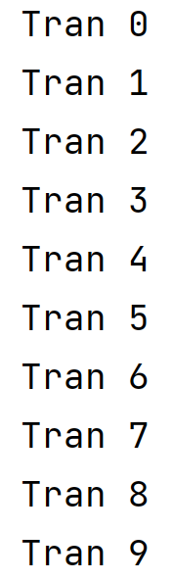
Loops and Arrays
What is going to be printed?
String[] tran = new String[10];
for(int i = 0; i < tran.length; i++) {
tran[i] = String.format(“Tran %d”, i);
}
for(int i = 0; i < tran.length; i++) {
System.out.println(tran[i]);
}

Slide 9
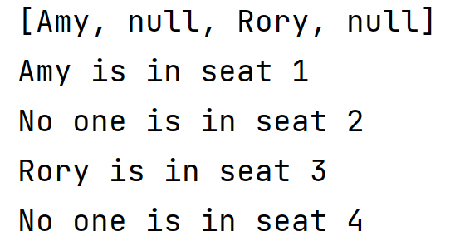
Loops and Arrays
What is going to be printed?
String[] seats = new String[4];
seats[0] = "Amy";
seats[2] = "Rory";
System.out.println(Arrays.toString(seats));
for(int i = 0; i < seats.length; i++) {
System.out.printf("%s is in seat %d%n", seats[i] != null ? seats[i] : "No one", i+1);
}

Slide 10
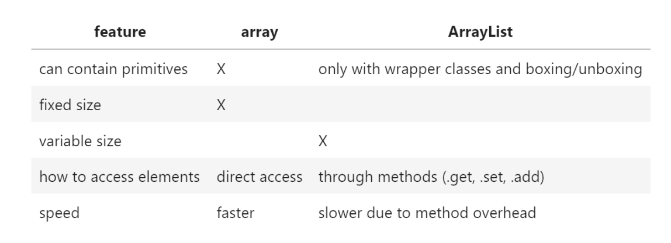
Arrays versus ArrayLists
ArrayLists are lists that use Array as the underlining structure
Arrays are just how you declare a group of objects in order
ArrayList is an individual object someone wrote

Slide 11
When use arrays over ArrayLists?
When your size is fixed, arrays are much faster to use!
When you need to keep order on sparsely populated datasets (that are often fixed sizes)
[value, null, null, null, value, null, value]
They are used about equally, just depends on what you are doing.

Slide 12
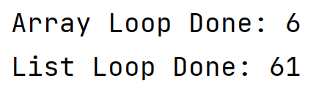
When use arrays over ArrayLists?
long[] values = new long[1000000];
Instant start = java.time.Instant.now();
for(int i = 0; i < values.length; i++) {
values[i] = i * 10l;
}
Instant end = java.time.Instant.now();
System.out.println("Array Loop Done: " + java.time.Duration.between(start, end).toMillis());
List<Long> valList = new ArrayList<>(); // remember polymorphism use List
start = java.time.Instant.now();
for(int i = 0; i < 1000000; i++) {
valList.add(i*10l);
}
end = java.time.Instant.now();
System.out.println("List Loop Done: " + java.time.Duration.between(start, end).toMillis());
//note this is not really the best way to determine the time between algorithms just an example

Slide 13
Worksheet
Do the arrays worksheet.
In class code and worksheet code - https://github.com/CSU-CompSci-CS163-4/Handouts/tree/main/ClassExamples/10Arrays

