Slide 1
Reading Files

Slide 2

Announcements
NEXT WEEK
Exam 2
Don’t procrastinate
and catch up if you need!
TODO Reminders:
Readings are due before lecture
Reading 14 (zybooks) – you should have already done that ☺
Lab 09 – go to your lab to have the participation points
Reading 15 (zyBooks)
Lab 10 – go to your lab to have the participation points
Reading 16 (zybooks)
RPA 7
Keep practicing your RPAs in a spaced and mixed manner ☺
Help Desk
Day | Time : Room
Monday | 12 PM - 2 PM : CSB 120
Tuesday | 6 PM - 8 PM : Teams
Wednesday | 3 PM - 5 PM : CSB 120
Thursday | 6 PM - 8 PM : Teams
Friday | 3 PM - 5 PM : CSB 120
Saturday | 12 PM - 4 PM : Teams
Sunday | 12 PM - 4 PM : Teams

Slide 3
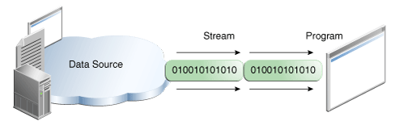
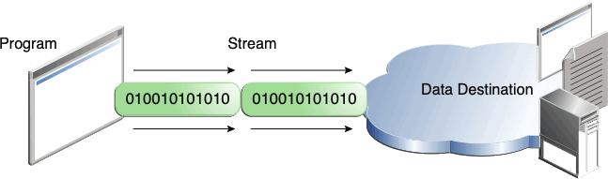
I/O Streams
https://docs.oracle.com/javase/tutorial/essential/io/streams.html
A stream is a sequence of data.
A program uses an input stream to read data from a source, one item at a time:
A program uses an output stream to write data to a destination, one item at time:

Slide 4
OutputStream
System.out is a predefined OutputStream object reference that is associated with a system's standard output, usually a computer screen.
The print() and println() methods are overloaded in order to support the various standard data types, such as int, boolean, float, etc., each method converting that data type to a sequence of characters.

Slide 5
InputStream
System.in is an input byte stream
When using an InputStream, a programmer must append the clause throws IOException when using the method read()
A throws clause tells the Java virtual machine that the corresponding method may exit unexpectedly due to an exception, which is an event that disrupts a program's execution.
Instead of reading a byte stream, dealing with IOException, and after it converting the data to a String or other data types, we have been using the Wrapper class named Scanner ☺
Scanner scnr = new Scanner(System.in);
automatically scanning a sequence of bytes and converting those bytes to the desired data type depending on the type of method we use to read the data (nextLine(), nextInt(), etc.)

Slide 6
Scanner – reading from a String
When we want to read something from the terminal we use:
Scanner scnr = new Scanner(System.in);
The parameter System.in indicates that we are reading from the terminal.
Sometimes we may want to read something from a String, so instead of using System.in as a parameter we have a String as a parameter
String line = "Let me be that I am and seek not to alter me.\n-Thank you!"; Scanner scanner = new Scanner(line);

Slide 7
Scanner – reading from a String
public class ScannerString { public static void main(String args[]){ String line = "Let me be that I am and seek not to alter me.\n-Thank you!"; Scanner scanner = new Scanner(line); int tokenCounter = 0; while(scanner.hasNext()) { tokenCounter++; System.out.println(scanner.next()); } System.out.println(tokenCounter); } }
.hasNext() – returns true if the scanner has another token in its input
.next() – finds and returns the next complete token from this scanner.
Each token is separated by a delimiter, default delimiter is whitespace.

Slide 8
Scanner – What is printed?
public class ScannerString { public static void main(String args[]){ String line = "Let me be that I am and seek not to alter me.\n-Thank you!"; Scanner scanner = new Scanner(line); int tokenCounter = 0; while(scanner.hasNext()) { tokenCounter++; System.out.println(scanner.next()); } System.out.println(tokenCounter); } }
Let
me
be
that
I
am
and
seek
not
to
alter
me.
-Thank
you!
14

Slide 9
Scanner – reading from a String
import java.util.Scanner; public class ScannerString { public static void main(String args[]){ String line = "Let me be that I am and seek not to alter me.\n-Thank you!"; Scanner scanner = new Scanner(line); int lineCounter = 0; while(scanner.hasNext()) { lineCounter++; System.out.println(scanner.nextLine()); } System.out.println(lineCounter); } }
.hasNext() – returns true if the scanner has another token in its input
.nextLine() – advances this scanner past the current line and returns the input that was skipped

Slide 10
Scanner – What is printed?
import java.util.Scanner; public class ScannerString { public static void main(String args[]){ String line = "Let me be that I am and seek not to alter me.\n-Thank you!"; Scanner scanner = new Scanner(line); int lineCounter = 0; while(scanner.hasNext()) { lineCounter++; System.out.println(scanner.nextLine()); } System.out.println(lineCounter); } }
Let me be that I am and seek not to alter me.
-Thank you!
2

Slide 11
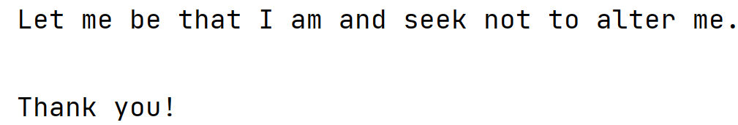
Scanner – reading from a String
import java.util.Scanner; public class ScannerString { public static void main(String args[]){ String line = "Let me be that I am and seek not to alter me.\n-Thank you!"; Scanner scanner = new Scanner(line); scanner.useDelimiter("-"); int otherCounter = 0; while(scanner.hasNext()) { otherCounter++; System.out.println(scanner.next()); } } }
.useDemiter(String) - Sets this scanner's delimiting pattern to a pattern constructed from the specified String
What is printed now?

Slide 12
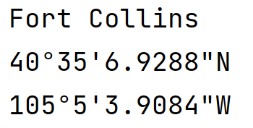
Scanner – what is printed?
import java.util.Scanner; public class StringLocation { public static void main(String args[]){ String location = "Fort Collins,40°35'6.9288\"N,105°5'3.9084\"W"; Scanner locScan = new Scanner(location); locScan.useDelimiter(","); String city = locScan.next(); String lat = locScan.next(); String lon = locScan.next(); System.out.println(city); System.out.println(lat); System.out.println(lon); } }

Slide 13
Scanner – different uses
Input Streams
System.in
Strings
File
FileInputStream
When we want to read something from the terminal we use:
Scanner scnr = new Scanner(System.in);
The parameter System.in indicates that we are reading from the terminal.
When we want to read something from a String we use:
String line = "Let me be that I am and seek not to alter me.\n-Thank you!"; Scanner scanner = new Scanner(line);
What happens if instead of reading from the terminal or a String, we want to read from a file?
We need to use the File class!
And pass an object of File as a parameter instead of System.in or a String when we construct a Scanner object

Slide 14
Scanner – reading from a File Basic Structure
import java.io.File; import java.io.IOException; import java.util.Scanner; public class FileReadingBasicStructure { public static void readFile(String fileName){ try { Scanner fileIn = new Scanner(new File(fileName)); // now the file is in a scanner, and looping matters! while(fileIn.hasNext()) { // could also use hasNextLine() System.out.println(fileIn.nextLine()); } }catch(IOException ex) { // there was an error finding the file or reading the file! // so how do you hand that? For now, we just say that and end the //program System.err.print("Error reading file!"); ex.printStackTrace(); } } public static void main(String args[]){ readFile("file.txt"); } }
Creates a Scanner from a file
While still has elements
Reads the line
Test for the exception

Slide 15
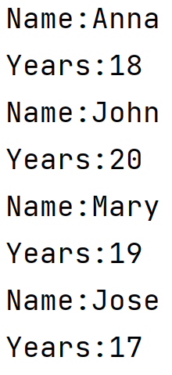
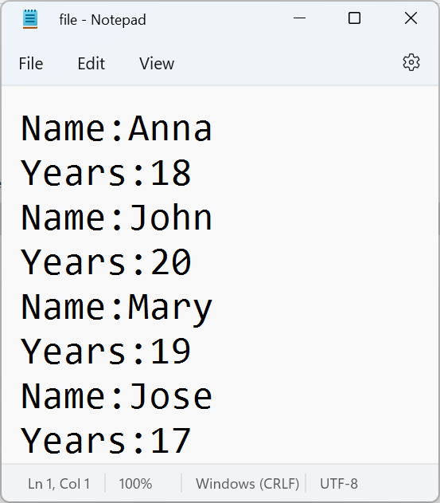
What is printed?
import java.io.File; import java.io.IOException; import java.util.Scanner; public class FileReadingBasicStructure { public static void readFile(String fileName){ try { Scanner fileIn = new Scanner(new File(fileName)); // now the file is in a scanner, and looping matters! while(fileIn.hasNext()) { // could also use hasNextLine() System.out.println(fileIn.nextLine()); } }catch(IOException ex) { // there was an error finding the file or reading the file! // so how do you hand that? For now, we just say that and end the //program System.err.print("Error reading file!"); ex.printStackTrace(); } } public static void main(String args[]){ readFile("file.txt"); } }

Slide 16
Reading from a File and Creating Objects to add into an ArrayList
public class Person { private String name; private int yearsOld; public Person(String name){ setName(name); setYearsOld(0); } public Person(String name, int years){ setName(name); setYearsOld(years); } public void setName(String name){ this.name = name; } public void setYearsOld(int years){ yearsOld = years; } public String getName(){ return name; } public int getYearsOld(){ return yearsOld; } public String toString(){ return "Name: " + name + " Years Old: " + yearsOld; } }

Slide 17
Reading from a File and Creating Objects to add into an ArrayList
public static ArrayList<Person> readFilePerson(String fileName){ ArrayList<Person> list = new ArrayList<>(); try { Scanner fileIn = new Scanner(new File(fileName)); String name = ""; int years = 0; int index = 0; int lineNumber = 0; while(fileIn.hasNext()) { String line = fileIn.nextLine(); if(line.contains("Name")){ index = line.indexOf(":"); name = line.substring(index+1, line.length()); lineNumber++; } else if (line.contains("Years")){ index = line.indexOf(":"); years = Integer.parseInt(line.substring(index+1, line.length())); lineNumber++; }
if(lineNumber == 2){ Person p = new Person(name, years); list.add(p); lineNumber = 0; } } }catch(IOException ex) { System.err.print("Error reading file!"); ex.printStackTrace(); } return list; } public static void main(String args[]){ ArrayList<Person> lst = readFilePerson("file.txt"); System.out.println(lst); }

