Slide 1
More Loops

Slide 2

Announcements
NEXT WEEK
Exam 2
Don’t procrastinate
and catch up if you need!
TODO Reminders:
Readings are due before lecture
Reading 14 (zybooks) – you should have already done that ☺
Lab 09 – go to your lab to have your participation points
Reading 15 (zyBooks) – you should have already done that ☺
Lab 10 – go to your lab to have your participation points
Reading 16 (zybooks)
RPA 7
Keep practicing your RPAs in a spaced and mixed manner ☺
https://www.linkedin.com/pulse/end-day-we-can-endure-much-more-than-think-beatriz-alvarado/
Help Desk
Day | Time : Room
Monday | 2 PM - 5 PM : CSB 120
Tuesday | 6 PM - 8 PM : Teams
Wednesday | 3 PM - 5 PM : CSB 120
Thursday | 6 PM - 8 PM : Teams
Friday | 3 PM - 5 PM : CSB 120
Saturday | 12 PM - 4 PM : Teams
Sunday | 12 PM - 4 PM : Teams

Slide 3
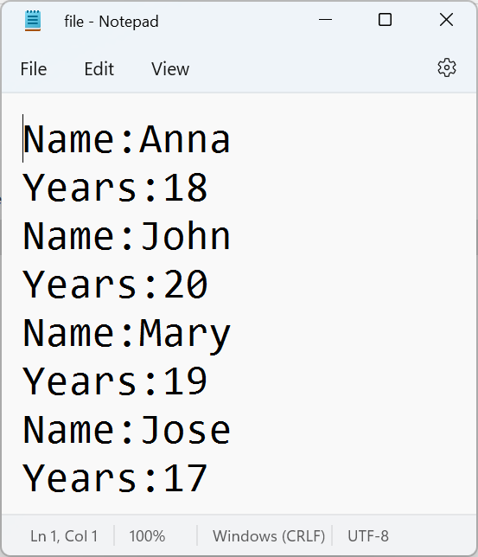
Review – How to read and print from a file
public static void readFile(String fileName){ try { Scanner fileIn = new Scanner(new File(fileName)); while(fileIn.hasNext()) { String line = fileIn.nextLine(); System.out.println(line); } }catch(IOException ex) { System.err.print("Error reading file!"); ex.printStackTrace(); } }

Slide 4
Review – How to parse the String to get specific content
public static void readFile(String fileName){ try { Scanner fileIn = new Scanner(new File(fileName)); while(fileIn.hasNext()) { String lineName = fileIn.nextLine(); String lineYear = fileIn.nextLine(); String name = parse(lineName); String year = parse(lineYear); System.out.println(name); System.out.println(year); } }catch(IOException ex) { System.err.print("Error reading file!"); ex.printStackTrace(); } } public static String parse(String line) { //.trim() removes any spaces that we have at the //begin or end of the string return line.substring(line.indexOf(":") + 1).trim(); }

Slide 5
Review – How to create an object from the specific content
public static ArrayList<Person> readFile(String fileName){ ArrayList<Person> lst = new ArrayList<>(); try { Scanner fileIn = new Scanner(new File(fileName)); while(fileIn.hasNext()) { String lineName = fileIn.nextLine(); String lineYear = fileIn.nextLine(); String name = parse(lineName); String year = parse(lineYear); Person p = new Person(name, Integer.parseInt(year)); lst.add(p); } }catch(IOException ex) { System.err.print("Error reading file!"); ex.printStackTrace(); } return lst; } public static String parse(String line) { //.trim() removes any spaces that we have at the //begin or end of the string return line.substring(line.indexOf(":") + 1).trim(); }

Slide 6
Recall Activity – Different Types of Loops
What is the output of each one of those loops?
1)
for(int x = 0; x < 100; x++) {
System.out.println(x);
}
3)
int counter = 10;
String tracker = "Track:";
do {
tracker += " " + counter;
}while(++counter < 11);
System.out.println(counter);
System.out.println(tracker);
2)
int count = 10;
while(--count > 0) {
// block of code to repeat
// notice, --count is valid
System.out.print(count + “ ”);
}

Slide 7


What is printed in each case?
Why that happened?
1)
int counter = 10;
String tracker = "Track:";
do {
tracker += " " + counter;
}while(++counter < 11);
System.out.println(counter);
System.out.println(tracker);
2)
int counter = 10;
String tracker = "Track:";
do {
tracker += " " + counter; }while(counter++ < 11); System.out.println(counter); System.out.println(tracker);

Slide 8
Incrementor and Decrementor
++ or -- BEFORE the variable means
add or subtract by 1, and then use the modified variable
++ or -- AFTER the variable means
use the value in the variable, and then add or subtract by one modifying the variable

Slide 9
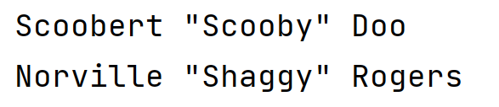
Incrementor Example – What is printed?
public class TrackerExample { private ArrayList<String> values; private int current = 0; public TrackerExample(ArrayList<String> toTrack) {
values = toTrack; } public String getCurrent() { return values.get(current++); } }
public class AppTracker { public static void main(String args[]){ ArrayList<String> students = new ArrayList<>(); students.add("Scoobert \"Scooby\" Doo"); students.add("Norville \"Shaggy\" Rogers"); students.add("Daphne Blake"); students.add("Velma Dinkley"); students.add("Fred Jones"); TrackerExample tracked =
new TrackerExample(students); System.out.println(tracked.getCurrent()); System.out.println(tracked.getCurrent()); } }

Slide 10
Are those methods equivalent?
public String getCurrent() { return values.get(current++); }
public String getCurrent() { String tmp = values.get(current); current += 1; return tmp; }

Slide 11
Do While Loop
A unique loop
For and While – both check and then run
Do-While
runs block of code and then checks
Guarantees at least one run
Format:
do {
//code block
} while(condition);
loops while condition is true
Scanner scnr = new Scanner(System.in);
int x;
do {
System.out.print(“Please enter a number: ”);
x = scrn.nextInt();
System.out.println();
}while(x < 10);
What this do…while is doing?
It is validating the number read,
the number needs to be greater or
equal than 10 to be valid.

Slide 12
Changing loop order: Break / Continue
break
allows to break out of the loop completely (early exit)
continue
allows us to move back to the top of the code block
with for loop, the incrementor is still completed
for(int x = 0; x < 100; x++) {
if(x == 10) break;
System.out.print(x);
}
for(int x = 1; x < 10; x++) {
if(x%2 == 0) continue;
System.out.print(x);
}
0123456789
13579

Slide 13

Nesting Loops
What is printed?
for (char c = 'A'; c < 'D'; c++) {
System.out.print("Seat:");
for (int i = 0; i < 2; i++) {
System.out.print(" " + c + i);
}
System.out.println();
}
What code would I want to change if I wanted to make 3 seats per row?
What code would I change if I wanted to add another row?

Slide 14
Do the Worksheet for Today’s class
Worksheet is also available on Canvas

