Slide 1
ArrayList

Slide 2

Announcements
TODO Reminders:
Readings are due before lecture
Reading 11 (zybooks) – you should have already done that ☺
Lab 07 – be on lab to have your participation points
Reading 12 (zyBooks)
Lab 08 – be on lab to have your participation points
Reading 13 (zybooks)
RPA 6
Keep practicing your RPAs in a spaced and mixed manner ☺
https://thestrive.co/100-best-effort-quotes-to-help-you-win-in-life/
Help Desk
Day | Time : Room
Monday | 12 PM - 2 PM : CSB 120
Tuesday | 6 PM - 8 PM : Teams
Wednesday | 3 PM - 5 PM : CSB 120
Thursday | 6 PM - 8 PM : Teams
Friday | 3 PM - 5 PM : CSB 120
Saturday | 12 PM - 4 PM : Teams
Sunday | 12 PM - 4 PM : Teams

Slide 3
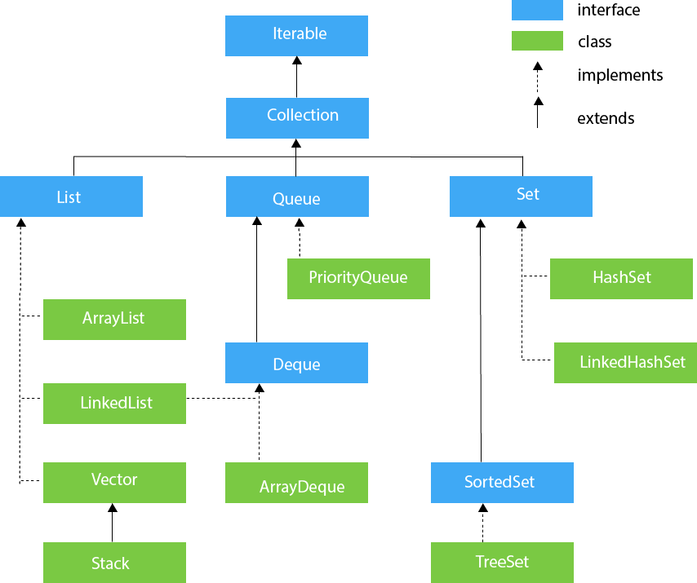
Collections
A collection represents a group of objects, known as its elements.
Some collections allow duplicate elements and others do not. Some are ordered and others unordered.
It is an Interface
We will learn more later
For now, an interface specifies a set of behaviors (methods) that other classes needs to implement.

Slide 4
List
An ordered collection (also known as a sequence).
The user of this interface has precise control over where in the list each element is inserted.
The user can access elements by their integer index (position in the list), and search for elements in the list.

Slide 5
ArrayList
Resizable-array implementation of the List Interface.
Each ArrayList instance has a capacity.
Capacity is the size of the array used to store the elements.
When an instance of an ArrayList reaches its capacity, the instance grown automatically (resize), by doubling its initial capacity.

Slide 6
Collections CS1 and CS2
CS1
CS2

Slide 7
ArrayList in Code
public class Box { private int width; private int height; private int length;
/** getters and setters **/ public int getArea() { return getHeight()*getLength()*getWidth(); } //… }
construct ArrayList object
ArrayList<Box> boxList = new ArrayList<>();
boxList.add(new Box(10,3,4)); boxList.add(new Box(5, 5, 5)); boxList.add(new Box(10,3,13));
for(Box box : boxList) { System.out.println(box); }
System.out.println(boxList.size());
boxList.remove(2); // element in position 2
System.out.println(boxList.size());
Tells us which type
Add elements (must use add)
For-each is ideal for iteration!
size == 3 actually counts elements
remove elements
size == 2

Slide 8
ArrayList in Code
ArrayList<Box> boxList = new ArrayList<>();
Creates a space to store 10 Boxes, all elements are null.
ArrayList@7ba7
index | object
0 | null
1 | null
2 | null
3 | null
4 | null
5 | null
6 | null
7 | null
8 | null
9 | null
Memory Stack
variable | value
boxList | ArrayList@7ba7

Slide 9
ArrayList in Code
public class Box { private int width; private int height; private int length;
/** getters and setters **/ public int getArea() { return getHeight()*getLength()*getWidth(); } //… }
boxList.add(new Box(10,3,4)); boxList.add(new Box(5, 5, 5)); boxList.add(new Box(10,3,13));
ArrayList@7ba7
index | object
0 | Box@01
1 | Box@02
2 | Box@03
3 | null
4 | null
5 | null
6 | null
7 | null
8 | null
9 | null
Memory Stack
variable | value
boxList | ArrayList@7ba7
Box@01
width | 10
height | 3
length | 4
Box@02
width | 5
height | 5
length | 5
Box@03
width | 10
height | 3
length | 13

Slide 10
Wrapper Classes
ArrayList<Integer> list = new ArrayList<>(); list.add(10); list.add(2); list.add(-1);
int total = list.get(0) + list.get(1); System.out.println(total); // prints 12
ArrayList
Only Stores Objects
Wrapper Classes to the rescue
int has Integer
double has Double
boolean has Boolean
char has Character
(and so on)
Boxing and Unboxing
Allows automatic conversion between wrapper and primitive
Integer myInt = 10;
Same as Integer myInt = new Integer(10);
A simplest representation:
[10, 2, -1]
That is actually how it is going to be printed if you print the ArrayList reference.

Slide 11
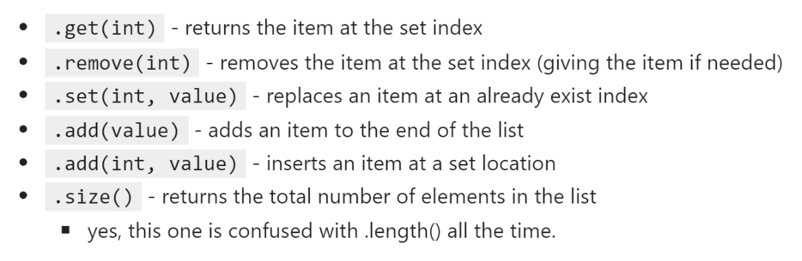
ArrayList: Some Methods
https://docs.oracle.com/javase/8/docs/api/java/util/ArrayList.html

Slide 12
For Each
for(Type element: list)
Get all the elements that are in a list starting from the begin until the end
ArrayList<Integer> list = new ArrayList<>(); list.add(10); list.add(2); list.add(-1);
for(Integer element: list)
System.out.println(element);

Slide 13
Example
import java.util.ArrayList; public class ArrayListInts { public static void main(String args[]){ //creates an Arraylist named lst with 10 initial capacity ArrayList<Integer> lst = new ArrayList<>(); lst.add(11); lst.add(20); lst.add(40); lst.add(33); System.out.println("Size of the list: " + lst.size()); for(int i = 0; i < lst.size(); i++){ System.out.println("Index: " + i + " Element: " + lst.get(i)); } System.out.println("Remove element from index 2"); lst.remove(2); System.out.println("Size of the list: " + lst.size()); for(int i = 0; i < lst.size(); i++){ System.out.println("Index: " + i + " Element: " + lst.get(i)); }
System.out.println("Add 1 in index 0"); lst.add(0, 1); System.out.println("Size of the list: " + lst.size()); for(Integer elem: lst){ System.out.println(elem); } System.out.println("Remove 1 from the list"); lst.remove((Integer)1); System.out.println("Size of the list: " + lst.size()); for(int i = 0; i < lst.size(); i++){ System.out.println("Index: " + i + " Element: " + lst.get(i)); } } }
What is the difference between
lst.remove((Integer)1); and
lst.remove(1); instructions?

