Slide 1
Java Exceptions

Slide 2
Announcements
Opening Question:
How are you feeling about working with files?
Terryn is excited to add this additional in-person time, so please make sure to use it!
Wednesday
2:00-3:00 PM
Computer Science Building - 315 (third floor lab)
Todo:
Practical 3 – finish it this week
Practical 4 – start as soon as you finish Practical 3!

Slide 3
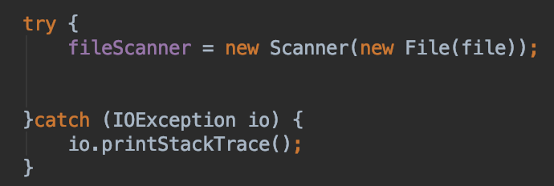
Controlling Exceptions
We can’t control every possible error situation
For example:
What happens if the file is not there?
What if you don’t have permission to read it?
Not just files
What about network connections?
What if printers aren’t there?
Introducing
try – catch
and exception handling

Slide 4
Try - Catch
try
try a block of code.
If it runs properly, great!
catch
an exception happened!
run the catch block of code
throws
allows you to “throw” the exception
requires someone else to handle it
Exception
an object / class we use for errors!
You can write you own
or use built in cases
Checked (compile time) or Unchecked (run time)
Checked requires try/catch/throws
IOException - Input / output exception - checked
FileNotFoundException - Subset of IOException, but allows you to specify exactly that it is file not found - checked
ArrayIndexOutOfBoundsException - you don’t usually try/catch this, but you can - unchecked
NullPointerException - you don’t usually try/catch this - unchecked
NumberFormatException - Shows up when you take a string that doesn’t look like a number, and try to make it a number - unchecked

Slide 5
Recall Discussion
What lines of code are needed to read in a file or write out a file?
Use zybooks/labs/previous slides to figure it out
Now, look at the exception block..
Can you tell the difference between – FileNotFound or if some other error happened (like you don’t have permission)?

Slide 6
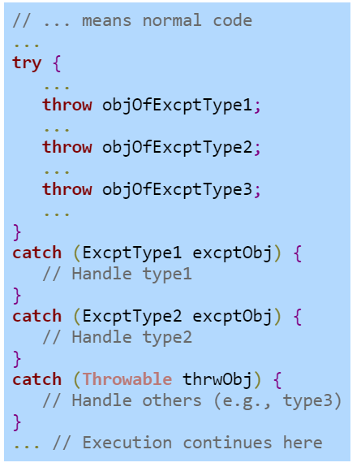
Multiple Handlers
Multiple exceptions can happen
Needs to handle the more specifics first than the more generic

Slide 7
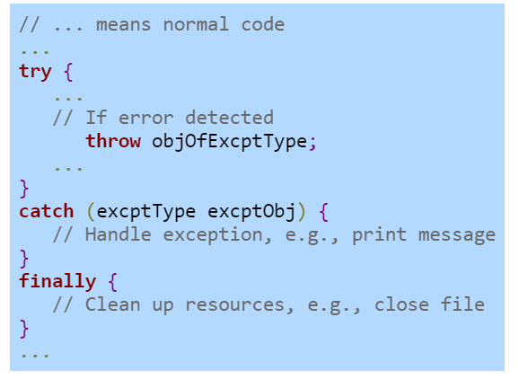
Finally Block
Exception can happen
Handle the exception
Block of commands that executes after the program exits the corresponding try or catch blocks. It is always executed!

Slide 8
Example of Multiple Handlers and Finally
import java.io.File; import java.io.FileNotFoundException; import java.io.IOException; import java.util.Scanner; public class FilesException { private String fileName; public FilesException(String fileName){ this.fileName = fileName; } public String readFile(){ String strFromFile = ""; Scanner scnrFile = null; try{ scnrFile = new Scanner(new File(fileName)); while(scnrFile.hasNext()){ strFromFile += scnrFile.nextLine() + "\n"; } }catch(FileNotFoundException fileExp){ System.out.println("File not found!"); }catch(IOException ioExp){ System.out.println("Something wrong with file!"); }finally { scnrFile.close(); } return strFromFile; } }

Slide 9
Group Coding
Write a program that takes in input from a client, and then writes that input a file. The program ends when “exit” is entered.
First think about what do you need to do to solve this problem (divide-glue-conquer).
Write a sequence of steps in English on how to do that.
Translate your sequence of steps to a Java method(s).

Slide 10
Example Code and Useful Info

Slide 11
import java.util.Scanner; public class BMIExceptHandling { public static int getWeight(Scanner scnr) throws Exception { int weightParam; // User defined weight (lbs) // Get user data System.out.print("Enter weight (in pounds): "); weightParam = scnr.nextInt(); // Error checking, non-negative weight if (weightParam < 0) { throw new Exception("Invalid weight."); } return weightParam; } public static int getHeight(Scanner scnr) throws Exception { int heightParam; // User defined height (in) // Get user data System.out.print("Enter height (in inches): "); heightParam = scnr.nextInt(); // Error checking, non-negative height if (heightParam < 0) { throw new Exception("Invalid height."); } return heightParam; }
public static void main(String[] args) { Scanner scnr = new Scanner(System.in); int weightVal; int heightVal; float bmiCalc; char quitCmd; quitCmd = 'a'; while (quitCmd != 'q') { try { //Get user data weightVal = getWeight(scnr); heightVal = getHeight(scnr); // Calculate BMI and print user health info if no input error // Source: http://www.cdc.gov/ bmiCalc = ((float) weightVal / (float) (heightVal * heightVal)) * 703.0f; System.out.println("BMI: " + bmiCalc); System.out.println("(CDC: 18.6-24.9 normal)"); } catch (Exception excpt) { // Prints the error message passed by throw statement System.out.println(excpt.getMessage()); System.out.println("Cannot compute health info"); } // Prompt user to continue/quit System.out.print("\nEnter any key ('q' to quit): "); quitCmd = scnr.next().charAt(0); } } }

Slide 12
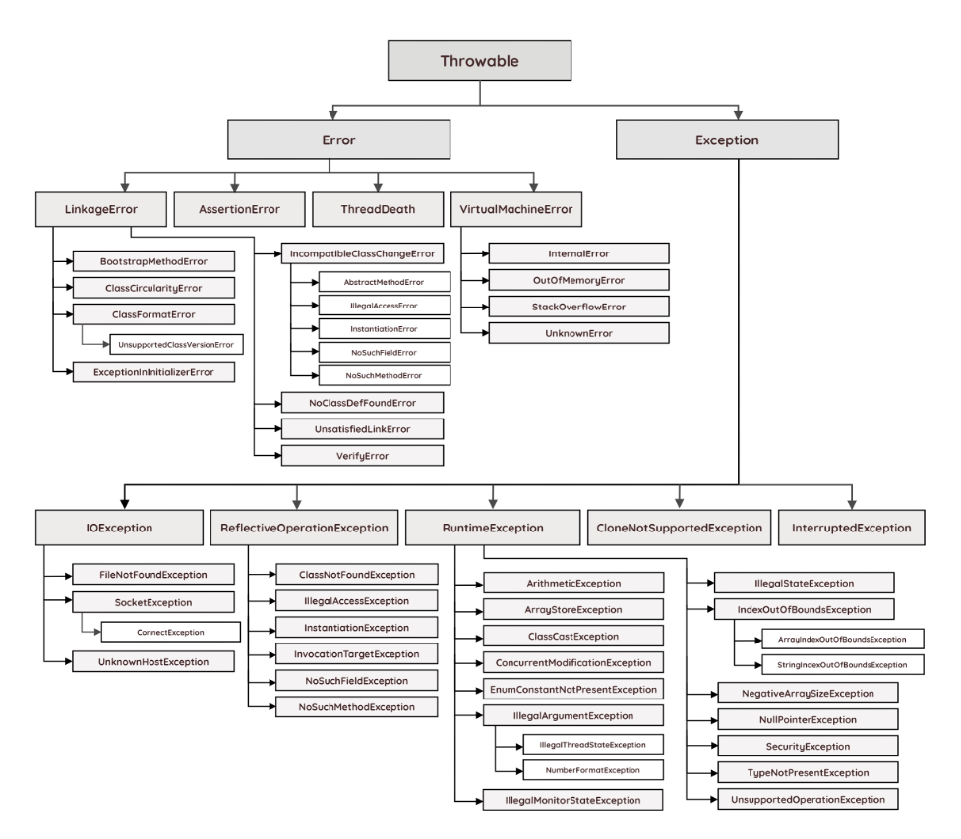
Java Exception Hierarchy
Error class is used to indicate a more serious problem in the architecture and should not be handled in the application code.
Exception class is used for exception conditions that the application may need to handle.
Exceptions are further subdivided into checked (compile-time) and unchecked (run-time) exceptions.
https://rollbar.com/blog/java-exceptions-hierarchy-explained/

Slide 13
Java Exception Hierarchy
Exceptions that can occur at compile-time are called checked exceptions since they need to be explicitly checked and handled in code.
All classes with the exception of Error and RuntimeException are checked
Unchecked exceptions can be thrown "at any time" (i.e. run-time). Therefore, methods don't have to explicitly catch or throw unchecked exceptions.
RuntimeException
https://rollbar.com/blog/java-exceptions-hierarchy-explained/

