Slide 1
Polymorphism

Slide 2
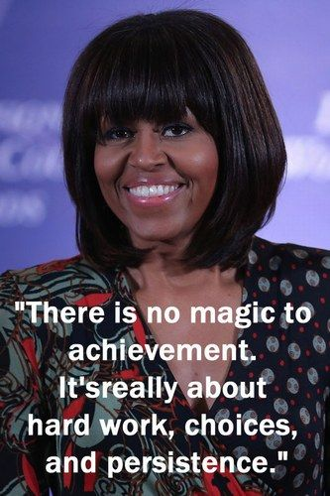
Announcements
TODO Reminders:
Readings are due before lecture
Reading 20 (zybooks) – you should have already done that ☺
Lab 13
Reading 21 (zyBooks)
Lab 12
Reading 22 (zybooks)
RPA 10
Keep practicing your RPAs in a spaced and mixed manner ☺
Help Desk
https://www.pinterest.com/pin/342062534189160703/
Day | Time : Room
Monday | 12 PM - 2 PM : CSB 120
Tuesday | 6 PM - 8 PM : Teams
Wednesday | 3 PM - 5 PM : CSB 120
Thursday | 6 PM - 8 PM : Teams
Friday | 3 PM - 5 PM : CSB 120
Saturday | 12 PM - 4 PM : Teams
Sunday | 12 PM - 4 PM : Teams

Slide 3
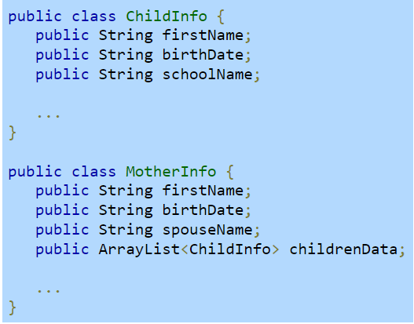
Recall Activity
Analyze the classes below. What type of relationship do we have: ‘has-a’ or ‘is-a’?
Explain using your own words.

Slide 4
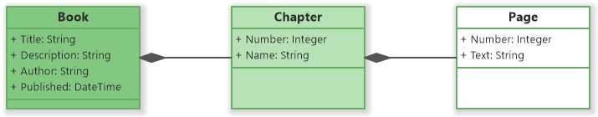
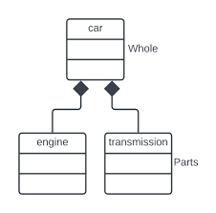
Composition
Has-a relationship

Slide 5
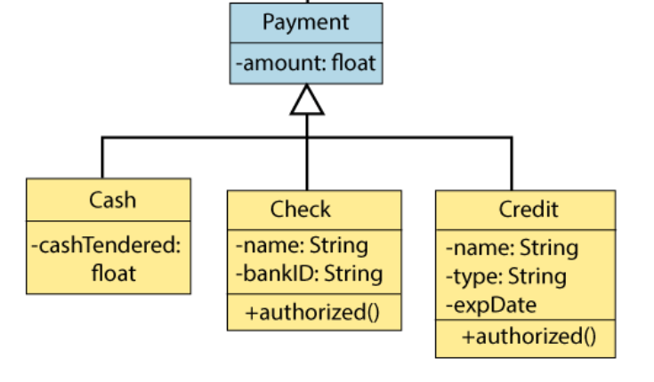
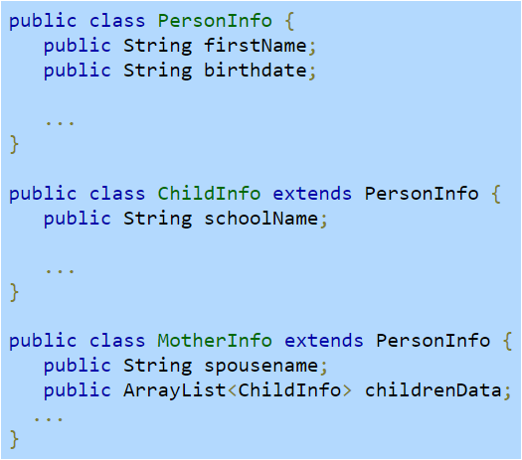
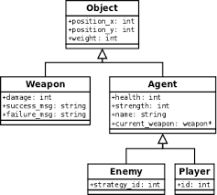
Inheritance
Is-a relationship

Slide 6
Polymorphism
Refers to determining which program behavior to execute depending on data types
Polymorphism of methods – methods overloading
compile-time polymorphism
compiler determines which of several identically-named methods to call based on the method's arguments
Polymorphism of variables – involves derived classes (inheritance)
runtime polymorphism
compiler cannot make the determination but instead the determination is made while the program is running

Slide 7
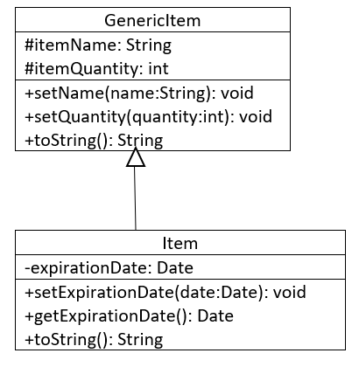
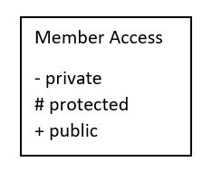
Polymorphism of variable
Substitution principle - you can always use a subclass object when a superclass object is expected
Super class variable can store super class types and sub class types as well
Sub class variable can only store sub class types
GenericItem g1 = new GenericItem();
Correct!
GenericItem g2 = new Item();
Correct!
Item g3 = new Item();
Correct!
Item g4 = new GenericItem();
Incorrect!

Slide 8
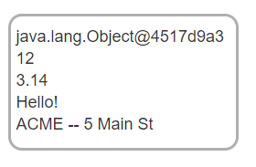
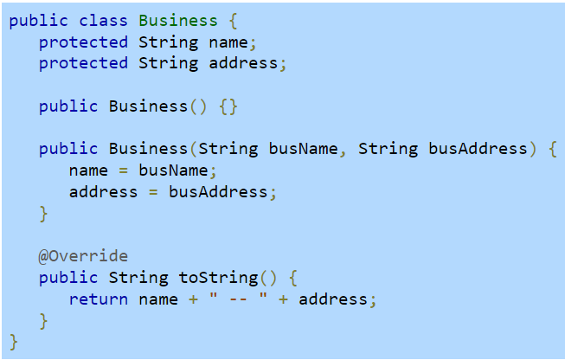
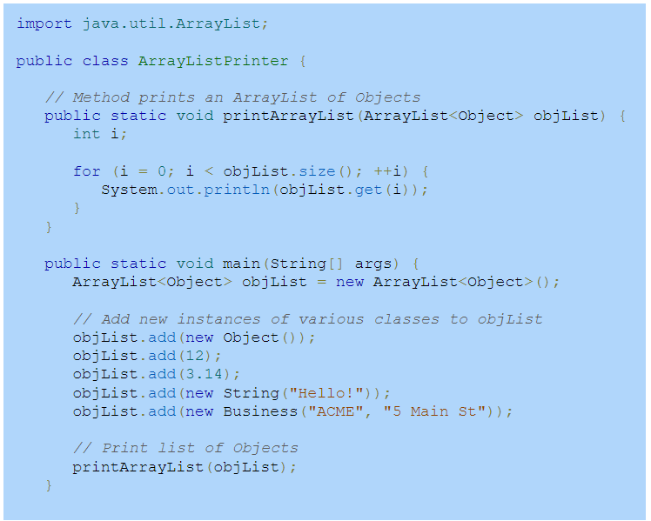
ArrayList of Objects
Store a collection of objects of various class types

Slide 9
instanceof
Rewrite the class Pet to have its constructors properly overloaded.
public static void printArrayListV2(ArrayList<Object> objList) { int i; for (i = 0; i < objList.size(); ++i) { Object obj = objList.get(i); if(obj instanceof String) System.out.println("String:" + objList.get(i)); else if(obj instanceof Integer) System.out.println("Integer:" + objList.get(i)); else if(obj instanceof Double) System.out.println("Double:" + objList.get(i)); else if(obj instanceof Business) System.out.println("Business:" + objList.get(i)); } }

Slide 10
Worksheet
Complete the Polymorphism worksheet
Codes from this lecture and worksheet - https://github.com/CSU-CompSci-CS163-4/Handouts/tree/main/ClassExamples/10Polymorphism

