Slide 1
NS-3 Tutorial
March 2023

Slide 2
Outline
NS-3 network architecture
Simulation program flow
Customize your network
Debug your program

Slide 3
NS-3 network architecture
Application
Application
Application
Application
Sockets-like
API
Protocol
stack
Protocol
stack
Packet(s)‏
Node
Node
NetDevice
NetDevice
NetDevice
Channel
NetDevice
Channel

Slide 4
NS-3 network architecture
Node
Application
Application
Application
Application
Sockets-like
API
Protocol
stack
Protocol
stack
Packet(s)‏
Node
Node
NetDevice
NetDevice
NetDevice
Channel
NetDevice
Channel

Slide 5
NS-3 network architecture
Generate flows
(pattern, size, time)
Application
Application
Application
Application
Sockets-like
API
Protocol
stack
Protocol
stack
Packet(s)‏
Node
Node
NetDevice
NetDevice
NetDevice
Channel
NetDevice
Channel

Slide 6
NS-3 network architecture
Transport logic
(TCP/UDP, IPv4/6)
Application
Application
Application
Application
Sockets-like
API
Protocol
stack
Protocol
stack
Packet(s)‏
Node
Node
NetDevice
NetDevice
NetDevice
Channel
NetDevice
Channel

Slide 7
NS-3 network architecture
Application
Application
Application
Application
Sockets-like
API
Protocol
stack
Protocol
stack
Packet(s)‏
Node
Node
NetDevice
NetDevice
NetDevice
Channel
NetDevice
Channel

Slide 8
NS-3 network architecture
Header, tag, meta data
Application
Application
Application
Application
Sockets-like
API
Protocol
stack
Protocol
stack
Packet(s)‏
Node
Node
NetDevice
NetDevice
NetDevice
Channel
NetDevice
Channel

Slide 9
Simulation program flow
Configure setting
Build network
Run simulation
Process outputs

Slide 10
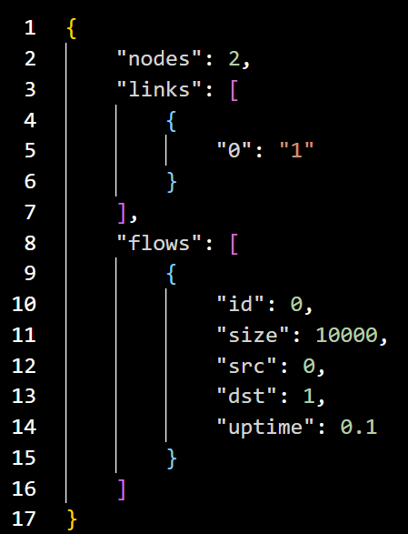
Simulation program flow
Configuration file
Configure setting
Build network
Run simulation
Process outputs

Slide 11
Simulation program flow
Configuration file
Configure setting
CMD
Build network
Run simulation
Process outputs

Slide 12
Simulation program flow
Configuration file
Configure setting
CMD
Environment variable
Build network
Run simulation
Process outputs

Slide 13
Simulation program flow
Configure setting
Build network
Run simulation
Process outputs

Slide 14

Simulation program flow
Configure setting
Create nodes
Build network
Run simulation
Process outputs

Slide 15
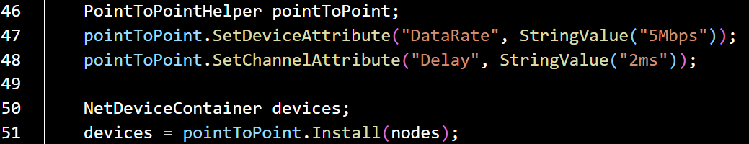
Simulation program flow
Configure setting
Create nodes
Create devices with attributes
Build network
Run simulation
Process outputs

Slide 16

Simulation program flow
Configure setting
Create nodes
Create devices with attributes
Create stack with attributes
Build network
Run simulation
Process outputs

Slide 17
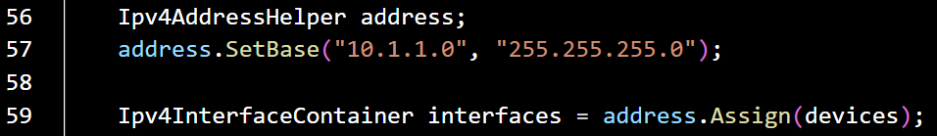
Simulation program flow
Configure setting
Create nodes
Create devices with attributes
Create stack with attributes
Build network
Set ip and routing
Run simulation
Process outputs

Slide 18
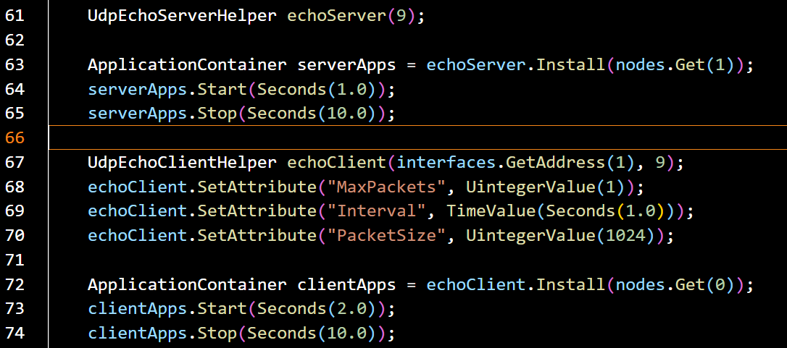
Simulation program flow
Create nodes
Configure setting
Create devices with attributes
Create stack with attributes
Set ip and routing
Build network
Set application
Run simulation
Process outputs

Slide 19
Simulation program flow
Configure setting
int main (int argc, char *argv[])
{
// Set default attribute values
// Parse command-line arguments
// Configure the topology; nodes, channels, devices, mobility
// Add (Internet) stack to nodes
// Configure IP addressing and routing
// Add and configure applications
// Configure tracing
// Run simulation
}
Build network
Run simulation
Process outputs

Slide 20
Simulation program flow
Configure setting
Build network
Run simulation
Process outputs

Slide 21
Simulation program flow
Configure setting
Sed, awk, cut, gnuplot…
Build network
Run simulation
Process outputs

Slide 22
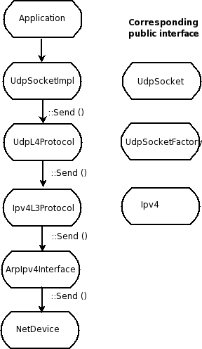
Customize your network
src/application
src/internet
src/internet
src/internet
src/internet
src/point-to-point

Slide 23
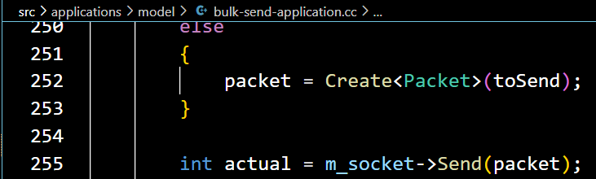
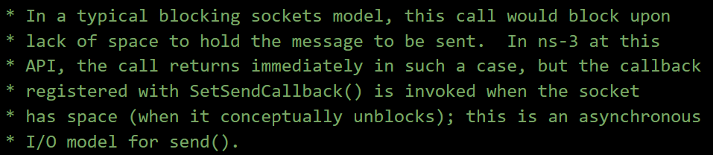
Customize your network
The send is an asynchronous I/O model.

Slide 24
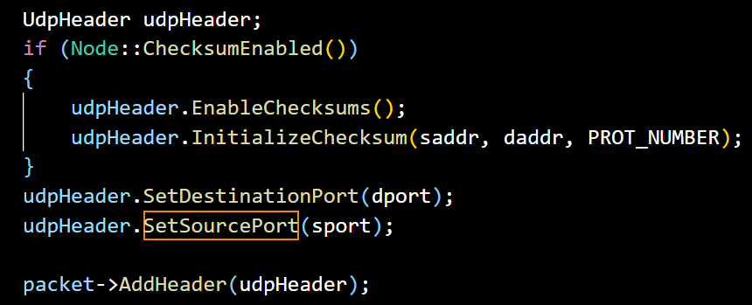
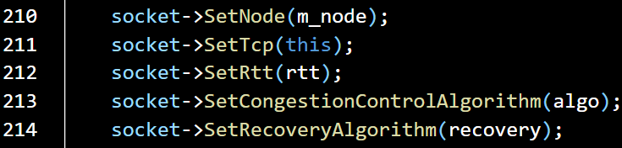
Customize your network
Add UDP/TCP header
TCP congestion algorithm

Slide 25
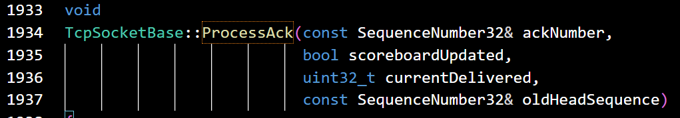
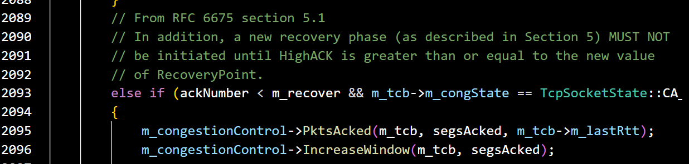
Customize your network
Add UDP/TCP header
TCP congestion algorithm

Slide 26
Customize your network
Forward the packet from ip layer to different socket according to the port.

Slide 27
Customize your network

Slide 28
Customize your network
Add IP header and routing.

Slide 29
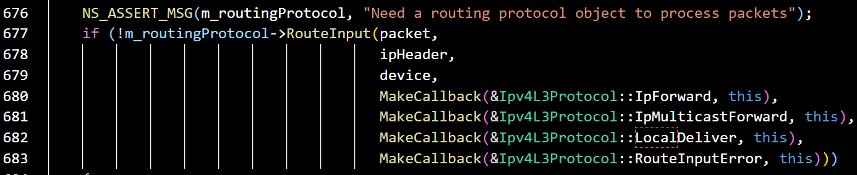
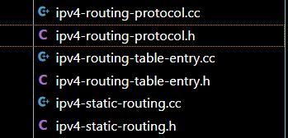
Customize your network
Add IP header and routing.
Routing type:

Slide 30
Customize your network
Add Ethernet header and send to its peer.

Slide 31
Customize your network
Traffic Control layer between IPV4L3 and NetDevice

Slide 32
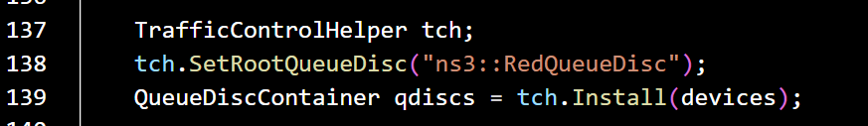
Customize your network
Traffic Control layer between IPV4L3 and NetDevice

Slide 33
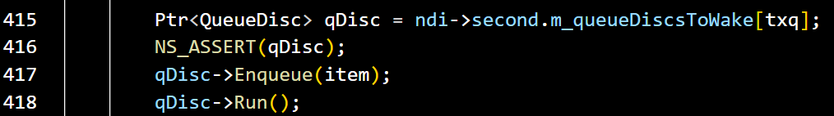
Customize your network
Traffic Control layer between IPV4L3 and NetDevice

Slide 34
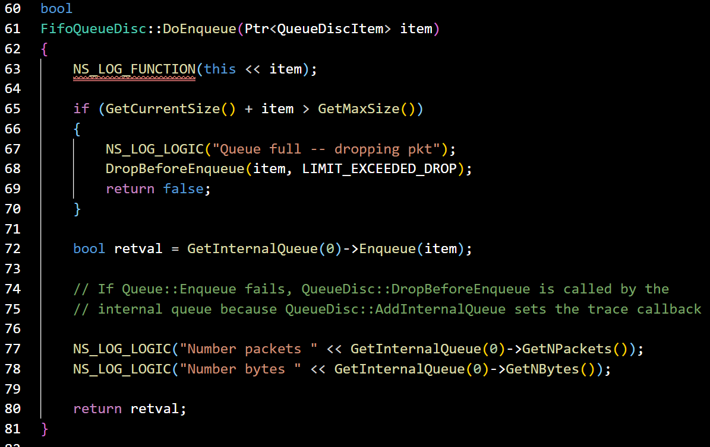
Customize your network
Traffic Control layer between IPV4L3 and NetDevice

Slide 35
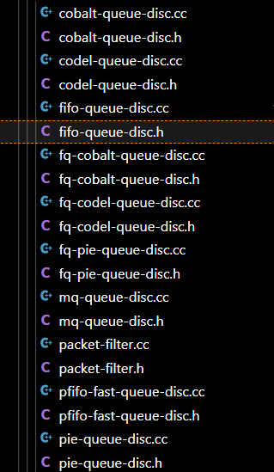
Customize your network
Traffic Control layer between IPV4L3 and NetDevice

Slide 36

Debug your program
Logging levels:
NS_LOG_ERROR (...): serious error messages only
NS_LOG_WARN (...): warning messages
NS_LOG_DEBUG (...): rare ad-hoc debug messages
NS_LOG_INFO (...): informational messages (eg. banners)
NS_LOG_FUNCTION (...):function tracing
NS_LOG_PARAM (...): parameters to functions
NS_LOG_LOGIC (...): control flow tracing within functions
Logging ”components”
Logging messages organized by components
Usually one component is one .cc source file
NS_LOG_COMPONENT_DEFINE ("OlsrAgent");
Displaying log messages. Two ways:
Programatically:
LogComponentEnable("OlsrAgent", LOG_LEVEL_ALL);
From the environment:
NS_LOG="OlsrAgent" ./my-program

Slide 37
How to get node id?
Node
xxxx->GetObject<Node>()->GetId()
Application
Application
Application
Application
Sockets-like
API
Protocol
stack
Protocol
stack
Packet(s)‏
Node
Node
NetDevice
NetDevice
NetDevice
Channel
NetDevice
Channel

Slide 38
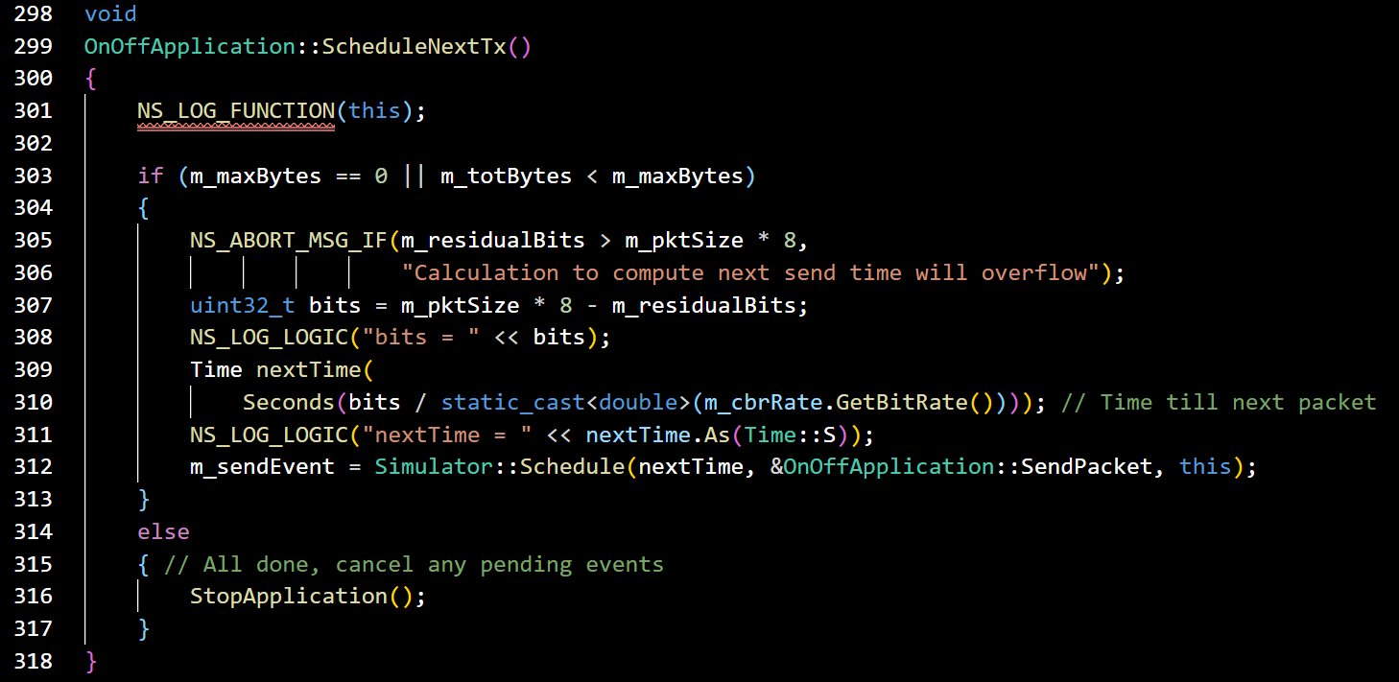
How to send constant reate flow
&& set timer?

