Slide 1
PBPK Modeling and MCSim Workshop
QCPT Group
July 9, 2016

Slide 2
Accounting for variability
Exposure of population to a certain amount of xenobiotic results in a range of target tissue/organ concentrations.
Leads to a variation in the response to the chemcial
Toxicology: response → toxicity
Pharmacology: response → efficacy & toxicity
Physiological differences will result in differences in ADME for a given chemical.

Slide 3
Population variability
Individuals are going to differ in their body weights, metabolic enzyme abundance,
Need a way to describe the ADME

Slide 4
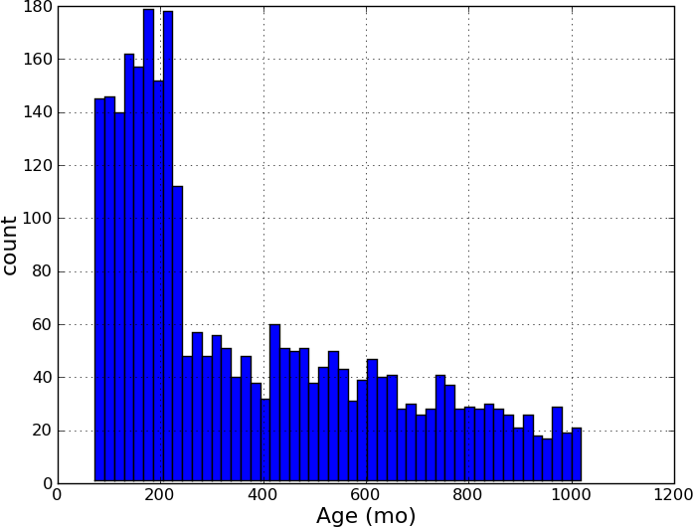
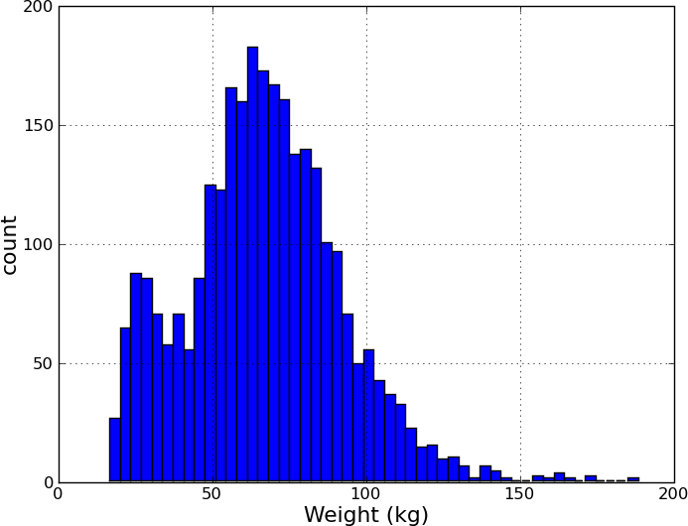
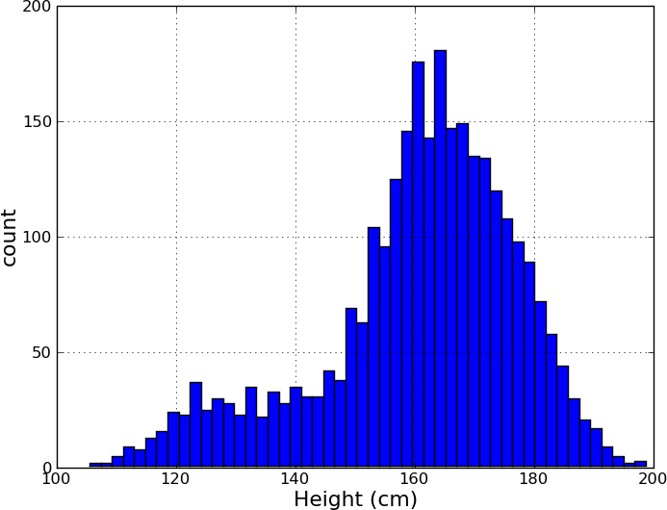
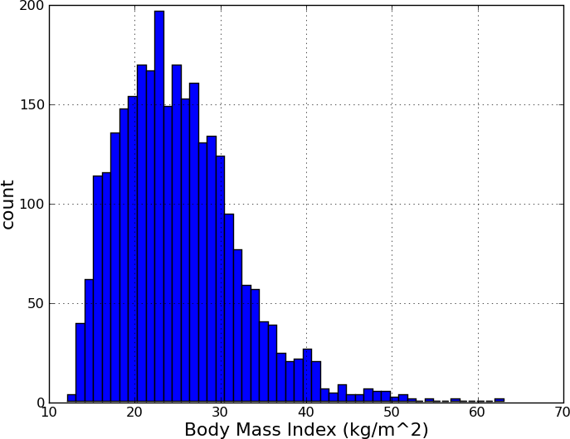
Population distributions
NHANES data

Slide 5
PBPK parameters
Parameter (units) | Abbreviation | Mean |  | Coefficient of Variation
 |  | Rat | Human
Body Weight (kg) | BW | 0.23 | 65 | 0.16
Cardiac Output (L/h/kg^{0.75}) | QCC | 14.1 | 16.2 | 0.2
Compartment
Lung | Q_{LUC} | 14.1 | 16.2 | 0.3
 | V_{LUC} | 0.005 | 0.0076 | 0.2
Brain | Q_{BRC} | 0.02 | 0.12 | 0.3
 | V_{BRC} | 0.0057 | 0.02 | 0.2
Fat | Q_{FC} | 0.07 | 0.0675 | 0.3
 | V_{FC} | 0.07 | 0.2142 | 0.2
Heart | Q_{HC} | 0.049 | 0.045 | 0.3
 | V_{HC} | 0.0033 | 0.0047 | 0.2
Muscle | Q_{MC} | 0.278 | 0.145 | 0.3
 | V_{MC} | 0.4043 | 0.4 | 0.2
Bone | Q_{BC} | 0.122 | 0.05 | 0.3
 | V_{BC} | 0.073 | 0.1429 | 0.2
Skin | Q_{SKC} | 0.058 | 0.05 | 0.3
 | V_{SKC} | 0.1903 | 0.0371 | 0.2
Kidney | Q_{KC} | 0.141 | 0.18 | 0.3
 | V_{KC} | 0.0073 | 0.0044 | 0.2
Spleen | Q_{SC} | 0.01 | 0.01 | 0.3
 | V_{SC} | 0.002 | 0.0026 | 0.2
Gut | Q_{GC} | 0.14 | 0.14 | 0.3
 | V_{GC} | 0.027 | 0.0171 | 0.2
Liver | Q_{LAC} | 0.024 | 0.06 | 0.3
 | V_{LC} | 0.0366 | 0.0257 | 0.2
Carcass | Q_{CRC} | 0.088 | 0.1325 | 0.3
 | V_{CRC} | 0.1015 | 0.0448 | 0.2
Venous Blood | V_{BLVC} | 0.0493 | 0.0526 | 0.2
Arterial Blood | V_{BLAC} | 0.0247 | 0.0263 | 0.2
Rather than treat PBPK parameters as single points, view them as distributions.

Slide 6
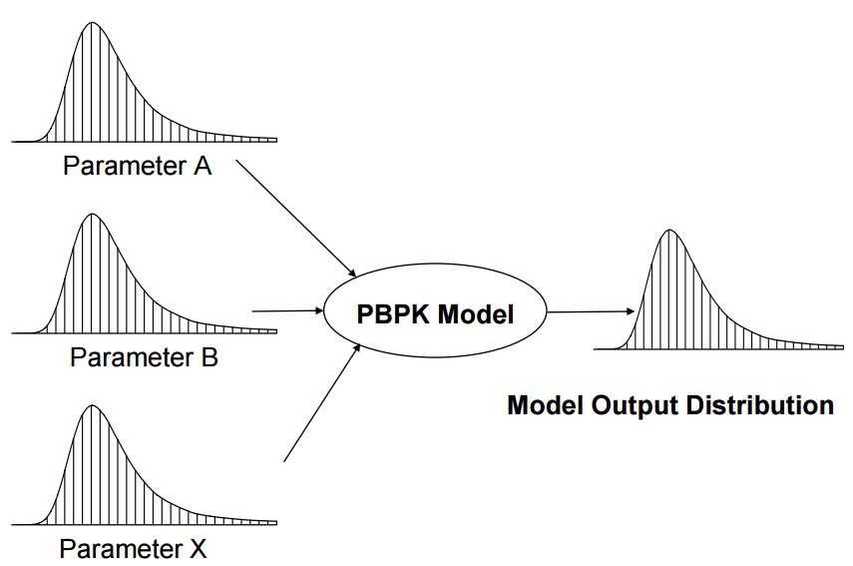
Monte-Carlo sampling

Slide 7
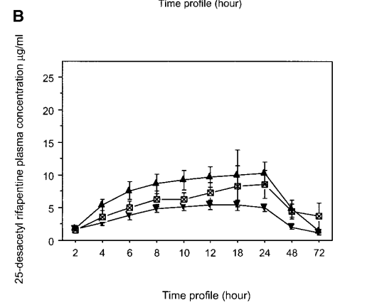
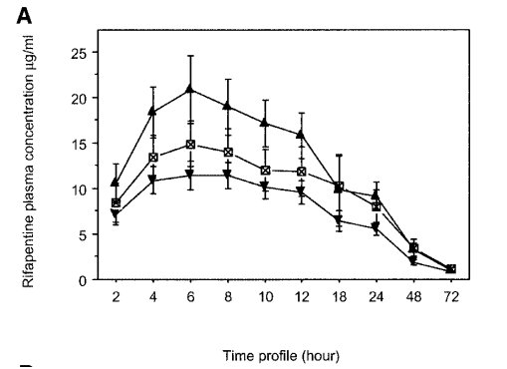
Data to model
Time-course pharmacokinetic data for rifapentine and 25-desactyl-refapentine in humans for three different doses.

Slide 8
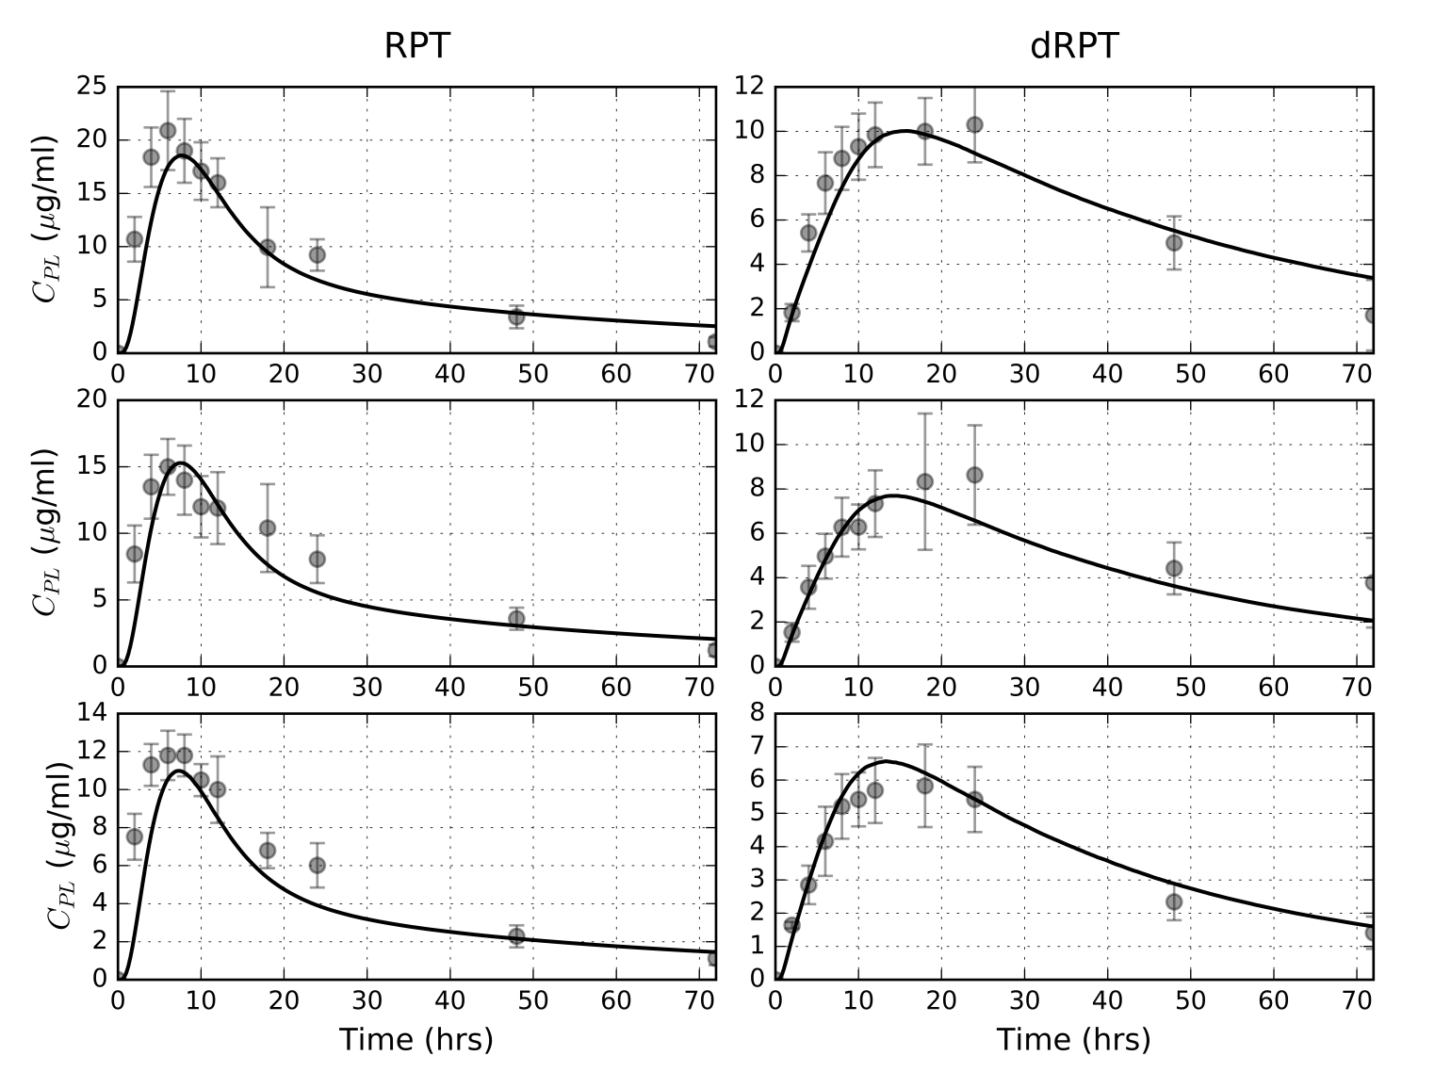
Using only the means

Slide 9
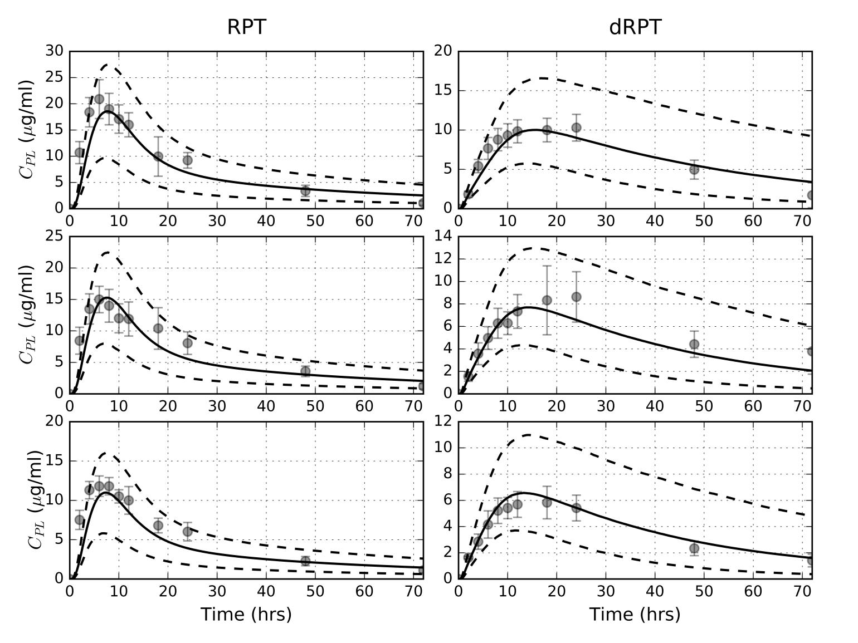
Creating prediction intervals

Slide 10
Today…
Utilize Monte-Carlo (MC) sampling techniques in MCSim
Post-process file
Apply quantile statistics to generate intervals
Apply MC methods to simple model developed yesterday
Develop whole body RPT model for rats and humans
Utilize published PBPK parameter distributions to predict plasma PK of RPT and dRPT in plasma

