Slide 1
Bayesian inference and Markov-chain Monte-Carlo for parameter estimation
PBPK Modeling and MCSim Workshop
QCPT Group
July 11, 2016

Slide 2
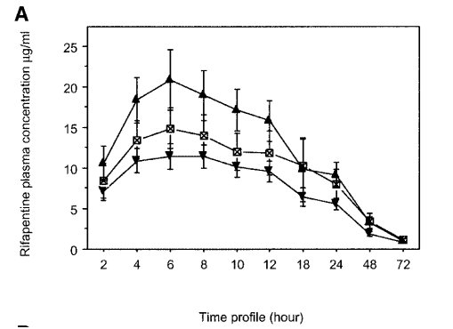
Data available to us
Most of our data is mined from the literature.
Presented as means and standard deviations

Slide 3
Study variability
Variability exists even within a single study
Need to utilize not only the mean pharmacokinetic values, but also the reported variability, when determining parameters.

Slide 4
Bayesian inference
We don’t have all organ/tissue concentrations at our disposal so we need to utilize what we have to inform our knowledge of the PBPK model parameters
Prior information: what do we know before calibrating the model?
In vitro metabolic parameters
Blood:Tissue partioning
Population distributions for cardiac output, body weights, etc.
What information do we have?
Time-course pharmacokinetic data

Slide 5
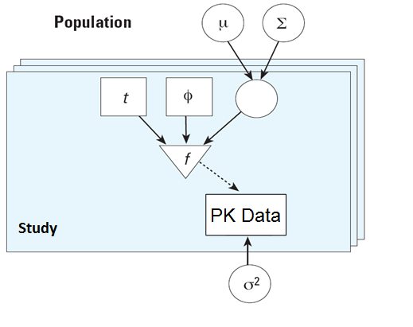
Model calibration
Update our prior parameter distributions based on the observed data.
The heart of Bayesian inference
Θ

Slide 6
Likelihood
Data reported in literature has a mean and standard deviation
Use these data to update the prior distribution

Slide 7
Create posterior distribution

Slide 8
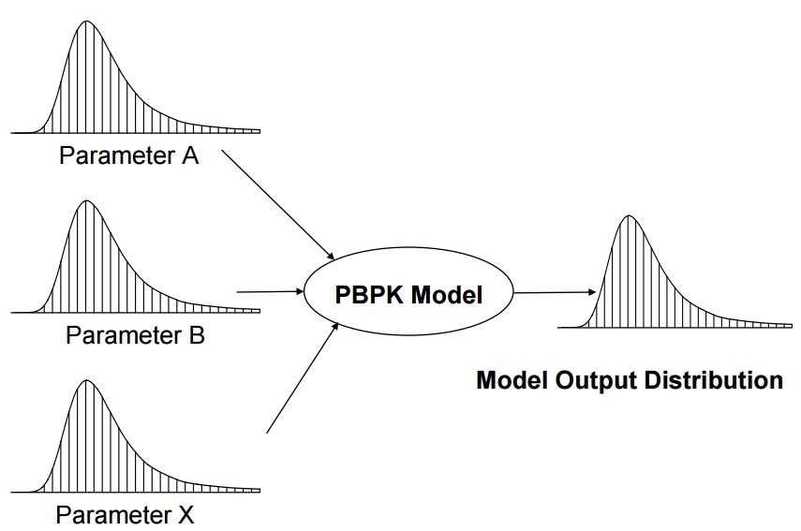
Posterior parameter distributions

Slide 9
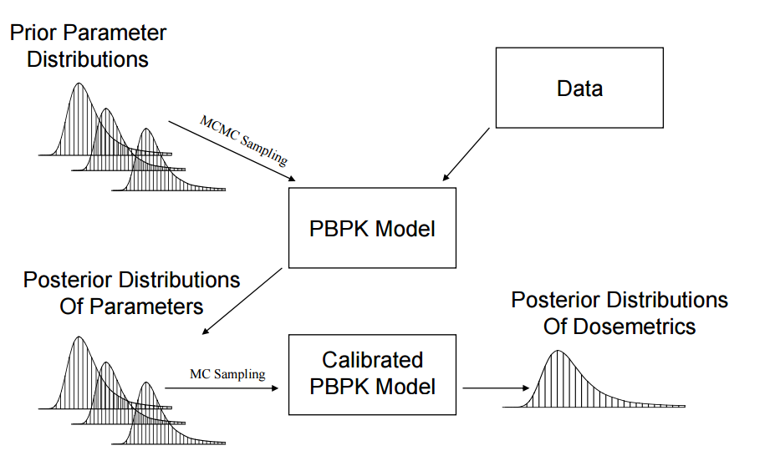
Putting it all together

Slide 10
Today …
Introduce MCMC parameter calibration in MCSim
Set up input file
Parse output file
Complete MCMC calibration of rifapentine model
Begin application to individual PBPK models

