Slide 1
PBPK Modeling and MCSim Workshop
QCPT Group
July 9, 2016

Slide 2
Accounting for variability
Exposure of population to a certain amount of xenobiotic results in a range of target tissue/organ concentrations.
Leads to a variation in the response to the chemical
Toxicology: response → toxicity
Pharmacology: response → efficacy & toxicity
Physiological/biochemical differences will result in differences in ADME for a given chemical.

Slide 3
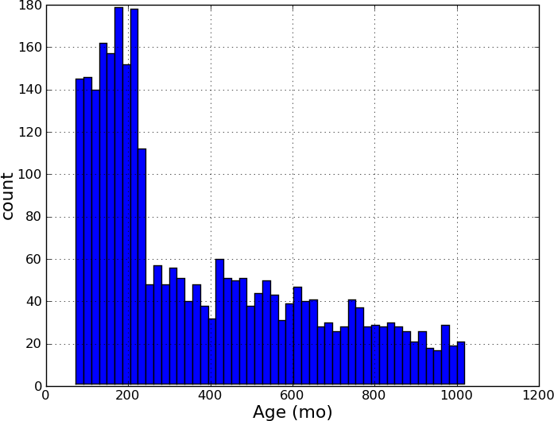
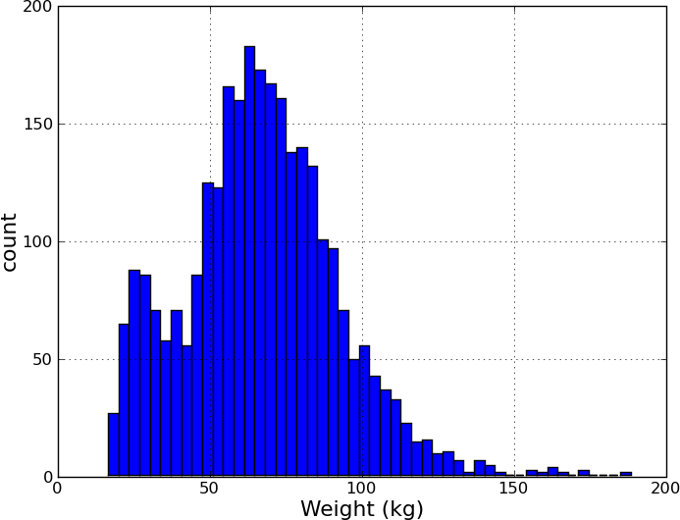
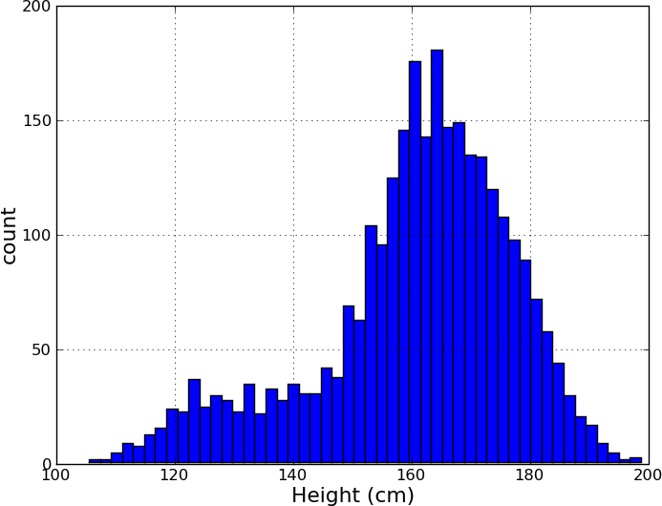
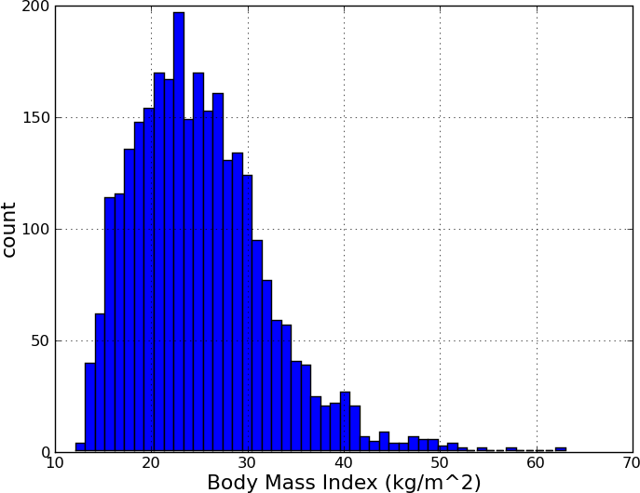
Anthropometric differences
NHANES data

Slide 4
Population variability
Aside from anthropometric measures, individuals differ in their enzyme abundances, exposure conditions, etc.
We need a way to account for these effects when evaluating ADME across a population

Slide 5
PBPK parameters
Rather than treat PBPK parameters as single points, view them as distributions.

Slide 6
Parameter (units) | Abbreviation | Mean |  | Coefficient of Variation
 |  | Rat | Human
Body Weight (kg) | BW | 0.23 | 65 | 0.16
Cardiac Output (L/h/kg^{0.75}) | QCC | 14.1 | 16.2 | 0.2
Compartment
Lung | Q_{LUC} | 14.1 | 16.2 | 0.3
 | V_{LUC} | 0.005 | 0.0076 | 0.2
Brain | Q_{BRC} | 0.02 | 0.12 | 0.3
 | V_{BRC} | 0.0057 | 0.02 | 0.2
Fat | Q_{FC} | 0.07 | 0.0675 | 0.3
 | V_{FC} | 0.07 | 0.2142 | 0.2
Heart | Q_{HC} | 0.049 | 0.045 | 0.3
 | V_{HC} | 0.0033 | 0.0047 | 0.2
Muscle | Q_{MC} | 0.278 | 0.145 | 0.3
 | V_{MC} | 0.4043 | 0.4 | 0.2
Bone | Q_{BC} | 0.122 | 0.05 | 0.3
 | V_{BC} | 0.073 | 0.1429 | 0.2
Skin | Q_{SKC} | 0.058 | 0.05 | 0.3
 | V_{SKC} | 0.1903 | 0.0371 | 0.2
Kidney | Q_{KC} | 0.141 | 0.18 | 0.3
 | V_{KC} | 0.0073 | 0.0044 | 0.2
Spleen | Q_{SC} | 0.01 | 0.01 | 0.3
 | V_{SC} | 0.002 | 0.0026 | 0.2
Gut | Q_{GC} | 0.14 | 0.14 | 0.3
 | V_{GC} | 0.027 | 0.0171 | 0.2
Liver | Q_{LAC} | 0.024 | 0.06 | 0.3
 | V_{LC} | 0.0366 | 0.0257 | 0.2
Carcass | Q_{CRC} | 0.088 | 0.1325 | 0.3
 | V_{CRC} | 0.1015 | 0.0448 | 0.2
Venous Blood | V_{BLVC} | 0.0493 | 0.0526 | 0.2
Arterial Blood | V_{BLAC} | 0.0247 | 0.0263 | 0.2

Slide 7
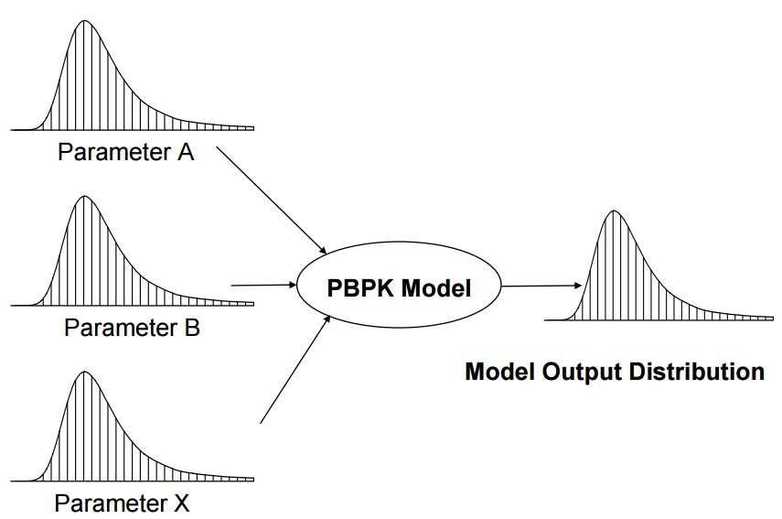
Monte-Carlo sampling

Slide 8
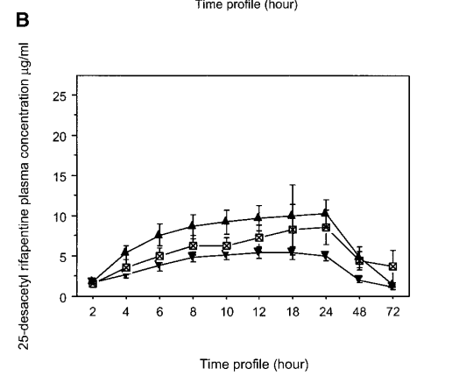
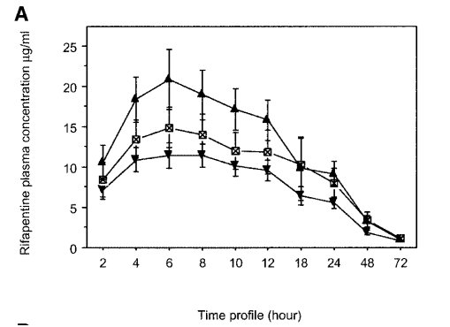
Data to model
Time-course pharmacokinetic data for rifapentine and 25-desactyl-refapentine in humans for three different doses.

Slide 9
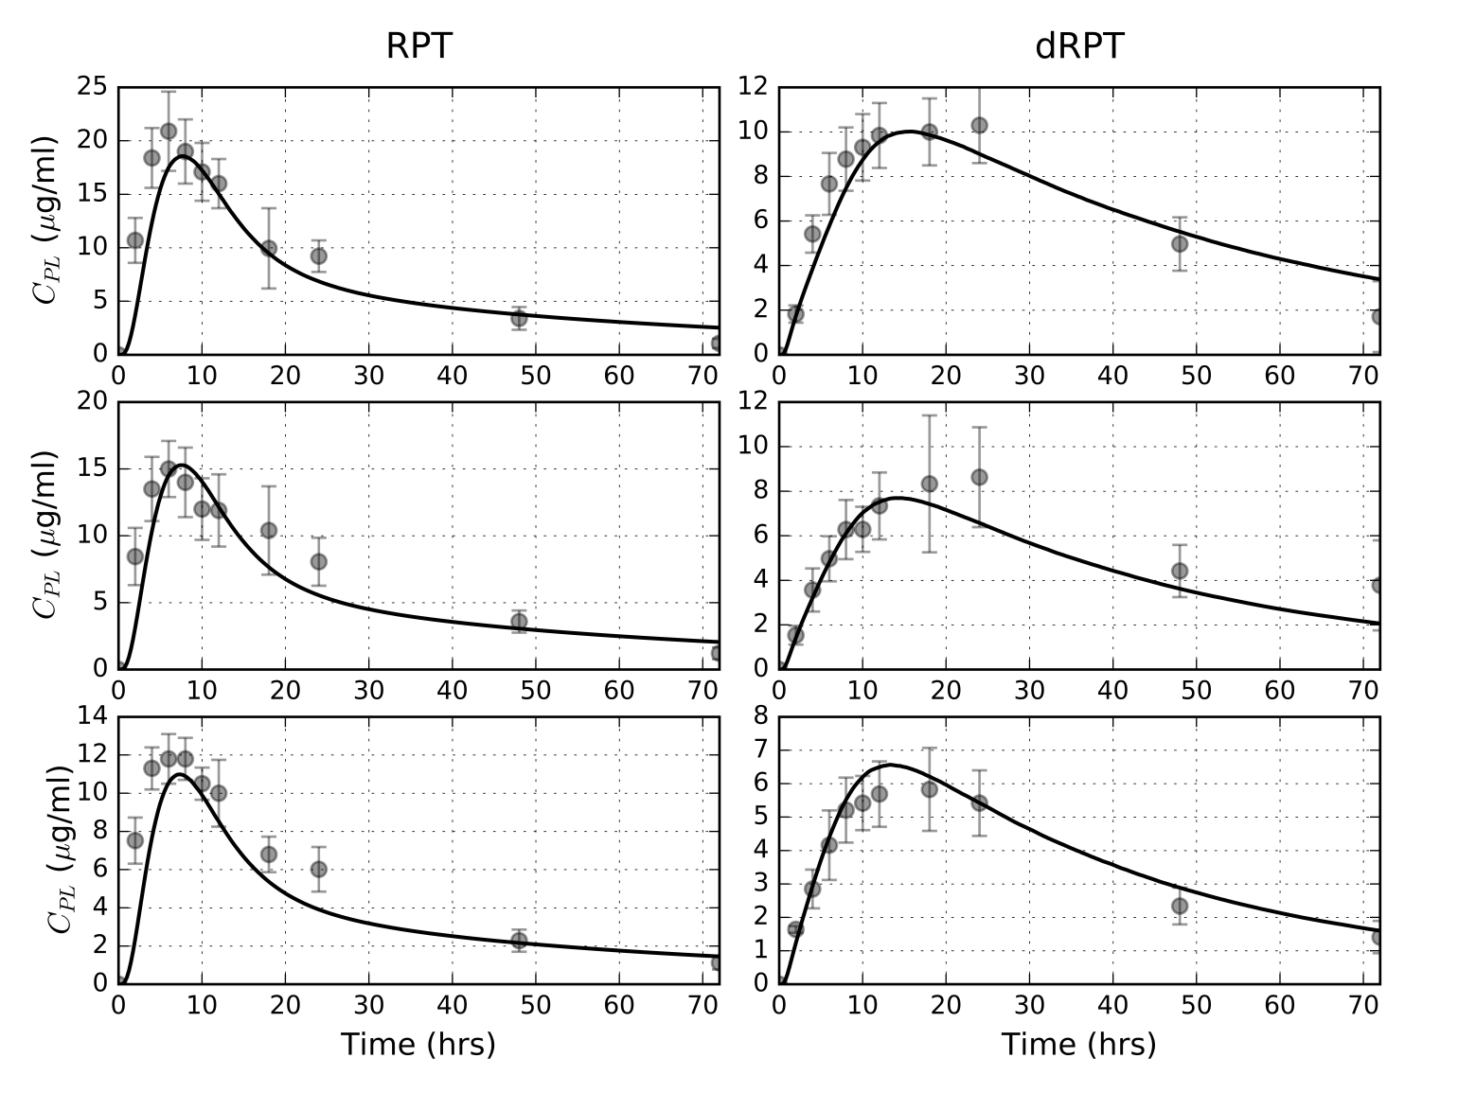
Using only the means

Slide 10
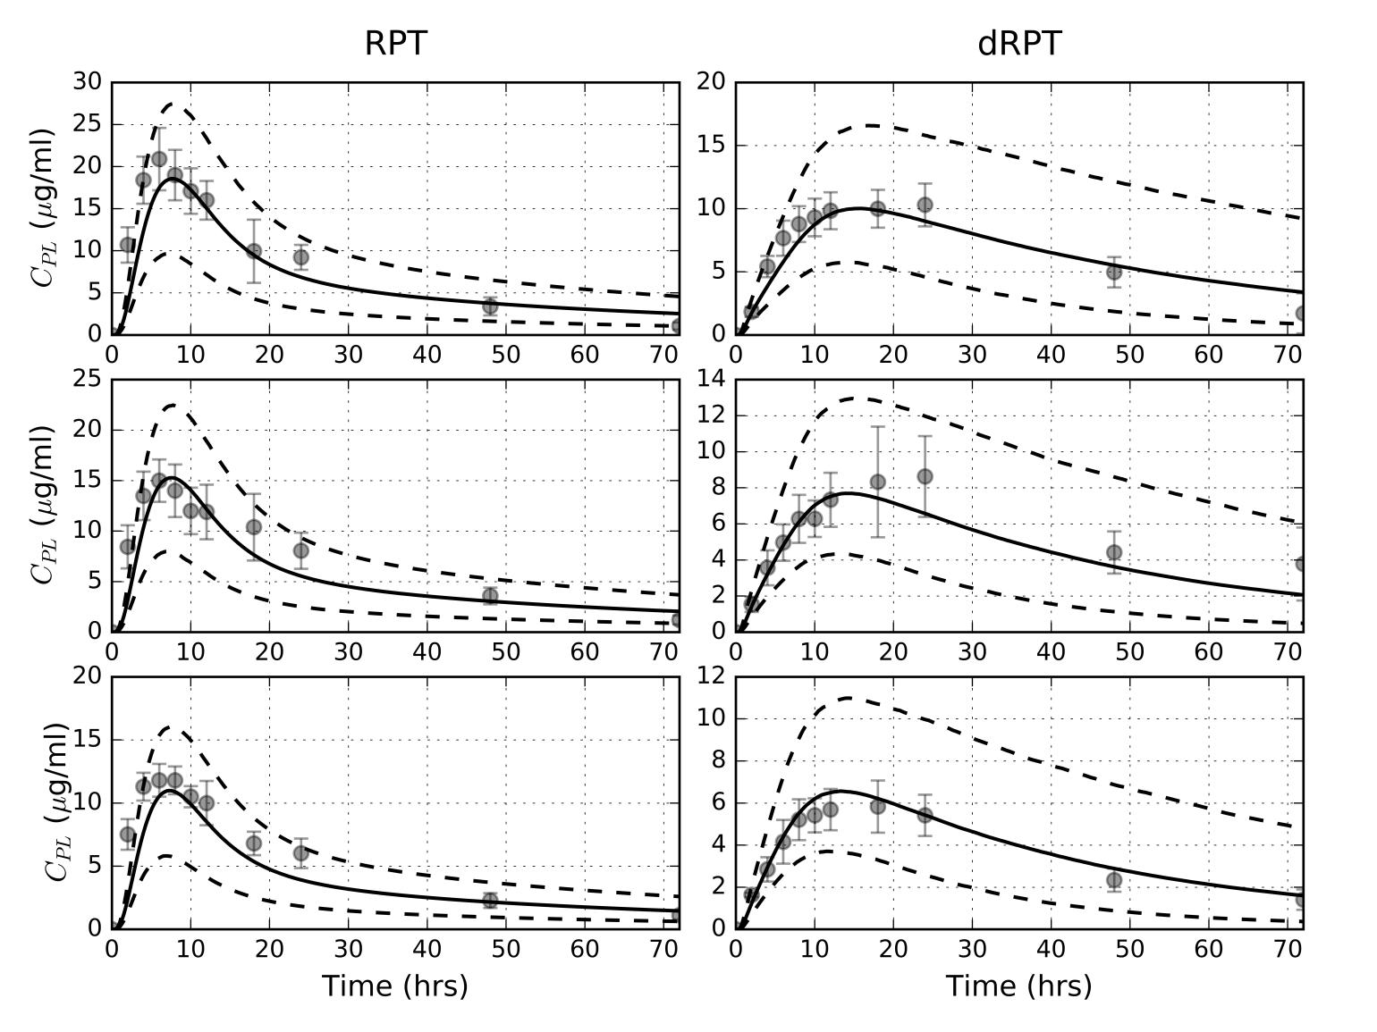
Creating prediction intervals

Slide 11
Today…
Utilize Monte-Carlo (MC) sampling techniques in MCSim
Post-process file
Apply quantile statistics to generate intervals
Apply MC methods to simple model developed yesterday
Develop whole body rifapentine (RPT) model for rats and humans
Utilize published PBPK parameter distributions to predict plasma PK of RPT and dRPT in plasma

