Slide 1
Chapter 10
Transaction Management and Concurrency Control

Slide 2
Learning Objectives
Chapter 10 covers:
Properties of database transactions
Concurrency control
Locking
Time stamping
Database recovery management

Slide 3
Transaction
Logical unit of work that must be entirely completed or aborted (All or nothing)
Includes:
SELECT statement(s)
Series of related UPDATE statements
Series of INSERT or DELETE statements
Combination of SELECT, UPDATE, INSERT or DELETE statements

Slide 4
Transaction
Must begin with the database in a known consistent state to ensure consistency
Consistent database state: All data integrity constraints are satisfied
Formed by two or more database requests
Database requests: Equivalent of a single SQL statement in an application program or transaction

Slide 5
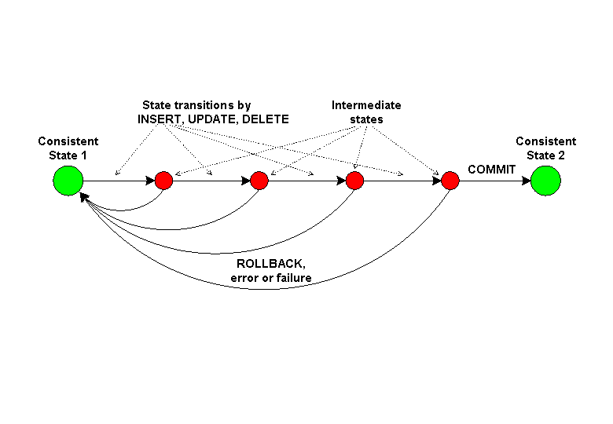
DB State Transition

Slide 6
Transaction Properties (ACID)
Atomicity
All operations of a transaction must be completed
If not, the transaction is aborted
Consistency
Follows the predefined rules of the database
Isolation
Data used during transaction cannot be used by second transaction until the first is completed
Durability
Ensures that once transactions are committed, they cannot be undone or lost
Serializability
Ensures that the schedule for the concurrent execution of several transactions should yield consistent results

Slide 7
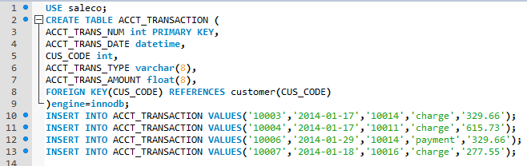
ACCT_TRANSACTION

Slide 8
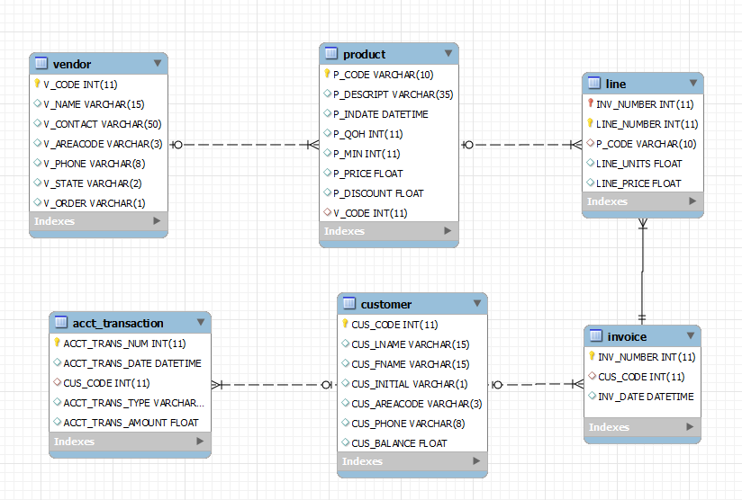
SALECO Transaction
What database changes occur when James Brown purchases 9 Hicut chain saw, 16 in.

Slide 9
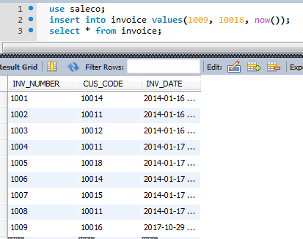
New Invoice is Created

Slide 10
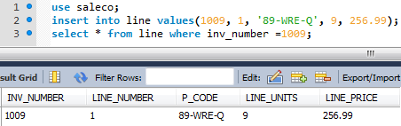
New Line Item is Created

Slide 11
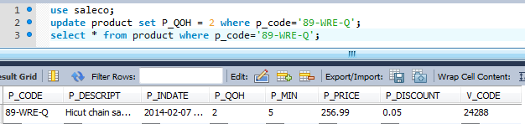
PROD_QOH -= LINE_UNITS
But what happens if QOH is zero or the line_units – QOH < 0?

Slide 12
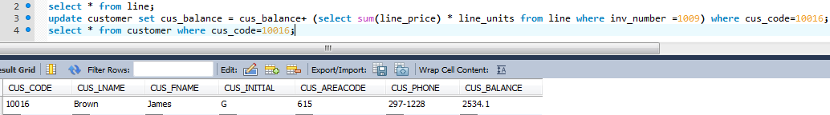
CUST_BALANCE += SUM(LINE_PRICE) + tax + shipping

Slide 13
Example of transaction (SALECO)
Atomicity – If a successful product purchase has been made, inventory will be reduced and James Brown’s balance will increase. (All or nothing)
Consistency – James Brown’s balance and SALECO’s QOH are modified based on predefined rules such as taxes and shipping and qty * price.
Isolation – Future queries should not see James Brown’s balance increased or SALECO QOH reduced until the transaction is complete (i.e. committed).
Durability – Once a purchase is complete, James Brown’s balance or SALECO’s QoH do not not revert back to their pre-purchase amounts.

Slide 14
Transaction Management with SQL
SQL statements that provide transaction support
START TRANSACTION
COMMIT (Write to DB file)
ROLLBACK (Undo all changes prior to last COMMIT)
Transaction sequence must continue until:
COMMIT statement is reached
ROLLBACK statement is reached
End of program is reached
Program is abnormally terminated

Slide 15
The Transaction Log
The transaction log records the details of all transactions
Any changes the transaction makes to the database
How to undo these changes
When transactions complete and how
The log is stored on disk, not in memory
If the system crashes it is preserved, unless…?
Write ahead log rule
The entry in the log must be made before COMMIT processing can complete

Slide 16
Transaction Log (2)
Keeps track of all transactions that update the database
DBMS uses the information stored in a log for:
Recovery requirement triggered by a ROLLBACK statement
A program’s abnormal termination
A system failure
MySQL Transaction Log is under /data

Slide 17
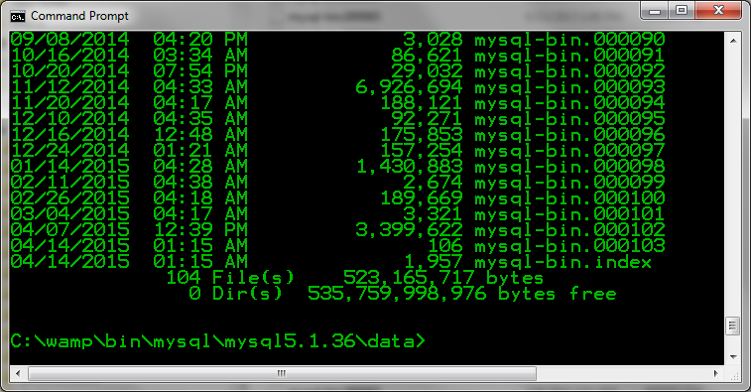
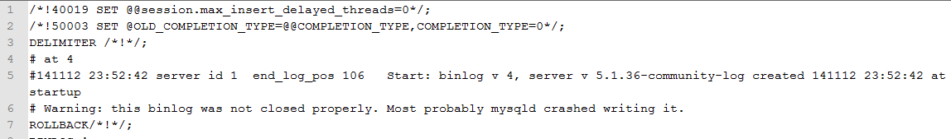
MYSQL-BIN-0000 (Example)
mysqlbinlog -u root ../data/mysql-bin.000094 > mysql-bin.000094.output.txt

Slide 18

Transactions in MySQL
To successfully transfer money, use the START TRANSACTION and COMMIT commands:
The database is not updated until the COMMIT command is executed

Slide 19


Implicit Transactions in MySQL
InnoDB supports transactions
MySQL runs by default with auto-commit enabled.
Each MySQL statement is treated as a single transaction, with an implicit COMMIT at the end.
In the previous example,
is the same as

Slide 20
The Transaction Manager
The transaction manager enforces the ACID properties
It schedules the operations of transactions
COMMIT and ROLLBACK are used to ensure atomicity
Locks or timestamps are used to ensure consistency and isolation for concurrent transactions
A log is kept to ensure durability in the event of system failure

Slide 21
COMMIT and ROLLBACK
COMMIT signals the successful end of a transaction
Changes made by the transaction are saved to disk
Changes are now visible to other transactions
ROLLBACK signals the unsuccessful end of a transaction
Changes made by the transaction are undone
As if the transaction never existed

Slide 22
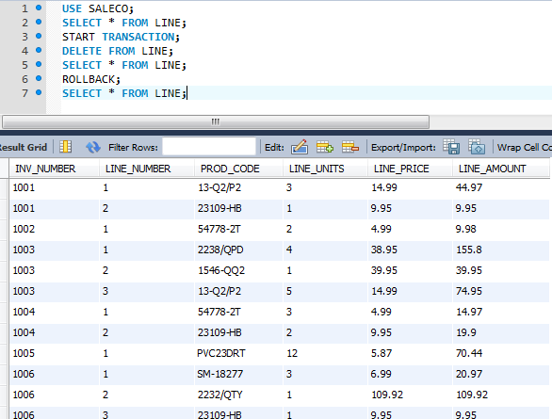
BEFORE DELETE

Slide 23
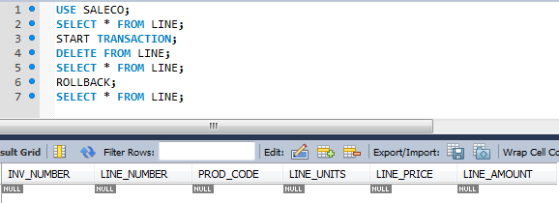
AFTER DELETE

Slide 24
AFTER ROLLBACK

Slide 25
Concurrency Control
Coordination of the simultaneous transactions execution in a multiuser database system
Objective - Ensures serializability of transactions in a multiuser database environment

Slide 26
Problems in Concurrency Control
Lost update
Occurs in two concurrent transactions when:
Same data element is updated
One of the updates is lost
Uncommitted data
Occurs when:
Two transactions are executed concurrently
First transaction is rolled back after the second transaction has already accessed uncommitted data
Inconsistent retrievals
Occurs when a transaction accesses data before and after one or more other transactions finish working with such data

Slide 27
The Scheduler
Establishes the order in which the operations are executed within concurrent transactions
Interleaves the execution of database operations to ensure serializability and isolation of transactions
Based on concurrent control algorithms to determine the appropriate order
Creates serialization schedule
Serializable schedule: Interleaved execution of transactions yields the same results as the serial execution of the transactions

Slide 28
Lock Granularity
Indicates the level of lock use
Levels of locking
Database-level lock
Table-level lock
Page-level lock
Page or diskpage: Directly addressable section of a disk
Row-level lock
Field-level lock

Slide 29
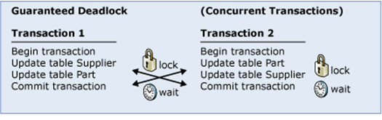
Problems in Using Locks
Transaction schedule might not be serializable
Deadlocks may occur when two transactions wait indefinitely for each other to unlock data
Control techniques
Deadlock prevention
Deadlock detection
Deadlock avoidance

Slide 30
Time Stamping
Assigns global, unique time stamp to each transaction
Produces explicit order in which transactions are submitted to DBMS
Properties
Uniqueness: Ensures no equal time stamp values exist
Monotonicity: Ensures time stamp values always increases

Slide 31
Time Stamping
Disadvantages
Each value stored in the database requires two additional stamp fields
Increases memory needs
Increases the database’s processing overhead
Demands a lot of system resources

Slide 32
Database Recovery Management
Database recovery: Restores database from a given state to a previously consistent state
Recovery transactions are based on the atomic transaction property
Atomic transaction property: All portions of a transaction must be treated as a single logical unit of work
If transaction operation cannot be completed:
Transaction must be aborted
Changes to database must be rolled back

