Slide 1
Chapter 11
Database Performance Tuning and Query Optimization

Slide 2
Learning Objectives (Ch. 11)
Chapter 11 covers:
Querying the data dictionary
Performance-tuning concepts
Query optimizer
Indexing

Slide 3
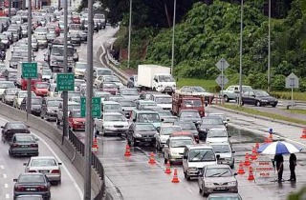
Database Performance-Tuning Concepts
Database Performance === Quick Query Execution
Database performance tuning
Set of activities and procedures that reduce response time of database system
DB tuning requires all aspects operate at optimum level with minimal bottlenecks

Slide 4
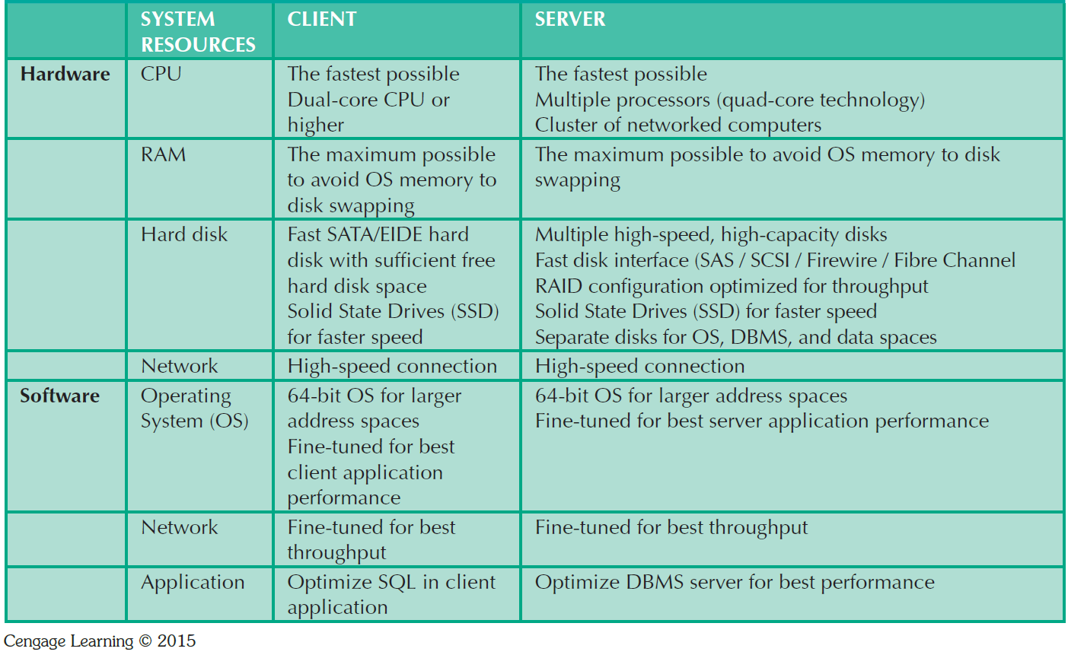
General Guidelines for Better System Performance

Slide 5

Performance Tuning: Client and Server
Client side: SQL performance tuning
Queries are responsive and require minimum resources
Server side: DBMS performance tuning
DBMS environment optimized
CACHE, I/O, locking, replication, backup

Slide 6
DBMS Architecture
DB data is stored in data files
Data files expand in increments known as EXTENTS
Data files are grouped in tablespaces
Tablespace: Logical grouping of several data files that store data with similar characteristics
Data cache: Shared, reserved memory area
Stores most recently accessed data blocks in RAM

Slide 7
DBMS Architecture (2)
SQL cache: Stores most recently executed SQL statements or PL/SQL procedures
DBMS retrieves data from permanent storage and places them in RAM (data cache)
Input/output request: Low-level data access operation that reads or writes data to and from computer devices
Cache is always faster than working with disk
Majority of performance-tuning activities focus on minimizing I/O operations

Slide 8
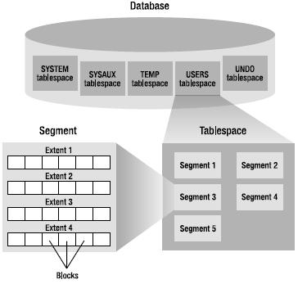
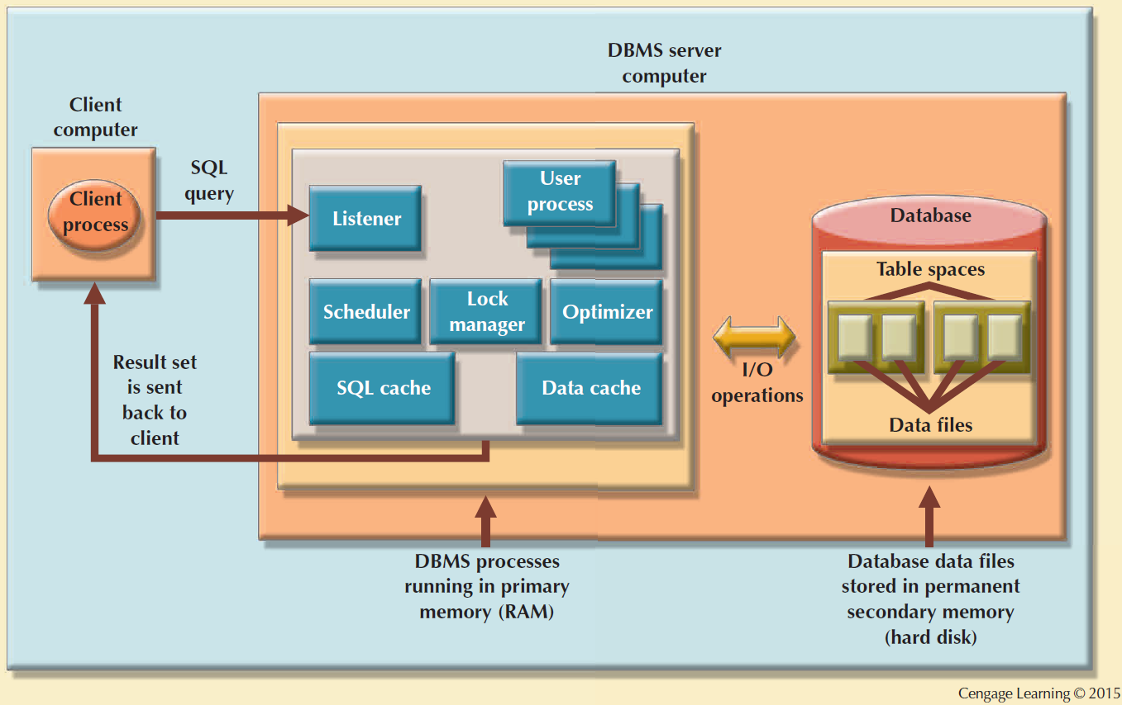
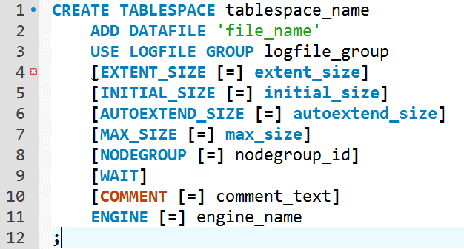
Basic DBMS Architecture

Slide 9
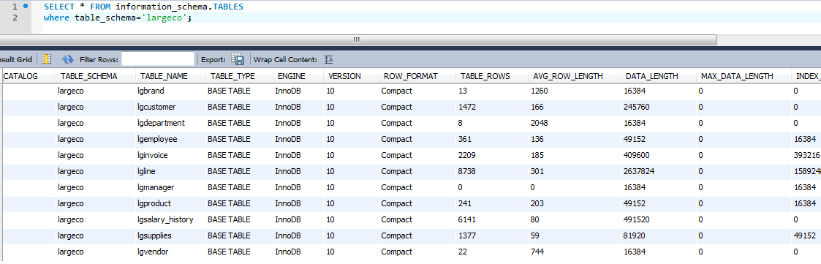
Know thy Data Dictionary

Slide 10
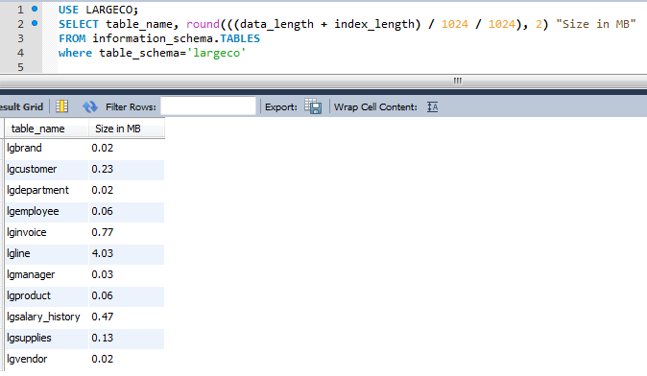
Table Sizes
Why?
Bytes to Megabytes = x / 1024 / 1024

Slide 11
Database Query Optimization Modes
Algorithms for query optimization are based on determining
query execution order and
data location / communication.
Automatic query optimization: DBMS finds the most cost-effective access path without user intervention
Manual query optimization: Requires that the optimization be selected and scheduled by the end user or programmer

Slide 12
Classification Based on Timing of Optimization
Static query optimization: best optimization strategy is selected when the query is compiled by the DBMS
Takes place at compilation time
Dynamic query optimization: Access strategy is dynamically determined by the DBMS at run time, using the most up-to-date information about the database
Takes place at execution time

Slide 13
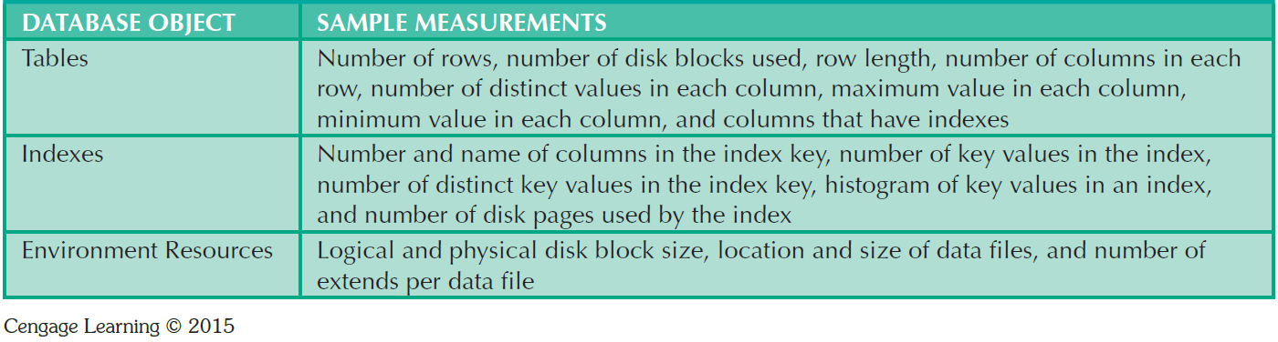
Sample Database Statistics Measurements
Which query is optimized? Why?
select * from faculty where lastname = ‘thoms’;
select * from faculty where dolphin_id= 12345’;

Slide 14
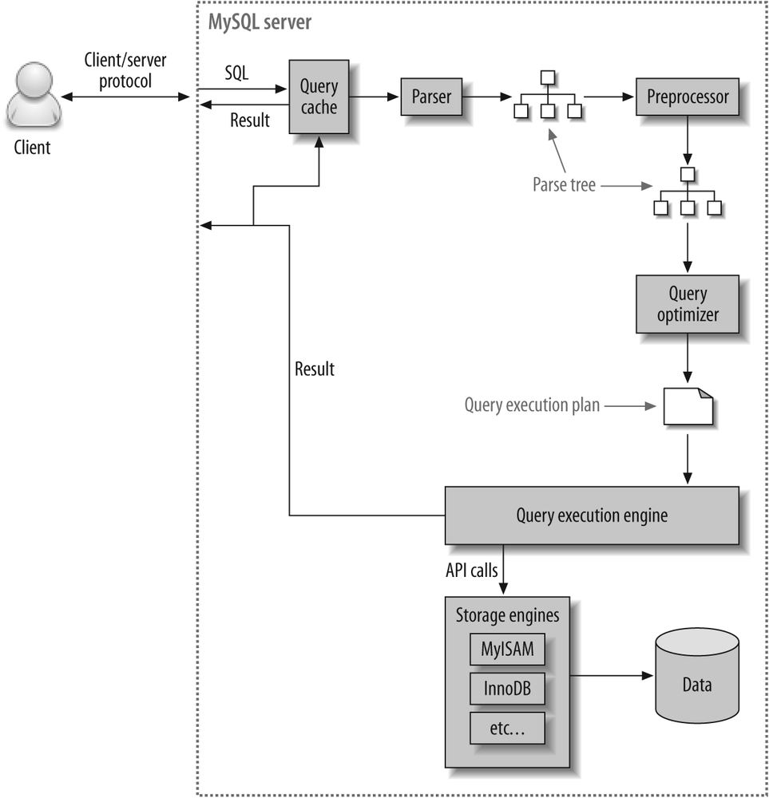
Query Processing (MySQL)
DBMS parses the SQL query and chooses the most efficient access/execution plan
DBMS executes the SQL query using the chosen execution plan
DBMS fetches the data and sends the result set back to the client

Slide 15
SQL Parsing Phase
Divide and Conquer
Query is broken down into smaller units
For efficiency, the original SQL query is transformed into slightly different version of the original SQL code
Query optimizer
Analyzes query to find most efficient way to access data
Access plans
DBMS-specific and translate client’s SQL query into a series of complex I/O operations
If access plan exists (cached), it is reused. If not, the optimizer chooses and caches new one.

Slide 16
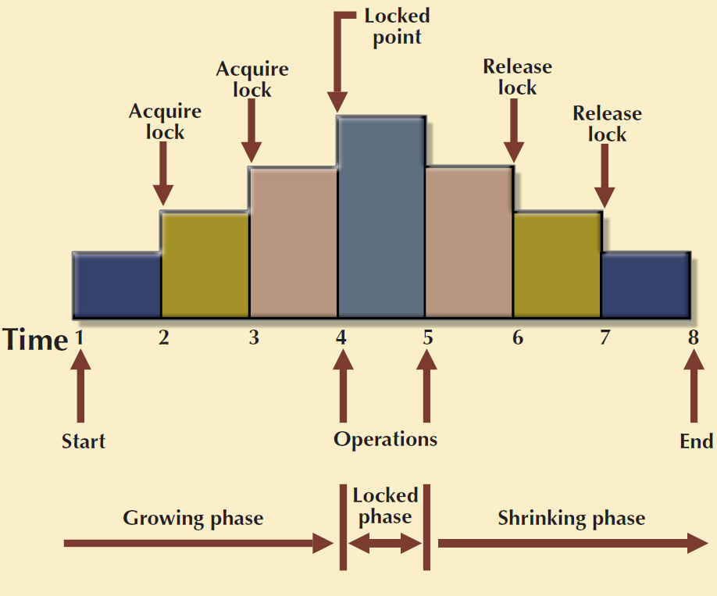
SQL Execution Phase
All I/O operations indicated in the access plan are executed
Locks are acquired
Data are retrieved and placed in data cache
Transaction management commands are processed

Slide 17
SQL Fetching Phase
Rows of resulting query result set are returned to client
DBMS may use temporary table space to store temporary data
DBMS coordinates the movement of the result set rows from the server cache to the client cache

Slide 18
Query Processing Bottlenecks
Delay introduced in the processing of an I/O operation that slows the system
Caused by the:
CPU
RAM
Hard disk
Network
Application code

Slide 19
Indexes and Query Optimization
Indexes
Ordered set of values that contain the index key and pointers
Help speed up data access
Facilitate searching, sorting, using aggregate functions, and join operations
More efficient than a full table scan

Slide 20
Indexes and Query Optimization
Data sparsity: Number of different values a column could have
Data structures used to implement indexes:
Hash indexes
B-tree indexes
Bitmap indexes
DBMSs determine best type of index to use

Slide 21
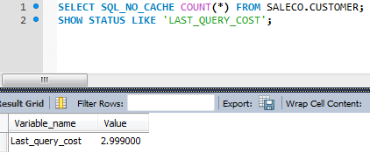
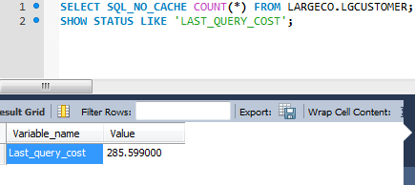
SALECO v. LARGECO

Slide 22
SALECO v. LARGECO
Optimizer estimates are based on:
Number of pages per table or index,
Cardinality (number of distinct values) of indexes
Length of rows and keys, and key distribution.
Does not consider caching and assumes every read will result in a disk I/O operation.
Optimizer estimates it would need _____ random data page reads to select customers from saleco versus _____ random data page reads to select customers from largeco.

Slide 23
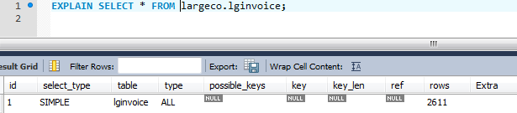
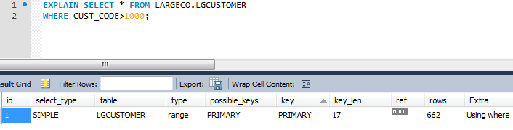
EXPLAIN

Slide 24
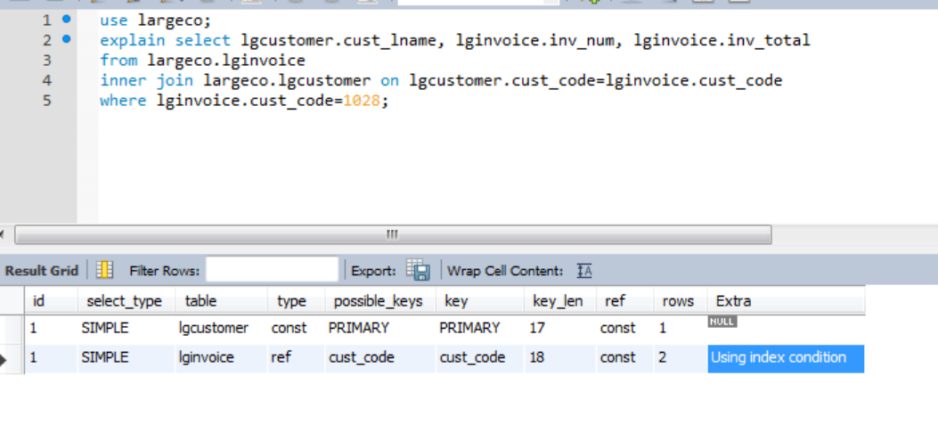
EXPLAIN
MySQL executes this query in two steps
The first step finds the desired rows in LGINVOICE. MySQL’s optimizer knows the number of rows based on the index value of CUST_CODE. (Line 5)
MySQL treats CUST_CODE from the row found in the first step as a known constants. (Line 4)

Slide 25

SQL Performance Tuning
Most current RDBMSs perform automatic query optimization at the server end
Most SQL performance optimization techniques are DBMS-specific and are rarely portable
Majority of performance problems are related to poorly written SQL code and lack of proper indexing (i.e. poor DB design)

Slide 26
Conditional Expressions (1)
Expressed within WHERE or HAVING clauses of a SQL statement
Restricts the output of a query to only rows matching conditional criteria
Guidelines to write efficient conditional expressions in SQL code
Use simple columns or literals as operands
Numeric field comparisons are faster than character, date, and NULL comparisons

Slide 27
Conditional Expressions (2)
Equality comparisons are faster than inequality comparisons
Transform conditional expressions to use literals
Write equality conditions first when using multiple conditional expressions
When using multiple AND conditions, write the condition most likely to be false first
When using multiple OR conditions, put the condition most likely to be true first
Avoid the use of NOT logical operator

Slide 28
DBMS Performance Tuning (1)
DBMS performance tuning at server end focuses on setting parameters used for:
Data cache
SQL cache
Sort cache
Optimizer mode
Partition tables based on usage
Use denormalized tables where appropriate
Store computed and aggregate attributes in tables

Slide 29
DBMS Performance Tuning (2)
Recommendations for physical storage of databases:
Use RAID (Redundant Array of Independent Disks) to provide a balance between performance improvement and fault tolerance
Minimize disk contention
Put high-usage tables in their own table spaces
Assign separate data files in separate storage volumes for indexes, system, and high-usage tables

Slide 30
DB Indexes
Indexes find rows with specific column values.
Without an index, a database begins with the first row and reads through the entire table.
The larger the table, the more this costs.
Indexes quickly determines the position to seek to in the middle of the data file without having to look at all the data.
If a table has 1,000 rows, this is at least 100 times faster than reading sequentially.

Slide 31
Index Selectivity
Measure of the likelihood that an index will be used in query processing
Indexes are used when a subset of rows from a large table is to be selected based on a given condition
Index cannot always be used to improve performance

Slide 32
Index Data Structure (MySQL)
PRIMARY KEY, UNIQUE, INDEX, and FULLTEXT are stored in B-trees (innodb uses B+ trees).
Find rows matching a WHERE clause quickly.
Eliminate rows from consideration.
Retrieves rows from other tables when performing joins.
MySQL can use indexes on columns more efficiently if they are declared as the same type and size.

Slide 33
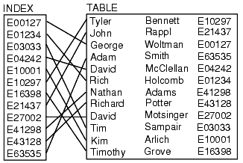
Index Example
select * from table where id=‘E21437’
Search Index for E21437
Retrieve pointer to table
Retrieve data

Slide 34
B-tree Data Structure
Self-balancing tree that keeps data sorted and allows searches, sequential access, insertions, and deletions in logarithmic time.
The B-tree is a generalization of a binary search tree in that a node can have more than two children (Comer 1979).
MySQL uses B+ trees where each leaf links to another in a manner that all leafs connect.

Slide 35
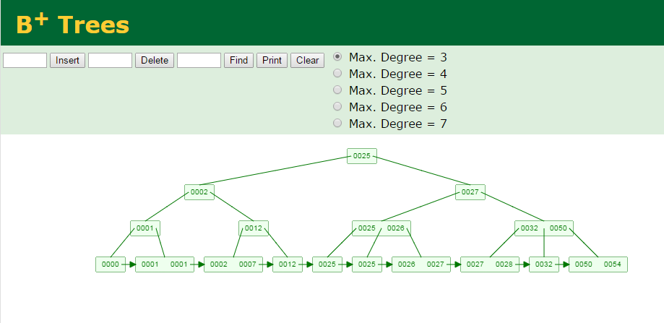
B+ Tree Example

