Slide 1
Chapter 14
Database Connectivity (JDBC & MongoDB)

Slide 2
Learning Objectives (Ch. 14)
Chapter 14 covers:
Java JDBC Architecture
Java SQL Statements, Prepared Statements and ResultSets
MongoDB Driver / Architecture
Examples

Slide 3
JDBC
Java Database Connectivity (JDBC) was a Sun trademark (now owned by Oracle)
Standardized API for use by Java programs, but there are many versions of SQL
Allows access to databases to connect from Java
Also specifies how third-party vendors should write database drivers to access specific SQL versions

Slide 4
JDBC Architecture
Oracle
Driver
Oracle
Java Application
JDBC
MSSQL
Driver
Sequel
Network
Services
MySQL
Driver
MySQL

Slide 5
JDBC Architecture (cont.)
Application
JDBC
Driver
Java code calls JDBC library
JDBC loads the driver
Driver communicates with the DBMS
Application can interact with several DBs by using all corresponding drivers

Slide 6
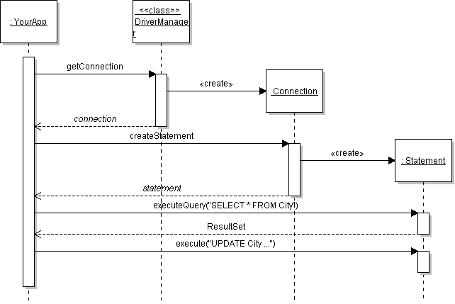
JDBC Overview
Connection to a database.
Execute SQL.
Parse results.

Slide 7
JDBC Overview
selects a specific Connection type and instantiates it
creates Statements for database actions

Slide 8
Manipulating Databases with JDBC
Complete Steps in Using JDBC
Load the driver
Define the Connection URL
Establish the Connection
Create a Statement object
Execute a query
Process the results
Close the connection

Slide 9
JDBC Drivers
JDBC consists of two parts:
JDBC API
JDBC Driver Manager: Communicates with vendor-specific drivers (MySQL, Sequel, Oracle, etc.) that control access and communication with the DBMS.

Slide 10
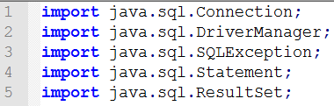
Connecting to a Database
java.sql.Connection is the standard interface for connecting to any database. Each database type requires its own jdbc driver that implements this interface.
DriverManager: Selects driver based on URL
MySQL driver mysql-connector-java-5.1.7-bin.jar

Slide 11
Where is the Database Driver?
Driver is in a JAR file.
JAR file must be found in the application CLASSPATH as:
An external jar file to your IDE project
JAR appended to the CLASSPATH CLASSPATH = /my/path/mysql-connector.jar;.
JAR added through the command line: java -cp /my/path/mysql-connector.jar ...
JAR located within JRE/lib/ext directory: C:/java/jre1.6.0/lib/ext/mysql-connector.jar

Slide 12
JDBC Driver for MySQL (Connector/J)
Connector/J : http://dev.mysql.com/downloads/connector/j/5.0.html
To install simply unzip (or untar) and put mysql-connector-java-[version]-bin.jar (I have installed mysql-connector-java-5.0.4-bin.jar) in the class path
For online documentation, see : http://dev.mysql.com/doc/refman/5.0/en/connector-j.html

Slide 13
Database URL
The format of a database URL is:
String DB_URL = "jdbc:mysql://dbserver:3306/saleco";
Protocol Sub-protocol Hostname Port DatabaseName
Port is the TCP port number where the database server is listening.
3306 is the default port for MySQL
Use hostname "localhost" for the local machine.

Slide 14
Database URL
The hostname and port are optional. MySQL driver defaults are localhost and port 3306
Example: These 4 URL refer to the same database
"jdbc:mysql://localhost:3306/saleco"
"jdbc:mysql://localhost/saleco"
"jdbc:mysql:///saleco"
"jdbc:mysql:/saleco"

Slide 15
Establishing the Connection
To execute an SQL command, use the Connection object to create an SQL Statement object.
String DB_URL ="jdbc:mysql:///saleco", "root","";
Connection connection =
DriverManager.getConnection(DB_URL);
if (!con.isClosed())
System.out.println("Successfully connected to MySQL server ...");

Slide 16
Executing SQL Commands
To execute an SQL command, use the Connection object to create an SQL Statement object.
Statement interface defines methods for executing commands.
Statement statement=connection.createStatement( );
// execute an UPDATE command
int count = statement.executeUpdate(
"UPDATE VENDOR
SET VEND_CONTACT=‘Smitty’ WHERE VEND_NUMBER=21225" );
System.out.println(
"Modified " + count + " records");

Slide 17
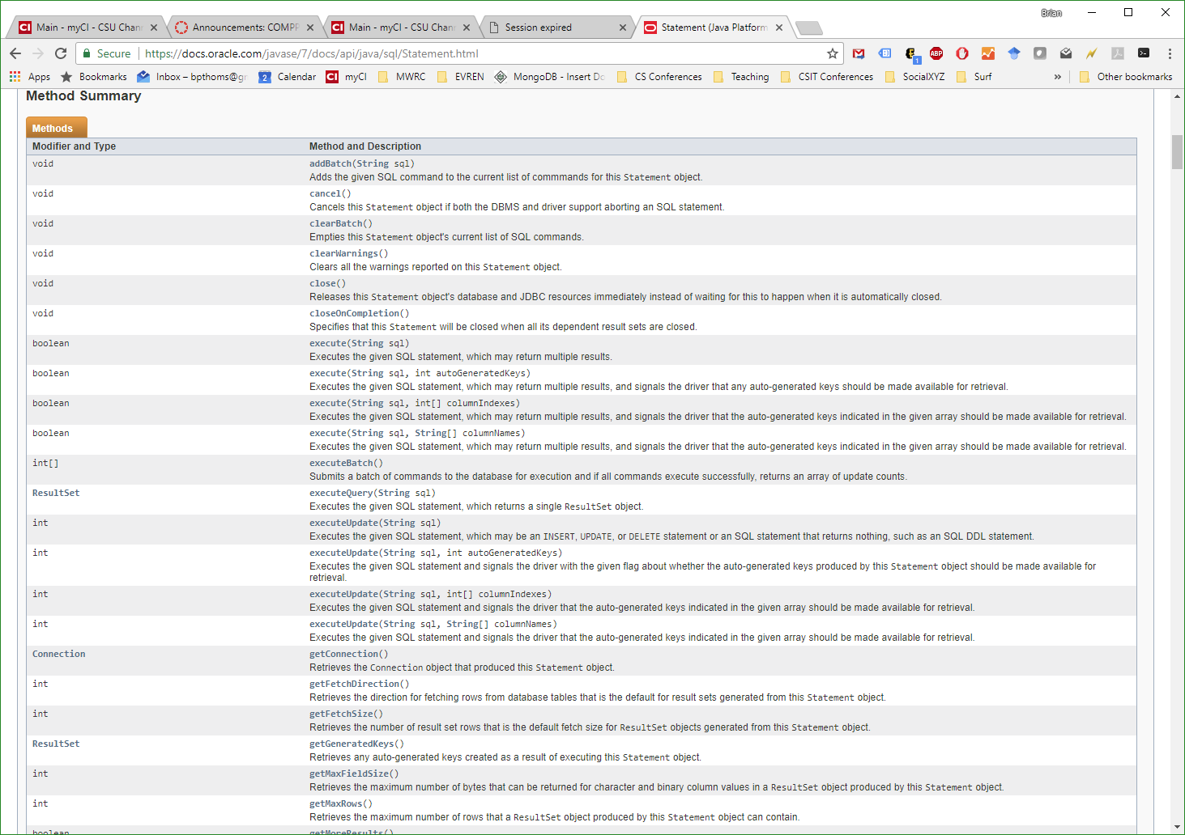
Java Statement Class

Slide 18
Executing SQL Queries
A statement.executeQuery( ) returns a ResultSet.
ResultSet is a scrollable set of values.
Statement statement = connection.createStatement();
// execute a SELECT command
ResultSet rs = statement.executeQuery(
"SELECT * FROM VENDOR;");
rs.first(); // scroll to first result
do {
String name = rs.getString(1);// get 1st field
int vend_num = rs.getInt("VEND_NUMBER");
...
} while( rs.next() );

Slide 19
Search for a VENDOR
Scanner console = new Scanner(System.in);
System.out.print( "Name of city to find? " );
String name = console.nextLine().trim();
String query =
“SELECT * FROM VENDOR WHERE VEND_NAME=‘” + name + “’”;
ResultSet rs = statement.executeQuery( query );

Slide 20
ResultSet Methods
ResultSet contains one "row" for each result returned from the query.
ResultSet contains get methods for column data:
"get" by column number -- starts at 1 (not 0)!
"get" by column name -- field names in table/query.
String query = "SELECT * FROM Country WHERE ...";
ResultSet rs = statement.executeQuery( query );
// go to first row of results
rs.first( );
// display the values
System.out.println( rs.getString( 1 ) );
System.out.println( rs.getInt( "population" ) );
get by column number
get by name

Slide 21
ResultSet Methods
A ResultSet contains one "row" for each result returned from the query. Indices start from 1 (not 0)!
ResultSet
next() : boolean
previous() : boolean
first() : boolean
last() : boolean
absolute( k )
getInt( name: String )
getInt( index: int )
...
go to next row of results. "false" if no more.
go to previous row. "false" if 1st result.
go to first row of results.
go to last row of results.
go to k-th row of results.
get int value of field "name"
get int value of k-th column in a record

Slide 22
ResultSet
ResultSet lets you access the results one-by-one without knowing how the results are organized.
ResultSet rs = statement.executeQuery( "..." );
while ( rs.next( ) ) {
String name = rs.getString("name");
int population = rs.getInt("popuation");
System.out.println( name +" "+population );
}

Slide 23
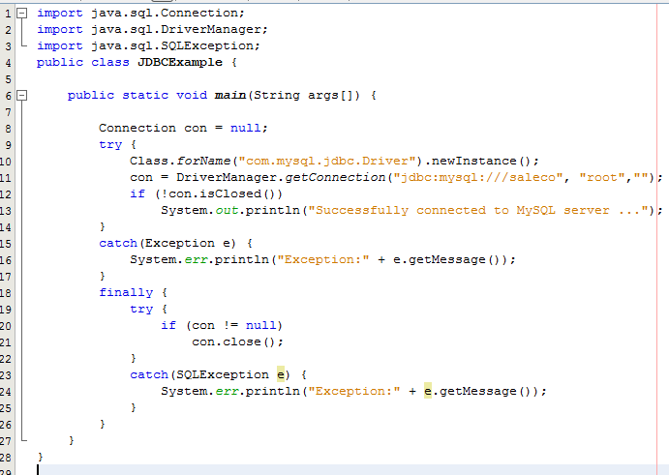
A complete program
Adapted from http://www.stardeveloper.com/articles/display.html?article=2003090401

Slide 24
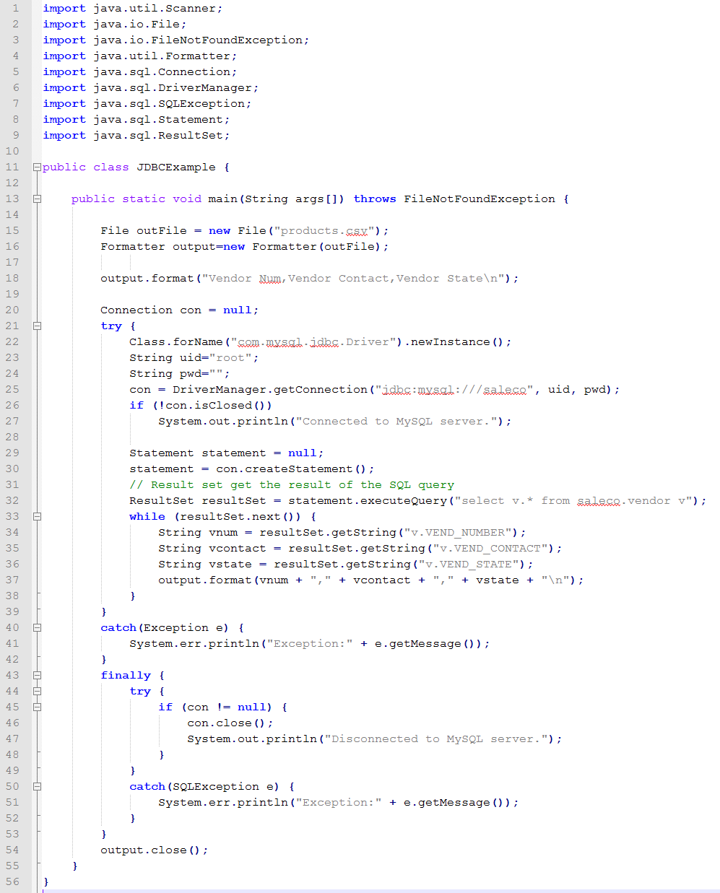
More Complete (JDBCExample.java)

Slide 25
Prepared Statements
Prepared Statements are used for queries that are executed many times
They are parsed (compiled) by the DBMS only once
Column values can be set after compilation
Instead of values, use ‘?’
Hence, Prepared Statements can be thought of as statements that contain placeholders to be substituted later with actual values

Slide 26
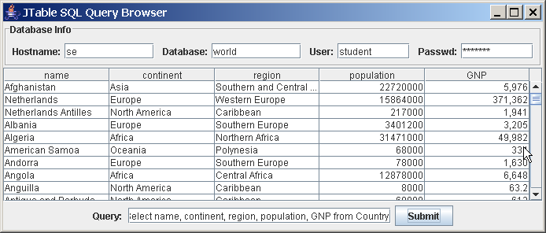
JTable
Swing object that converts result sets into looks spreadsheet-like table.
A JTable

Slide 27
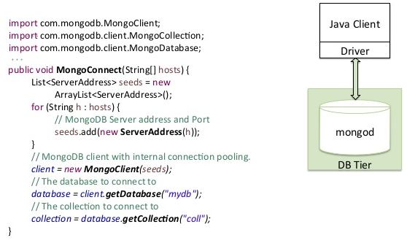
MongoDB Driver
The official MongoDB Java Driver providing both synchronous and asynchronous interaction with MongoDB. Powering the drivers is a new driver core and BSON library.

Slide 28
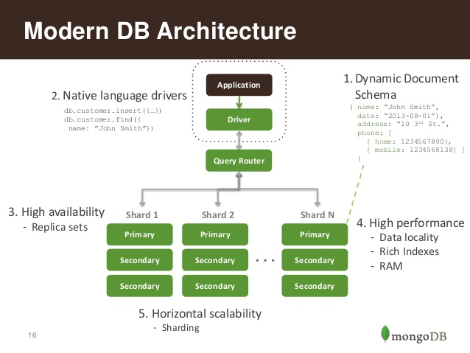
MongoDB Architecture

Slide 29
MongoDB Driver Features (1)
BSON Library
A standalone BSON library, with a new Codec infrastructure that you can use to build high-performance encoders and decoders without requiring an intermediate Map instance.
MongoDB Driver
Java driver that includes the legacy API as well as a new generic MongoCollection interface that complies with a new cross-driver CRUD specification.

Slide 30
MongoDB Driver Features (2)
MongoDB Async Driver
Asynchronous API can leverage either Netty or Java 7's AsynchronousSocketChannel for fast and non-blocking IO.
Core driver
The MongoDB Driver and Async Driver are both built on top of a new core library, which anyone can use to build alternative or experimental high-level APIs.

Slide 31
URL connection
The URL format is unified across official drivers from 10gen with some options not supported on some drivers due to natural reasons. The ones not supported by the Node.js driver are left out for simplicities sake.

Slide 32
URL Parts
mongodb:// is a required prefix to identify that this is a string in the standard connection format.
username:password@ is optional. If given, the driver will attempt to login to a database after connecting to a database server.
host1 is the only required part of the URI. It identifies either a hostname, IP address, or unix domain socket
:portX is optional and defaults to :27017 if not provided.
/database is the name of the database to login to and thus is only relevant if the username:password@ syntax is used. If not specified the “admin” database will be used by default.
?options are connection options. Note that if database is absent there is still a / required between the last host and the ? introducing the options. Options are name=value pairs and the pairs are separated by “&”.

Slide 33
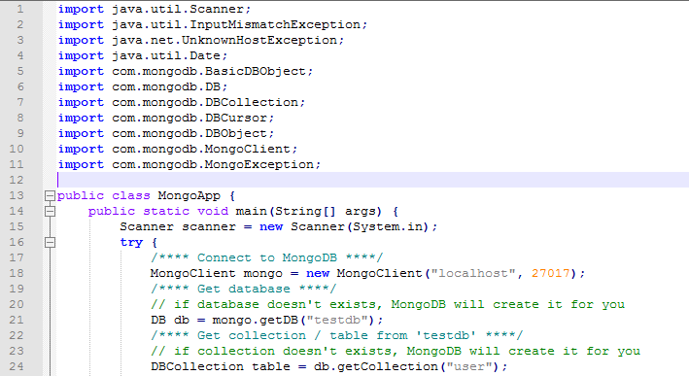
Mongo Imports and DB Connection

Slide 34
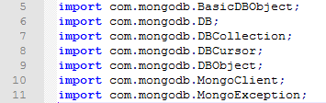
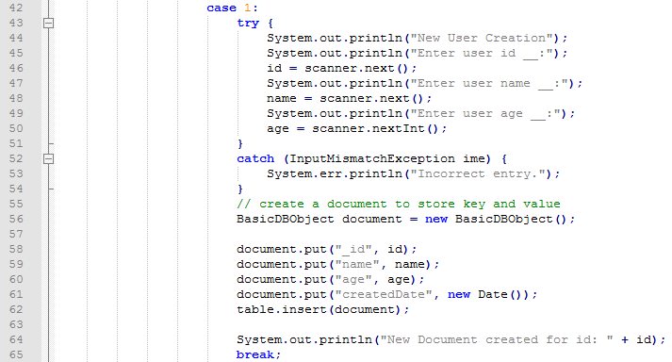
Mongo Insert

Slide 35
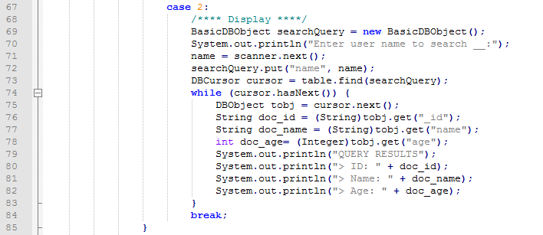
Mongo Search

Slide 36
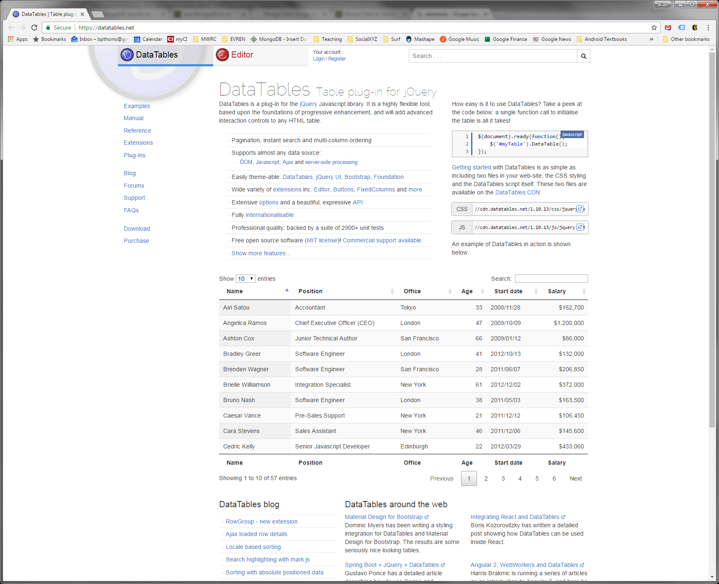
Web Interfaces: datatables.net

Slide 37
Simple In-Class
Let’s build a java program to output product information from saleco to a comma separated file products.csv.
Product Id
Product Name
Product Description
Product Price
Vendor

