Slide 1
Chapter 15
Database Administration and Security

Slide 2
About data…
Dirty data
Data that suffer from inaccuracies and inconsistencies
Data quality
Ensuring accuracy, validity, and timeliness of data
Data profiling software
Determine data patterns and compare them against standards defined by the organization
Master data management (MDM) software
Helps prevent dirty data by coordinating across multiple systems

Slide 3
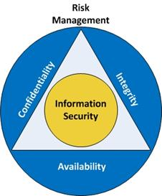
Information Security
Protection of information [systems] from unauthorized access, use, disclosure, disruption, modification or destruction.
Achieved through:
Confidentiality
Integrity
Availability
Notes:
Confidentiality – the property that electronic health information is not made available or disclosed to unauthorized persons or processes.
Integrity – the property that electronic health information have not been altered or destroyed in an unauthorized manner.
Availability – the property that electronic health information is accessible and useable upon demand by an authorized person.

Slide 4
DBA’s Managerial Role
Disaster management: Planning, organizing, and testing of database contingency plans and recovery procedures.
DBA manages DB use and data distribution / replication
Backups
Full backup
Incremental
Concurrent

Slide 5
Security Goals
Confidentiality: Protecting data against unauthorized access
Integrity: Keeping data consistent and free of errors or anomalies
Availability: Accessibility of data whenever required by authorized users and for authorized purposes
Compliance: Activities that meet data privacy and security reporting guidelines

Slide 6
Why do we need to secure information?
Human Threats
Non-Human Threats
Criminals
Surveillance
Discrimination
Control
Human error
Natural Disasters
Disk Failure
Software bugs

Slide 7

How many security fails can you spot?

Slide 8
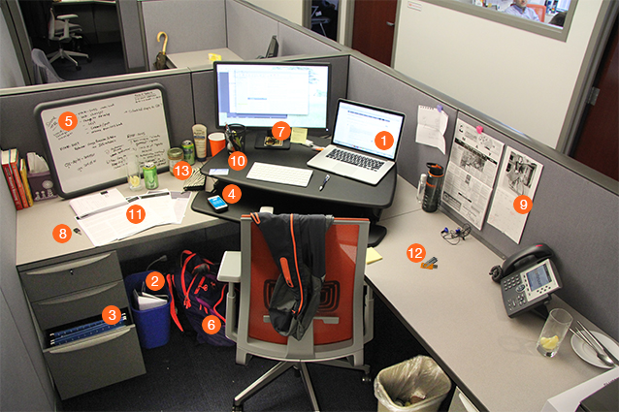
Spot 13 Security Flaws
Computer screen left on with no password protection – passer by has access to information on the device
Unshredded files in trash could contain sensitive information
File cabinet open - easy for someone to steal sensitive information
Cell phone left out in the open - may display sensitive information and/or can be easily stolen
Notes left on whiteboard - could contain confidential product updates, information or ideas
Backpack left out and open
Usernames and passwords left out in the open
Key to locked drawer left out in the open - easy access to confidential files
Calendar out in the open - could contain sensitive dates and/or information
Credit card left out on desk
Documents left out on desk that could contatin sensitive information
USB drive left out in the open
Wallet left on desk
Let me tell you about InfoSec

Slide 9
Database Security
DBMS features and related measures that comply with the security requirements
Authorization management: Procedures to protect database security and integrity.
User access management
DB View definition
DBMS access control
DBMS usage monitoring
Audit log: Automatically records description of database operations performed by all users

Slide 10
Database Security (Cont’d)
Ensure that the RDBMS starts automatically
Create tablespaces and datafiles
Tablespace: Logical storage space
Datafile: Physically stores the database’s data
Manage users and establish security
User: Allows a given person to log on to the database
Role: Authorize a user to connect to the database and use its system resources (roles are not formal in MySQL)
Profile: Control how much database resource a user can use
Least privilege.

Slide 11
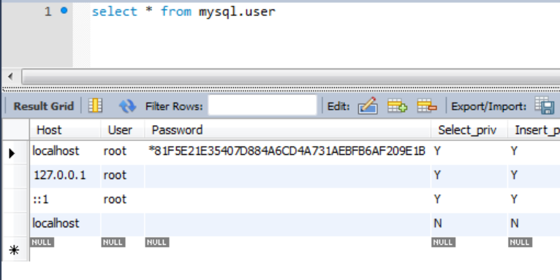
MySQL Security
Duh! Never grant users access to mysql.user table. Instead:
CREATE USER 'testuser'@'localhost 'IDENTIFIED BY 'password123';

Slide 12

MySQL Security
root@localhost
This is nice for development… But bad practice. Why?

Slide 13
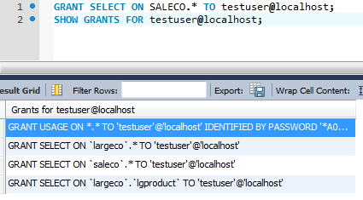
MySQL Security
testuser@localhost

Slide 14
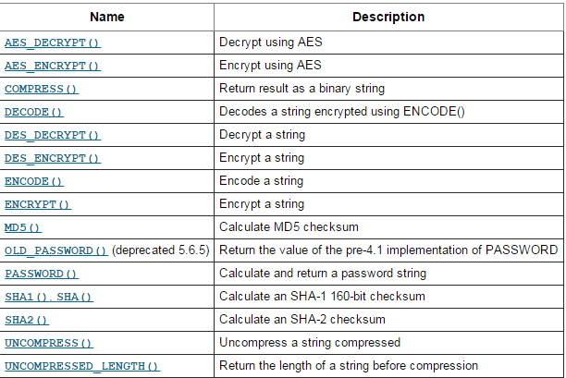
MySQL Encryption and Compression
AES v SHA

Slide 15
MySQL Encryption
Full Disk Encryption (FDE) means that the entire disk used by MySQL for storing the database is encrypted.
Simple, transparent and less error prone.
Transparent Data Encryption encrypts specific files since MySQL can be configured so that each DB table gets saved into a separate file.
Encrypting specific rows, fields or columns in MySQL through SQL or program code.

Slide 16
Encryption
AES
AES_ENCRYPT() and AES_DECRYPT() implement encryption and decryption of data using the official AES (Advanced Encryption Standard) algorithm,
DES (no longer secure)
DES_ENCRYPT(str[,{key_num|key_str}])
Encrypts the string with the given key using the Triple-DES algorithm.
Works only if MySQL has been configured with SSL support

Slide 17
Run the following

Slide 18
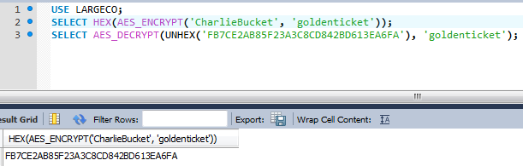
AES Example

