Slide 1
Chapter 3
The Relational Database

Slide 2
Learning Objectives
This chapter covers the relational model’s:
Conceptual Model
Relations (aka Tables)
Keys (Primary, Foreign)
Relational Algebra (Intro to SQL)
Data Dictionary (power of metadata)

Slide 3
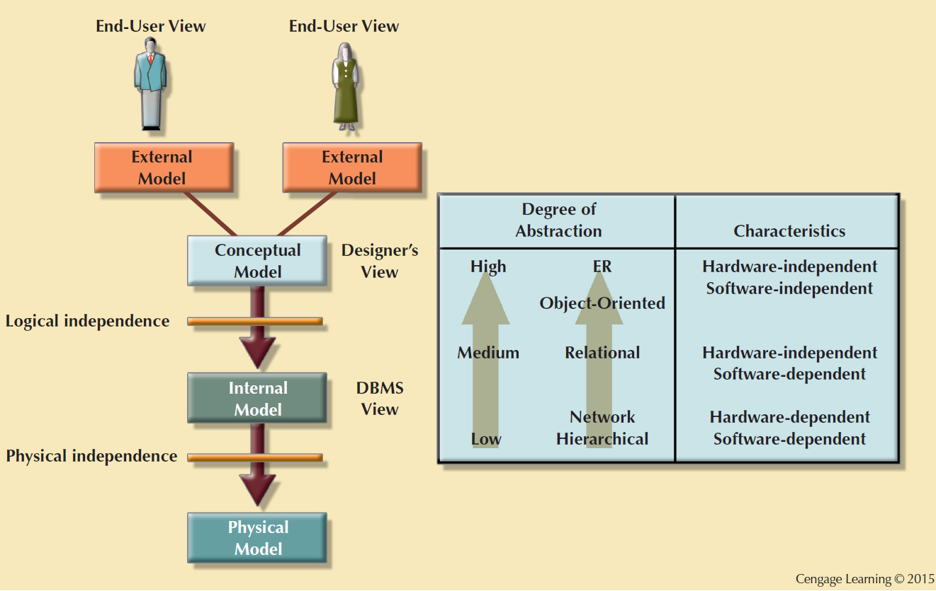
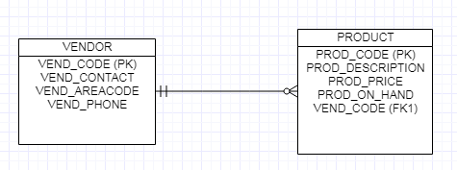
Conceptual Model
The ERD represents the conceptual model.

Slide 4
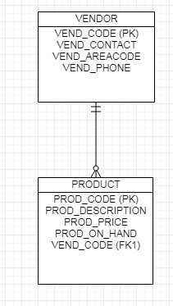
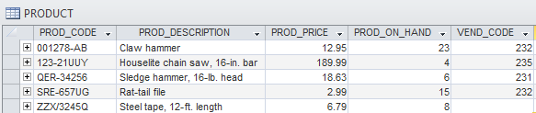
A Relation (aka table, file)
Puts the relation in relational databases.
Persistent, representation of an entity.
Groups related entity occurrences (instances of an entity)

Slide 5
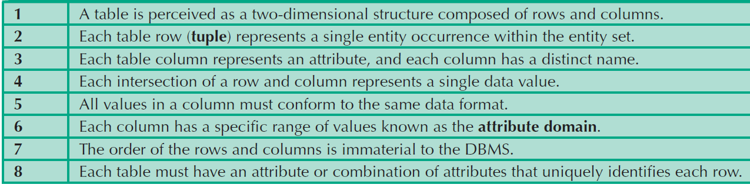
Characteristics of a Relational Table
1
2
3
4
5
6
7
8

Slide 6

NULL Keyword
When the intersection of a row and a column is absent of data.
Possibly reasons:
An unknown attribute value
A known, but missing, attribute value
A inapplicable condition (middle name/initial)
NOT NULL constraints enforce required data.
Meet Vidya
EID | FNAME | LNAME | ADDRESS
000001032 | Nfn | Vidyaranya | 388 Greenwich St. NY,NY10013

Slide 7

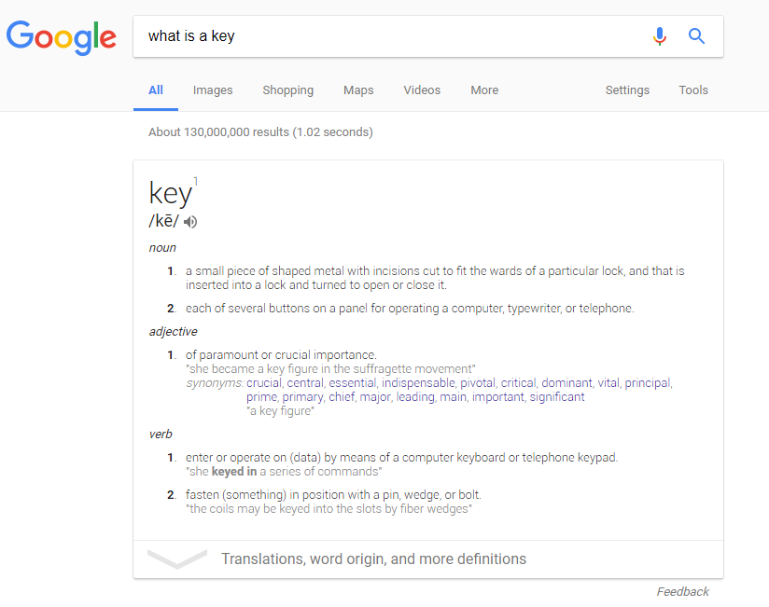
Keys
DICTIONARY.COM (30+ definitions)

Slide 8
Keys
Computers: a field or group of characters within a record that identifies the record, establishing its position among sorted records, and/or provides information about its contents. One or more attributes that determine other attributes.
Integral in DB design and developing efficient relational databases.
Used to:
Ensure table rows are unique (Primary Key)
Establish relationships (Foreign Key)
Ensures entity (1) and relational (2) integrity

Slide 9
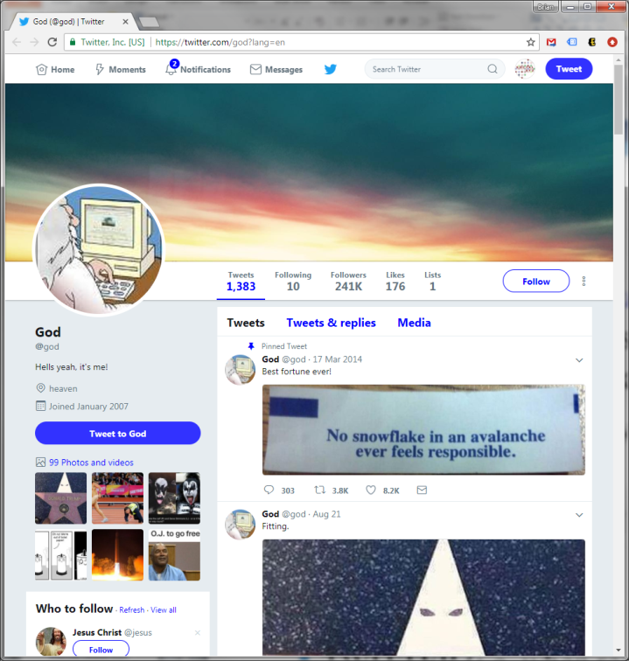
Primary Key (PK)
A designated attribute or combination of attributes that uniquely identifies a table instance.
Help me identify a proper PK?
STUDENT?
Dolphin ID but not SSN (Why?)
FYI - SSN is PII.
CAR?
VIN but not License Plate (Why?)
TWITTER?
Handle but not display name.

Slide 10
Keys are Powerful
Identify other attributes
Can Attribute X determine Attributes Y and Z?
Establish relationships. For example, knowing your Dolphin ID, I can query can:
Get a list of your courses or grades (D-student vs. A-student)
Locate your personal information and address.
Discover unpaid CI parking tickets
Review your health information (Did a student really miss a test b/c he or she was sick?)

Slide 11
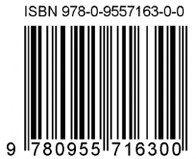
Determining Keys
Discovering keys can be tricky, so keep it simple.
What value(s) identify:
Student or Faculty at CI?
Book on Amazon?
Facebook Account?
Natural Key (SSN) vs. Surrogate Key (Dolphin ID)
Composite Key: A Primary Key that is composed of more than one attribute.
Apartment Building + Unit Number comprises a single apartment address.

Slide 12
Functional Dependence
Determinant: Attribute whose value determines another
DolphinId can determine student info including address information.
Dependent: Attribute whose value is determined by the other attribute
Student Name (FNAME + LNAME) or Address (STREET + APT + CITY + STATE + ZIP) is determined by DolphinId.

Slide 13
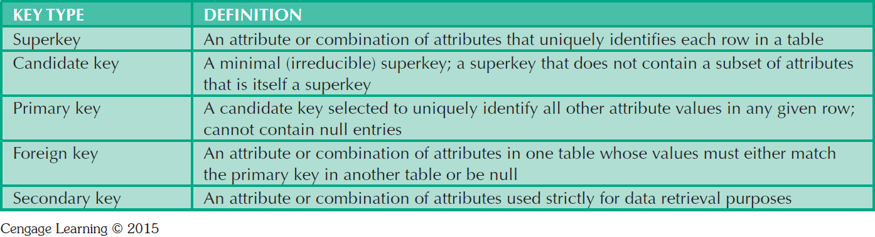
Relational Database Keys
Is a social security number a [super, candidate, primary, foreign, secondary] key?
A primary distinction between candidate and primary key is done for DB optimization and searching and sometimes security (e.g. SSN vs. DolphinId).

Slide 14
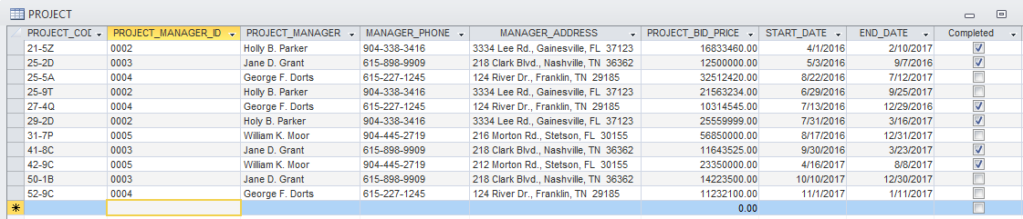
PK and Indexing
Primary Keys have a special role within the RDBMS and are automatically indexed.
PROJECT_INDX
PROJECT_PCODE_INDEX | REC_LOCATION
21-5Z | 1
25-2D | 2
25-5A | 3
25-9T | 4
27-4Q | 5
29-2D | 6
31-7P | 7
41-8C | 8
42-9C | 9
50-1B | 10
52-9C | 11
Adding project code 28-4F is sorted in the table index, but not the project table.

Slide 15
Entity Integrity
A Primary Key ensures entity integrity or a record’s uniqueness (a.k.a. First Normal Form or 1NF)
Cannot contain duplicate values
One SSN per U.S. citizen
One DolphinID per student
Cannot contain NULL values
FYI - AUTO_INCREMENT is not always enough!

Slide 16
Referential Integrity
Every reference to an entity instance by another entity instance is valid (a.k.a. Foreign Key).
Course Enrollment Example
If a student registers for a Fall 2017 section of CSIT 420, we know:
A student exists in table STUDENT.
A course exists in table COURSE.

Slide 17
Relational Integrity: Vendor Products
Consider our E-COMMERCE database where products sold are provided by an external vendor.
Represented as an ERD?
At the very least, we need two tables:
products
vendors
How do these tables relate?
SalesCo.mdb

Slide 18
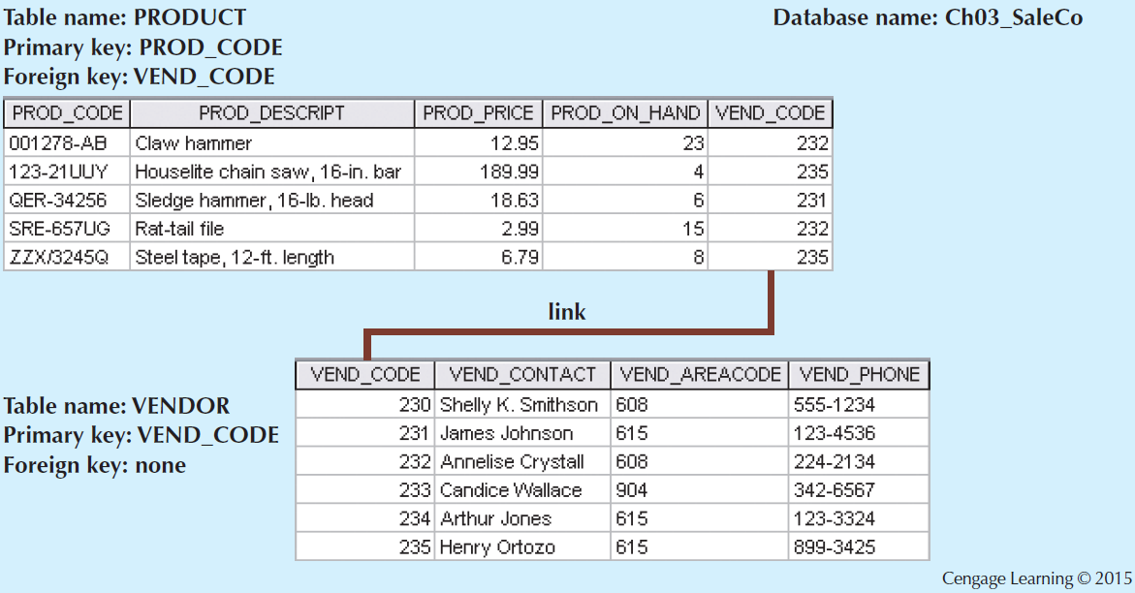
Relational Integrity: Vendor Products

Slide 19
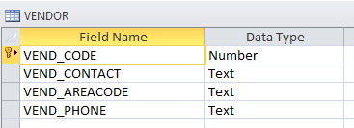
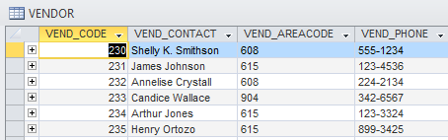
Integrity Rules (PK)
Entity Integrity | Description
Requirement | All primary key entries are unique, and no part of a primary key may be null
Purpose | Entity integrity and all rows are unique
Example | Vendor Code 235 represents Henry Ortozo and only Henry Ortozo
Design: Metadata
Table Data

Slide 20
Integrity Rules (FK)
Entity Integrity | Description
Requirement | A foreign key must link with a primary key in another table or be NULL
Purpose | Prevents update anomalies where data in FK-table is modified and no longer matches values in PK-table.
Example | 123-UUY (houselite chainsaw) is sold by a valid vendor in VENDOR (Henry Ortozo).

Slide 21
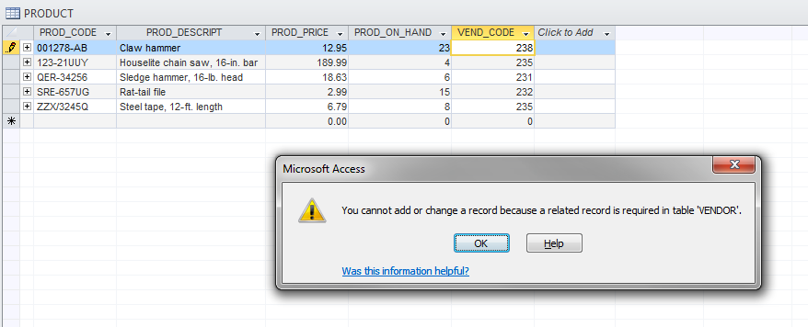
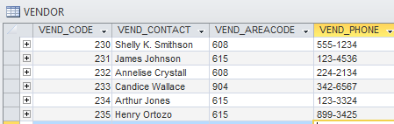
An Illustration of Integrity Rules

Slide 22
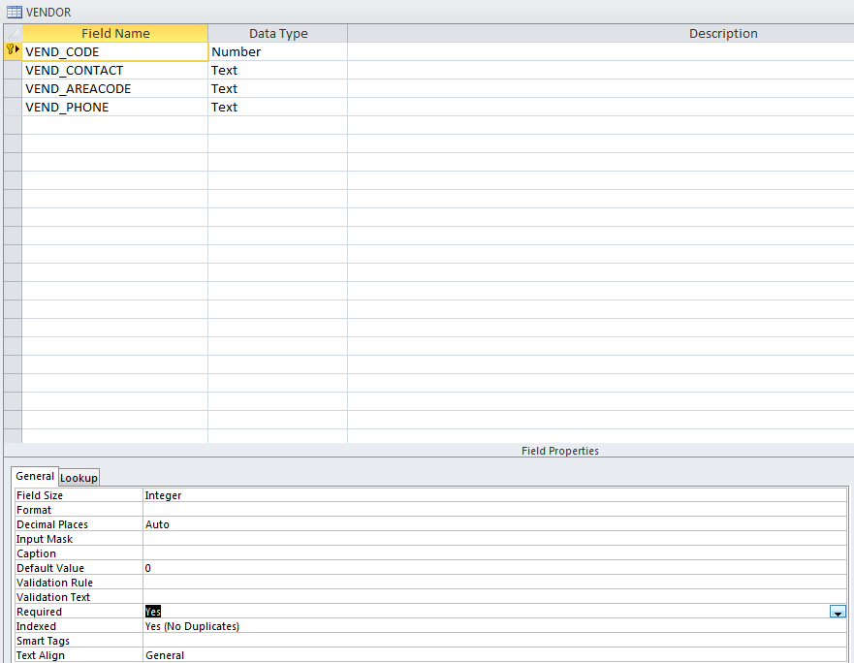
Handling Null Values
Flags: Special codes used to indicate the absence of some value
NOT NULL constraint
Ensures that every row in a table has a value for that column
Example: FirstName field must be added -> Nfn
UNIQUE constraint
Ensures that no duplicate values exist for that column
Example: 1 unique DolphinId can register for CSIT 420

Slide 23
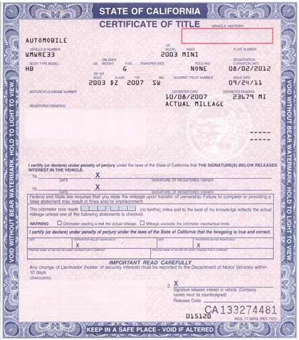
Ex: Car Ownership
DRIVER
LICENSE_ID | LNAME | FNAME | STATE
5TDFHVPCG | Jason | Statham | CA
6HRGFITSJ | Brian | Thoms | CA
5MZINQEAT | Sam | Elliot | TX
TITLE
TITLE_ID | VEHICLE_ID | OWNER_ID
62006234212 | 1GYFK36299R035007 | 5TDFHVPCG
62006441179 | WAUCFAFR9EA386228 | 5TDFHVPCG
62006543316 | YV1960AS2A1981766 | 6HRGFITSJ
VEHICLES
VIN | MAKE | MODEL | YEAR
1GYFK36299R035007 | BMW | M3 | 2015
WAUCFAFR9EA386228 | BMW | M5 | 2015
YV1960AS2A1981766 | Subaru | Outback | 2015
Help me draw the ERD

Slide 24
Relational Algebra
Theoretical way of manipulating table contents using relational operators (i.e. How to query relations)
Select (Restrict)
Unary operator that yields a horizontal subset of a table
Project
Unary operator that yields a vertical subset of a table
Union
Combines all rows from two tables, excluding duplicate rows
Union-compatible: Tables share the same number of columns, and their corresponding columns share compatible domains
Intersect
Yields only the rows that appear in both tables
Tables must be union-compatible to yield valid results

Slide 25
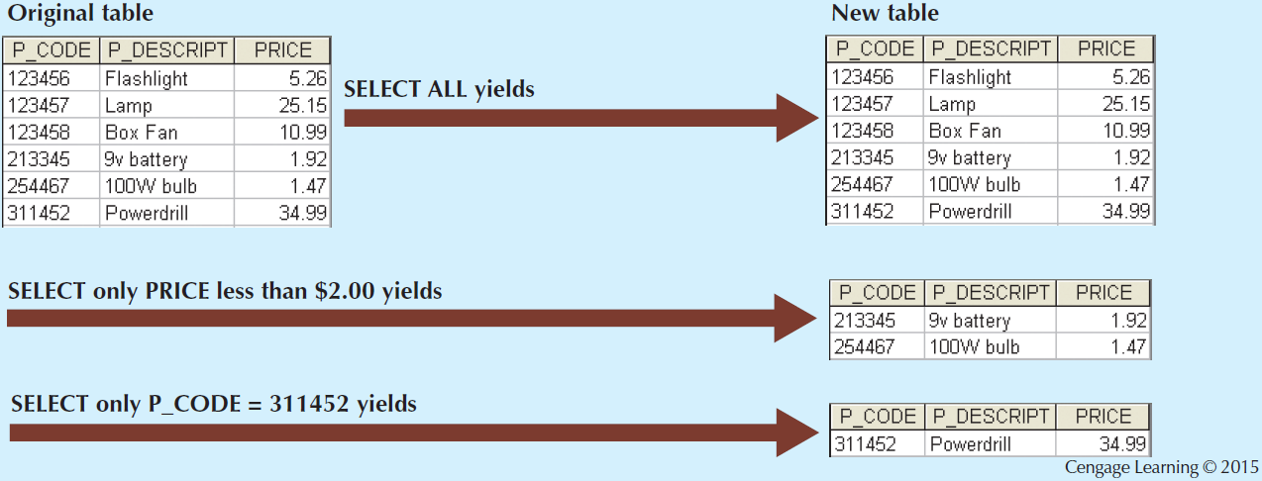
Select

Slide 26
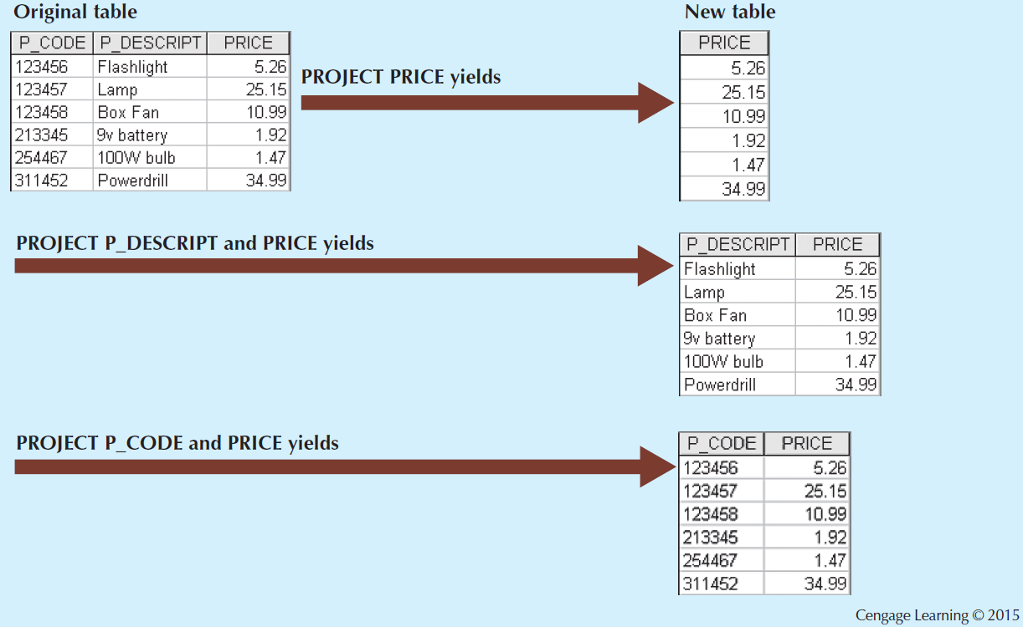
Project

Slide 27
SELECT and PROJECT in SQL
In SQL PROJECT and SELECT are the same operation, SELECT.
SELECT VendorFName, VendorLName
FROM VendorTbl
WHERE VendorID=123

Slide 28
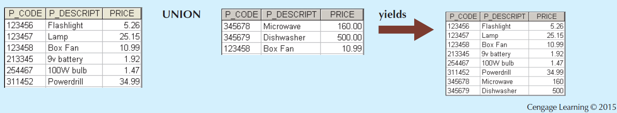
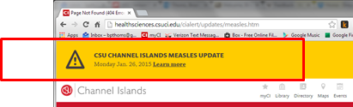
Union (combine tables)
The text messages sent to all cell numbers listed in the CI database, which is a union of:
Students
Faculty
Administrators
Support

Slide 29
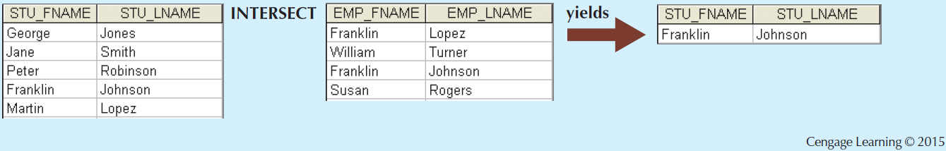
Intersect (match on like data)

Slide 30
UNION in SQL
In SQL
SELECT LocationID, DepartmentName
FROM Departments
UNION
SELECT LocationID, WarehouseName
FROM Warehouses;

Slide 31
Relational Set Operators
Difference
Yields all rows in one table that are not found in the other table
Tables must be union-compatible to yield valid results
Product
Yields all possible pairs of rows from two tables

Slide 32
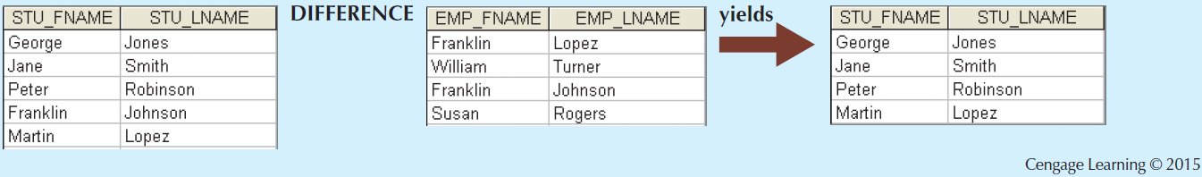
Difference

Slide 33
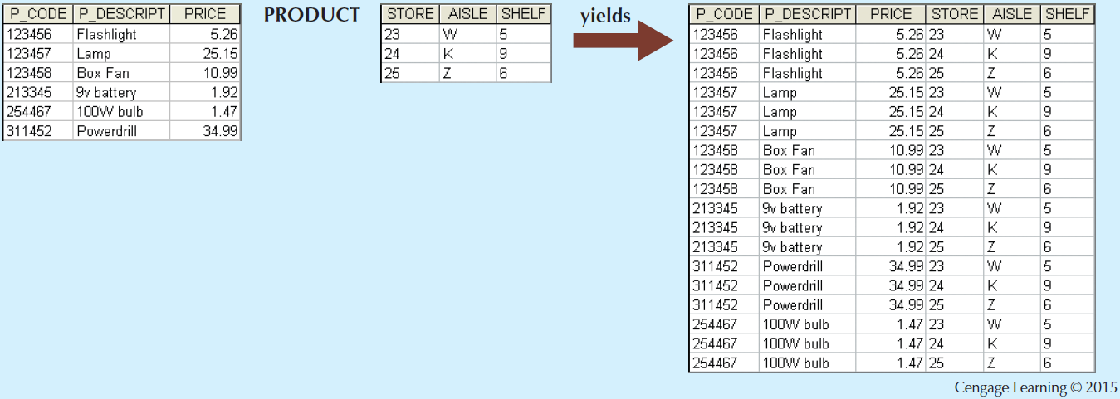
Product
Kind of useless, unless you want a dump of all data from each table mapped with all data from another.

Slide 34
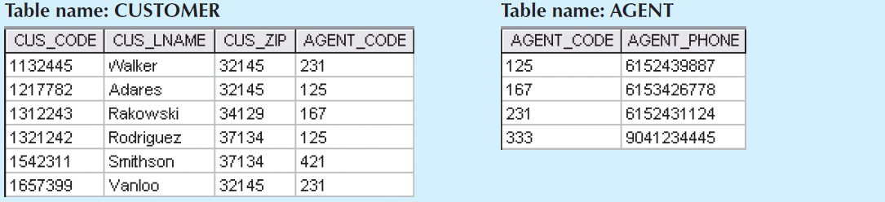
Relational Set Operators
Join
Allows information to be intelligently combined from two or more tables
One of the most important abilities of SQL and RDMBS. Allows data from multiple tables to be combined to form new information.

Slide 35
Joins in SQL
Attributes
SELECT CUS_LNAME, AGENT_PHONE
FROM CUSTOMER
LEFT JOIN AGENT ON CUSTOMER.AGENT_CODE=AGENT.AGENT_CODE
Tables
Intersection

Slide 36
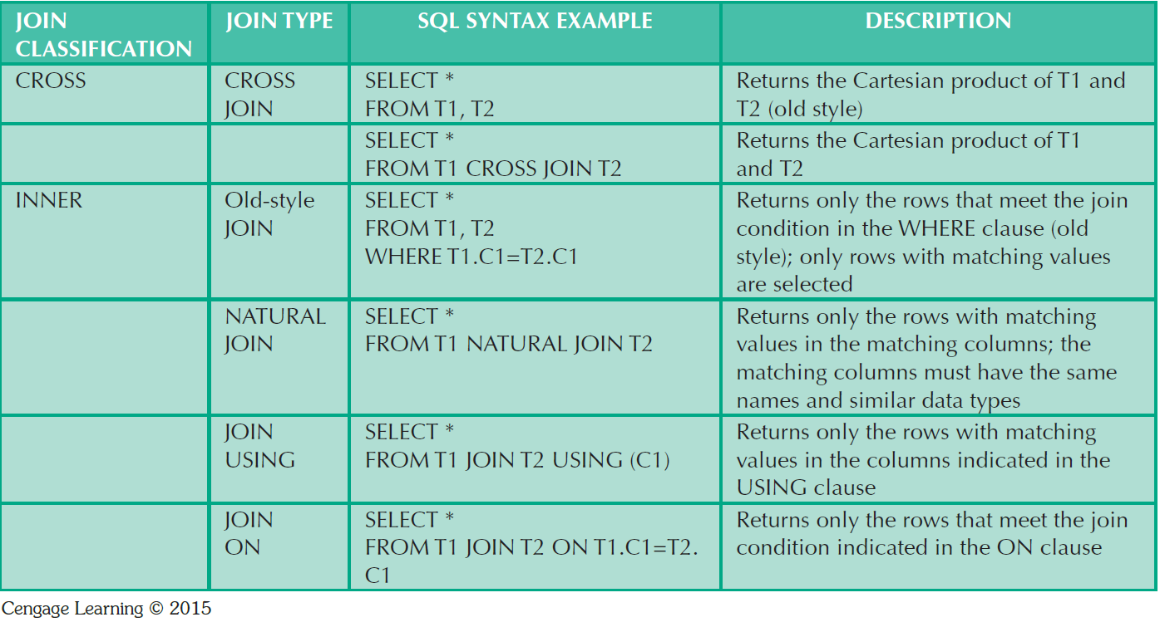
SQL Join Expression Styles
I’m old ☹
ANSI-89
Popular with the kids these days…
ANSI-92

Slide 37
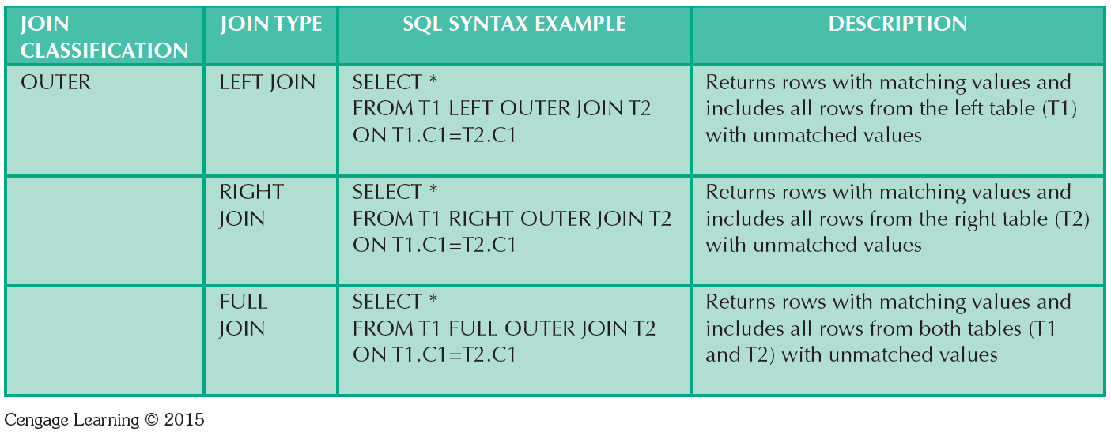
SQL Join Expression Styles

Slide 38


Slide 39
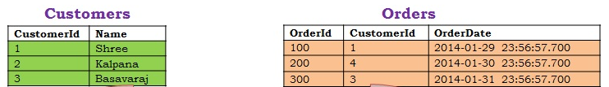
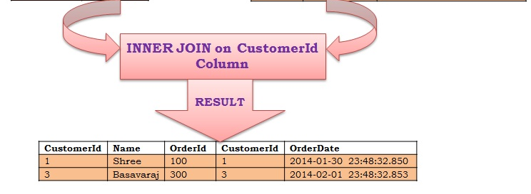
Inner Join
Result?
SELECT *
FROM Customers C
INNER JOIN Orders O
ON O.CustomerId = C.CustomerId
Syntax?

Slide 40
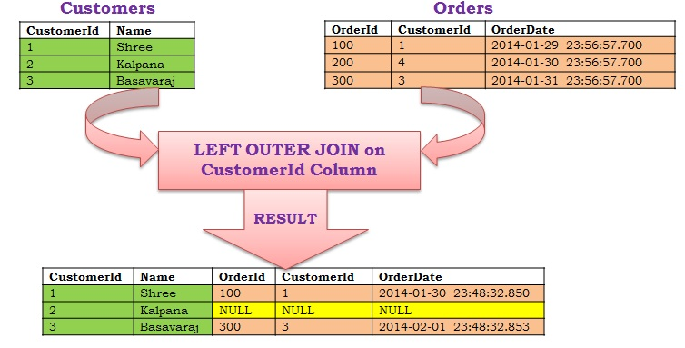
Left Outer Join
Result?
SELECT *
FROM Customers C
LEFT OUTER JOIN Orders O
ON O.CustomerId = C.CustomerId
Syntax?

Slide 41
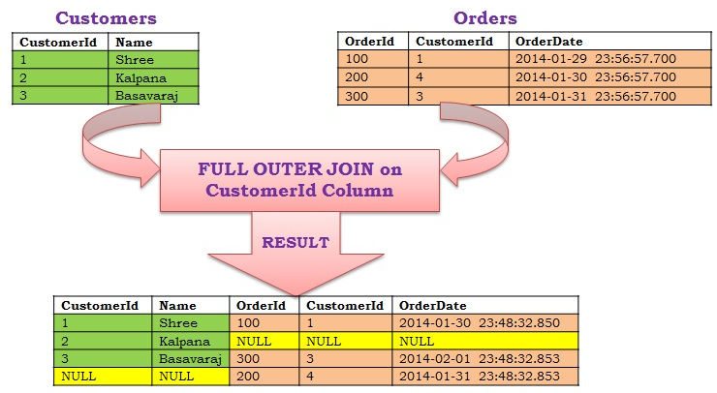
Full Outer Join
Result?
SELECT *
FROM Customers C
RIGHT OUTER JOIN Orders O
ON O.CustomerId = C.CustomerId
Syntax?

Slide 42
RDBMS Data Dictionary and the System Catalog
Data dictionary: Description of all tables in the database created by the user and designer
System catalog: System data dictionary that describes all objects within the database
Homonyms and synonyms must be avoided to lessen confusion
Homonym: Same name is used to label different attributes
Synonym: Different names are used to describe the same attribute

Slide 43
Relationships within the Relational Database
1:M relationship - Norm for relational databases
1:1 relationship - One entity can be related to only one other entity and vice versa
Many-to-many (M:N) relationship - Implemented by creating a new entity in 1:M relationships with the original entities
Composite entity (Bridge or associative entity): Helps avoid problems inherent to M:N relationships, includes the primary keys of tables to be linked
AKA Intersection Table

Slide 44
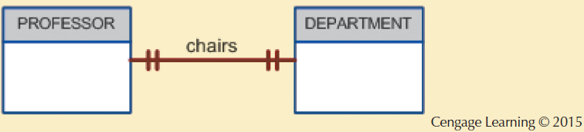
The 1:1 Relationship between PROFESSOR and DEPARTMENT

Slide 45
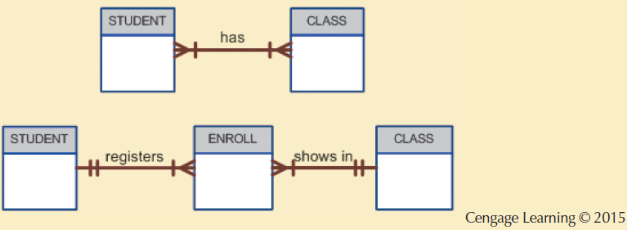
Changing the M:N Relationship to Two 1:M Relationships

Slide 46
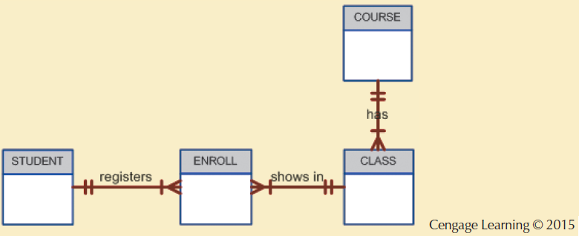
The Expanded ER Model

Slide 47
Summary
Tables are basic building blocks of a relational database
Keys are central to the use of relational tables
Keys define functional dependencies
Superkey
Candidate key
Primary key
Secondary key
Foreign key

Slide 48
Summary (cont’d.)
Each table row must have a primary key that uniquely identifies all attributes
Tables are linked by common attributes
The relational model supports relational algebra functions
SELECT, PROJECT, JOIN, INTERSECT UNION, DIFFERENCE, PRODUCT, DIVIDE
Good design begins by identifying entities, attributes, and relationships
1:1, 1:M, M:N

