Slide 1
Chapter 6
Normalization of Database Tables

Slide 2
Learning Objectives
This chapter covers:
Advanced Data Modeling
Normalization and its role in DB Design
Normal forms: 1NF, 2NF, 3NF, BCNF, and 4NF
How normal forms can be transformed from lower normal forms to higher normal forms
Situations where denormalization is preferred

Slide 3
Normalization
Evaluating table structures to minimize redundancy.
Reduces data anomalies and correct table structures.
Types:
First normal form (1NF)
Second normal form (2NF)
Third normal form (3NF)
Boyce-Codd normal form (BCNF)
Fourth normal form (4NF)

Slide 4
Database Anomalies
Data redundancy → Data anomalies (i.e. inconsistent data)
Insertion
Certain data cannot be inserted without the presence of other data.
Deletion
Certain data are lost because of the deletion of other data.
Update
One or more instances of duplicated data is updated, but not all.

Slide 5
Anomalies Examples
TABLE: COURSE
COURSE# (PK) | SECTION# (PK) | C_NAME
CSIT420 | 072 | Database Design
CSIT420 | 073 | Database Design
CSIT520 | 072 | Advanced Database Design
CSIT420 | 074 | Database Design

Slide 6
Insertion Anomaly
TABLE: COURSE
COURSE# (PK) | SECTION# (PK) | C_NAME
CSIT420 | 072 | Database Design
CSIT420 | 073 | Database Design
CSIT520 | 072 | Advanced Database Design
CSIT420 | 074 | Database Design
Suppose CS/IT approved a new course:
CSIT421: SQL & PL/SQL
How, if possible, could this information be entered into the COURSE table in its present form?

Slide 7
Deletion Anomaly
TABLE: COURSE
COURSE# (PK) | SECTION# (PK) | C_NAME
CSIT420 | 072 | Database Design
CSIT420 | 073 | Database Design
CSIT520 | 072 | Advanced Database Design
CSIT420 | 074 | Database Design
Suppose not enough students enrolled for the course CSIT520 (minimum cardinality), which has only one Section,072. CS/IT decides to drop this.
Can this be accomplished? What are the consequences?

Slide 8
Update Anomaly
TABLE: COURSE
COURSE# (PK) | SECTION# (PK) | C_NAME
CSIT420 | 072 | Database Design
CSIT420 | 073 | Database Design
CSIT520 | 072 | Advanced Database Design
CSIT420 | 074 | Database Design
Suppose course name for CSIT420 is changed to Database Theory.
How many times do you have to make this change in the COURSE table in its current form?

Slide 9
Database End Goal
A table (relation) is stable (‘good’) only if it is free from any of these anomalies at any point in time.
Must ensure that each and every table is free from anomalies.
Accomplished through normalization.

Slide 10
Normalization
Decomposing a table (i.e. splitting it up) into less redundant (and smaller) tables without losing information.
Foreign keys in the old table reference primary keys of the new ones.
Higher normal forms are better than lower normal forms.
Denormalization: Produces a lower normal form
Results in increased performance and greater data redundancy

Slide 11
Need for Normalization
Normally performed during the DB Design process:
Analyze relationships among attributes and entities
Determine if a structure can be improved
Break down entities into multiple sub-entities
Improve / Strengthen existing data structure
Normalizing existing databases is more difficult…

Slide 12
Normalization Process
Ensures each table conforms to the concept of well-formed relations
Each table represents a single object or intersection of objects.
No complete data item is unnecessarily stored in more than one table
All nonprime attributes in a table are dependent on the primary key
Each table is void of insertion, update, and deletion anomalies

Slide 13
Normalization Process
Goal is Third Normal Form (3NF).
Higher forms are not likely to be encountered in common business environments.
Works one relation at a time.
To begin:
Identify entity dependencies (table-level).
Progressively breaking the relation into new sets relations.

Slide 14
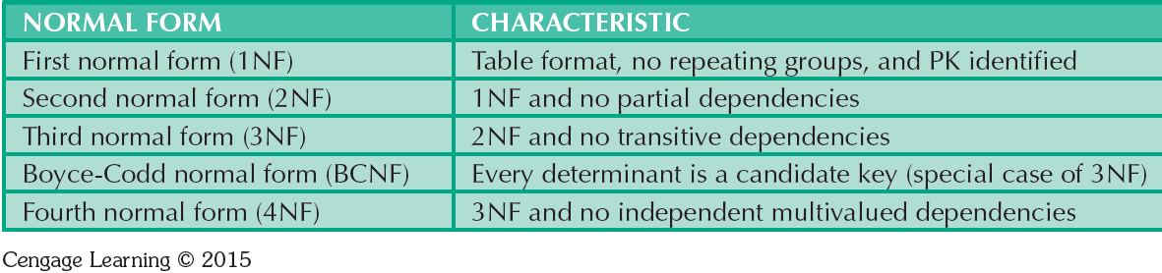
Normal Forms

Slide 15
Functional Dependence Concepts
Concept | Definition
Functional dependence | Attribute B is fully functionally dependent on the attribute A if each value of A determines one and only one value of B.
Functional dependence (Generalized definition) | Attribute A determines attribute B if all of the rows in the table that agree in value for attribute A also agree in value for attribute B.
Full functional dependence (composite key) | If attribute B is functionally dependent on a composite key A but not on any Subset of that composite key, the attribute B is fully functionally dependent on A.

Slide 16
Functional Dependence (Example)
Table "Employee"
What is a suitable determinant for this entity?
Functional dependency {Employee ID} → {Employee Fname}
Functional dependency {Employee ID} → {Employee Lname}
Functional dependency {Employee ID} → {Employee Address}
Functional dependency {Employee ID} → {Employee DOB}
Etc.

Slide 17
Functional Dependence (Example 2)
Table “Course"
What is a suitable determinant for this entity?
Functional dependency {Course ID} → {Course Name}
Functional dependency {Course ID} → {Course Credits}
Functional dependency {Course ID} → {Course Major}
Etc.

Slide 18
Dependencies: Definitions
Partial Dependency – Functional dependence in which a determinant is only part of the primary key
Straight forward and easy to identify
Partial Dependency

Slide 19
Dependencies: Definitions
Transitive Dependency – An attribute depends on another non-key attribute
Transitive Dependency

Slide 20
Conversion to First Normal Form
Identify and eliminate repeating groups
Group of multiple entries of same type can exist for any single key attribute occurrence
Steps:
Eliminate the repeating groups.
Identify a primary key.
Identify dependencies.

Slide 21
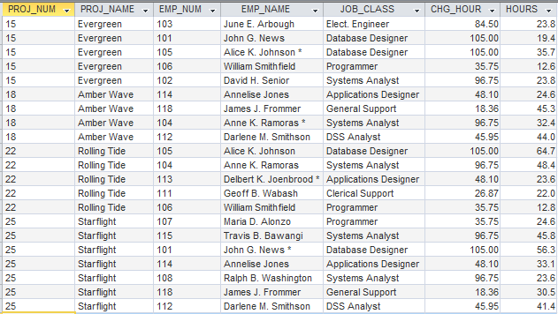
Moving to 1NF: ASSIGNMENT Table
(1NF) All rows comprise a unique instance of an entity.

Slide 22
Conversion to First Normal Form
1NF describes tabular format in which:
All key attributes are defined
There are no repeating groups in the table
All attributes are dependent on the primary key
All relational tables satisfy 1NF requirements
Tables may have partial and transitive dependencies
Subject to data redundancies and various anomalies

Slide 23
Conversion to First Normal Form
Dependency diagram: Depicts all dependencies found within given table structure
Overview of all relationships among table’s attributes
Makes it less likely that an important dependency will be overlooked

Slide 24
ASSIGNMENT Determinants?

Slide 25
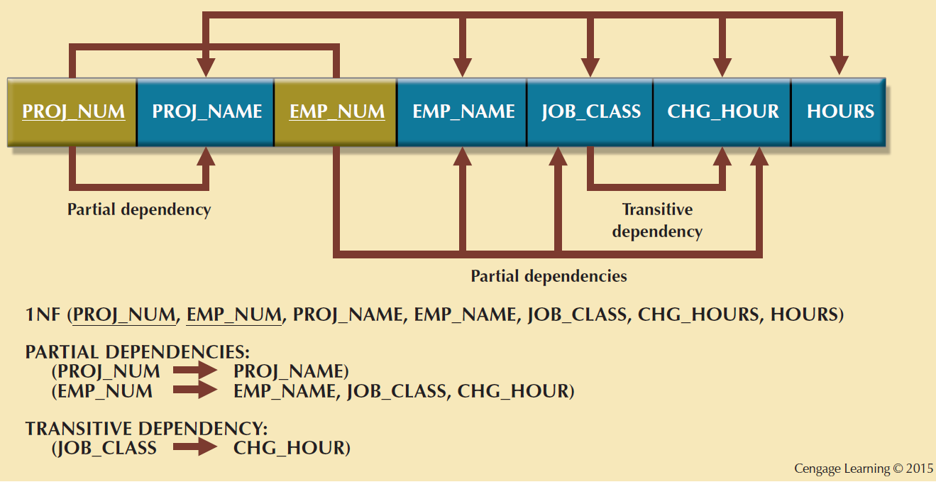
1NF Dependency Diagram

Slide 26
ASSIGNMENT Determinants

Slide 27
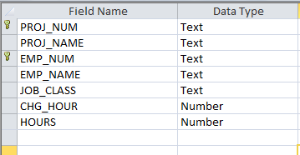
1NF – Primary Keys Added
Practice writing the DDL to add composite key for ProjectAssignment.

Slide 28
Conversion to Second Normal Form
Steps
Make new tables to eliminate partial dependencies
Reassign corresponding dependent attributes
Table is in 2NF when it:
Is in 1NF
Includes no partial dependencies

Slide 29
ASSIGNMENT Partial Dependencies?

Slide 30
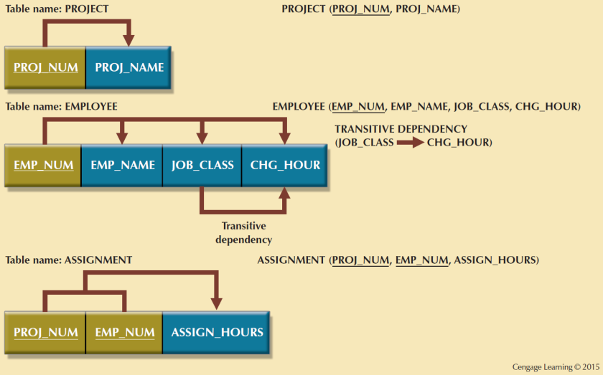
Second Normal Form (2NF) Conversion Results

Slide 31
ASSIGNMENT Partial Dependencies

Slide 32
Conversion to Third Normal Form
Steps
Make new tables to eliminate transitive dependencies
Determinant: Any attribute whose value determines other values within a row
Reassign corresponding dependent attributes
Table is in 3NF when it:
Is in 2NF
Contains no transitive dependencies

Slide 33
Transitive Dependencies?

Slide 34
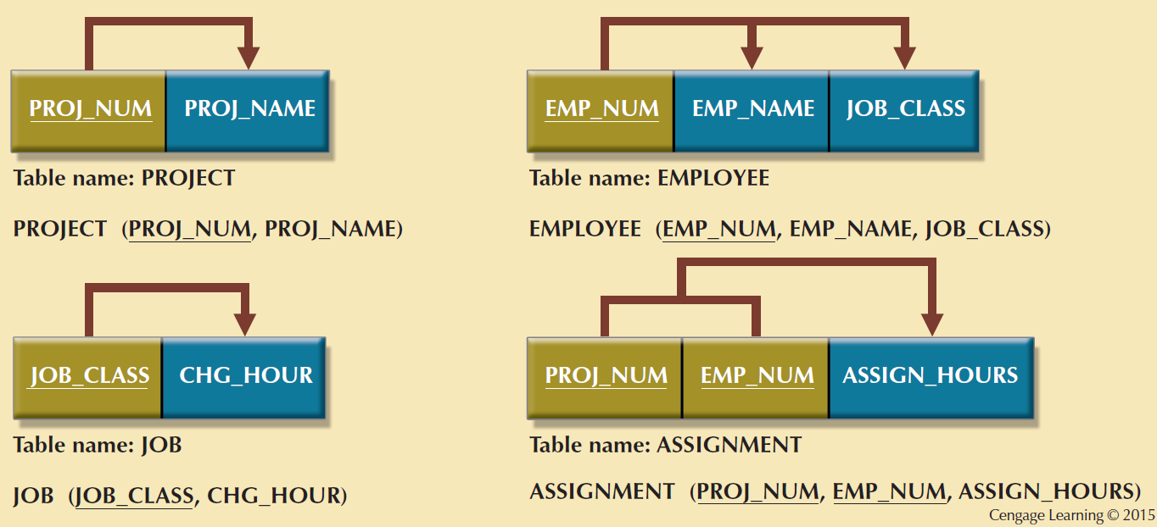
Third Normal Form (3NF) Conversion Results

Slide 35
ASSIGNMENT Partial Dependencies

Slide 36
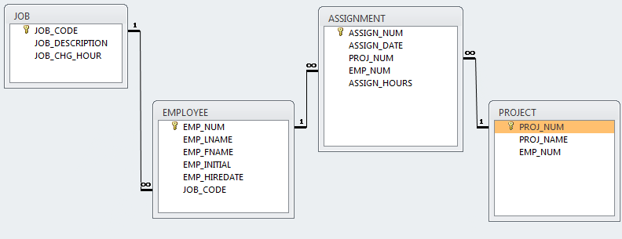
3NF – Eliminate Transitive Dependencies

Slide 37
Requirements for Good Normalized Set of Tables
Evaluate PK assignments and naming conventions
Refine attribute atomicity
Atomic attribute: Cannot be further subdivided
Identify new attributes and relationships
Refine PKs for data granularity
Granularity: Level of detail represented by the values stored in a table’s row
Maintain historical accuracy and evaluate using derived attributes

Slide 38
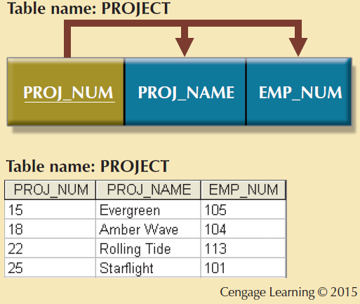
The Completed Database

Slide 39
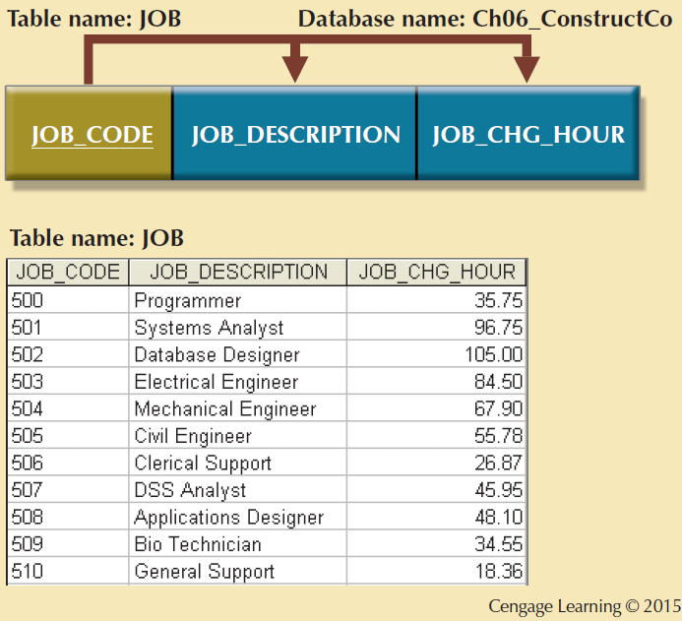
The Completed Database

Slide 40
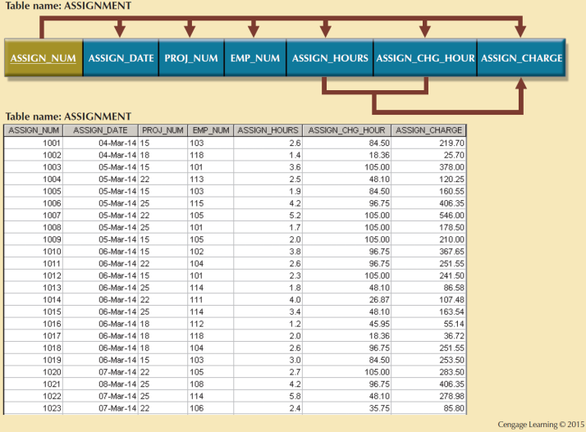
The Completed Database

Slide 41
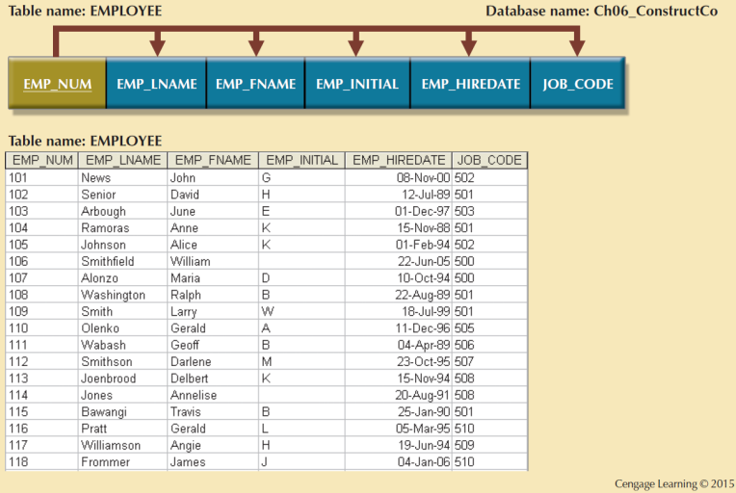
The Completed Database

Slide 42
Surrogate Keys
System-defined attribute
Used by designers when the primary key is considered to be unsuitable
Created an managed via the DBMS
Have a numeric value which is automatically incremented for each new row

Slide 43
Boyce-Codd Normal Form (BCNF)
Every determinant in the table should be a candidate key
Candidate key - Same characteristics as primary key but not chosen to be the primary key
Equivalent to 3NF when the table contains only one candidate key
Violated only when the table contains more than one candidate key
Considered to be a special case of 3NF

Slide 44
Normalization and Database Design
Normalization should be part of the design process
Proposed entities must meet required normal forms before table structures are created
Principles and normalization procedures must be understood to redesign and modify databases
ERD is created through an iterative process
Normalization focuses on the characteristics of specific entities

Slide 45
Denormalization
Design goals
Creation of normalized relations.
Processing requirements and speed.
Number of database tables expands when tables are decomposed to conform to normalization requirements.
Joining a larger number of tables:
Takes additional input/output (I/O) operations and processing logic
Reduces system speed

Slide 46
Denormalization
Defects in unnormalized tables
Data updates are less efficient because tables are larger
Indexing is more cumbersome
No simple strategies for creating virtual tables known as views.

Slide 47
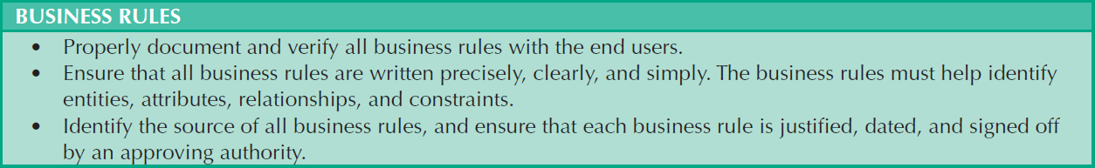
Data-Modeling Checklist
Cengage Learning © 2015

Slide 48
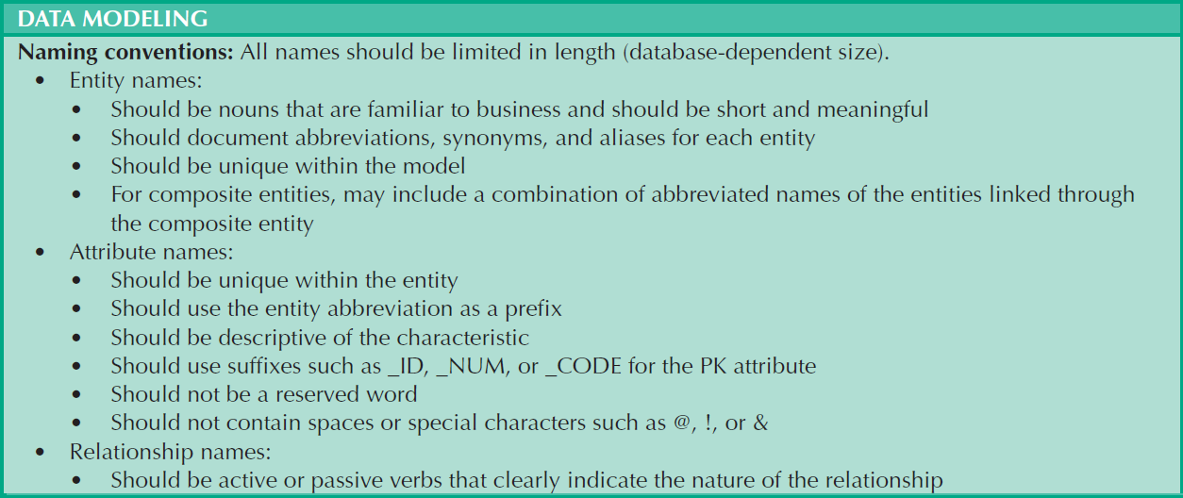
Data-Modeling Checklist
Cengage Learning © 2015

Slide 49
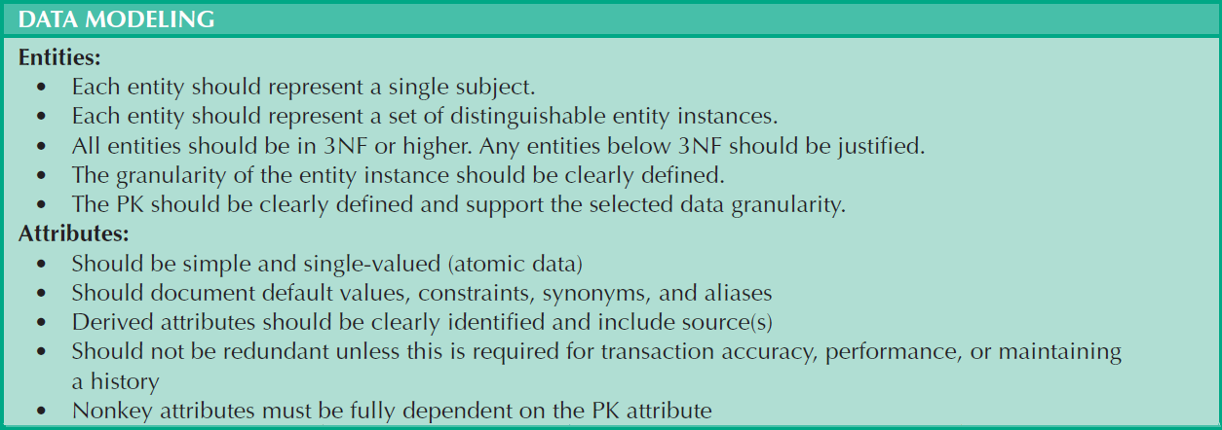
Data-Modeling Checklist
Cengage Learning © 2015

Slide 50
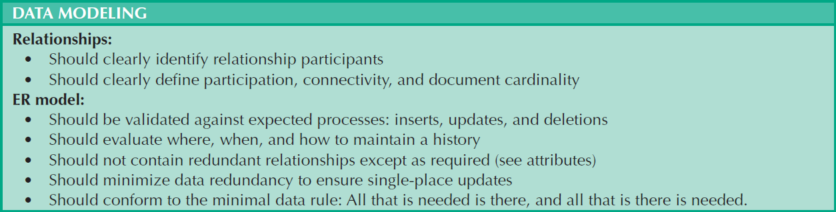
Data-Modeling Checklist
Cengage Learning © 2015

Slide 51
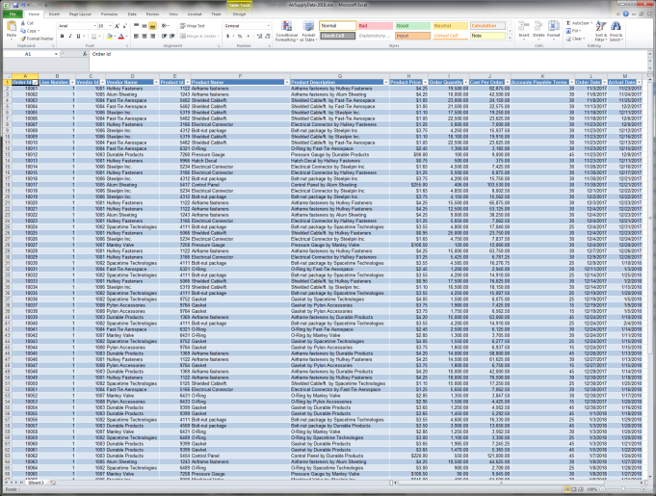
Week 10 Lab – Convert to 3NF and run some queries…

