Slide 1
Chapter 7 – Part I
Introduction to Structured Query Language (SQL)

Slide 2
Learning Objectives
DDL
SQL as data definition (table creation and indexes)
DML
SQL as data manipulation (insert, modify, delete, and select data)

Slide 3
Structured Query Language (SQL)
ANSI / ISO SQL
Declarative, nonprocedural language
Command set of less than 100 words
Many SQL dialects with only minor differences
Categories of SQL
Data definition language (DDL)
Defines the structure of the database
Data manipulation language (DML)
Allows for retrieval of database data

Slide 4
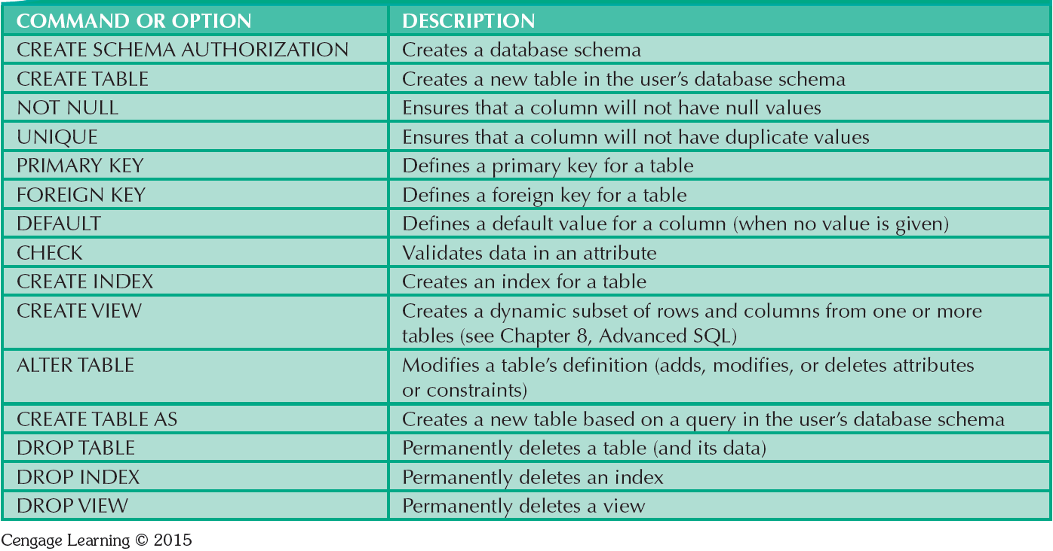
DDL Commands

Slide 5
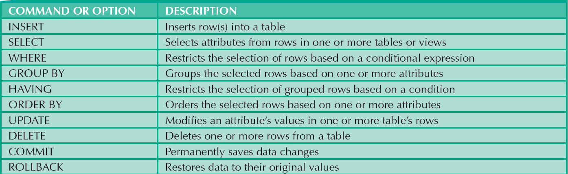
DML Commands

Slide 6
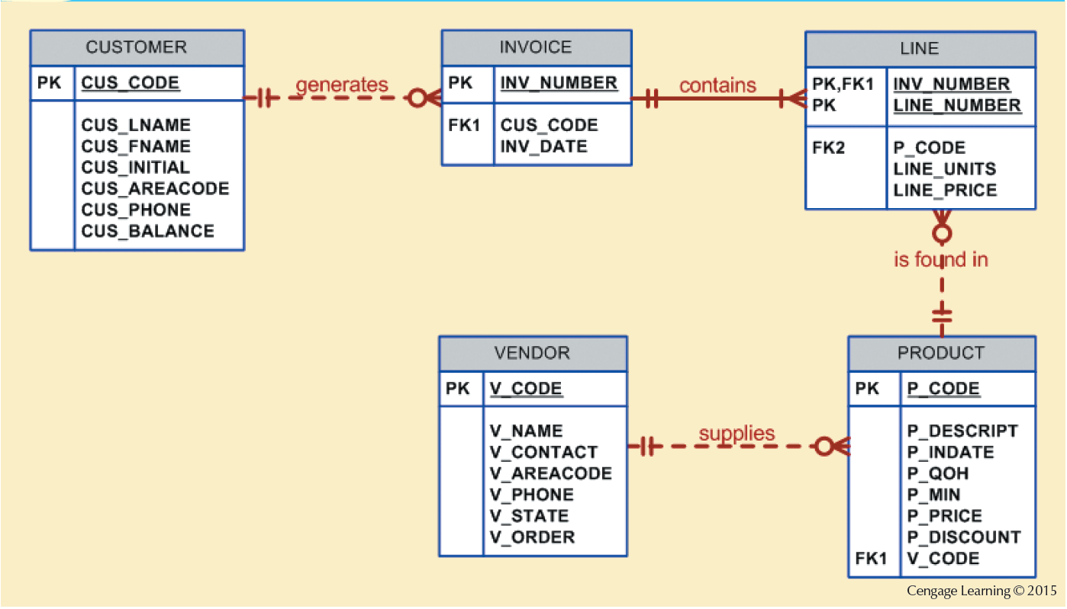
Database Model

Slide 7
Tasks to be Completed Before Using a New RDBMS
RDBMS Data Definition
Creates the underlying database structure
Creates physical files
Differs from one RDBMS to another
Authentication
DBMS verifies that only registered users access certain or all data.
Also used for DDL commands.
User should log on to RDBMS using user ID and password created by database administrator
SELECT * FROM mysql.user;

Slide 8
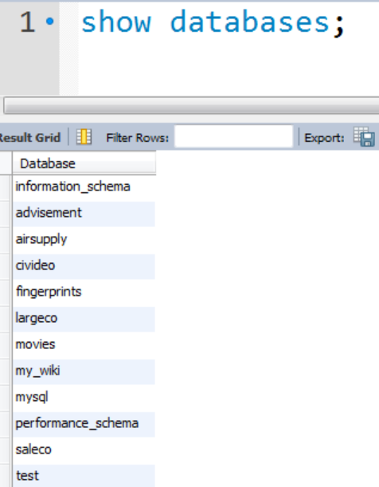

Database Schema
Logical grouping of DB objects (tables, views, stored procedures, etc.)
Allows a DBA to assign users to a single schema so that the user can only access the objects they are authorized to access.
CREATE SCHEMA <my_schema>;
Schema / database are the same in MySQL.

Slide 9
Database Table (Vendor)

Slide 10
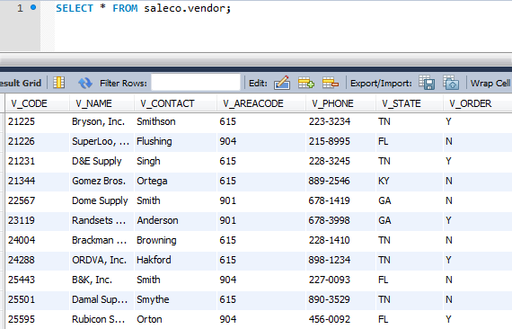
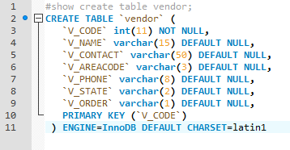
VENDOR

Slide 11
Database Table (Product)

Slide 12
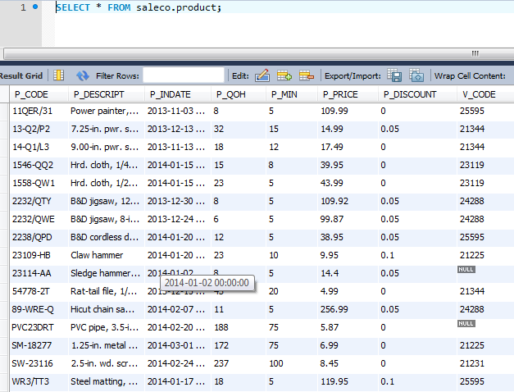
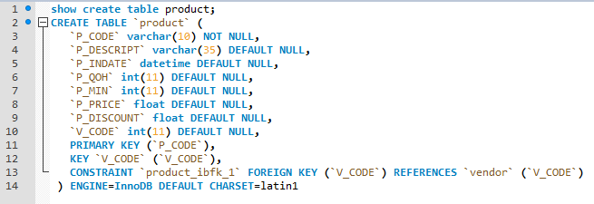
PRODUCT

Slide 13


Relational Integrity

Slide 14
Common SQL Data Types
Numeric
NUMBER(L,D) or NUMERIC(L,D)
Character
CHAR(L)
VARCHAR(L) or VARCHAR2(L)
Date
DATE
Really just int(8), so why the fuss?

Slide 15

MySQL Datatypes (DATE)
DATE, DATETIME, and TIMESTAMP
TIME
YEAR
Try to use timestamps that mirror application code.

Slide 16

MySQL Datatypes (NUMERIC)
Integer Types
INTEGER, INT, SMALLINT, TINYINT, MEDIUMINT, BIGINT
Fixed-Point Types (Exact Value)
DECIMAL, NUMERIC
Floating-Point Types (Approximate Value)
FLOAT, DOUBLE
Bit-Value Type
BIT

Slide 17
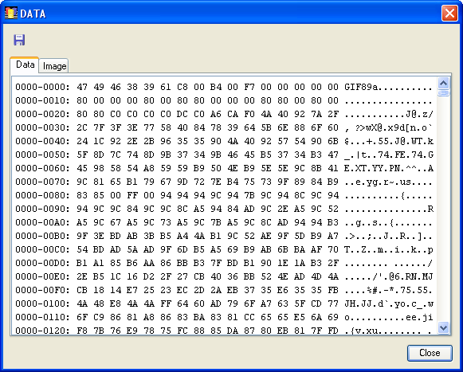
MySQL Datatypes (CHARACTER)
CHAR and VARCHAR
BINARY and VARBINARY
BLOB and TEXT
ENUM
SET

Slide 18
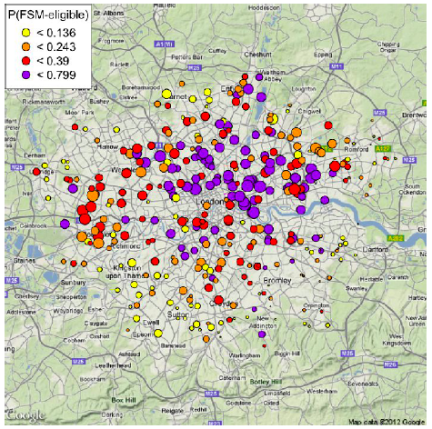
MySQL Datatypes (SPATIAL)
GEOMETRY
POINT
LINESTRING
POLYGON

Slide 19
Creating Table Structures
Syntax to create table
CREATE TABLE tablename(field metadata);
Formatting Technique
Use one line per field (attribute) definition
Capitalize SQL commands
Line up attribute characteristics and constraints and follow order precedence.
Features of table creating command sequence
NOT NULL specification
UNIQUE specification

Slide 20
CREATE USER TABLE
CREATE TABLE USER
(
UID INT(9) NOT NULL AUTO_INCREMENT PRIMARY KEY, NAME VARCHAR (36) NOT NULL,
CREATED_ON DATETIME NOT NULL
)
ENGINE=INNODB;
SQL statements end with a semicolon

Slide 21
Primary Key and Foreign Key
Primary Keys
Automatically enforces
NOT NULL
UNIQUE
Foreign Keys
Enforced only if relationship is established.
ANSI SQL allows
CASCADE ON DELETE or ON UPDATE
SET NULL
SET DEFAULT

Slide 22
CREATE USER TABLE
CREATE TABLE USER
(
UID INT(9) NOT NULL AUTO_INCREMENT PRIMARY KEY, NAME VARCHAR (36) NOT NULL,
CREATED_ON DATETIME NOT NULL
)
ENGINE=INNODB;
SQL statements end with a semicolon

Slide 23
Column Constraints
NOT NULL
Ensures that column does not accept nulls
UNIQUE
Ensures that all values in column are unique
DEFAULT
Assigns value to attribute when a new row is added to table
CHECK
Validates data when attribute value is entered

Slide 24
SQL Indexes
DBMS automatically creates unique index for primary keys
Composite index
Is based on two or more attributes
Syntax to create SQL indexes
CREATE INDEX indexname ON tablename();
Syntax to delete an index
DROP INDEX indexname;

Slide 25
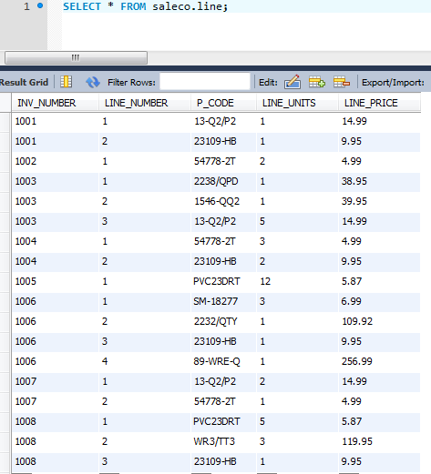
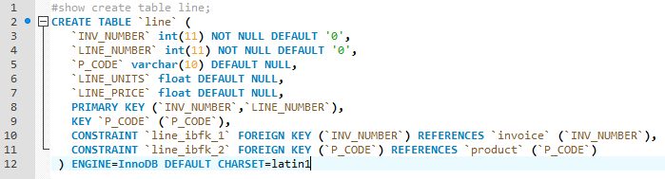
Composite Primary Key

Slide 26
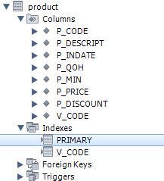
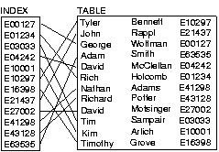
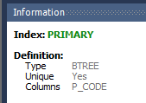
Database Index
Separate File
Data structure that improves the speed of data retrieval operations on a database table at the cost of additional writes and storage space to maintain the index data structure.

