Slide 1
Chapter 7 Part II
The Structured Query Language (SQL)
Chapter 8
Advanced SQL

Slide 2
Learning Objectives
This chapter covers:
Relational Algebra
SQL data definition (table creation and indexes)
SQL data manipulation (insert, modify, delete, and selecting data)
Subqueries
SQL date/numeric/string functions
PL/SQL
Views, Triggers and Stored Procedures

Slide 3
Relational Algebra and SQL
Relational algebra is attributed to E.F. Codd while at IBM (circa 1970)
Language for querying data stored in the RDBMS
SQL was originally based on relational algebra
SQL consists of a DDL and a DML.

Slide 4
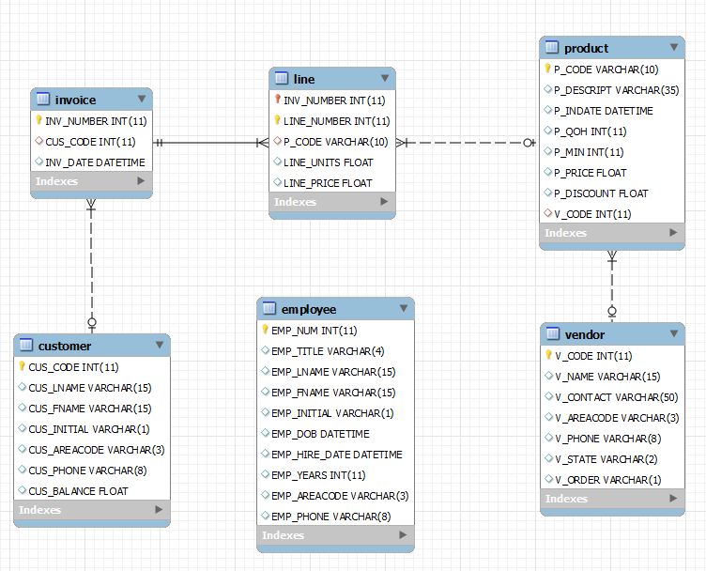
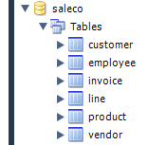
Play along with SALECO DB

Slide 5
Data Manipulation Commands
INSERT: Command to insert contents to a table
SELECT: Command to list the contents
Syntax - SELECT columnlist FROM tablename;
Wildcard character(*) to retrieve all columns
UPDATE: Command to modify data
Syntax - UPDATE tablename SET columnname = expression [, columnname = expression] [WHERE conditionlist];
Syntax - INSERT INTO tablename (columnlist) VALUES (values);
Syntax - INSERT INTO tablename SELECT columnlist FROM tablename;

Slide 6
Data Manipulation Commands
WHERE condition
Specifies the rows to be selected
ROLLBACK: Command to restore the database
Syntax - ROLLBACK;
Undoes the changes since last COMMIT command
DELETE: Command to delete
Syntax - DELETE FROM tablename
[WHERE conditionlist];

Slide 7
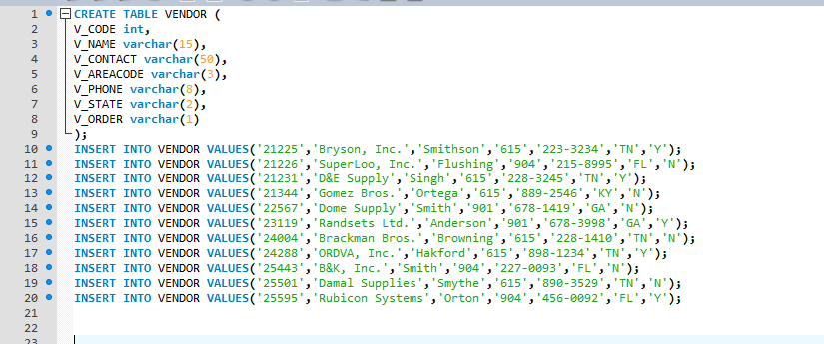
Inserts into SALECO.VENDOR

Slide 8
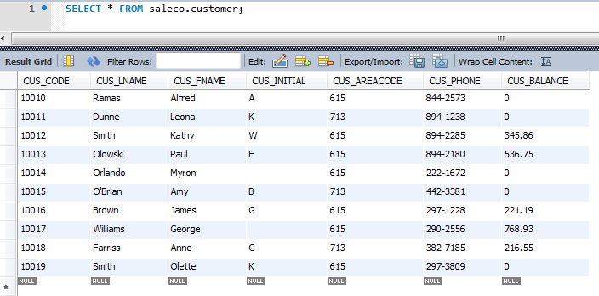
SELECT * FROM SALECO.CUSTOMER;
Select (Restrict)
Yields a horizontal subset of a table (specific rows)

Slide 9
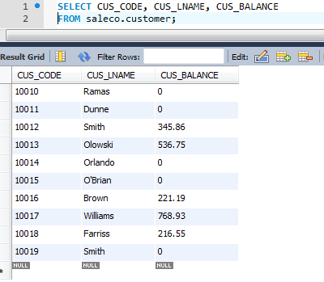
SELECT CUST_NUMBER, CUST_LNAME, CUST_BALANCE FROM SALECO.CUSTOMER;
Project
Yields a vertical subset of a table (specific columns)

Slide 10
Selecting Rows Using Conditional Restrictions
Rows are restricted based on the conditionslist:
SELECT columnlist
FROM tablelist
[WHERE conditionlist];
Used to select partial table contents by placing restrictions on the rows
Optional WHERE clause
Adds conditional restrictions to the SELECT statement

Slide 11
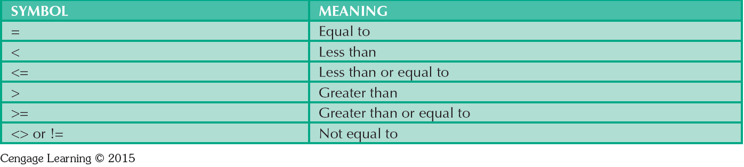
Comparison Operators

Slide 12
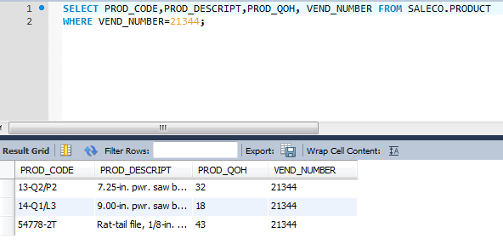
What is being Selected / Restricted?

Slide 13
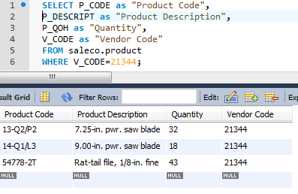
Alias (Example)
Alias: Alternate name given to a column or table in any SQL statement

Slide 14
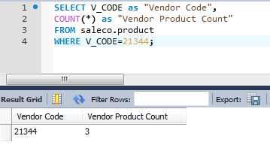
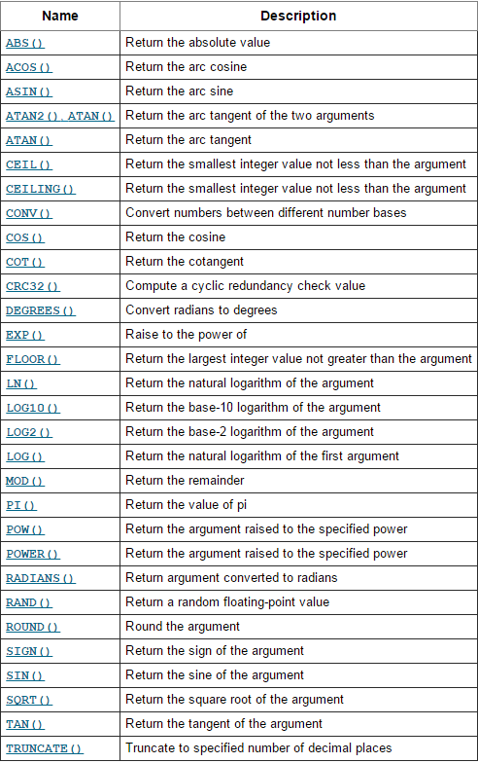
COUNT(*) as “QUANTITY BY VENDOR”
Just a few more functions in the MySQL Math Library

Slide 15
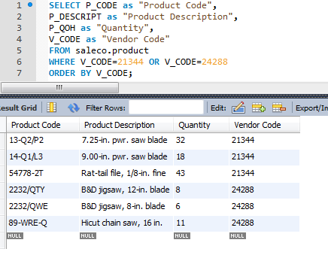
Compound Statements (logical OR)
Select all products by vendor 21344 or vendor 24288.

Slide 16
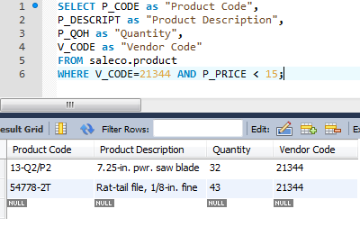
Compound Statements (logical AND)
Select all products by vendor 21344 that are less than $15.

Slide 17
Special Operators
BETWEEN
IS NULL
LIKE
IN
EXISTS
Checks whether attribute value is within a range
Checks whether attribute value is null
Checks whether attribute value matches given string pattern
Checks whether attribute value matches any value within a value list
Checks if subquery returns any rows

Slide 18
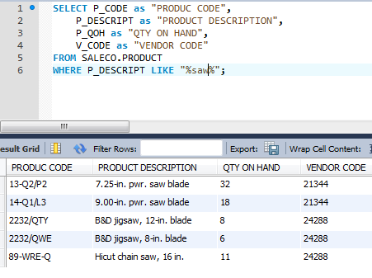

Find products like %jigsaw%

Slide 19
Ordering a Listing
ORDER BY clause is useful when listing order is important

Slide 20
Listing Unique Values
DISTINCT clause: Produces list of values that are unique
Syntax - SELECT DISTINCT columnlist
FROM tablelist;
Based entirely on SELECT attributes
Access places nulls at the top of the list
Oracle places it at the bottom
Placement of nulls does not affect list contents

Slide 21
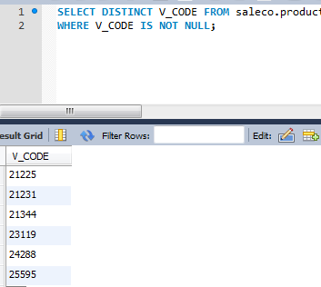
DISTINCT

Slide 22
Grouping Data
Frequency distributions created by GROUP BY clause within SELECT statement
Syntax - SELECT columnlist
FROM tablelist
[WHERE conditionlist]
[GROUP BY columnlist]
[HAVING conditionlist]
[ORDER BY columnlist [ASC | DESC]];

Slide 23
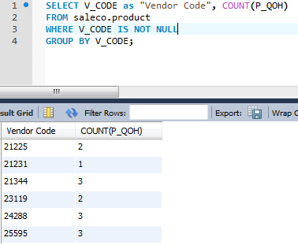
Grouping Data

Slide 24
HAVING Clause
Extension of GROUP BY feature
Applied to output of GROUP BY operation
Used in conjunction with GROUP BY clause in second SQL command set
Similar to WHERE clause in SELECT statement

Slide 25
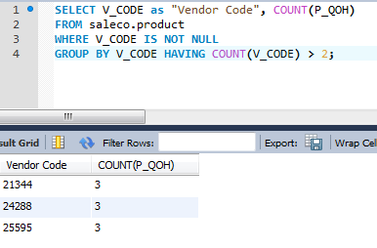
GROUP BY with HAVING

Slide 26
Joining Database Tables
Used to retrieve like data from multiple tables
Uses the equality comparison between foreign and primary keys
Tables are joined by listing tables in FROM clause of SELECT statement
Without a join, the RDBMS creates Cartesian product of every table in the FROM clause

Slide 27
Relationships in SALECO

Slide 28
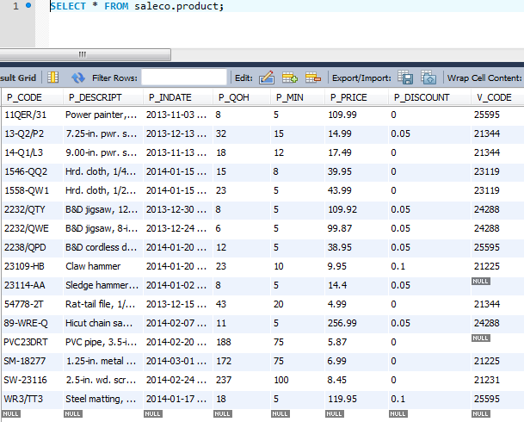
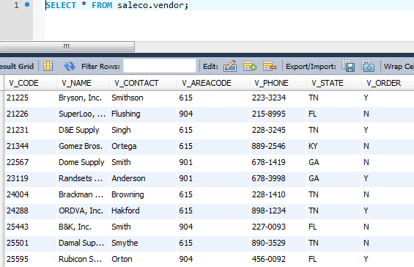
PRODUCT and VENDOR

Slide 29
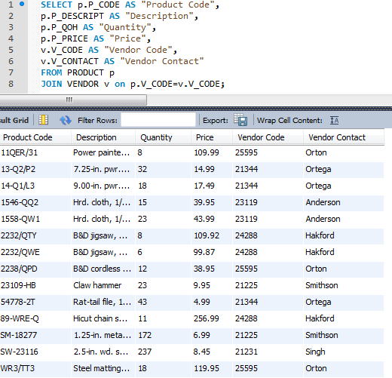
Retrieving products and vendor contacts.

Slide 30
SQL Joins
Natural join - Common values in common columns
Equality or inequality - Meet a given join condition
Outer join: Common values in common columns or have no matching values
Inner join: Only rows that meet a given criterion are selected

Slide 31
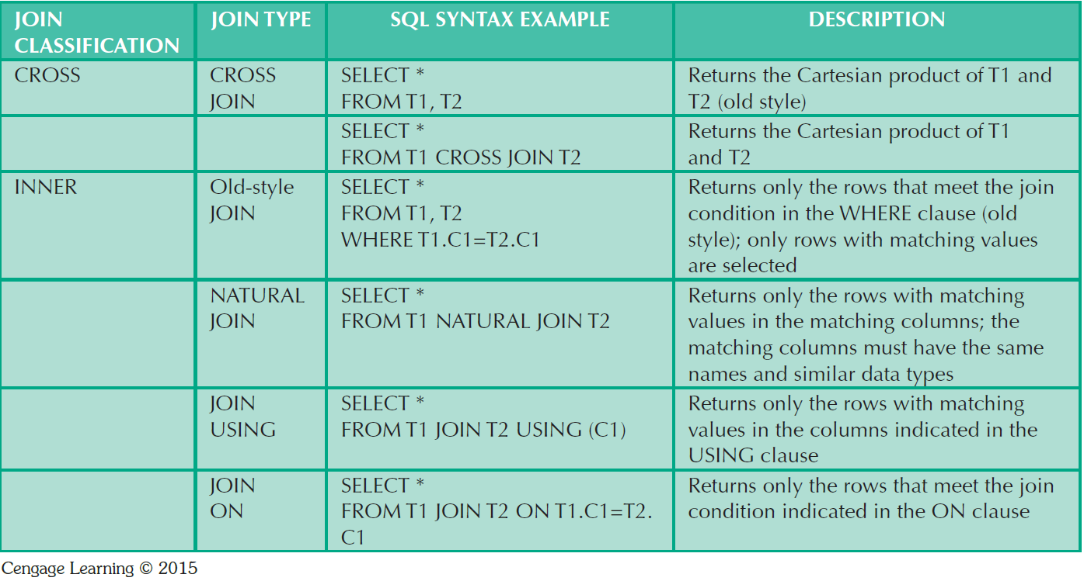
SQL Join Expression Styles
I’m old ☹
ANSI-89
Popular with the kids these days…
ANSI-92

Slide 32
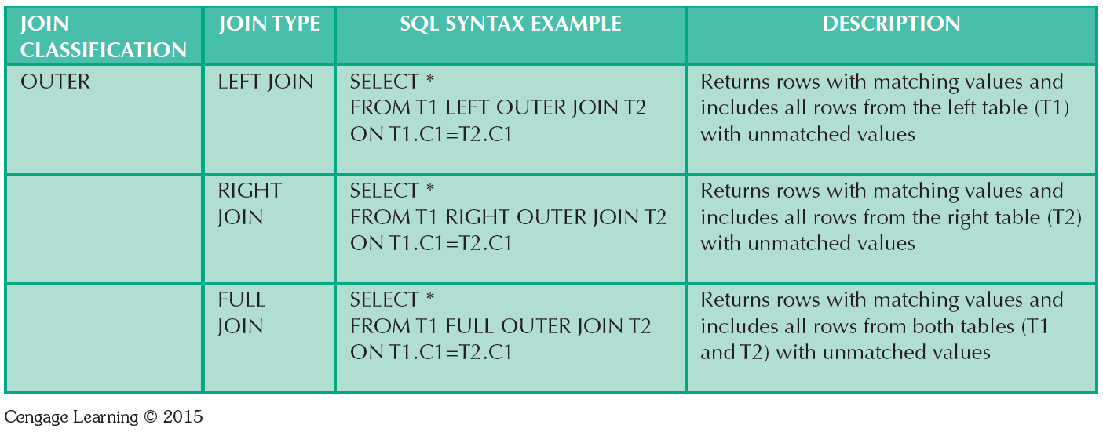
SQL Join Expression Styles

Slide 33


Slide 34
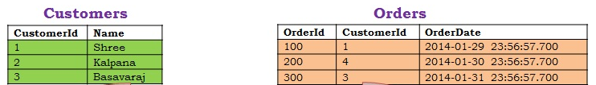
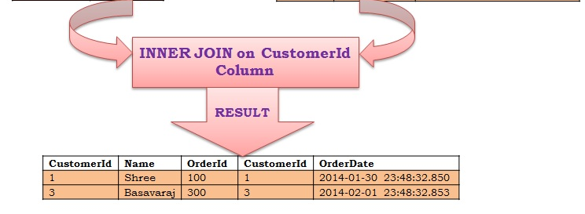
Inner Join
Result?
SELECT *
FROM Customers C
INNER JOIN Orders O
ON O.CustomerId = C.CustomerId
Syntax?

Slide 35
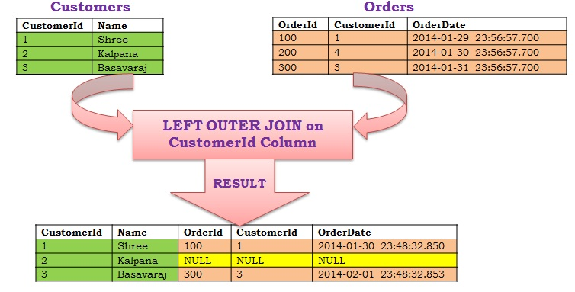
Left [outer] Join
Result?
SELECT *
FROM Customers C
LEFT OUTER JOIN Orders O
ON O.CustomerId = C.CustomerId
Syntax?

Slide 36
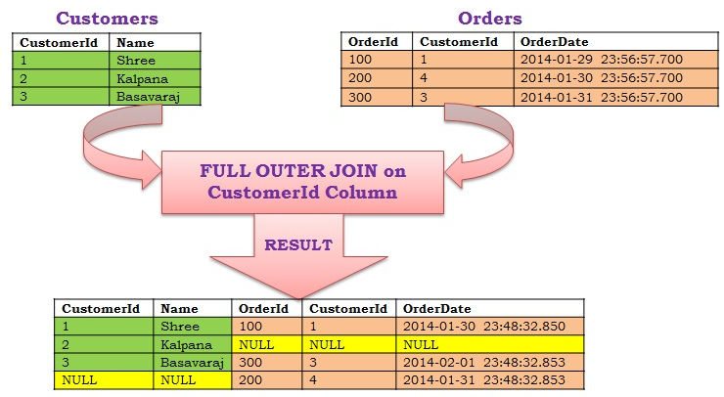
Full [outer] Join
Result?
SELECT *
FROM Customers C
RIGHT OUTER JOIN Orders O
ON O.CustomerId = C.CustomerId
Syntax?

Slide 37
Subqueries and Correlated Queries
Query within a Query
Can return:
One single value - One column and one row
A list of values - One column and multiple rows
A virtual table - Multicolumn, multirow set of values
No value - Output of the outer query might result in an error or a null empty set

Slide 38
WHERE Subqueries
Inner SELECT subquery
WHERE cust_id = (SELECT cust_id FROM customer)
Value generated by the subquery must be of a comparable data type
If the query returns more than a single value, the DBMS will generate an error

Slide 39
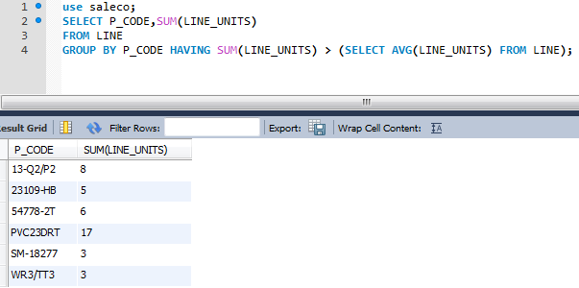
IN and HAVING Subqueries
IN subqueries
Used to compare a single attribute to a list of values
HAVING subqueries
restricts output of a GROUP BY query by applying conditional criteria to the grouped rows

Slide 40
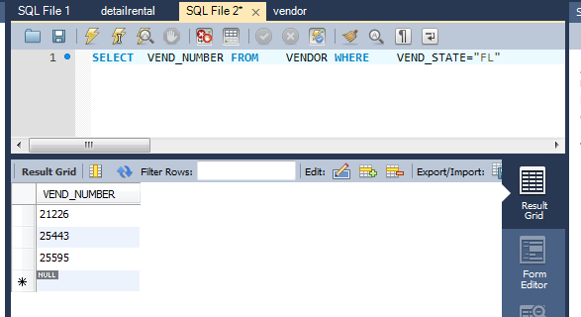
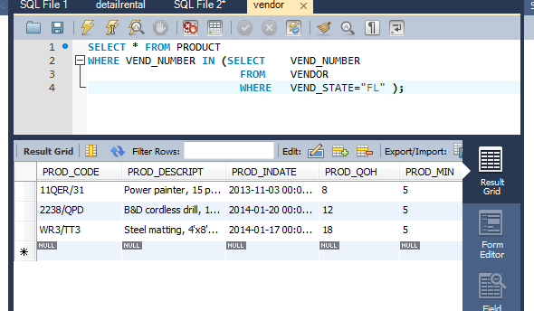
Example using saleco
Inner query result
Outer query result
Outer Query can only access data returned from the inner query.
Inner Query cannot access data from outer query.

Slide 41
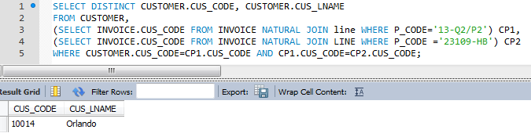
FROM Subqueries (temporary virtual tables)
FROM clause:
Specifies the tables from which the data will be drawn
Can use SELECT subquery

Slide 42
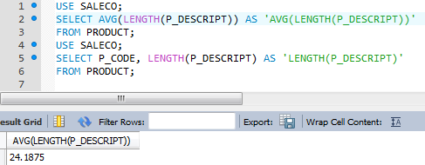
SQL Functions
Manipulate numerical, date, or string values
Values may be hardcoded, or may table attributes
May appear anywhere in an SQL statement where a value or an attribute can be used

Slide 43
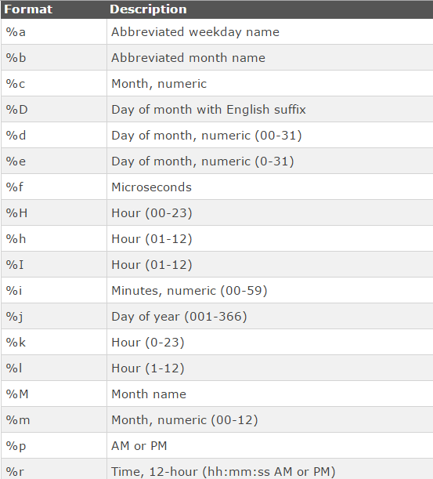
Date Formats

Slide 44
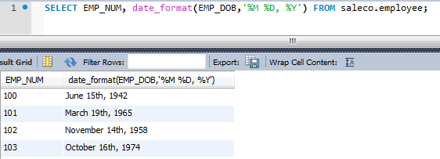
Date Functions

Slide 45
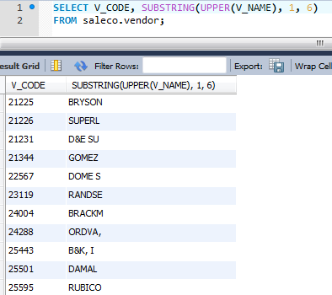
String Functions

Slide 46
VIEWS: aka Virtual Tables
View: Virtual table based on a SELECT query
Base tables: Tables on which the view is based
Permanent database object
CREATE VIEW statement: Data definition command that stores the subquery specification in the data dictionary
CREATE VIEW command
CREATE VIEW viewname AS SELECT query

Slide 47
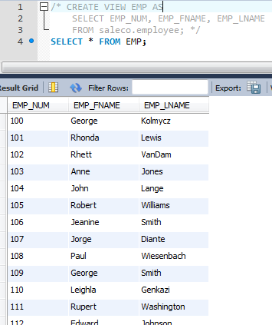

Slide 48
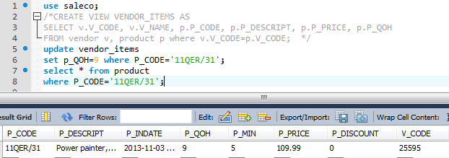
Non-Updatable View

Slide 49
Stored Procedures
Named collection of SQL statements
Advantages
Reduce network traffic and increase performance
Reduce code duplication by means of code isolation and code sharing

Slide 50
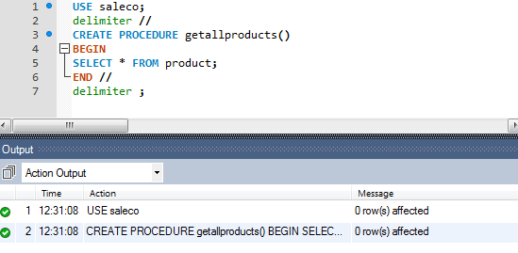
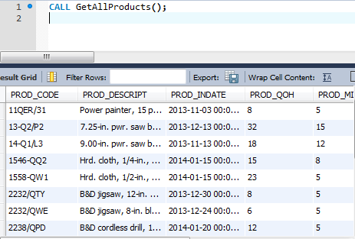
Stored Procedure Example

Slide 51
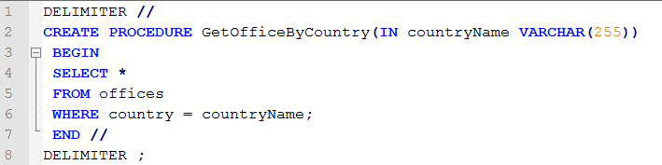
Stored Procedure Example (2)
Parameter
Arguments
CALL GetOfficeByCountry('USA')

Slide 52
Procedural SQL (PL/SQL and T-SQL)
Oracle, PostgreSQL, MySQL, MSSQL all have different implementations
Merging of SQL and traditional programming constructs
Provides conditional or looping operations
Shared code for better maintenance and control
Persistent stored module (PSM): Block of code containing:
Standard SQL statements
Procedural extensions that is stored and executed at the DBMS server

Slide 53
Procedural SQL (PL/SQL)
Procedural Language SQL (PL/SQL)
Use and storage of procedural code and SQL statements within the database
Procedural code is executed as a unit by DBMS when invoked by end user
End users can use PL/SQL to create:
Anonymous PL/SQL blocks and triggers
Stored procedures and PL/SQL functions

Slide 54
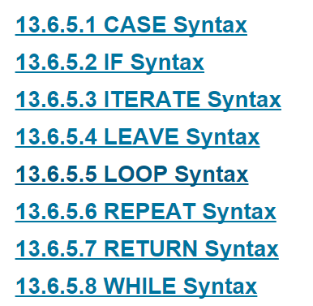
MySQL 5.x PL/SQL

Slide 55
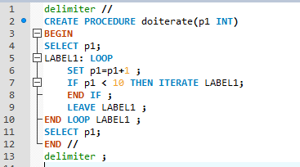
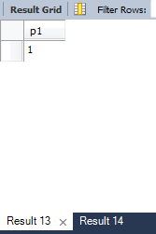
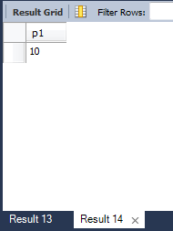
PL/SQL Example (MySQL)
Query 1
Query 2
call doiterate(1);

Slide 56
Triggers
SQL code invoked when DML event occurs
Parts of a trigger definition
Triggering timing - Indicates when trigger’s PL/SQL code executes
Triggering event - Statement that causes trigger execution
Triggering level - Statement- and row-level
Triggering action - PL/SQL code enclosed between the BEGIN and END keywords

Slide 57
Triggers
DROP TRIGGER trigger_name command
Deletes a trigger without deleting the table
Trigger action based on DML predicates
Actions depend on the type of DML statement that fires the trigger

Slide 58
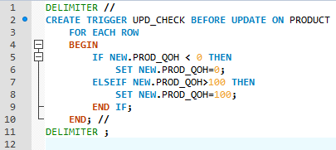
Trigger Example (1)

Slide 59
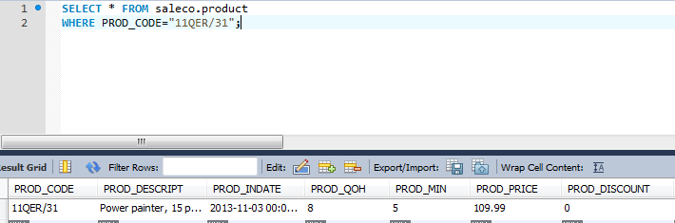
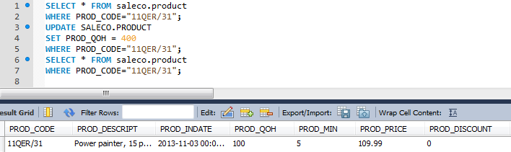
Trigger Example (2)

Slide 60
Summary
SQL is an ANSI standard common across most relational databases.
DDL is used to define DB objects.
DML is used to manipulate DB data.
Common SQL commands include SELECT, FROM and WHERE.
SQL can be ordered (order by), grouped (group by).
SQL can be nested with the use of sub queries.
Views and Stored Procedures are compiled SQL.

