Slide 1
Chapter N
MongoDB

Slide 2

MongoDB
Stands for humongous database.
NoSQL, document-oriented database.
Open-source under GNU AGPL and the Apache License since 2007.
Easy to install and use
Detailed documentation
Various APIs
JavaScript, Python, Ruby, Perl, PHP, Java, Java, Scala, C#, C++, Haskell, Erlang

Slide 3
MongoDB Features
Document-oriented
Ad-hoc queries
Indexing
Replication
Load balancing* (MapReduce)
File storage
Aggregation
Server-side JavaScript execution
Capped collections
Agile
Scalable

Slide 4
MongoDB (2)
General Purpose
Rich data model
Full featured indexes
Sophisticated query language
Easy to Use
Easy mapping to object oriented code
Native language drivers in all popular languages
Simple to setup and manage
Fast & Scalable
Operates at in-memory speed wherever possible
Auto-sharding built in
Dynamically add / remove capacity with no downtime

Slide 5
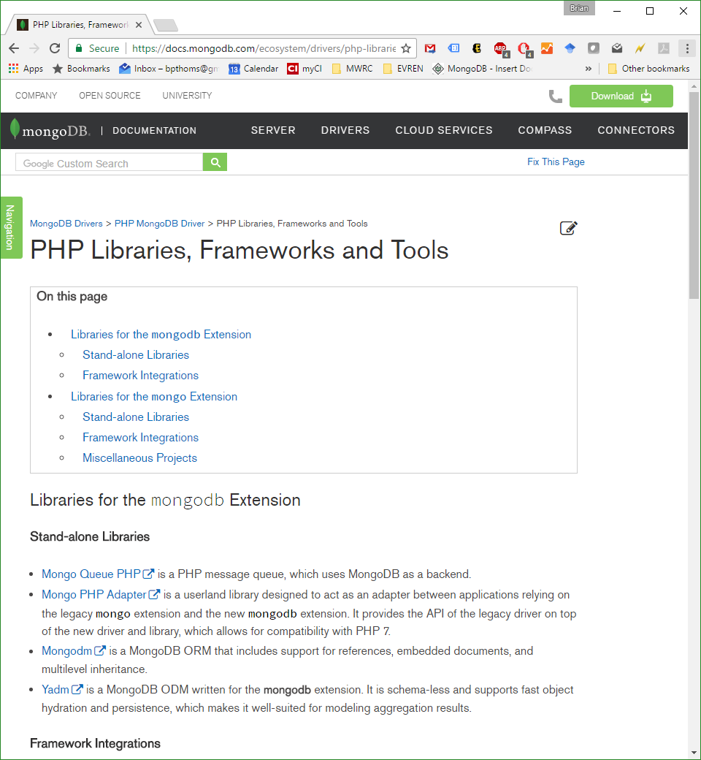
MongoDB Frameworks & Drivers

Slide 6
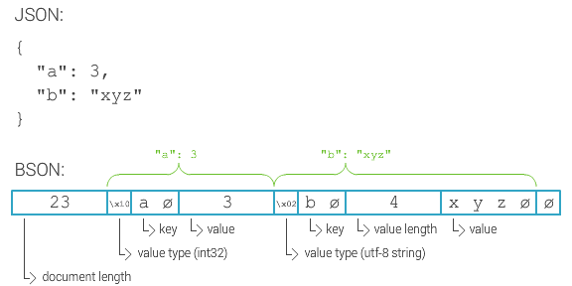
MongoDB (humongous)
Favors JSON-like documents, called BSON.

Slide 7
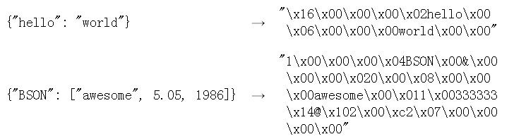
BSON
A binary format in which zero or more key/value pairs are stored as a single entity.
Lightweight, traversable, efficient.

Slide 8
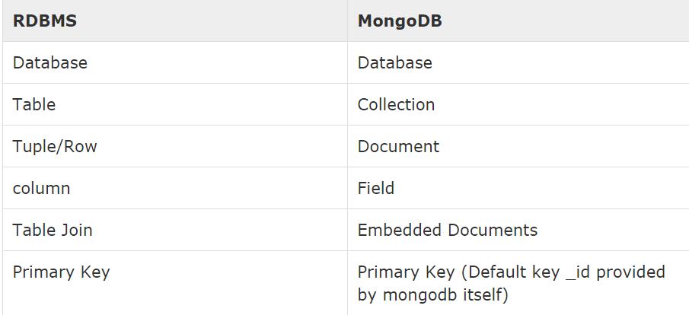
RDBMS vs MongoDB

Slide 9
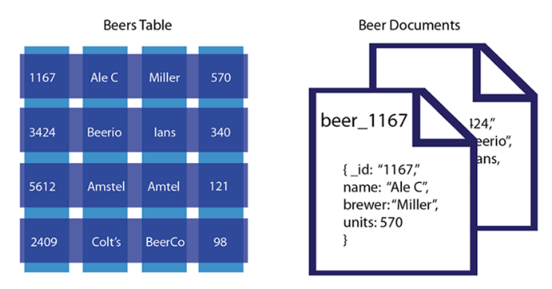
vs. RDBMS (1)

Slide 10
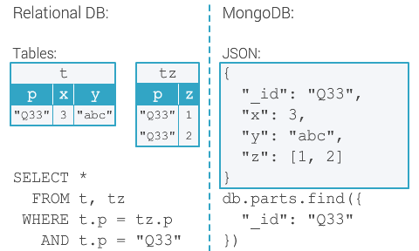
vs. RDBMS (2)

Slide 11
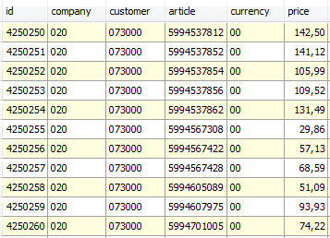
Horizontal Partitioning (sharding )
Separates very large databases (i.e. files) into smaller, faster, more easily managed parts called data shards (small part of a whole).
Partitions data
Scales write throughput
Increases capacity
Auto-balances
shard₁
shard₂
Host1:10000
Host2:10010
configdb
Host3:20000
Host4:30000
Client

Slide 12
Sharding Example (1)
A BSON document (which may have significant amounts of embedded data) resides on a single shard.
Sharding is the partitioning of data among multiple machines in an order-preserving manner.
Machine 1 | Machine 2 | Machine 3
Alabama → Arizona | Colorado → Florida | Arkansas → California
Indiana → Kansas | Idaho → Illinois | Georgia → Hawaii
Maryland → Michigan | Kentucky → Maine | Minnesota → Missouri
Montana → Montana | Nebraska → New Jersey | Ohio → Pennsylvania
New Mexico → North Dakota | Rhode Island → South Dakota | Tennessee → Utah
 | Vermont → West Virgina | Wisconsin → Wyoming

Slide 13
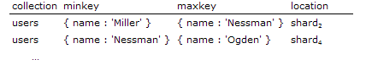
Shard Keys
Data is distributed at the collection level using a shard key.
Key pattern: { state : 1 }, { name : 1 }
Can be an indexed field or an indexed compound field that exists in every document in the collection.
Uses hash-based or range-based sharding.

Slide 14
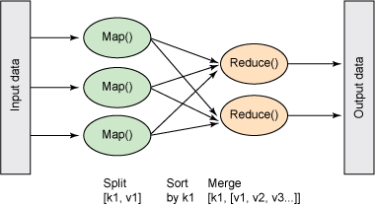
MapReduce (1)
A data processing paradigm for condensing large volumes of data into useful aggregated results.
Supports operations on sharded collections
Inspired by map() and reduce() functions used in functional programming.

Slide 15
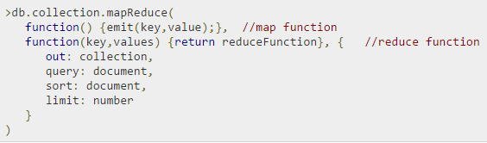
MapReduce (2)
map is a function that maps a value with a key and emits a key-value pair
reduce is a javascript function that reduces or groups all the documents having the same key
out specifies the location of the map-reduce query result
query specifies the optional selection criteria for selecting documents
sort specifies the optional sort criteria
limit specifies the optional maximum number of documents to be returned

Slide 16
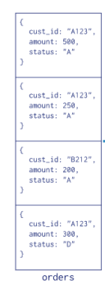
MapReduce Example
Consider the following document structure storing customer orders.
The document stores a cust_id, amount and status.
{ “cust_id“ : “A123", “amount“ : “500", “status“ : “A" }

Slide 17
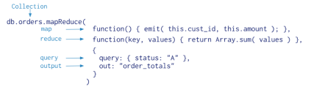
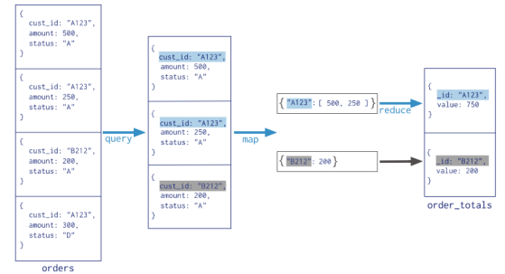
MapReduce Example
Result
3 documents matched the query (status:“A")
map function emitted 2 documents with key-value pairs
reduce function grouped mapped documents having the same this.cust_id and summed the values.

Slide 18
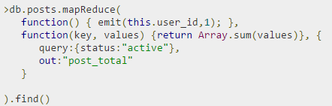

MapReduce Example
Result
Indicates that both users tom and mark have two posts in active states.

Slide 19
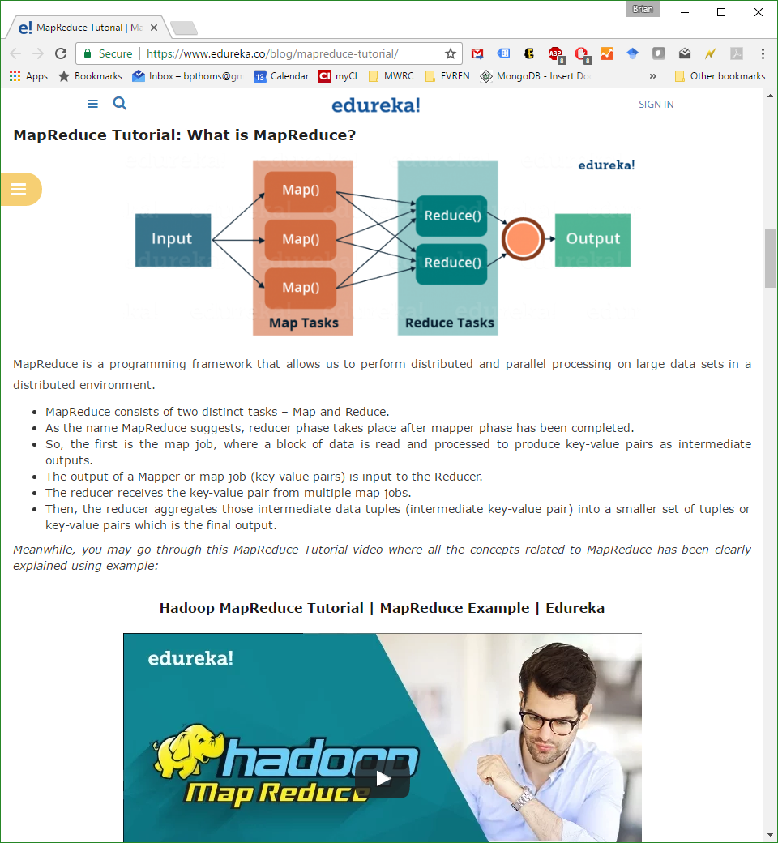
MapReduce Tutorial

Slide 20
MongoDB Transactions ACID vs. CAP
Atomicity
Consistency
Isolation
Durability
Consistency
Available
Partial fault-tolerance
More after we cover RDBMS Transactions
Notes:
BASE
Basically Available: some parts of system remain availabe on failure
Soft-state:
(the information will expire unless it is refreshed )
system will change state without user intervention due to eventual consistency
Eventually consistency:
asynchron propagation
consistancy window

Slide 21
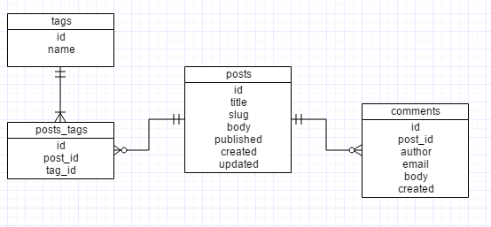
RDBMS Schema design
RDBMS: join

Slide 22
MongoDB Schema design
No predefined data schema.
Each document may have different data and different formats for data.
Relationships exist through embedding or linking.
Embedding is the nesting of objects and arrays inside a BSON document(prejoined). Results in the duplication of data.
Linking references documents(client-side follow-up query).

Slide 23
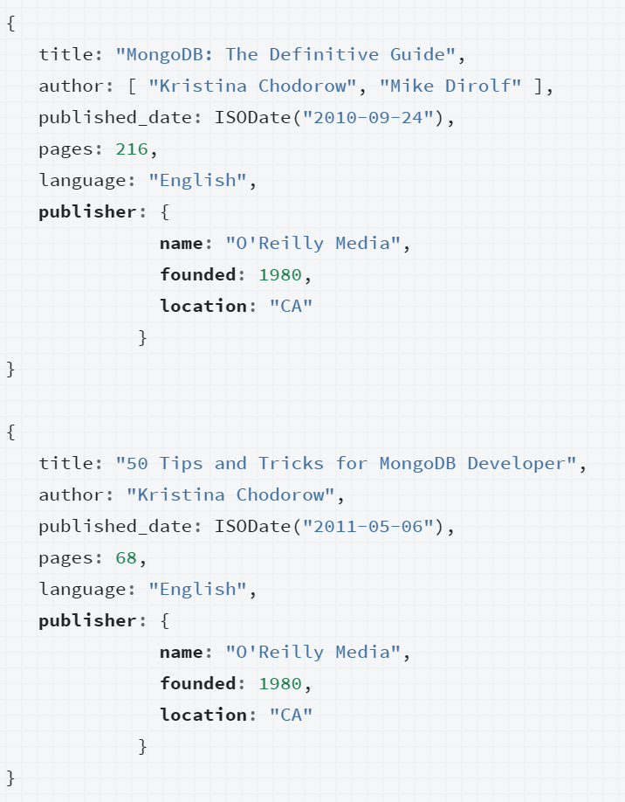
MongoDB Relationships (1)
Represent how various documents are logically related to each other.
Can be modeled via Embedded and Referenced approaches.
Relationships can be either 1:1, 1:M or M:N.

Slide 24
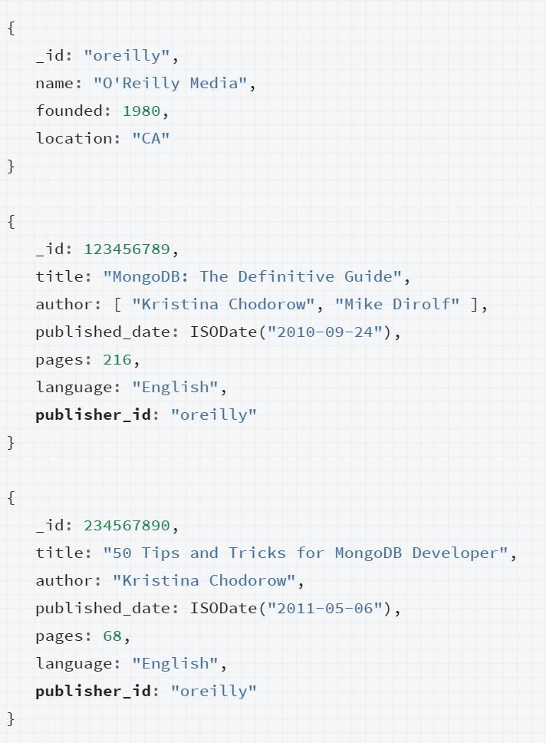
MongoDB Relationships (2)
Represent how various documents are logically related to each other.
Can be modeled via Embedded and Referenced approaches.
Relationships can be either 1:1, 1:M or M:N.

Slide 25
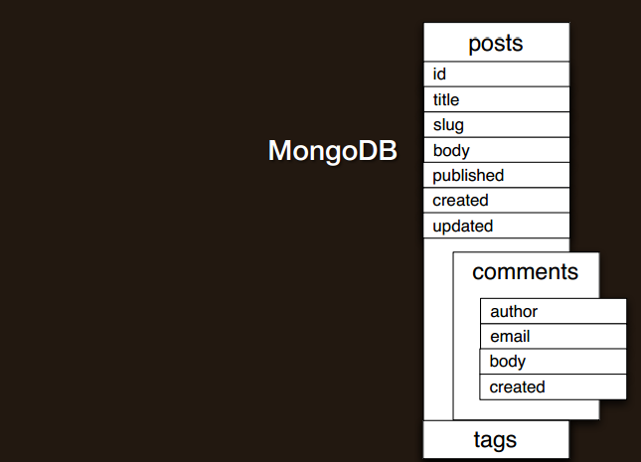
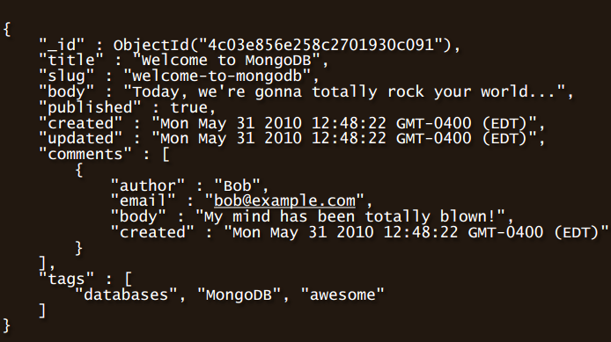
Schema design

Slide 26
CRUD
Create
db.collection.insert( <document> )
db.collection.save( <document> )
db.collection.update( <query>, <update>, { upsert: true } )
Read
db.collection.find( <query>, <projection> )
db.collection.findOne( <query>, <projection> )
Notes:
Create
The field name _id is reserved for use as a primary key; its value must be unique in the collection, is immutable, and may be of any type other than an array.
The field names cannot start with the $ character.
The field names cannot contain the . character.
Create with save
If the <document> argument does not contain the _id field or contains an _id field with a value not in the collection, the save() method performs an insert of the document.
Otherwise, the save() method performs an update.

Slide 27
CRUD
Update
db.collection.update( <query>, <update>, <options> )
Delete
db.collection.remove( <query>, <justOne> )

Slide 28
CRUD example
> db.user.insert({
first: "John",
last : "Doe",
age: 39
})
> db.user.find () {
"_id" : ObjectId("51…"),
"first" : "John",
"last" : "Doe",
"age" : 39
}
> db.user.update(
{"_id" : ObjectId("51…")},
{
$set: {
age: 40,
salary: 7000}
}
)
> db.user.remove({
"first": /^J/
})

Slide 29
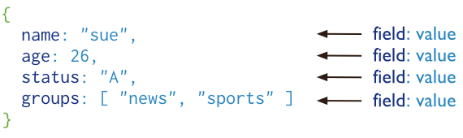
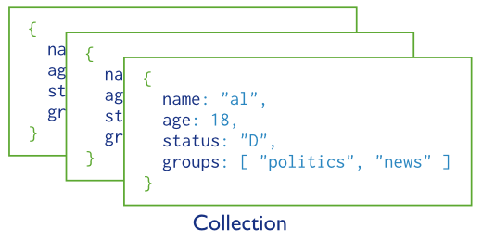
Basic operations
users

Slide 30
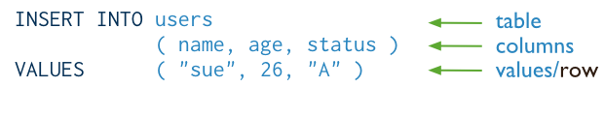
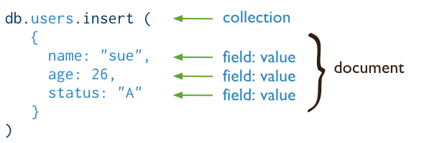
CRUD operations - create
Insert a new user.
SQL
MongoDB

Slide 31
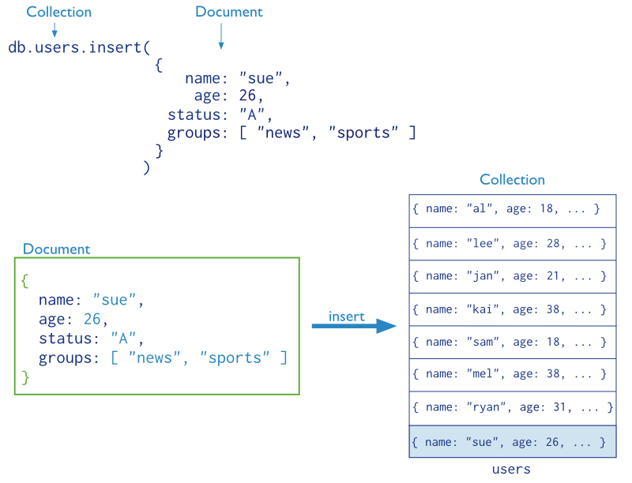
CRUD operations – create (cont’d)

Slide 32
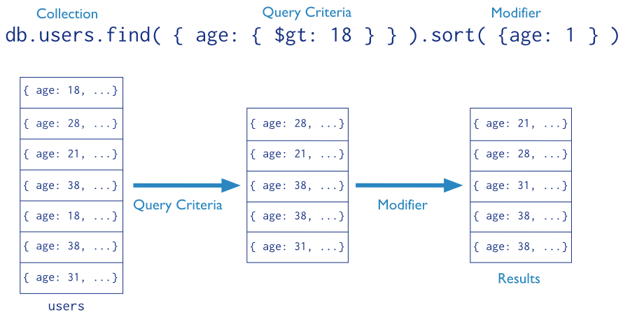
CRUD operations - read
Find the users of age greater than 18 and sort by age.

Slide 33

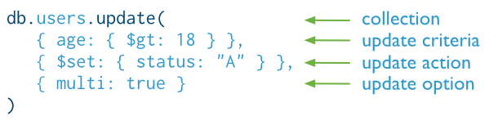
CRUD operations - update
Update the users of age greater than 18 by setting the status field to A.
SQL
MongoDB

Slide 34

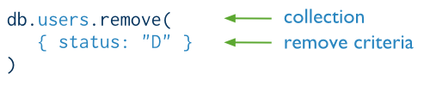
CRUD operations - delete
Delete the users with status equal to D.
SQL
MongoDB

Slide 35
A Quick Run Through MongoDB…

Slide 36
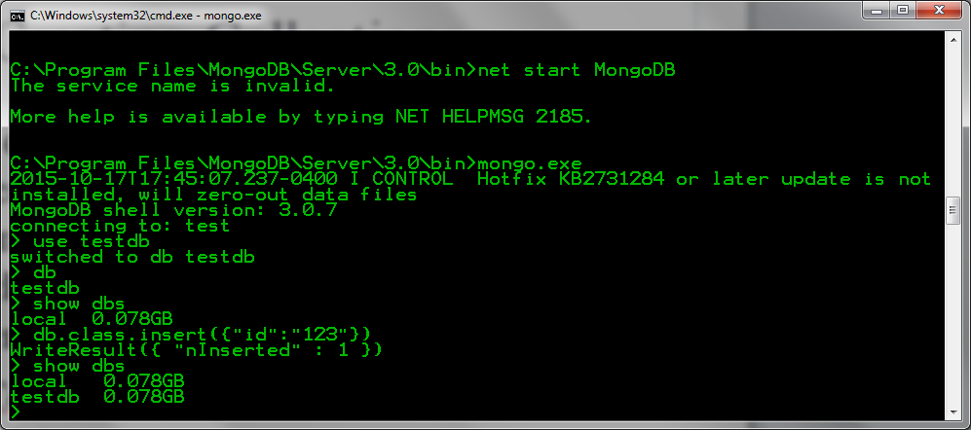
Start MongoDB Shell

Slide 37
Creating a Database

Slide 38
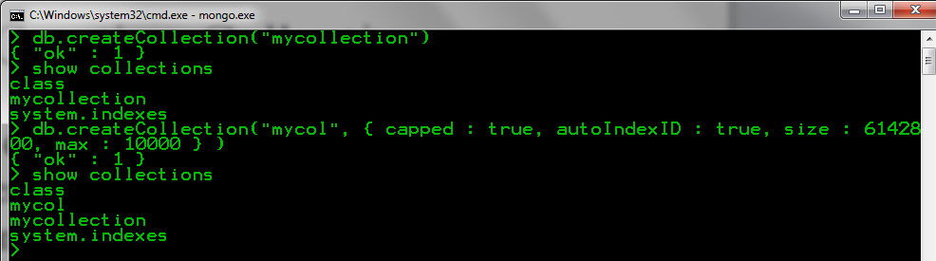
MongoDB Collection
Group of MongoDB documents.
Equivalent of an RDBMS table.
Exists within a single schemaless database.
Documents within a collection can have different fields.

Slide 39
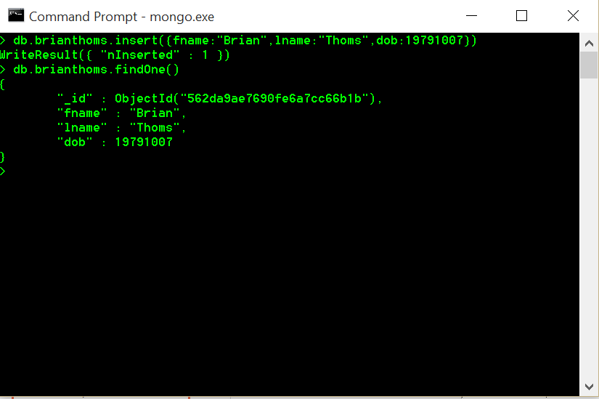
Inserting Data

Slide 40
Querying Data db.mycol.find().pretty()
RDBMS Equivalent | MongoDB Syntax
where lname = ‘thoms' | db.mycol.find({"lname":“thoms"}).pretty()
where likes < 50 | db.mycol.find({"likes":{$lt:50}}).pretty()
where likes <= 50 | db.mycol.find({"likes":{$lte:50}}).pretty()
where likes > 50 | db.mycol.find({"likes":{$gt:50}}).pretty()
where likes >= 50 | db.mycol.find({"likes":{$gte:50}}).pretty()
where likes != 50 | db.mycol.find({"likes":{$ne:50}}).pretty()

Slide 41
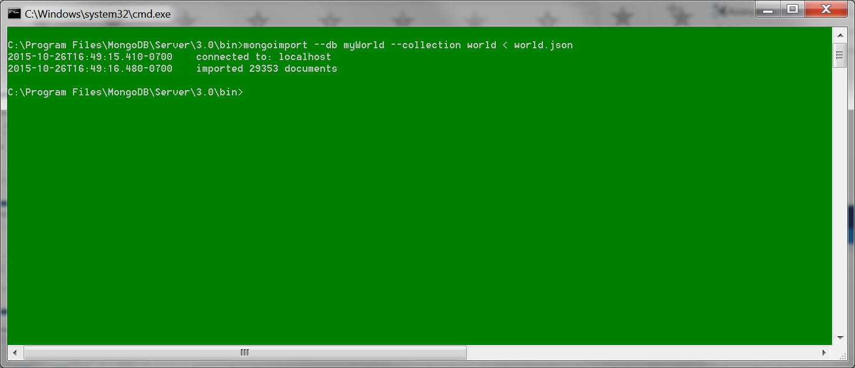
Importing Cities…

Slide 42
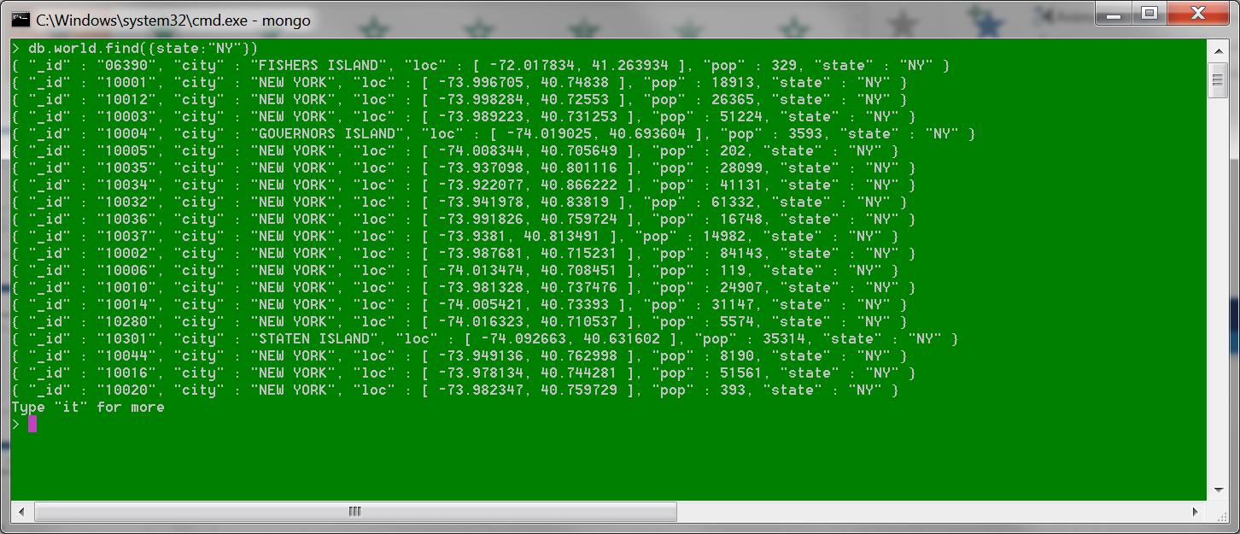
Querying Cities

Slide 43
CITIES.JSON
Import cities.json database into a new collection, called cities.
Perform the following queries:
Return all data with information related to New York or California
Return all data with information where the population is greater than 10k.
Return all data with information from your hometown.
Insert data for all cities where you have lived or visited in the last five years.

