Slide 1
Chapter N
NoSQL

Slide 2
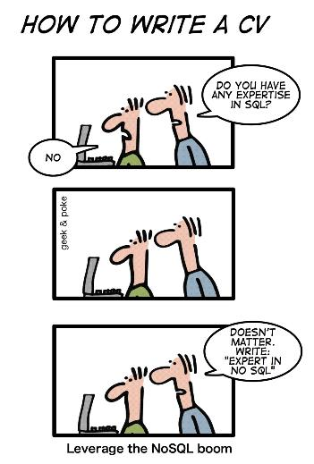
Learning Objectives
This chapter covers:
NoSQL Paradigms
Hands-on NoSQL
MongoDB

Slide 3
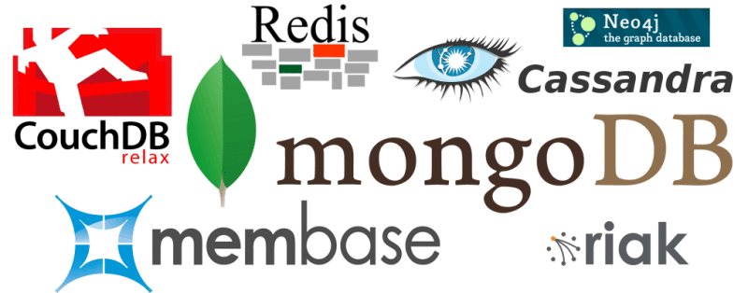
NoSQL Databases
Refers to "non relational" or "not only SQL").
Mechanisms for data storage and retrieval that are not founded in RDBMS.
Introduced to handle large-scale semi-structured data, while providing fault-tolerance and load-balancing.
Lack RDBMS features (typed columns, secondary indexes, triggers, and advanced query languages, etc).
Four categories:
Key-Value,
Wide-Columnar,
Document and
Graph.

Slide 4
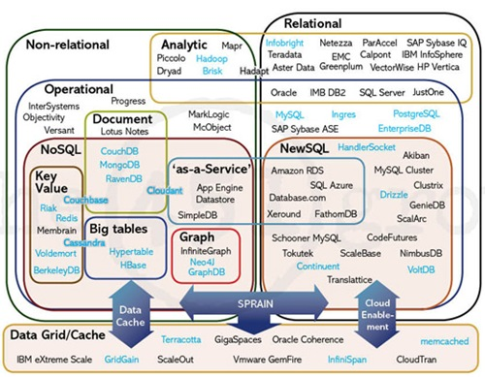
Database Technologies

Slide 5
A need for NoSQL
Explosion of social media (Facebook, Twitter, YouTube) with large data needs
Rise of cloud-based solutions such as Amazon S3 (simple storage solution)
Just as moving to dynamically-typed languages (Ruby/PHP), a shift to dynamically-typed data with frequent schema changes
Agile Development
Open-source community

Slide 6
Major Papers on NoSQL
Three major papers were the seeds of the NoSQL movement
Google - BigTable
Stores data using arbitrary {row key: row column} arrays.
Amazon - DynamoDB
Distributed key-value data store
Eventual consistency
Eric Brewer - CAP Theorem
Consistency: every read receives the most recent write or an error
Availability: every request receives a (non-error) response
Partition Tolerance: the system continues to operate despite an arbitrary number of messages being dropped

Slide 7
NoSQL: CAP vs ACID
CAP
Consistency: All nodes always give the same answer.
Availability: Nodes always answer queries and accept updates.
Partition-tolerance: System continues working even if one or more nodes die.
Atomic
All or nothing.
Consistency
Proper constraints are followed.
Isolation
Transactions are securely and independently processed without interference.
Durable
After a transaction is committed it will remain committed.

Slide 8
(1) Key-Value Pair (KVP)
Hash table where there is a unique key and a pointer to a particular item of data.
Table Rows are schema-less.
Each row has a unique id.
Scales to huge amounts of data.
Examples: Amazon DynamoDB (SS3), Windows Azure, Oracle NoSQL.

Slide 9
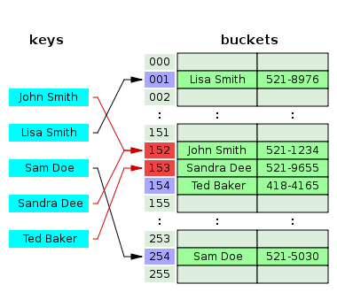

The Hash Table
Type | Unordered associative array
Invented | 1953
Time complexity in big O notation
 | Average | Worst case
Space | O(n) | O(n)
Search | O(1) | O(n)
Insert | O(1) | O(n)
Delete | O(1) | O(n)
java.lang.String
public int hashCode()
s[0]*31^(n-1) + s[1]*31^(n-2) + ... + s[n-1]

Slide 10
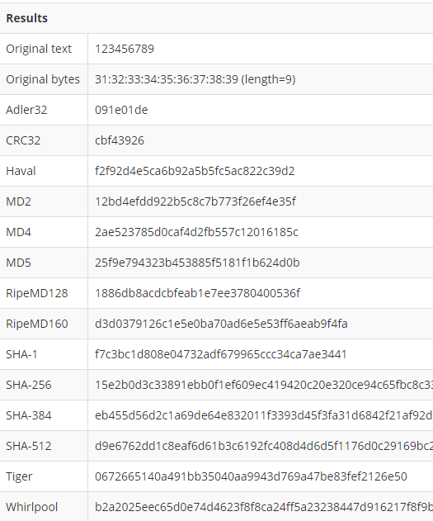
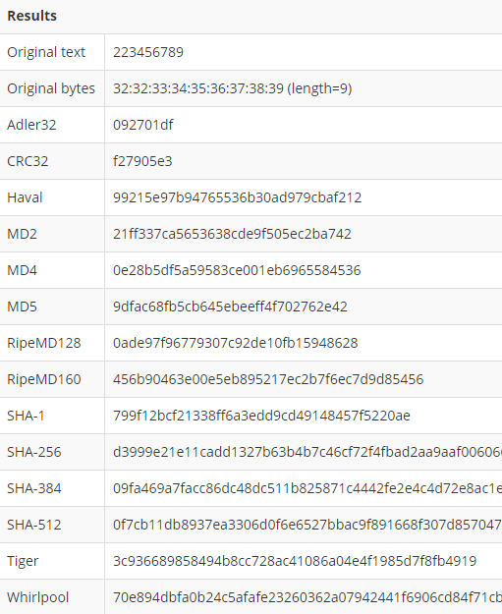
Hashing Results

Slide 11
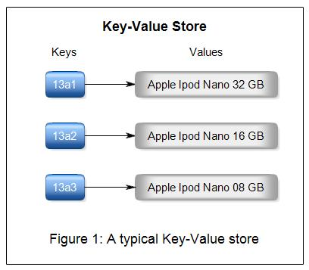
Benefits of KVP
Fault-tolerance - Continue operating even during failures.
Queries – Easy way of accessing data.
Storage options – Large array of hardware options are available.
Data replication – Data is effectively and efficiently transferred from one system to another.
Predictable latency – Detect and avoid bottlenecks.
Tunable consistency - Consistency can be configured per cluster, data center, or individual I/O operation.

Slide 12
(2) [Wide] Column Store
Sub-type of key-value database.
Uses tables, rows, and columns, but unlike a relational database, columns are created for each row rather than being predefined by the table structure
Examples: Google BigTable, Apache Cassandra

Slide 13
Columns and Column Families
Column: The basic unit in a wide-column database and consists of a key and value pair.
Column family: Each row in the column family has a unique identifier key, and then as many columns as it needs to hold the information.
UserProfile = {
Cassandra = {emailAddress:"cassandra@apache.org", age:20},
TerryCho = {emailAddress:"terry.cho@apache.org", gender:"male"},
BThoms= {emailAddress:“brian.thoms@csuci.edu", gender:“male", address:“Los Angeles"},
}

Slide 14
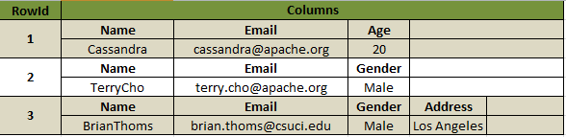
Wide Column Store Example
The first row contains three columns, one called “name”, “email” and “age”; but the third row contains different columns for Gender and Address, but not Age.
Rows are flexible and can have different arrangements of columns.

Slide 15
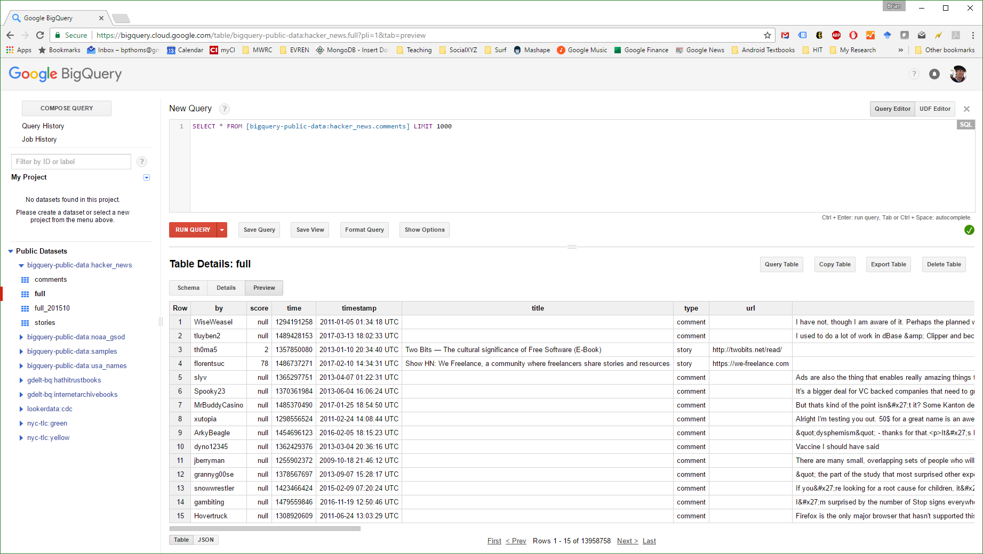
BigQuery

Slide 16
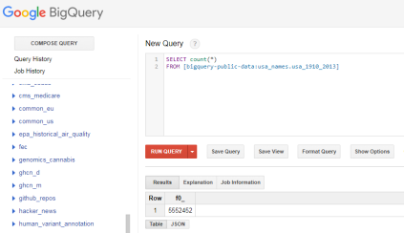
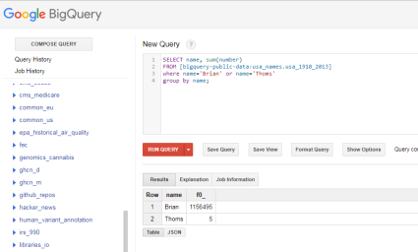
BigQuery (2)

Slide 17
Super Columns & Super Column Families
Super column
Contains many key-value pairs – as many as are needed to adequately hold the data. As with columns, super columns need not be declared.
Super column family
The super column family is a collection of super columns.

Slide 18
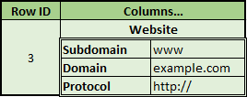
Super Column Store Example (1)
Note: A value in a key-value collection can be another key-value collection.
Website in this example is a super column, meaning it is another key-value collection

Slide 19
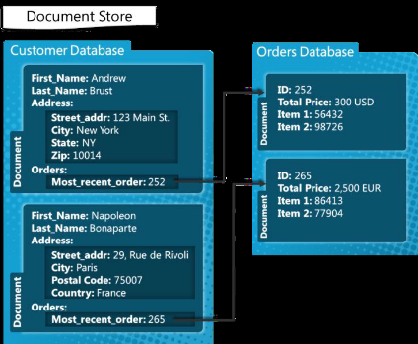
Super Column Store Example (2)

Slide 20
Wide-Column Benefits
High Scalability means it’s well-suited for distribution across multiple data stores and computing nodes.
Sorting and some data manipulation occurs directly from the database rather than relying solely on the application.
Indexing at different levels of columns helps with data processing.
Increased granularity allows updates at the individual column rather than having to replace all of the data when something changes.

Slide 21
(3) Graph Database
Uses graph structures for semantic queries with nodes, edges and properties to represent and store data.
Based on property-graph model:
Nodes represent entities.
Properties are characteristics of nodes.
Edges connect nodes and represent relationships.
Important information is mostly stored in the edges.
Patterns emerge in examining the interconnections of nodes, properties, and edges.

Slide 22
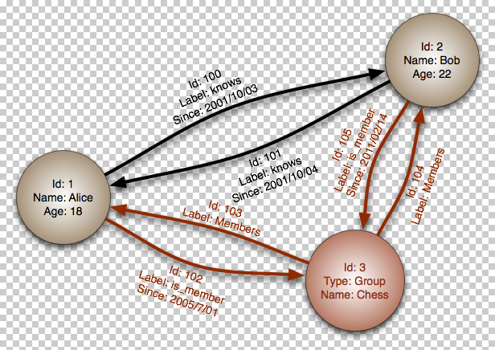
Graph Database Example (1)

Slide 23
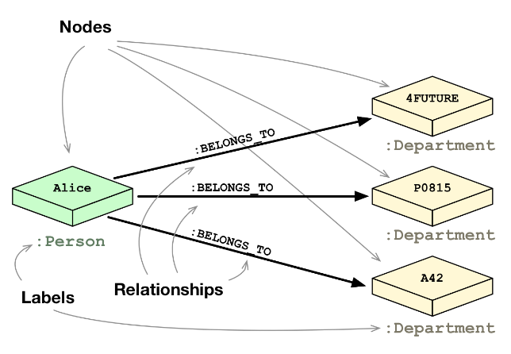
Graph Database Example (2)

Slide 24
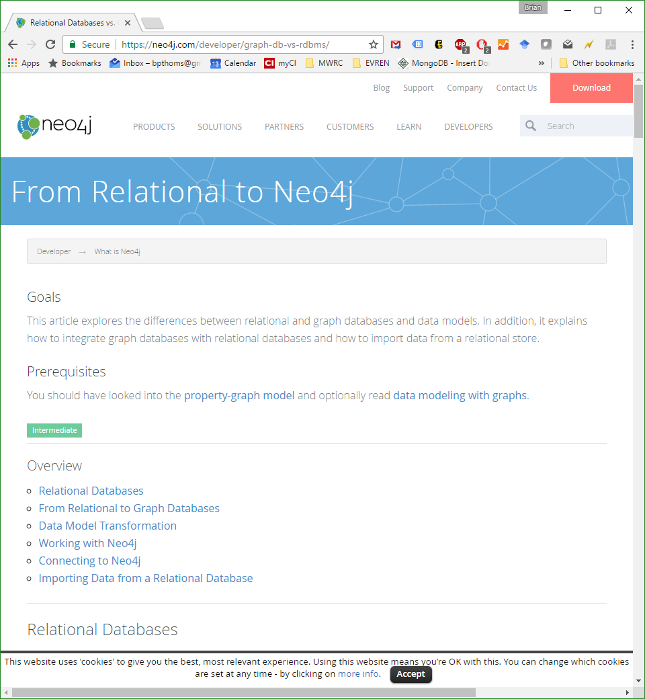
neo4j

Slide 25
(4) Document Store
Designed for storing, retrieving, and managing document-oriented information, also known as semi-structured data.
Inherently a subclass of the key-value store.
Internal data structure
Key-value stores opaque data
Document stores metadata
Examples: MongoDB, CouchDB, Amazon SimpleDB.

Slide 26
Document Store Example Query
> db.user.findOne({age:37})
{
"_id" : ObjectId("5114e0bd42…"),
"first" : "John",
"last" : "Doe",
"age" : 39,
"interests" : [
"Reading",
"Mountain Biking ]
"favorites": {
"color": "Blue",
"sport": "Soccer"}
}

Slide 27
Relational vs. Document
Relational | Document
Database | Database
Table, View | Collection
Row | Document (JSON, BSON)
Column | Field
Index | Index
Join | Embedded Document
Foreign Key | Reference
Partitioning | Sharding
Notes:
Javascript

Slide 28
Summary
NoSQL is non-relational, or not-only SQL.
Four major types:
KVP
Wide-Column*
Graph
Document*
*subsets of KVP

