Slide 1

Introduction to MySQL and SQL

Slide 2
Road Map
Introduction to MySQL
Connecting and Disconnecting
Entering Basic Queries
Creating and Using a Database

Slide 3
MySQL
MySQL open source database.
It is named after co-founder Michael Widenius's daughter, My (this is not a joke).
Officially pronounced “my Ess Que Ell” (not my sequel).
Handles very large databases; very fast performance.
Why learn RDBMS with MySQL?
Free (much cheaper than Oracle!)
Installs locally
Easy to use Shell for creating tables, querying tables, etc.
Easy interface with programming languages

Slide 4
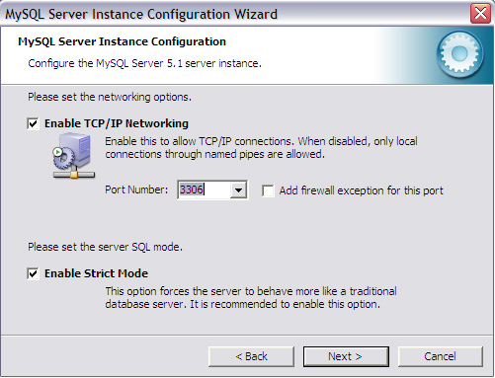
Port 3306
A port is a process-specific construct that serves as a communications endpoint in a computer's host operating system.

Slide 5
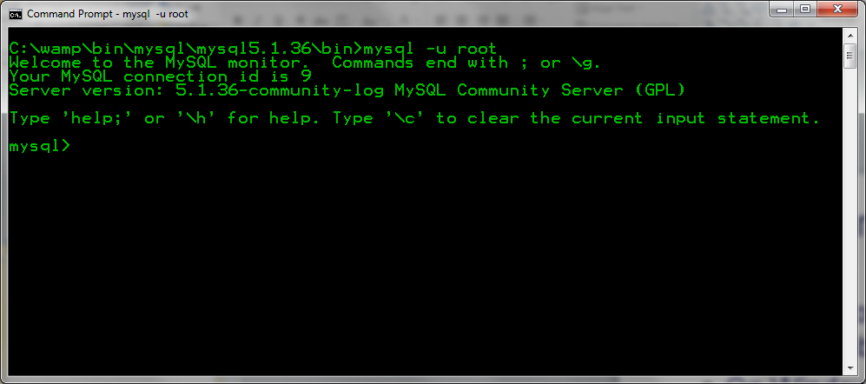
Connecting to MySQL
MySQL provides an interactive shell for creating tables, inserting data, etc.
On Windows, under c:\mysql\bin, type:
mysql start
Or, click on the Windows icon

Slide 6
Sample Session
For example:
Enter password: *****
Welcome to the MySQL monitor. Commands end with ; or \g.
Your MySQL connection id is 241 to server version: 3.23.49
Type 'help;' or '\h' for help. Type '\c' to clear the buffer.
mysql>
To exit the MySQL Shell, just type QUIT or EXIT:
mysql> QUIT
mysql> EXIT

Slide 7
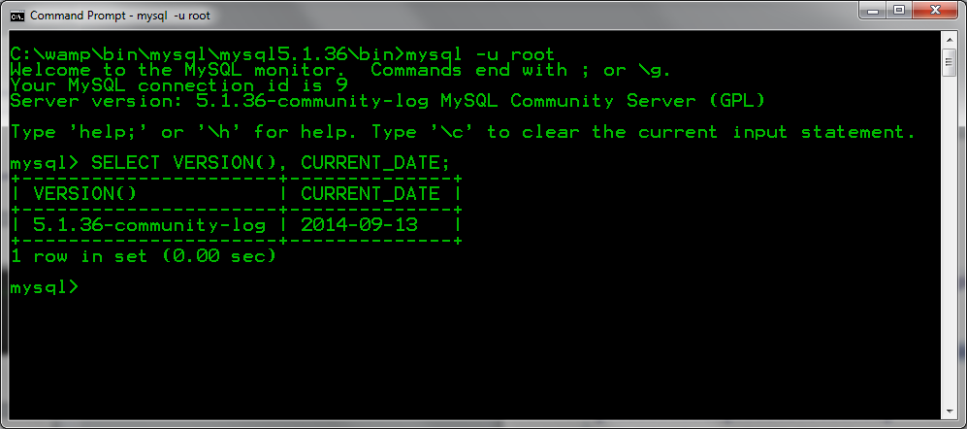
Basic Queries
Once logged in, you can try some simple queries.
For example:
mysql> SELECT VERSION(), CURRENT_DATE;
+-----------+--------------+
| VERSION() | CURRENT_DATE |
+-----------+--------------+
| 3.23.49 | 2002-05-26 |
+-----------+--------------+
1 row in set (0.00 sec)
Note that most MySQL commands end with a semicolon (;)
MySQL returns the total number of rows found, and the total time to execute the query.

Slide 8
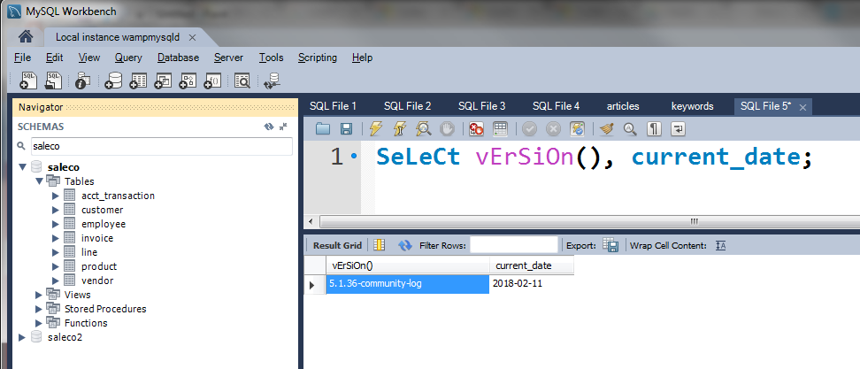
Basic Queries
Keywords may be entered in any lettercase.
The following queries are equivalent:
mysql> SELECT VERSION(), CURRENT_DATE;
mysql> select version(), current_date;
mysql> SeLeCt vErSiOn(), current_DATE;

Slide 9
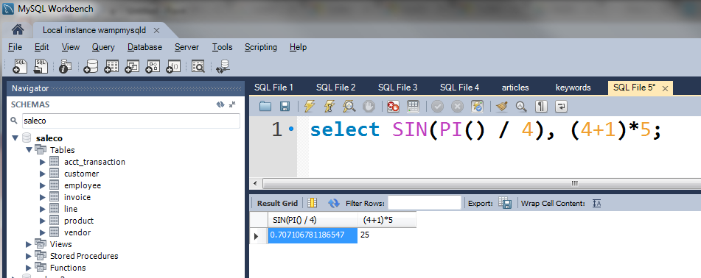
Basic Queries
Here's another SQL query. It demonstrates that you can use mysql as a simple calculator:
mysql> SELECT SIN(PI()/4), (4+1)*5;
+-------------+---------+
| SIN(PI()/4) | (4+1)*5 |
+-------------+---------+
| 0.707107 | 25 |
+-------------+---------+

Slide 10
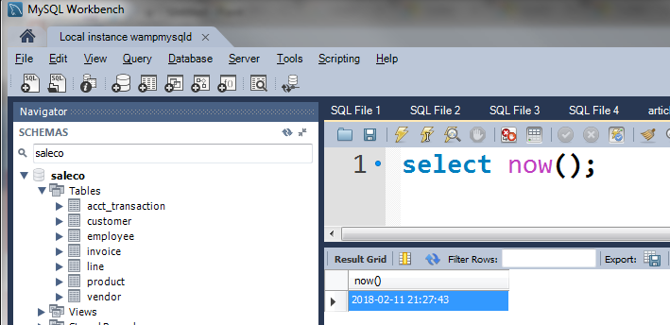
Basic Queries
You can also enter multiple statements on a single line. Just end each one with a semicolon:
mysql> SELECT VERSION(); SELECT NOW();
+--------------+
| VERSION() |
+--------------+
| 3.22.20a-log |
+--------------+
+---------------------+
| NOW() |
+---------------------+
| 2004 00:15:33 |
+---------------------+

Slide 11
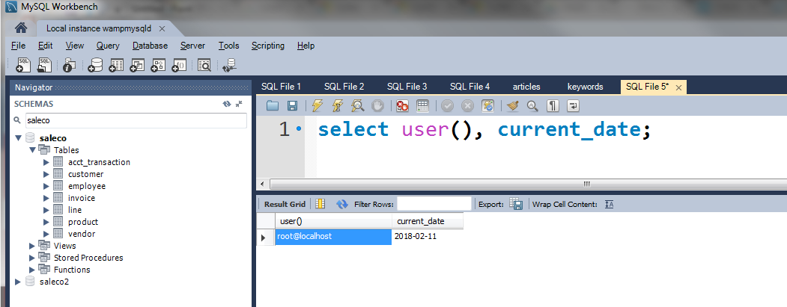
Multi-Line Commands
mysql determines where your statement ends by looking for the terminating semicolon, not by looking for the end of the input line.
Here's a simple multiple-line statement:
mysql> SELECT
-> USER()
-> ,
-> CURRENT_DATE;
+--------------------+--------------+
| USER() | CURRENT_DATE |
+--------------------+--------------+
| joesmith@localhost | 1999-03-18 |
+--------------------+--------------+

Slide 12
Canceling a Command
If you decide you don't want to execute a command that you are in the process of entering, cancel it by typing \c
mysql> SELECT
-> USER()
-> \c
mysql>

Slide 13
Using a Database
To get started on your own database, first check which databases currently exist.
Use the SHOW statement to find out which databases currently exist on the server:
mysql> show databases;
+----------+
| Database |
+----------+
| mysql |
| test |
+----------+
2 rows in set (0.01 sec)

Slide 14
Using a Database
To create a new database, issue the “create database” command:
mysql> create database csuci;
To the select a database, issue the “use” command:
mysql> use csuci;

Slide 15
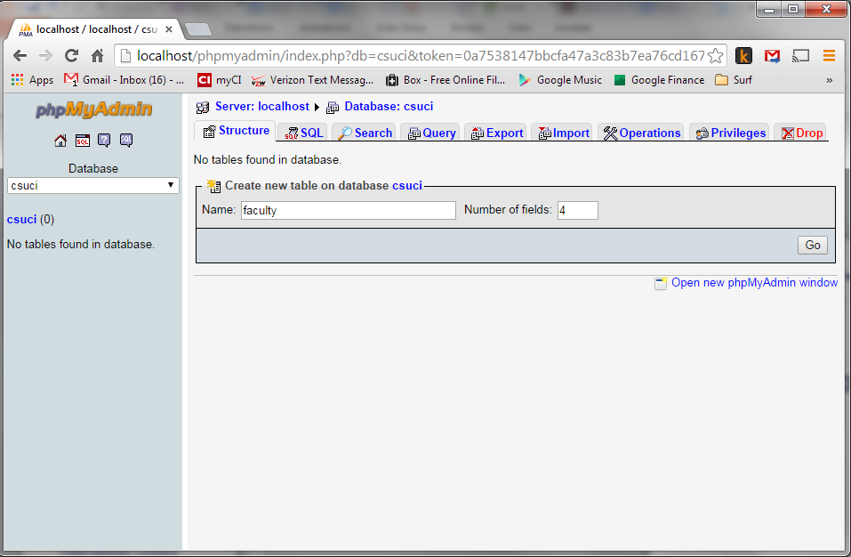
CREATE TABLE faculty;

Slide 16
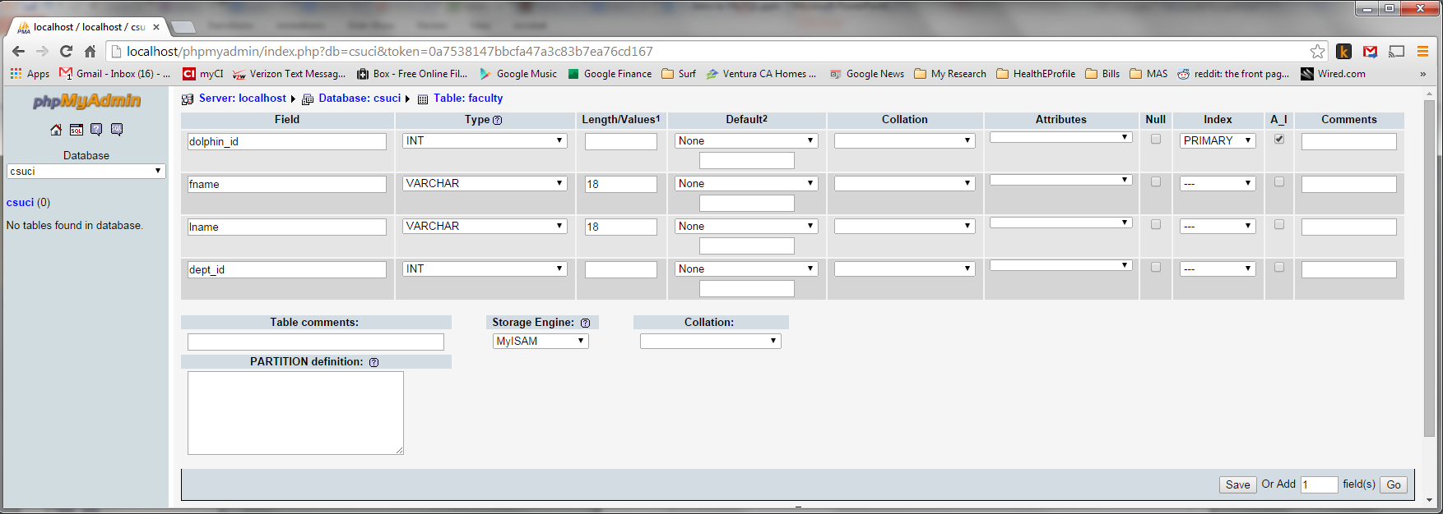
CREATE TABLE faculty;

Slide 17
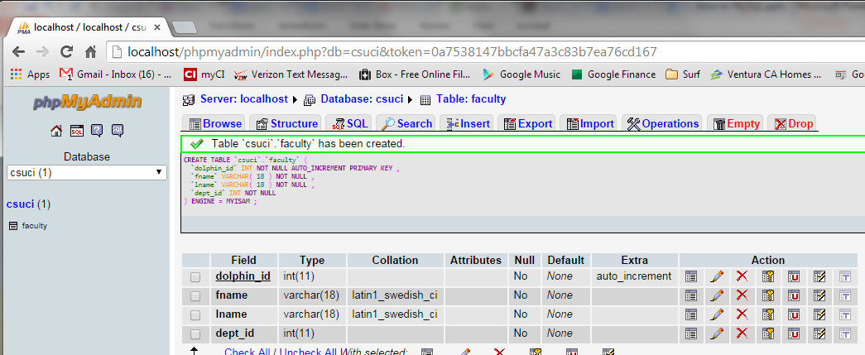
CREATE TABLE faculty;

Slide 18
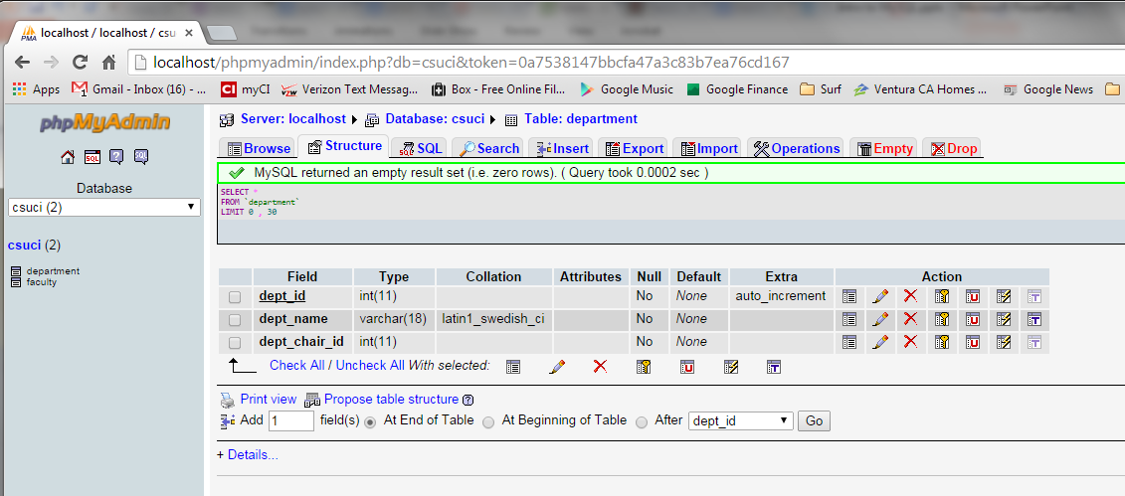
CREATE TABLE department;

Slide 19
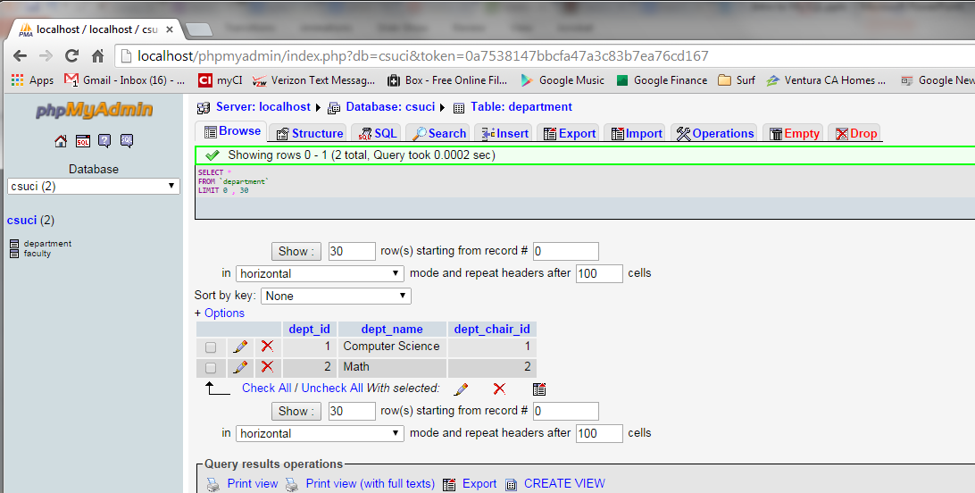
INSERT INTO department;

Slide 20
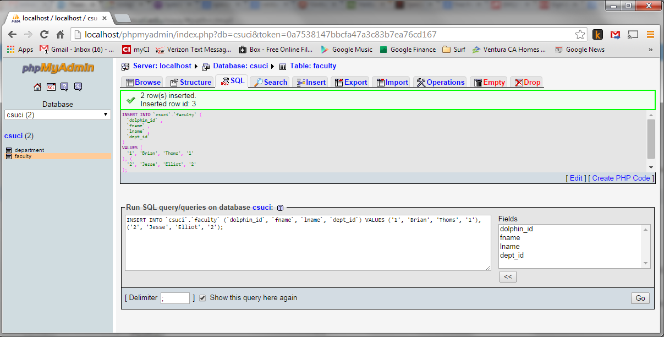
INSERT INTO faculty;

Slide 21
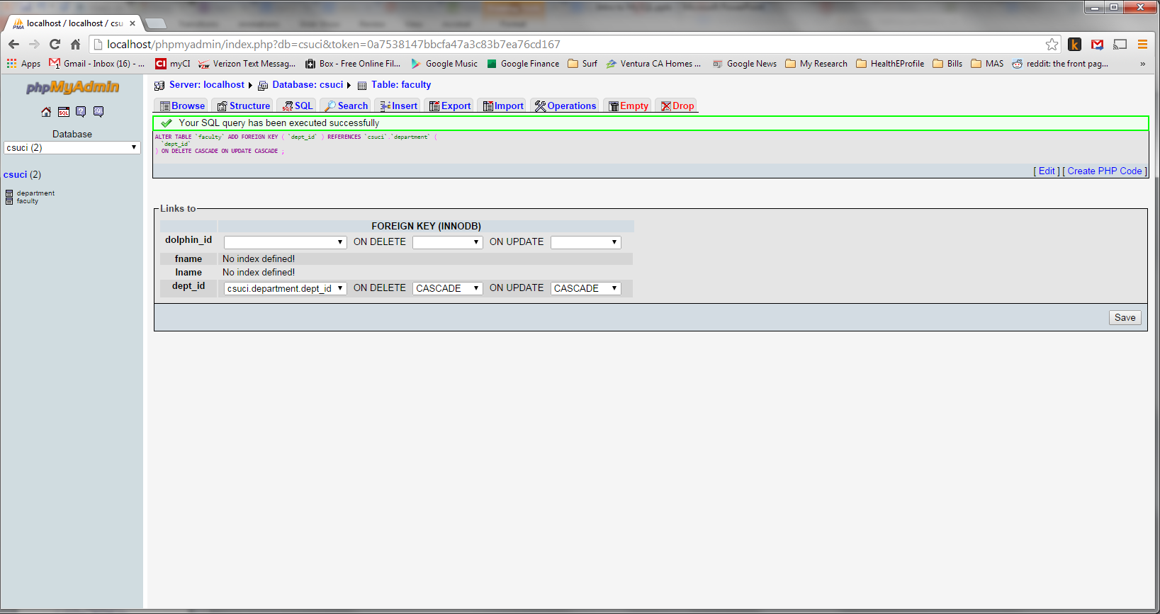
RELATE faculty to department

Slide 22
RELATE faculty TO department

Slide 23
CASCADE UPDATE/DELETE
Removing entry from either table, removes the entry from the other.

Slide 24
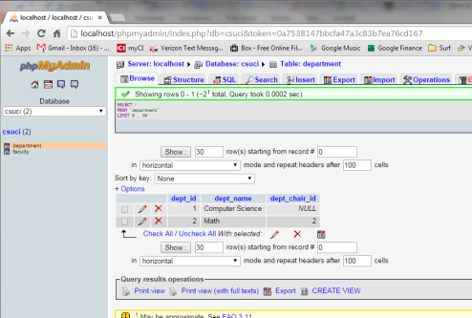
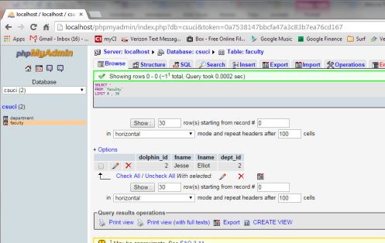
Example

Slide 25
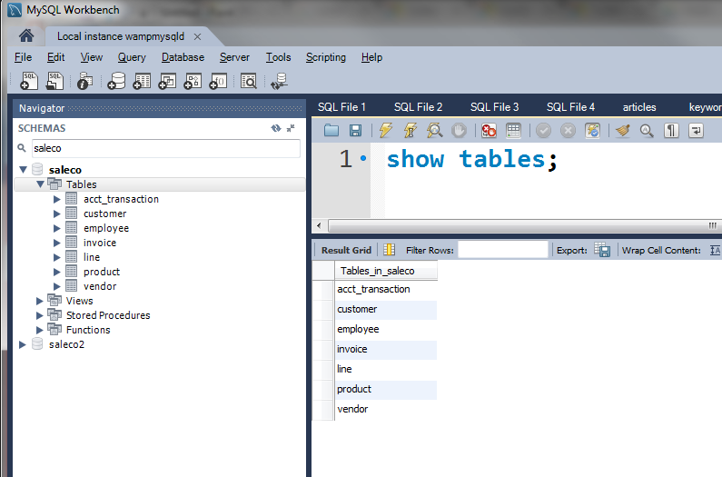
Show Tables

Slide 26
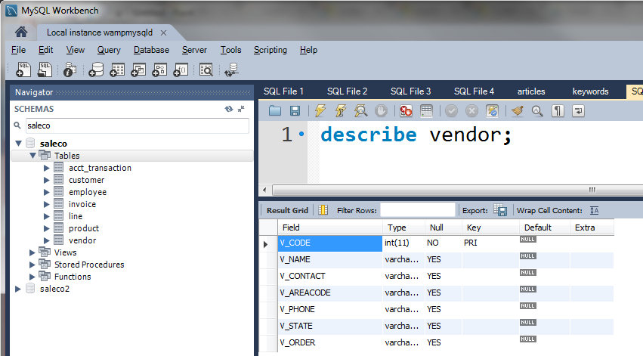
Describing Tables

Slide 27
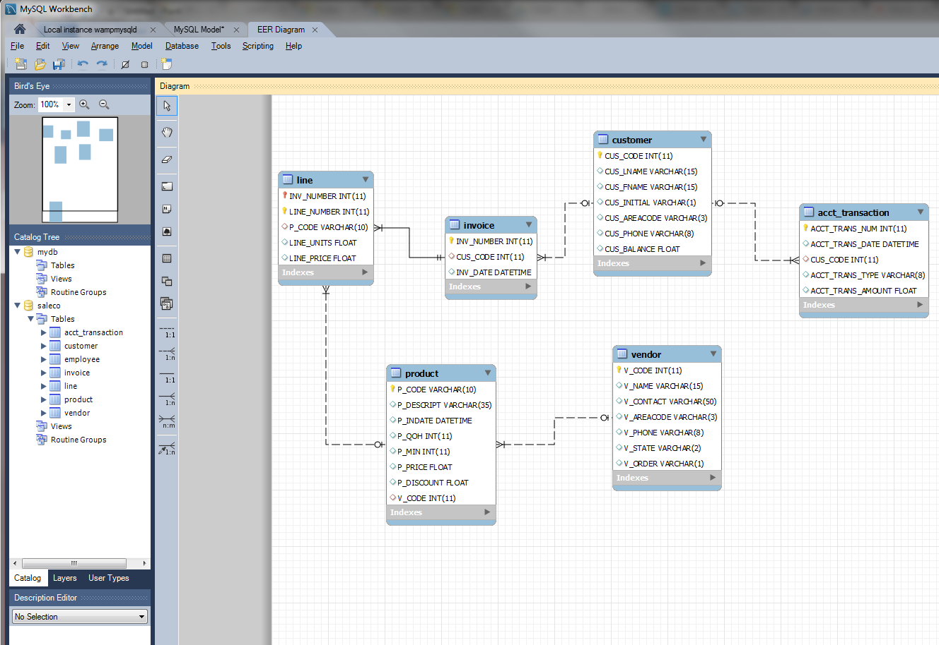
Reverse Engineering

Slide 28
Summary
SQL provides a structured language for querying/updating multiple databases.
The more you know SQL, the better.
The most important part of SQL is learning to retrieve data.
selecting rows, columns, boolean operators, pattern matching, etc.
Keep playing around in the MySQL Shell.

