Slide 1
COMP-162 Embedded Systems
Lecture 3: Introduction to C programming

Slide 2
Agenda
Recap
GPIO
Logic and Shift Operations
Addressing Modes
Subroutines and the Stack
Outline
Variables in C (types, local/global)
Functions (parameters, prototypes)
for-loop and while-loop
if-then and if-then-else
Arrays with indexed access
RAM/ROM and initialization

Slide 3
Variables
Type
int32_t
uint32_t
int16_t
uint16_t
int8_t
uint8_t
char
Scope
Global -> everywhere
Local -> within {}
Allocation
Global -> ROM or RAM
Local -> registers or stack
32-bit access
LDR
STR
16-bit access
LDRH LDRSH
STRH
8-bit access
LDRB LDRSB
STRB
Naming style
Globals (capital)
Locals (lower)
Notes:
AREA DATA, ALIGN=2
Height SPACE 2
AREA |.text|, CODE, READONLY, ALIGN=2
; Height = 10;
LDR R0,=Height
MOV R1,#10
STRH R1,[R0]

Slide 4
Expressions
Must operate on similar types
variable = value;
Arithmetic
+ - * / %
Logical
& | ^ ~ >> <<
Relational (two values to boolean)
< <= > >= == !=
Boolean (false is 0, true is nonzero)
&& || !

Slide 5
Conditionals
if-then
if(A>M){
M = A;
}
if((letter>=’A’)&&(letter<=’Z’)){
letter = letter+(‘a’-’A’);
}
if-then-else
if(A>B){
M = A;
}else{
M = B;
}
uint16_t Height;
int main(void){
if(Height > -5){
Height = 0;
}
}
Notes:
; if(Height > -5){
; Height = 0;
; }
LDR R0,=Height
LDRSH R1,[R0]
CMP R1,#-5
BLE skip
MOV R1,#0
STRH R1,[R0]
skip

Slide 6
Loops
for-loop
m = 0;
for(i=0; i<10; i++){
m = m+i;
}
while-loop
int main(void){uint32_t m;
while(1){
m = 1000000;
while(m){
m--;
}
// stuff
}
}
while(GPIO_PORTF_DATA_R&0x10){
}
Notes:
MOV R4,#0 ;m = 0;
;for(int32_t i=0; i<10; i++){
MOV R5,#0 ;i=0
myFunForLoop
CMP R5,#10
BGE myFunForLoopDone
ADD R4,R4,R5 ; m = m+i;
ADD R5,R5,#1 ;i++
B myFunForLoop
myFunForLoopDone
;}

Slide 7
Functions
Prototype/declaration
uint32_t max(uint32_t a, uint32_t b);
uint32_t CardiacOutput(uint32_t t[1000]);
int32_t dot(int32_t a[], int32_t b[],int32_t l)
Definition
uint32_t max(uint32_t a, uint32_t b){uint32_t r;
if(a>b){
r = a;
}else{
r = b;
}
return r;
}
Invocation
c = max(x+3;y);
Notes:
max CMP R0,R1
BLS notGt
MOV R4,R0
B maxDone
notGt MOV R4,R1
maxDone
MOV R0,R4
BX LR

Slide 8
Example Not Gate
Should be local, made global to help debugging
uint32_t In,Out;
void Not_Init(void);
int main(void){
Not_Init();
while(1){ // operations to be executed over and over go here
In = GPIO_PORTE_DATA_R & 0x01;
Out = ~In;
GPIO_PORTE_DATA_R = (GPIO_PORTE_DATA_R&~0x02)|Out<<1;
}
}
void Not_Init(void){
volatile uint32_t delay;
SYSCTL_RCGCGPIO_R |= 0x10; // Turn clock on PortE
delay = 100; // Wait
GPIO_PORTE_DIR_R |= 0x02; // PE1 is output
GPIO_PORTE_DIR_R &= ~(0x01); // PE0 is input
GPIO_PORTE_DEN_R |= 0x03;
}

Slide 9
Memory segments
Code (Flash EEPROM)
0x00000000 Initial stack
0x00000004 Initial PC
…
0x00000200 Your code
...
0x0003FFFC
Data
0x20000000 Your globals
0x20000004...
Stack
0x20000402
0x20000404
0x20000408 SP-> top
Heap

Slide 10
Call by value versus reference
noChange
MOV R0,#5
BX LR
Change
MOV R1,# 5
STR R1,[R0]
BX LR
main
LDR R0,=a
MOV R1,#55
STR R1,[R0]
LDR R0,=a
BL noChange
LDR R0,=a
BL Change
BX LR
void noChange(uint32_t val){
val = 5;
}
void Change(uint32_t *val){
*val = 5;
}
uint32_t a;
int main(void){
a = 55;
noChange(a);
Change(&a);
}

Slide 11
Pointers
AREA DATA, ALIGN=2
a SPACE 4
b SPACE 4
void swap(uint32_t *a,uint32_t *b){
uint32_t t;
t = *a;
*a = *b;
*b = t;
}
uint32_t a,b;
int main(void){
a = 3; b=4;
swap(&a,&b);
}
main
LDR R0,=a
MOV R1,#3
STR R1,[R0]
LDR R0,=b
MOV R1,#5
STR R1,[R0]
LDR R0,=a
LDR R1,=b
BL swap
BX LR
swap
LDR R3,[R0] ;t=*a
LDR R4,[R1] ;*b
STR R4,[R0] ;*a =*b
STR R3,[R1]
BX LR

Slide 12
Arrays
Definition (type, size, allocation
#define LEN 10
int16_t Data[10]; // global RAM
const int16_t Prime[5]={2,3,5,7,11}; // global ROM
void fun(void){ char name[8];
}
Access
Data[0] = 55;
Data[1] = 72;
Zero index address calculation Buf[i]
32 bit: Buf+4*i
16 bit: Buf+2*i
8 bit: Buf+i

Slide 13
Array example
Definition (type, size, allocation)
#define LEN 10
int32_t aa[LEN];
int32_t bb[LEN];
Access
int32_t s=0;
for(int32_t i=0;i<l;i++){
s += a[i]*b[i];
}
Review: what is?
aa[0]
&aa[0]
aa
aa[i]

Slide 14
Array example
AREA DATA, ALIGN=2
aa SPACE 4*10
bb SPACE 4*10
i RN 4
main MOV i,#0 ;i=0
MOV R3,#5
forloop2
CMP i,#5 ;is i<5
BGE forDone2
LDR R0,=aa ;aa[i] = aa+4*i
ASL R2,i,#2 ;R2=i*4
STR i,[R0,R2]
LDR R6,=bb
STR R3,[R6,R2] ;bb+i*4
ADD i,i,#1
B forloop2
forDone2
Address calculation
64-bit base+8*index
32-bit base+4*index
16-bit base+2*index
8-bit base+index
Access
for(int i=0; i< 5;i++){
aa[i] = i;
bb[i] = 5;
}

Slide 15
Array parameters
s RN 4
i RN 5
dot MOV s,#0 ;s=0
MOV i,#0 ;i=0
LDR R0,=aa ;aa[i] = aa+4*i
LDR R1,=bb ;bb[i] = bb+4*i
forloop3
CMP i,R2 ;is i<l
BGE forDone3
ASL R6,i,#2 ;i*4
LDR R7,[R0,R6]
LDR R8,[R1,R6]
MUL R7,R7,R8
ADD s,s,R7
ADD i,i,#1
B forloop3
forDone3
MOV R0,s
BX LR
Parameter is pass by reference
int32_t dot(int32_t a[], int32_t b[], int32_t l){
int32_t s=0;
for(int32_t i=0;i<l;i++){
s += a[i]*b[i];
}
return s;
}
Invocation pass by reference
int main(void){
int32_t result;
result = dot(aa,bb,5);
while(1){
}
}

Slide 16
Summary
Variables (type, size, allocation)
Expressions
Conditionals
If-then and if-then-else
For-loop
While-loop
Functions
Arrays

Slide 17
Call by value vs call by reference
void swap(int32_t aa, int32_t bb){ int32_t tmp;
tmp = aa;
aa = bb;
bb = tmp;
}
void swap2(int32_t *aa, int32_t *bb){ int32_t tmp;
tmp = *aa;
*aa = *bb;
*bb = tmp;
}
int32_t a=33;
int32_t b=44;
int main(void){
Output_Init(); // initialize output device
swap(a,b);
printf("swap a=%d, b=%d\n",a,b);
swap2(&a,&b);
printf("swap2 a=%d, b=%d\n",a,b);
while(1){};
}

Slide 18
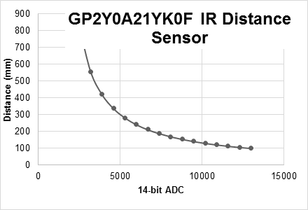
IR distance sensor
#define K1 1195172
#define K2 -1058
uint32_t IRconvert(uint32_t n){
return = K1/(n + K2);
}
uint32_t IRconvert(uint32_t n){
uint32_t d;
if(n<3000) return 800;
if(n>13000) return 100;
d = K1/(n + K2);
return d;
}
d = 1195172/(n – 1058 )

Slide 19
Maximum of an array
int32_t max(int32_t data[],
uint32_t size){
int32_t ans,i;
ans = - 2147483648; // smallest possible
for(i=0; i < size; i++){
if(data[i] > ans){
ans = data [i];
}
}
return ans;
}
#define SIZE 10
int32_t MyData[SIZE];
int main(){int32_t myMax;
while(1){
// fill up MyData
myMax = max(MyData,SIZE);
}
}

Slide 20
Dot product
#define LEN 5
int32_t aa[LEN];
int32_t bb[LEN];
int32_t dot(int32_t a[], int32_t b[],
int32_t length){ int32_t s=0;
for(int32_t i=0;i< length;i++){
s += a[i]*b[i];
}
return s;
}
int main(void){
int32_t result;
for(int i=0; i< LEN;i++){
aa[i] = i;
bb[i] = 5;
}
result = dot(aa,bb,LEN);
while(1){ }
}

Slide 21
Capitalize letters in string
char name[10] = "Jonathan";
// uncapitalize every letter
void uncap(char str[]){int i=0;
while(str[i]){
str[i] |= 0x40;
i++;
}
}
void uncap(char *p){
while(*p){
*p |= 0x40;
p++;
}
}

Slide 22
Agenda
Recap
GPIO
Logic and Shift Operations
Addressing Modes
Subroutines and the Stack
Introduction to C
Outline
Debugging
Digital Logic
GPIO TM4C123/LM4F120 Specifics
Switch and LED interfacing
Arithmetic Operations
Random Number Generator example

Slide 23
Debugging
Testing, Diagnostics, Verification, Validation
Debugging Actions
Functional debugging, input/output values
Performance debugging, input/output values with time (how fast does it execute)
Resource debugging, I/O values w/ time and resources (how much memory, power, …)
Tracing, measure sequence of operations
Profiling,
measure percentage for tasks,
time relationship between tasks
Optimization, make tradeoffs for overall good
improve speed,
improve accuracy,
reduce memory,
reduce power,
reduce size,
reduce cost

Slide 24
Debugging Intrusiveness
Intrusive Debugging
degree of perturbation caused by the debugging itself
how much the debugging slows down execution
Non-intrusive Debugging
characteristic or quality of a debugger
allows system to operate as if debugger did not exist
e.g., logic analyzer, ICE, JTAG
Minimally intrusive
negligible effect on the system being debugged
e.g., dumps(ScanPoint) and monitors
Highly intrusive
print statements, breakpoints and single-stepping

Slide 25
… Debugging
Instrumentation: Code we add to the system that aids in debugging
E.g., print statements
Good practice: Define instruments with specific pattern in their names
Use instruments that test a run time global flag
leaves a permanent copy of the debugging code
causing it to suffer a runtime overhead
simplifies “on-site” customer support.
Use conditional compilation (or conditional assembly)
Keil supports conditional assembly
Easy to remove all instruments
IF symbol / ELSE / ENDIF; --predefine “symbol SETL {TRUE}” in ASM options
#ifdef / #else #endif
Visualization: How the debugging information is displayed

Slide 26
Debugging Aids in Keil
Interface
Breakpoints
Registers including xPSR
Memory and Watch Windows
Logic Analyzer, GPIO Panel
Single Step, StepOver, StepOut, Run, Run to Cursor
Watching Variables in Assembly
EXPORT VarName[DATA,SIZE=4]
Command Interface (Advanced but useful)
WS 1, `VarName,0x10
LA (PORTD & 0x02)>>1

Slide 27
ARM ISA : ADD, SUB and CMP
ARITHMETIC INSTRUCTIONS
ADD{S} {Rd,} Rn, <op2> ;Rd = Rn + op2
ADD{S} {Rd,} Rn, #im12 ;Rd = Rn + im12
SUB{S} {Rd,} Rn, <op2> ;Rd = Rn - op2
SUB{S} {Rd,} Rn, #im12 ;Rd = Rn - im12
RSB{S} {Rd,} Rn, <op2> ;Rd = op2 - Rn RSB{S} {Rd,} Rn, #im12 ;Rd = im12 - Rn
CMP Rn, <op2> ;Rn - op2
CMN Rn, <op2> ;Rn - (-op2)
Addition
C bit set if unsigned overflow
V bit set if signed overflow
Subtraction
C bit clear if unsigned overflow
V bit set if signed overflow

Slide 28
ARM ISA : Multiply and Divide
32-BIT MULTIPLY/DIVIDE INSTRUCTIONS
MUL{S} {Rd,} Rn, Rm ;Rd = Rn * Rm
MLA Rd, Rn, Rm, Ra ;Rd = Ra + Rn*Rm
MLS Rd, Rn, Rm, Ra ;Rd = Ra - Rn*Rm
UDIV {Rd,} Rn, Rm ;Rd = Rn/Rm unsigned
SDIV {Rd,} Rn, Rm ;Rd = Rn/Rm signed
Multiplication does not set C,V bits

Slide 29
Condition Codes
Bit | Name | Meaning after add or sub
N | negative | result is negative
Z | zero | result is zero
V | overflow | signed overflow
C | carry | unsigned overflow
C set after an unsigned addition if the answer is wrong
C cleared after an unsigned subtract if the answer is wrong
V set after a signed addition or subtraction if the answer is wrong

Slide 30
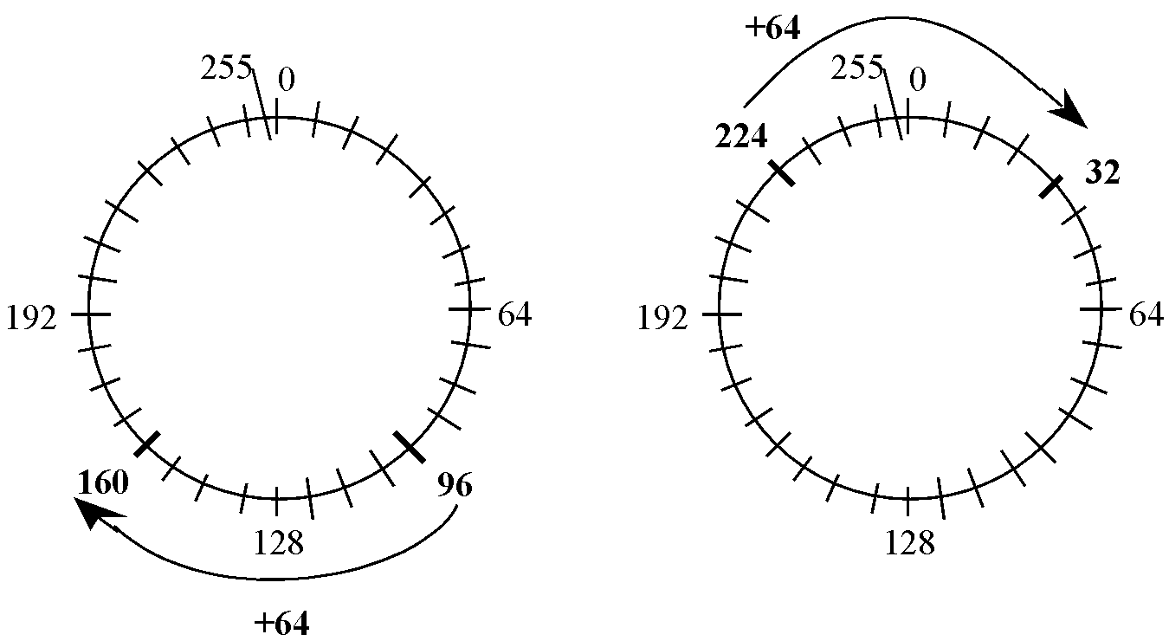
8-bit unsigned number wheel
96+64
224+64
C bit Set
C bit Cleared
The carry bit, C, is set after an unsigned addition when the result is incorrect.
The carry bit, C, is clear after an unsigned subtraction when the result is incorrect.

Slide 31
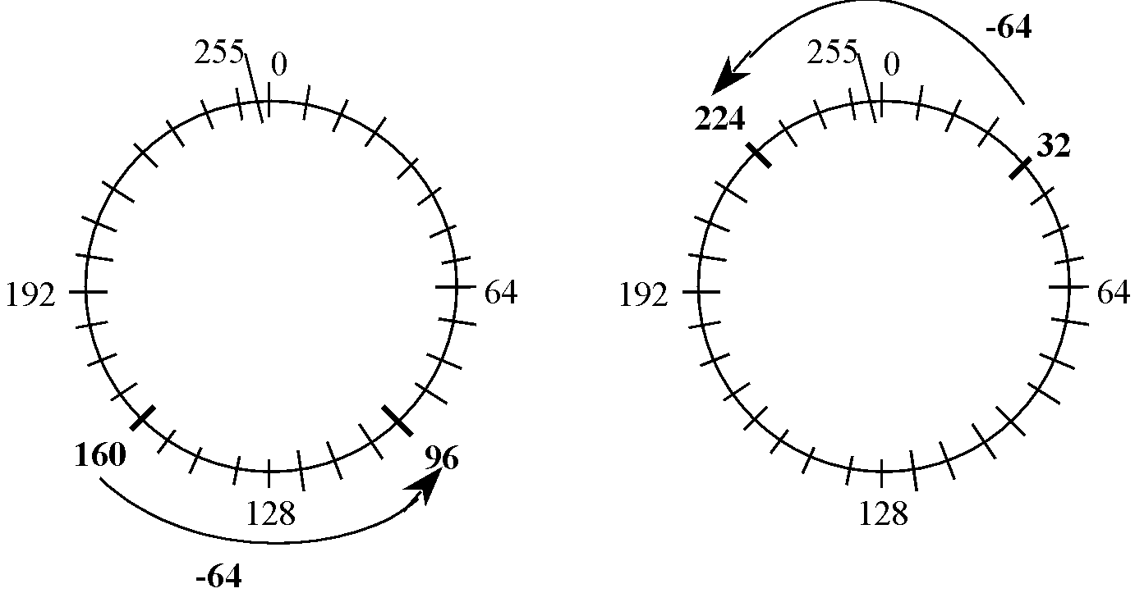
8-bit unsigned number wheel
160-64
32-64
C bit Set
C bit Cleared
The carry bit, C, is set after an unsigned addition when the result is incorrect.
The carry bit, C, is clear after an unsigned subtraction when the result is incorrect.

Slide 32
Algorithm (unsigned)
Find values of both numbers interpreted as unsigned
Perform addition or subtraction
Does the result fit as an unsigned?
No -> addition C=1, subtraction C=0
Yes -> addition C=0, subtraction C=1
For example: 255 + 5 = 260, C = 1 and the actual answer is 260-256 = 4

Slide 33
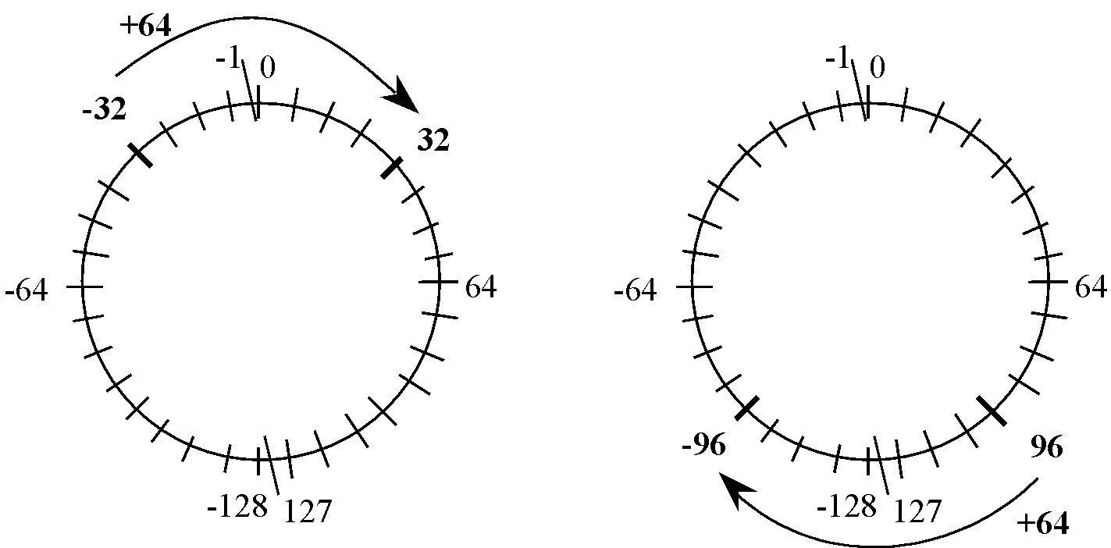
8-bit signed number wheel
-32+64
96+64
V bit Cleared
V bit Set
The overflow bit, V, is set after a signed addition or subtraction when the result is incorrect.

Slide 34
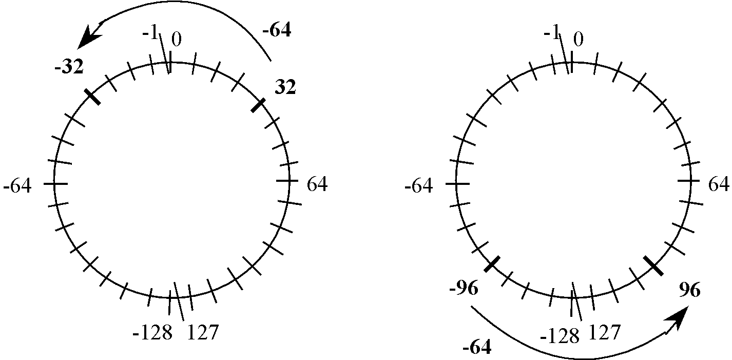
8-bit signed number wheel
32-64
-96-64
V bit Cleared
V bit Set
The overflow bit, V, is normally set when we cross over from 127 to -128 while adding or cross over from -128 to 127 while subtracting.

Slide 35
Algorithm (signed)
Find values of both numbers interpreted as signed
Perform addition or subtraction
Does the result fit as a signed?
No -> V=1
Yes -> V=0
8-bit
Examples: 10 – 5 = 5, V=0
-100 – 100 = -200, V=1

Slide 36
Addition Summary
Let the 32-bit result R be the result of the 32-bit addition X+M.
N bit is set
if unsigned result is above 2³¹-1 or
if signed result is negative.
N = R₃₁
Z bit is set if result is zero
V bit is set after a signed addition if result is incorrect
C bit is set after an unsigned addition if result is incorrect

Slide 37
Subtraction Summary
Let the 32-bit result R be the result of the 32-bit subtraction X-M.
N bit is set
if unsigned result is above 2³¹-1 or
if signed result is negative.
N = R₃₁
Z bit is set if result is zero
V bit is set after a signed subtraction if result is incorrect
C bit is clear after an unsigned subtraction if result is incorrect

Slide 38
Trick Question
When the subtraction (32 – 129) is performed in an 8-bit system what is the result and the status of the NZVC bits?

Slide 39
Trick Question
When the subtraction (32 – 129) is performed in an 8-bit system what is the result and the status of the NZVC bits?
Answer = 159
NZVC = 1010

