Slide 1
COMP462: Embedded Systems
Lecture 4: Switch Interface, LED Interface, Branches, Stack Operations, Condition codes

Slide 2
Agenda
Recap, C programming
Variables (type, size, allocation)
Expressions
Conditionals
Loops
Functions (parameter passing)
Outline
Switch interface
LED interface
Conditional Branches (condition codes)
Delay loops, duty cycle (PWM)
Abstraction & Refinement
Device Driver

Slide 3
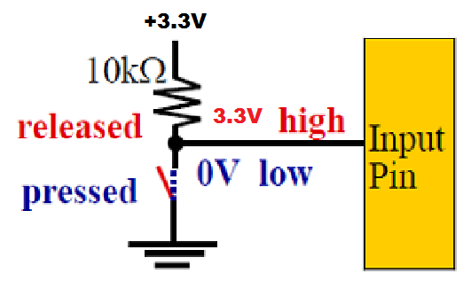
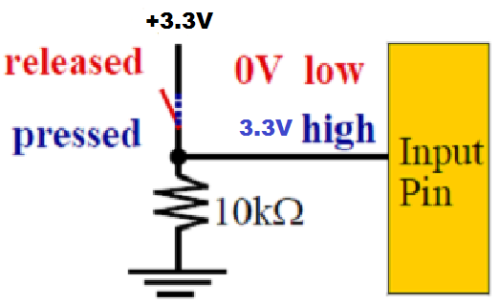
Switch Configuration
negative – pressed = ‘0’
positive – pressed = ‘1’

Slide 4
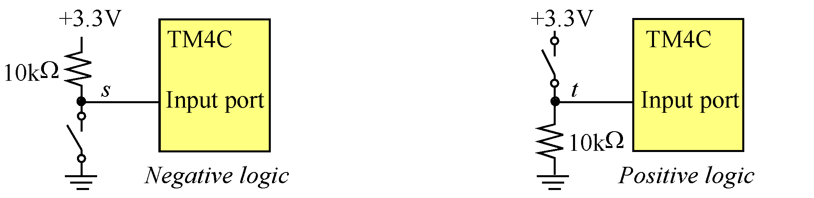
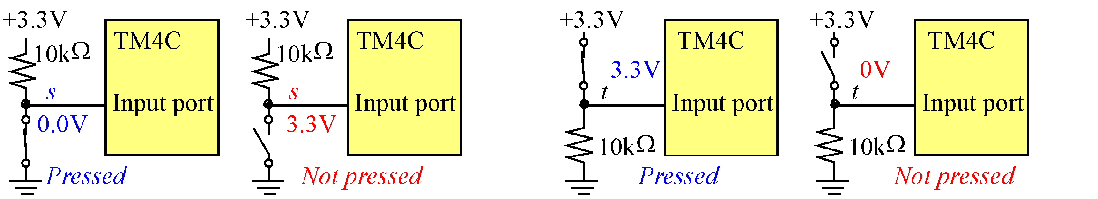
Switch Configuration
Negative Logic s
– pressed, 0V, false
– not pressed, 3.3V, true
Positive Logic t
– pressed, 3.3V, true
– not pressed, 0V, false

Slide 5
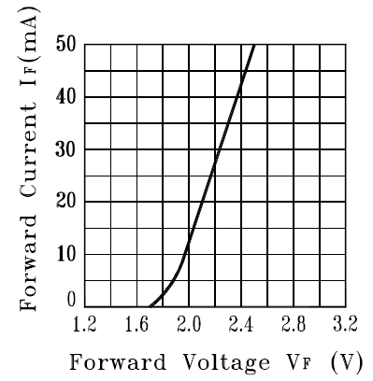
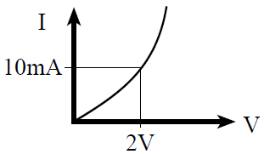


LED Interfacing
LED current
LED voltage
Brightness = power = V*I
anode (+)
cathode (-)
“Big voltage connects to big pin”
Diode

Slide 6
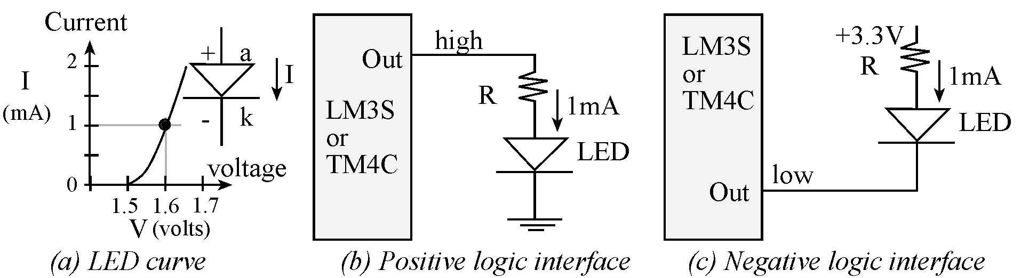
Low current LED Interface
Current less than 8 mA
Diode

Slide 7
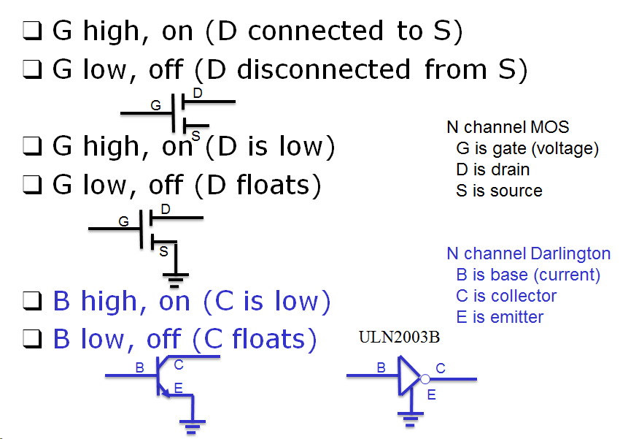
Transistors used as switches

Slide 8
LED Interfacing
R = (3.3V – 1.6)/0.001
= 1.7 kOhm
R = (5.0-2-0.7)/0.01
= 230 Ohm
h
i
g
h
L
M
3
S
+
5
V
O
u
t
o
r
R
1
0
m
A
L
M
3
S
R
1
m
A
T
M
4
C
ULN2003B
o
L
E
D
r
L
E
D
T
M
4
C
h
i
g
h
0
.
O
u
5
V
t
B
E
C
LED current < 8 mA
LED current > 8 mA
LED come in a variety of ways
Voltage, current
Brightness (efficiency)
Size

Slide 9
Pulse Width Modulation
Oscillate LED
On for H time
Off for L time
Increase frequency until the eyes see it as continuous
Period is H+L
Frequency is 1/(H+L)
PWM
Fixed period P = H+L
Duty cycle = H/(H+L) ranges from 0 to 1
H ranges from 0 to P
L = P-H
Brightness is linear with duty cycle
Power = (V_{d}*I_{d})*H/(H+L)

Slide 10
For Loops for time delay
Delay SUBS R0,R0,#1
BNE Delay
BX LR
Main BL LED_Init
Loop MOV R0,#1
BL LED_Out
LDR R0,=250000
BL Delay
MOV R0,#0
BL LED_Out
LDR R0,=250000
BL Delay
B Loop
void Delay(uint32_t time){
while(time){
time--;
}
}
int main(void){
LED_Init();
while(1){
LED_Out(1);
Delay(2500000);
LED_Out(0);
Delay(2500000);
}
}
Use TExasDisplay to measure time delay
What if 2500000 were much smaller? E.g., 50000
What if delays were 10000 and 90000?
What if there were two loops (inner loops delaysH,100000-H) (outer loop varies H)

Slide 11
Device driver
Abstraction (separation of concerns)
Header file
Prototypes for public functions
What it does
Code file
Implementations
How it works
void Switch_Init(void);
uint32_t Switch_In(void);
void LED_Init(void);
void LED_Out(uint32_t data);

Slide 12
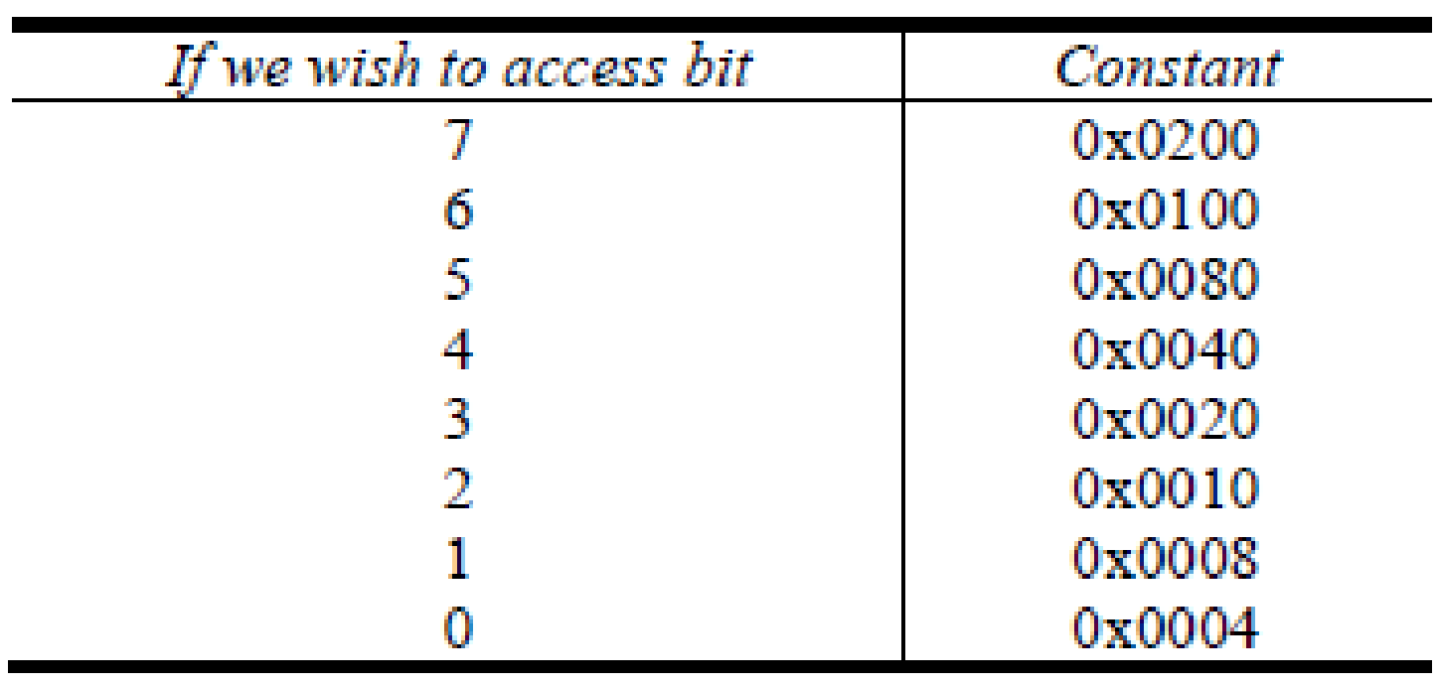
I/O Port Bit-Specific
I/O Port bit-specific addressing is used to access port data register
Define address offset as 4*2^{b}, where b is the selected bit position
Add offsets for each bit selected to base address for the port
Example: PF4 and PF0
Port F = 0x4002.5000
0x4002.5000+0x0004+0x0040
= 0x4002.5044
Provides friendly and atomic access to port pins
Show PortF_Input2 function in InputOutput_xxxasm

Slide 13
Condition Codes
Bit | Name | Meaning after add or sub
N | negative | result is negative
Z | zero | result is zero
V | overflow | signed overflow
C | carry | unsigned overflow
C set after an unsigned addition if the answer is wrong
C cleared after an unsigned subtract if the answer is wrong
V set after a signed addition or subtraction if the answer is wrong

Slide 14
Conditional Branch Instructions
Unsigned conditional branch
follow SUBS CMN or CMP
BLO target ; Branch if unsigned less than (if C=0, same as BCC)
BLS target ; Branch if unsigned less than or equal to (if C=0 or Z=1)
BHS target ; Branch if unsigned greater than or equal to (if C=1, same as BCS)
BHI target ; Branch if unsigned greater than (if C=1 and Z=0)
CMP R0,R1
R0<R1
BLO
R0≥R1
target
Next instruction

Slide 15
Conditional Branch Instructions
Signed conditional branch
follow SUBS CMN or CMP
BLT target ; if signed less than (if (~N&V | N&~V)=1, i.e. if N≠V)
BGE target ; if signed greater than or equal to (if (~N&V | N&~V)=0, i.e. if N=V)
BGT target ; if signed greater than (if (Z | ~N&V | N&~V)=0, i.e. if Z=0 and N=V)
BLE target ; if signed less than or equal to (if (Z | ~N&V | N&~V)=1, i.e. if Z=1 or N≠V)
CMP R0,R1
R0<R1
BLT
R0≥R1
target
Next instruction

Slide 16
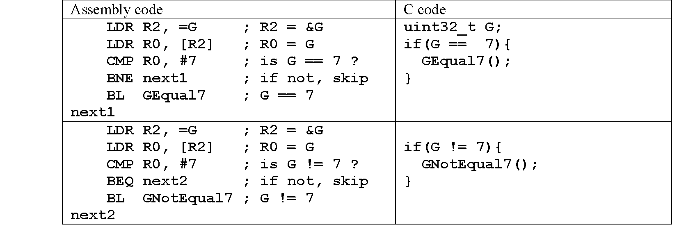
Equality Test
Program 2.7.1. Conditional structures that test for equality.

Slide 17
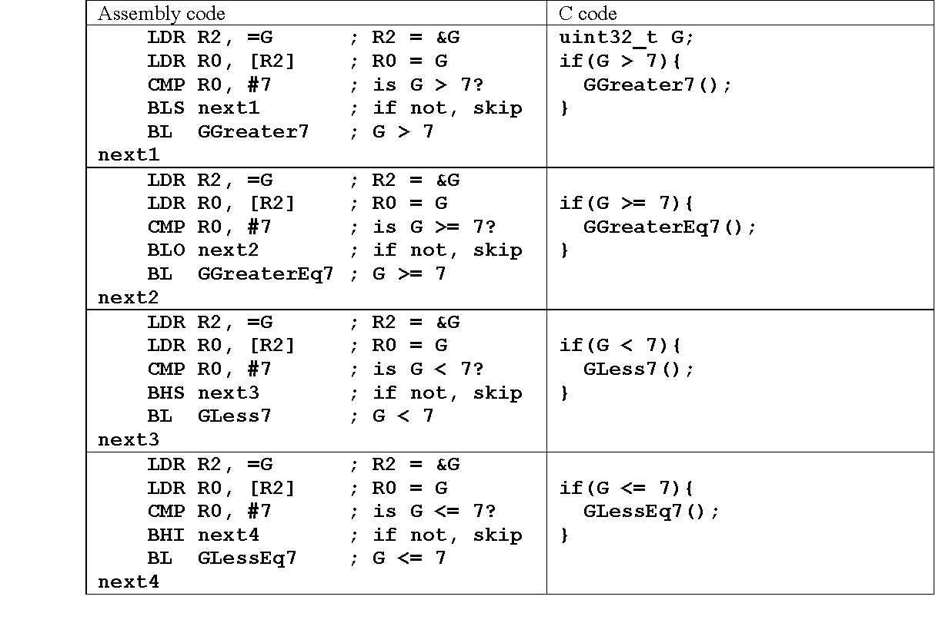
Unsigned Conditional Structures
Program 2.7.2. Unsigned conditional structures.

Slide 18
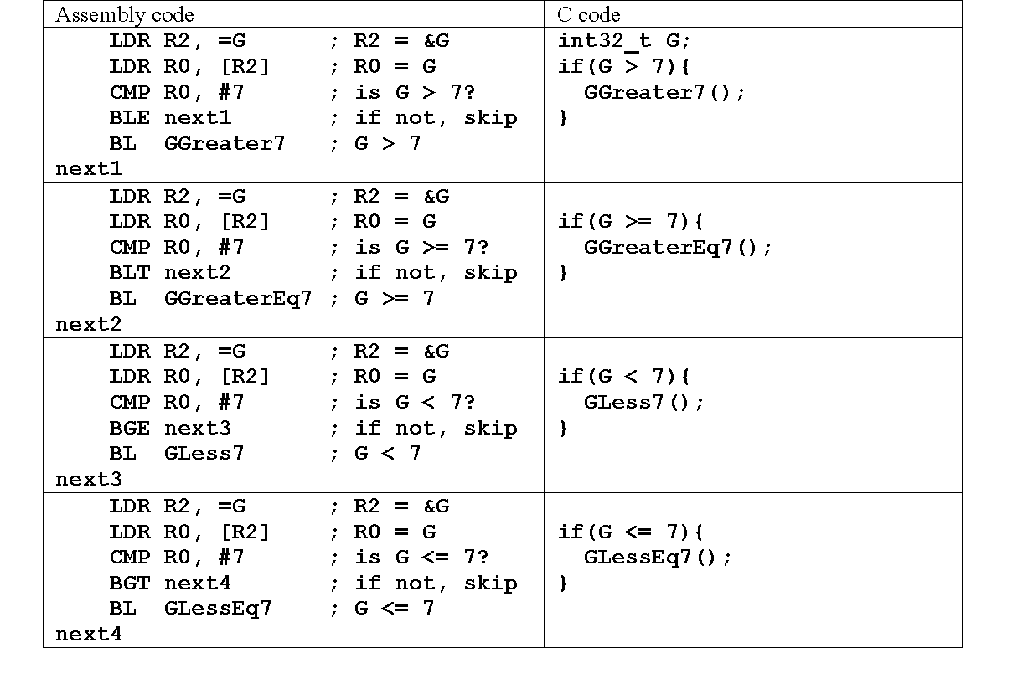
Signed Conditional Structures
Program 2.7.4. Signed conditional structures.

Slide 19
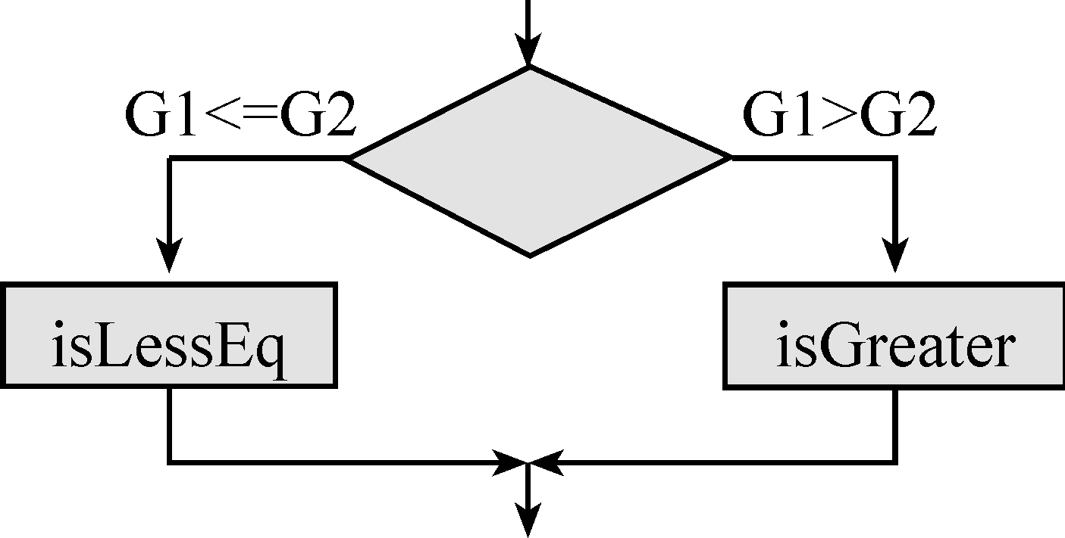
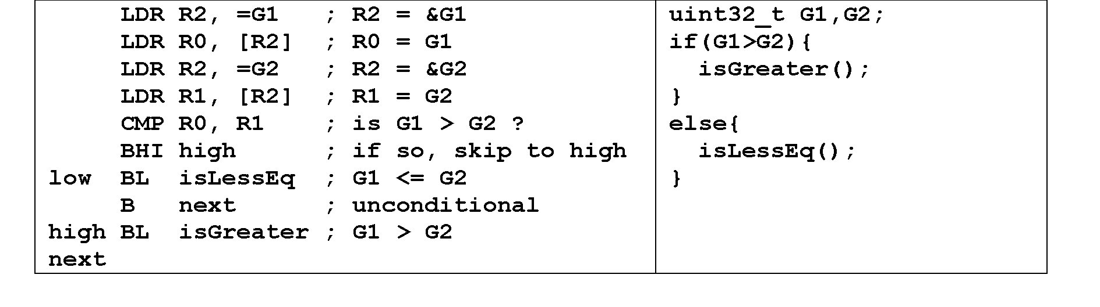
If-then-else
Program 2.7.6

Slide 20
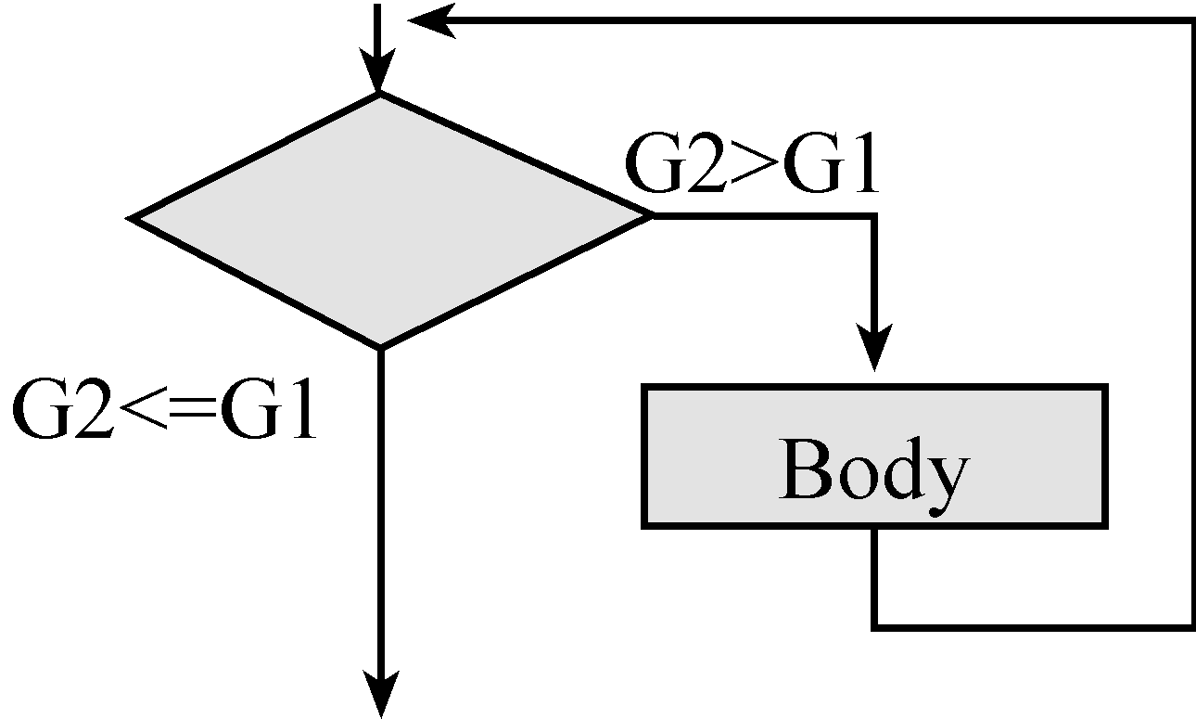
While Loops
LDR R4, =G1 ; R4 -> G1
LDR R5, =G2 ; R5 -> G2
loop LDR R0, [R5] ; R0 = G2
LDR R1, [R4] ; R1 = G1
CMP R0, R1 ; is G2 <= G1?
BLS next ; if so, skip to next
BL Body ; body of the loop
B loop
next
uint32_t G1,G2;
while(G2 > G1){
Body();
}
Program 2.7.8

Slide 21
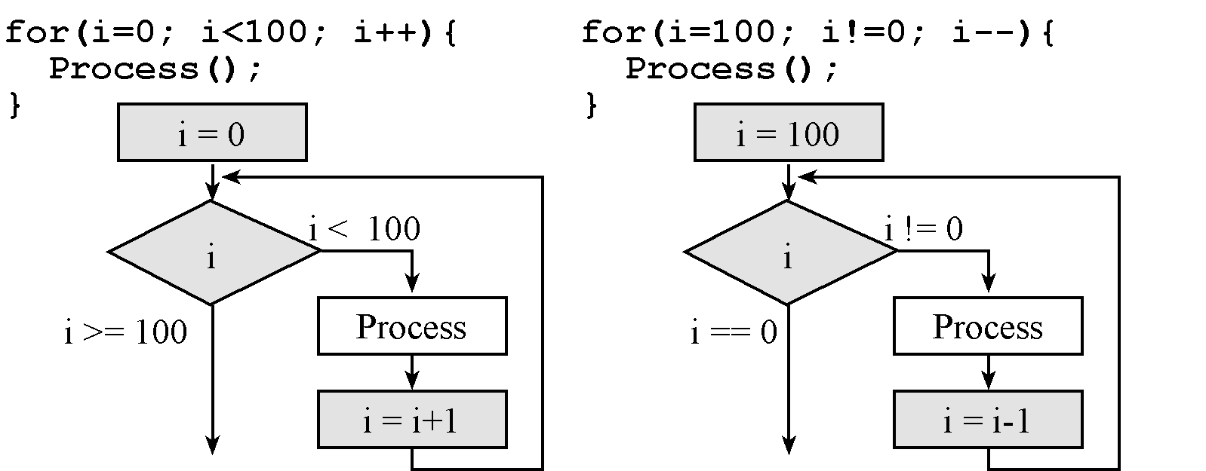
For Loops

Slide 22
For Loops
MOV R4, #0 ; R4 = 0
loop CMP R4, #100 ; index >= 100?
BHS done ; if so, skip to done
BL Process ; process function*
ADD R4, R4, #1 ; R4 = R4 + 1
B loop
done
for(i=0; i<100; i++){
Process();
}
Count up
MOV R4, #100 ; R4 = 100
loop BL Process ; process function
SUBS R4, R4, #1 ; R4 = R4 - 1
BNE loop
done
for(i=100; i!=0; i--){
Process();
}
Count down

Slide 23
Registers to pass parameters
High level program
Sets Registers to contain inputs
Calls subroutine
6) Registers contain outputs
Subroutine
3) Sees the inputs in registers
4) Performs the action of the subroutine
5) Places the outputs in registers

Slide 24
Stack to pass parameters
High level program
Pushes inputs on the Stack
Calls subroutine
6) Stack contain outputs (pop)
7) Balance stack
Subroutine
3) Sees the inputs on stack (pops)
4) Performs the action of the subroutine
5) Pushes outputs on the stack

Slide 25
Assembly Parameter Passing
Parameters passed using registers/stack
Parameter passing need not be done using only registers or only stack
Some inputs could come in registers and some on stack and outputs could be returned in registers and some on the stack
Calling Convention
Application Binary Interface (ABI)
ARM: use registers for first 4 parameters, use stack beyond, return using R0
Keep in mind that you may want your assembly subroutine to someday be callable from C or callable from someone else’s software

Slide 26
ARM Arch. Procedure Call Standard (AAPCS)
ABI standard for all ARM architectures
Use registers R0, R1, R2, and R3 to pass the first four input parameters (in order) into any function, C or assembly.
We place the return parameter in Register R0.
Functions can freely modify registers R0–R3 and R12. If a function needs to use R4 through R11, it is necessary to push their current register values onto the stack, use the register, and then pop the old value off the stack before returning.

Slide 27
Parameter-Passing: Registers
Caller
;--call a subroutine that
;uses registers for parameter passing
MOV R0,#7
MOV R1,#3
BL Exp
;; R2 becomes 7^3 = 343 (0x157)
Callee
;---------Exp-----------
; Input: R0 and R1 have inputs XX an YY
; Output: R2 has the result XX raised to YY
; Comments: R1 and R2 and non-negative
; Destroys input R1
XX RN 0
YY RN 1
Pow RN 2
Exp
ADDS XX,#0
BEQ Zero
ADDS YY,#0 ; check if YY is zero
BEQ One
MOV pow, #1 ; Initial product is 1
More MUL pow,XX ; multiply product with XX
SUBS YY,#1 ; Decrement YY
BNE More
B Retn ; Done, so return
Zero MOV pow,#0 ; XX is 0 so result is 0
B Retn
One MOV pow,#1 ; YY is 0 so result is 1
Retn BX LR
Call by value
Suggest changes to make it AAPCS
Return by value

Slide 28
Parameter-Passing: Stack
Caller
;-------- call a subroutine that
; uses stack for parameter passing
MOV R0,#12
MOV R1,#5
MOV R2,#22
MOV R3,#7
MOV R4,#18
PUSH {R0-R4}
; Stack has 12,5,22,7 and 18
; (with 12 on top)
BL Max5
; Call Max5 to find the maximum
;of the five numbers
POP {R5}
;; R5 has the max element (22)
Callee
;---------Max5-----------
; Input: 5 signed numbers pushed on the stack
; Output: put only the maximum number on the stack
; Comments: The input numbers are removed from stack
numM RN 1 ; current number
max RN 2 ; maximum so far
count RN 0 ; how many elements
Max5
POP {max} ; get top element (top of stack)
; store it in max
MOV count,#4 ; 4 more to go
Again POP {numM} ; get next element
CMP numM,max
BLT Next
MOV max, numM ; new numM is the max
Next SUBS count,#1 ; one more checked
BNE Again
PUSH {max} ; found max so push it on stack
BX LR
Call by value
Return by value
Flexible style, but not AAPCS

Slide 29
Parameter-Passing: Stack & Regs
Caller
;------call a subroutine that uses
;both stack and registers for
;parameter passing
MOV R0,#6 ; R0 elem count
MOV R1,#-14
MOV R2,#5
MOV R3,#32
MOV R4,#-7
MOV R5,#0
MOV R6,#-5
PUSH {R4-R6} ; rest on stack
; R0 has element count
; R1-R3 have first 3 elements;
; remaining on Stack
BL MinMax
;; R0 has -14 and R1 has 32
;; upon return
Callee
;---------MinMax-----------
; Input: N numbers reg+stack; N passed in R0
; Output: Return in R0 the min and R1 the max
; Comments: The input numbers are removed from stack
numMM RN 3; hold the current number in numMM
max RN 1 ; hold maximum so far in max
min RN 2
N RN 0 ; how many elements
MinMax
PUSH {R1-R3} ; put all elements on stack
CMP N,#0 ; if N is zero nothing to do
BEQ DoneMM
POP {min} ; pop top and set it
MOV max,min ; as the current min and max
loop SUBS N,#1 ; decrement and check
BEQ DoneMM
POP {numMM}
CMP numMM,max
BLT Chkmin
MOV max,numMM ; new num is the max
Chkmin CMP numMM,min
BGT NextMM
MOV min,numMM ; new num is the min
NextMM B loop
DoneMM MOV R0,min ; R0 has min
BX LR
Not AAPCS

Slide 30
System Design
What does being in a state mean?
List state parameters
What is the starting state of the system?
Define the initial state
What information do we need to collect?
List the input data
What information do we need to generate?
List the output data
How do we move from one state to another?
Actions we could do
What is the desired ending state?
Define the ultimate goal

Slide 31
System Design
Successive Refinement
Stepwise Refinement
Systematic Decomposition

Slide 32
System Design
Start with a task and decompose the task into a set of simpler subtasks
Subtasks are decomposed into even simpler sub-subtasks
Each subtask is simpler than the task itself
Make design decisions
document decisions and subtask requirements
Ultimately, subtask is so simple, it can be converted to software

Slide 33
System Design
Four building blocks (structured):
“do A then do B” → sequential
“do A and B in either order” → sequential (parallel)
“if A, then do B” → conditional
“for each A, do B” → iterative
“do A until B” → iterative
“repeat A over & over forever” → iterative (condition always true)
“on external event do B” → interrupt
“every t msec do B” → interrupt

Slide 34
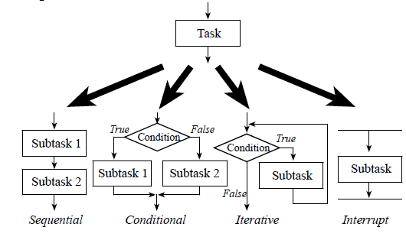
Successive Refinement

Slide 35
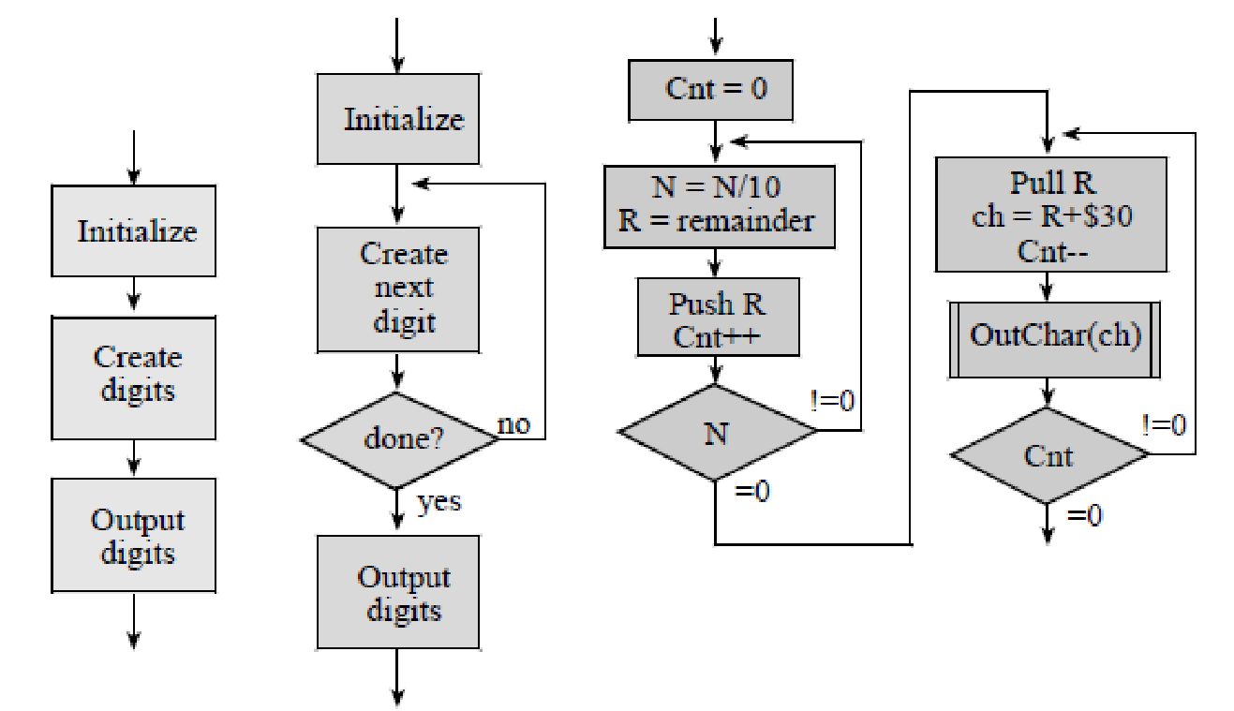
Successive Refinement
Successive refinement example for iterative approach

Slide 36
Abstraction - Device Driver
Abstraction allows us to modularize our code and give us the option to expose what we want users to see and hide what we don’t want them to see.
A Device Driver is a good example where abstraction is used to expose public routines that we want users of the driver to call and use private routines to hide driver internals from the user (more on private routines later)
LED Driver (PE0)
LED_Init
A user simply has to know
what a routine expects and
what it returns in order to
call it (calling convention).
Internals do not matter to caller
LED_Off
LED_On
LED_Toggle

Slide 37
Port E LED Abstraction
PE0 EQU 0x4005C004 ;bit-specific address Port E bit 0
LED_Init
LDR R1, =SYSCTL_RCGCGPIO_R ; R1 -> SYSCTL_RCGCGPIO_R
LDR R0, [R1] ; previous value
ORR R0, R0, #0x00000010 ; activate clock for Port E
STR R0, [R1]
NOP
NOP ; allow time to finish activating
LDR R1, =GPIO_PORTE_DIR_R ; R1 -> GPIO_PORTE_DIR_R
LDR R0, [R1] ; previous value
ORR R0, R0, #0x01 ; PE0 output
STR R0, [R1] ; set direction register
LDR R1, =GPIO_PORTE_DEN_R ; R1 -> GPIO_PORTE_DEN_R
LDR R0, [R1] ; previous value
ORR R0, R0, #0x01 ; enable PE0 digital port
STR R0, [R1] ; set digital enable register
BX LR
Program 4.3. Software interface for an LED on PE0 (SSR_xxx.zip).

Slide 38
malloc and free
Only 32k bytes of RAM total
#include <stdlib.h>
int16_t *p; // shared pointer
void CreateIt(void){
p = (char*)malloc(100*sizeof(int16_t));
}
void UseIt(int32_t n){
p[n] = n;
}
void KillIt(void){
free(p);
}
int main(void){ int16_t i;
CreateIt();
for(i=0;i<100;i++){
UseIt(i);
}
KillIt();
while(1){};
}
To use heap with Keil
Edit startup.s to create heap
Include standard library
Problems
Heap becomes full
Leakage
Access before allocation
Fragmentation
Not deterministic
https://www.youtube.com/watch?v=5VnDaHBi8dM

Slide 39
Scope and allocation
Allocation Scope | Temporary | Permanent
Private (restricted) | Local | Static
Public (unrestricted) | Heap | Global

Slide 40
LED Interfacing Review
LED current > 8 mA
R = (5.0-2-0.7)/0.01 = 230 Ohm
Use 220 ohm, it is close enough
+
5
V
T
M
4
C
R
1
0
m
A
ULN2003B
L
E
D
h
i
g
h
0
.
O
u
7
V
t
B
E
C
LED is a diode
P = V*I determines brightness
Resistor used to set Vd,Id operating point
Only conducts one way
Id,Vd curve is exponential (very nonlinear)

